Slide 1

Design Principles Tensions & Synergies
v3.0
Ilias Bartolini

Slide 2
HOW IT WORKS
Divide into pairs
Start setup development environment
Explain the tensions & synergies
Choose a design principle or rule
Game of life
Implement a new user story (45min)
Showcase changes
How did it affect other principles? Post-it!!
Repeat
Conclusions
Feedback
BREAK
Notes:
2 objectives:
- You can just learn and practice one design principle
- You can try to understand how the principles relate each other

Slide 3
Introductions

Slide 4
http://bit.ly/oo_dojo
Fork me!
Follow README to build & test

Slide 5
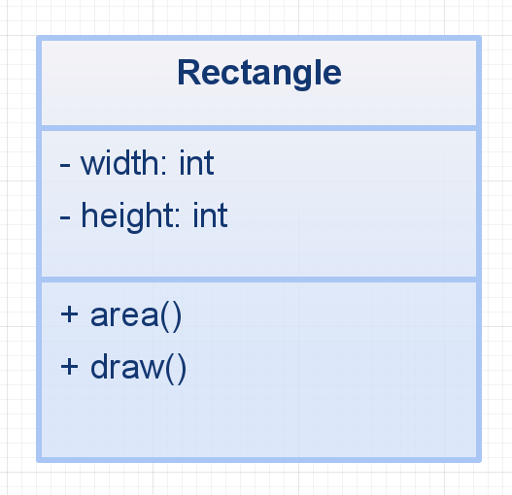
A SIMPLE EXAMPLE

Slide 6


A SIMPLE EXAMPLE
Encapsulation
Single Responsibility

Slide 7
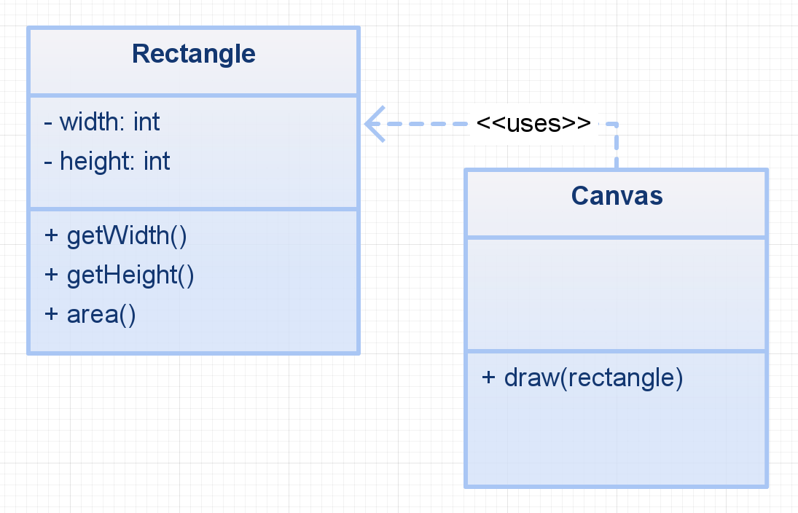
A SIMPLE EXAMPLE

Slide 8
A SIMPLE EXAMPLE
Encapsulation
Single Responsibility

Slide 9
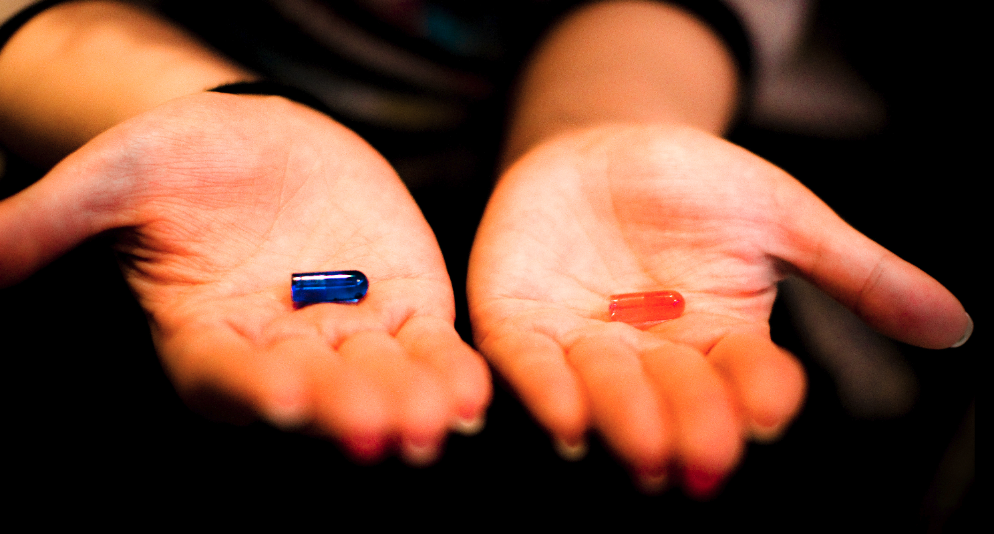
Single Responsibility vs Encapsulation

Slide 10
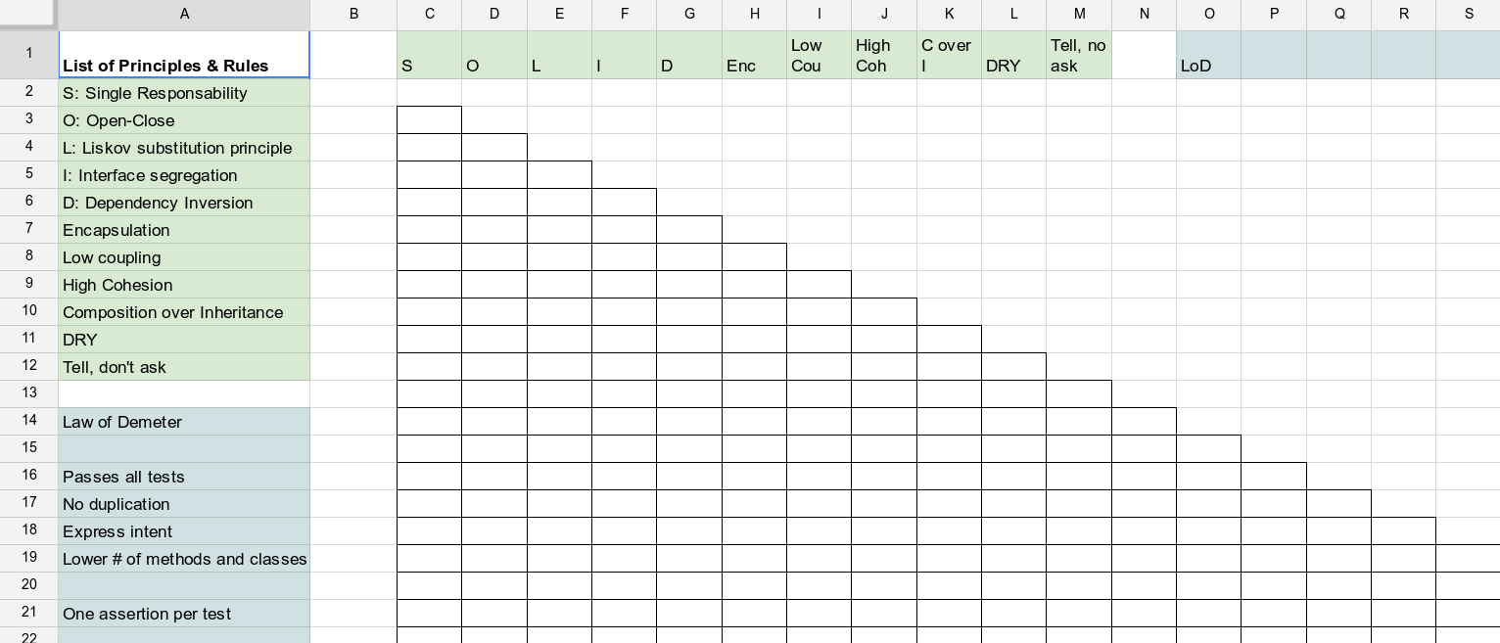
SOME PRINCIPLES AND RULES...

Slide 11
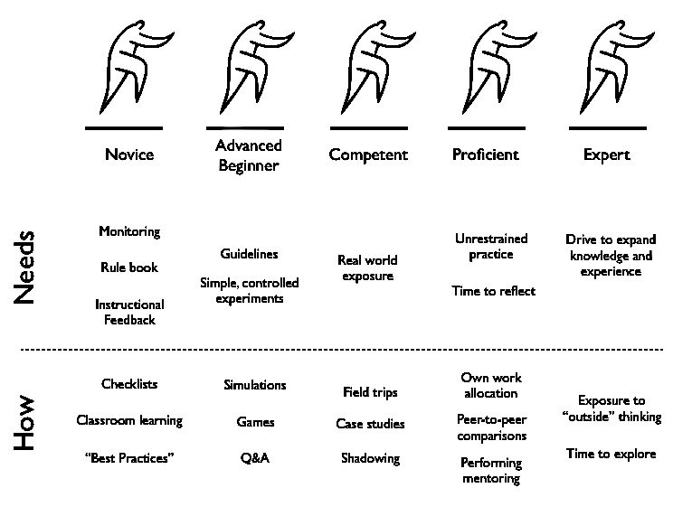
USING PRINCIPLES AND RULES...
Patrick Kua - http://www.slideshare.net/thekua/learning-about-learning-with-dreyfus-7924019

Slide 12

Conway's Game of Life
http://en.wikipedia.org/wiki/Conway%27s_Game_of_Life
Any live cell with fewer than two live neighbours dies,
as if caused by under-population.
Any live cell with two or three live neighbours lives on to the next generation.
Any live cell with more than three live neighbours dies,
as if by overcrowding.
Any dead cell with exactly three live neighbours becomes a live cell,
as if by reproduction.

Slide 13
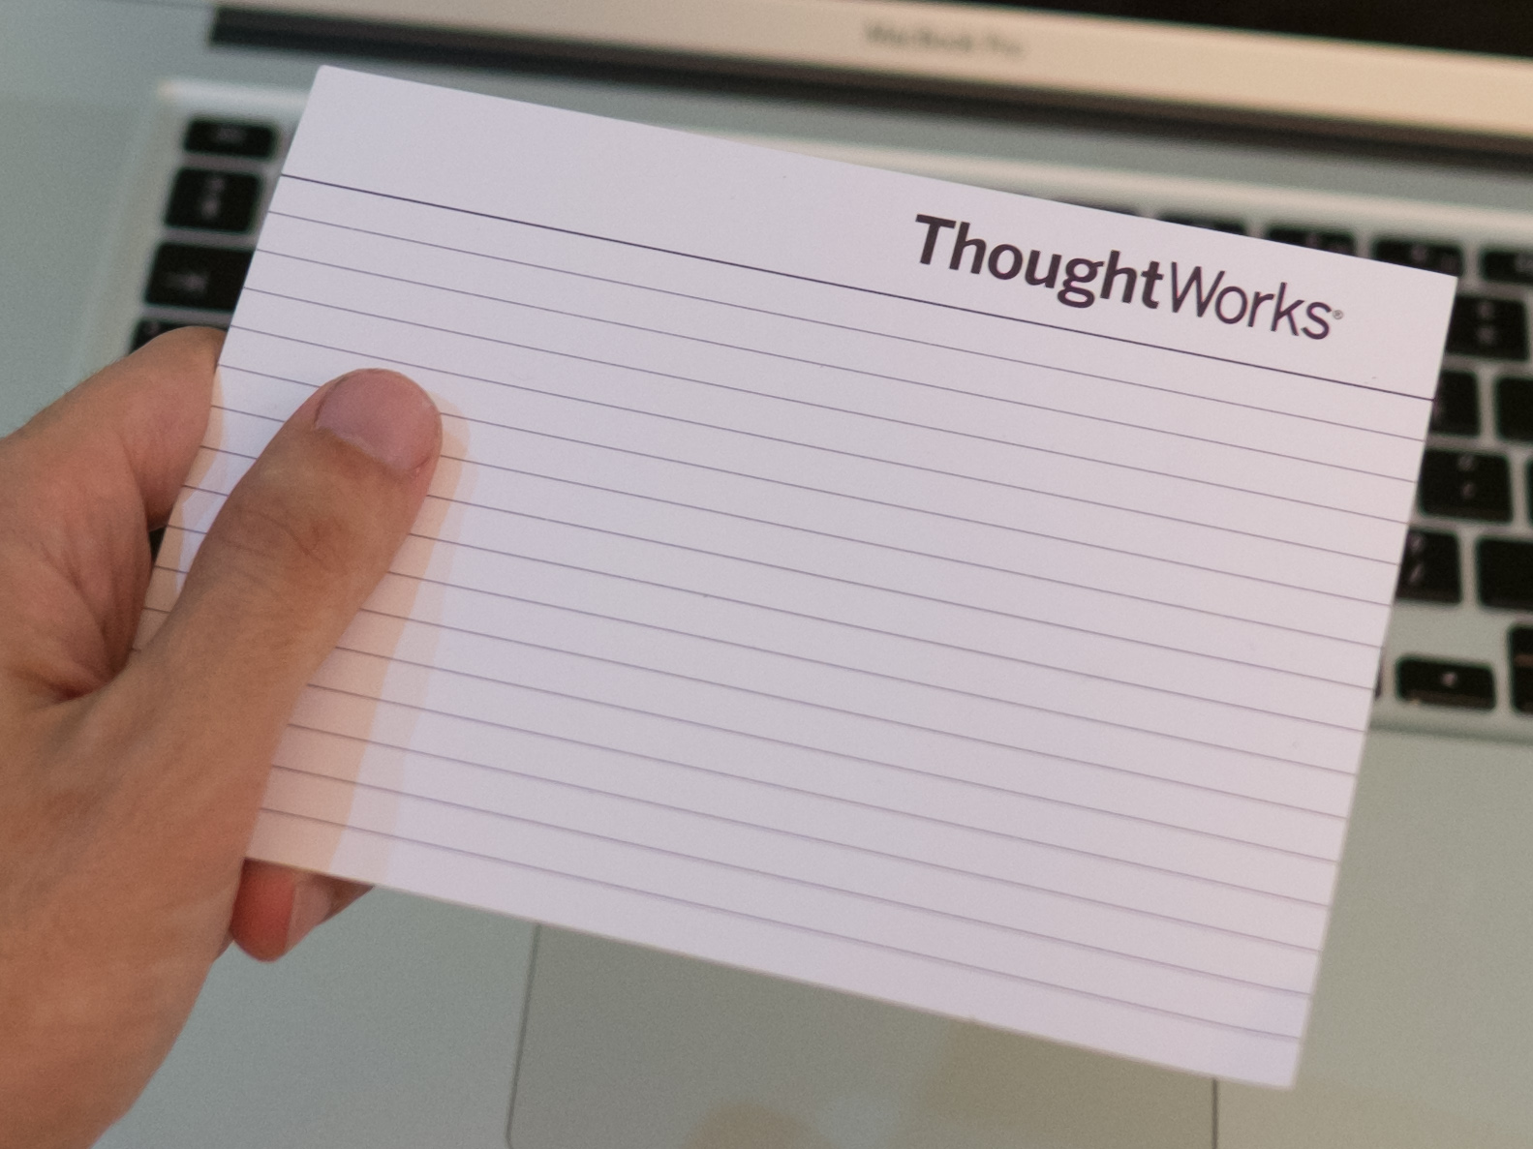
#5
As the supreme product owner
I want any cell with >= 4 alive neighbours to become a zombie
so that apocalypse can begin..

Slide 14
#5
As the supreme product owner
I want any cell with >= 4 alive neighbours to become a zombie
so that apocalypse can begin..
(ps. Zombies will be forever zombie, cannot die or become alive again)

Slide 15
Code showcase
Don't worry,
be crappy :-)

Slide 16
TENSIONS AND SYNERGIES (v3.0)
WHAT WE LEARNED SO FAR... ??
Open-Close
Dependency
Inversion
Encapsulation
Tell,
don't ask
Interface
Segregation
Single
Responsibility
Low
Coupling
DRY
Demeter
?
High
Cohesion
Liskov
Substitution
Composition over inheritance
Dependency
Injection
No code duplication
Express Intent
https://docs.google.com/spreadsheets/d/1jiqS5soI0PCo8Rm4M6LFJ20L3I6yJeyuOjLAK23RDWY/edit

Slide 17
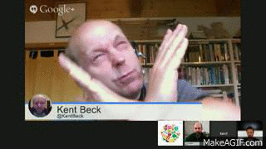
Design decisions are trade-offs

Slide 18
Recap

Slide 19
Questions?

Slide 20
DO YOU WANT TO REPEAT THIS EXERCISE?
http://bit.ly/oo_dojo_facilitator

Slide 21
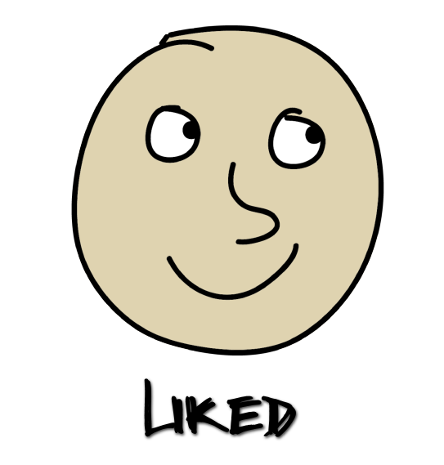


Feedback

Slide 22

THANKS
Modify and reuse CC-BY-SA
https://github.com/iliasbartolini/design_principles_dojo_facilitator_guide
Contributions from:
Luca Minudel
Matteo Vaccari
CC photo credits:
https://www.flickr.com/photos/torek/4444673930

