Slide 1



Reactive Synthesis with Spectra
A Tutorial
Shahar Maoz Jan Oliver Ringert
Notes:
I am very happy to present today some of the results of my project SYNTECH, on synthesis technologies for reactive systems software engineers.

Slide 2
Setup
Installation, configuration, project import
Notes:
Before we start, what is reactive synthesis all about?

Slide 3
Outline
Install using update site
Configure JTLV for MAC
Import projects

Slide 4
[L1] Write your first specification
variable declarations, assumptions and guarantees
Notes:
Before we start, what is reactive synthesis all about?

Slide 5
Outline
Variables:
System and environment variables
Variable types: Boolean, enumeration, bounded integer
Assumptions and guarantees
Initial, safety, liveness

Slide 6
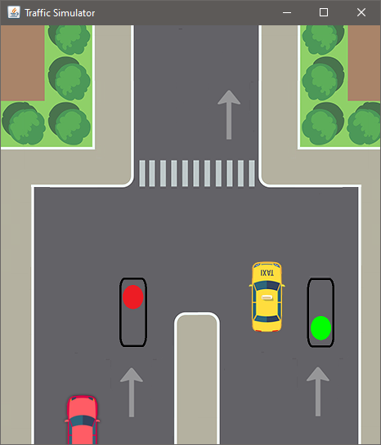

Examples
Traffic light example with A and B
Grid world with a robot
Notes:
Model AB example
Model only grid

Slide 7
Task
Extend specification GridL1.spectra with the following guarantee
When the robot is at the end of the grid, it does not try to move outside.
Extend specification TrafficL1.spectra with the following assumptions
Always eventually traffic will arrive at each light.

Slide 8
[A1] Synthesize your first controller
checking realizability and synthesizing a controller
Notes:
Before we start, what is reactive synthesis all about?

Slide 9
Outline
Synthesis traffic light controller
Grid world controller to see that it is too large

Slide 10
Task
Specifications TrafficA1a.spectra and TrafficA1b.spectra combine liveness assumptions/guarantees into one
check for each whether it is realizable
If it is, synthesize a controller
Explain why each specification is either unrealizable or how it realizes the specification.

Slide 11
[L2] Advanced language constructs
Type definitions, defines, predicates, arrays
Notes:
Before we start, what is reactive synthesis all about?

Slide 12
Outline
Definitions (traffic car waiting)
Type definitions (move)
Arrays (grid)
Predicates (grid)

Slide 13
Task
Extend specification GridL2.spectra with the following predicate
invMove(Move a, Move b) to assert that two parameters of type Move are inverse to each other, e.g., UP and DOWN or LEFT and RIGHT.

Slide 14
[A2] Unrealizability
checking realizability, unrealizablity core, counter-strategies
Notes:
Before we start, what is reactive synthesis all about?

Slide 15
Outline
Unrealizable spec (Traffic)

Slide 16
Task
Analyze specifications TrafficL2b.spectra to TrafficL2d.spectra
Understand a reason for unrealizability using a core or counterstrategy.

Slide 17
[L3] Advanced language constructs
patterns and past operators
Notes:
Before we start, what is reactive synthesis all about?

Slide 18
Outline
Response for traffic
Between for robot

Slide 19
Task
Extend specification TrafficA3.spectra
Add an assumption that carA is always eventually followed by carB (use the pattern pRespondsToS).

Slide 20
[E1] Basic step-by-step simulation
interactive simulation using the Spectra Controller walker
Notes:
Before we start, what is reactive synthesis all about?

Slide 21
Outline
Steps as environment: simple traffic, 1a what happens when no cars come? What happens when a car comes?
Step as both
Deterministic vs. non-deterministic
TrafficL3 Hiding variables of system
GridL3 breakpoints p1, p2, p3 from spec, reachability

Slide 22
Task
Synthesize a controller for specification GridL3_less.spectra and explore it as both players. Do not use determinization of the controller (settings dialog).

Slide 23
[E2] Execute your reactive system
using the synthesized controller in your Java application
Notes:
Before we start, what is reactive synthesis all about?

Slide 24
Outline
GUI
But also minimal cmd line app

Slide 25
Task
Extend the specification and the execution with an additional input variable emergency and a guarantee that in case of emergency both lights are red.
Extend the command line simulation with the new input.

Slide 26
[E3] Advanced step-by-step simulation
Using breakpoints and reachability
Notes:
Before we start, what is reactive synthesis all about?

Slide 27
Outline
Breapoints for grid
P1, p2, reach 5,5

Slide 28
Task
Synthesize a controller for specification TrafficA1.spectra and check whether a state with carA & carB & greenB is reachable for the synthesized controller.

Slide 29
[A3] Non-well-separation
checking non-well-separation, non-well-separation core
Notes:
Before we start, what is reactive synthesis all about?

Slide 30
Non-Well-Separation
GR(1) correct-by-construction: As long as all assumptions are satisfied, the system will satisfy all guarantees.
A non-well-separated environment can be forced to violate at least one assumption from some reachable state.

Slide 31
Task
Analyze specification TrafficA3b.spectra for non-well-separation and identify reasons for non-well-separation, if any.

Slide 32
[L4] Triggers
Left |=> RIGHT
Notes:
Before we start, what is reactive synthesis all about?

Slide 33
Operators for Regular Expressions
Operator | Symbol | Example
concatenation | [...][...] | [true] [carA & !greenA]
union | [...] | [...] | [carB] | [carA]
intersection | [...] & [...] | [carB] & [greenB]
kleene-star (zero-or-more) | [...]* | [carA & !carB]*
plus (one-or-more) | [...]+ | [carA & !carB]+
optional (zero-or-one) | [...]? | [carA]?
exact repetitions | [...]{k} | [carA]{4}
at-least-repetitions | [...]{k, } | [carA]{4, }
ranged-repetitions | [...]{k, m} | [carA]{1, 4}
negation | ~[...] | ~[carA]

Slide 34
Outline
gar trig [true]* [carA & !greenA]{4} |=> [greenA];
gar trig [true]* [carB & !greenB]{4} |=> [greenB];
asm trig [true]* [carA] |=> [true]{0, 3} [carB];
gar trig [true]* [greenA & greenB] |=> [false];
gar trig [true]* [carA & !greenA]{4} |=> [greenA]+ [!greenA] [greenB];

Slide 35
Task
Extend specification GridL4.spectra
Add a guarantee that the robot should never be away from position p1 for more than 20 steps.

