Slide 1

Pilot Project
Machine Learning and Content Analytics
MSc in Business Analytics
Dionysios Pavlogeorgatos
AM: p2822016
Ilias Tsachtsarlis
AM: p2822019

Slide 2
Project Scope
Part of the course Machine Learning and Content Analytics
Identification of the argumentative statements of scientific abstracts and manually annotation
Develop an annotation’s classification model using:
Heuristic model
Machine learning sequence model
Evaluate Results
Embeddings Graph extracting cliques

Slide 3
Project Journey
Data Annotation
Cleansing/ Transformations
Exploratory Data Analysis
Heuristic Model
ML Algorithms: Sequence Model
Embeddings Graph extracting cliques

Slide 4
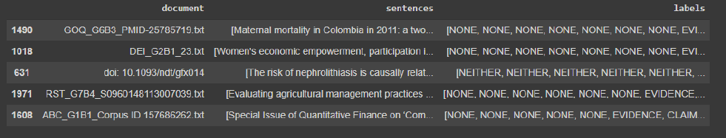
Dataset Overview
Our dataset consists of 2,686 scientific abstracts
Sourced from the Sustainable Development Goals of the United Nations
Each row stands for an abstract, named in ‘document’ column, ‘sentences’ column containing in a list form each sentence of the abstract and the ‘labels’ column.

Slide 5
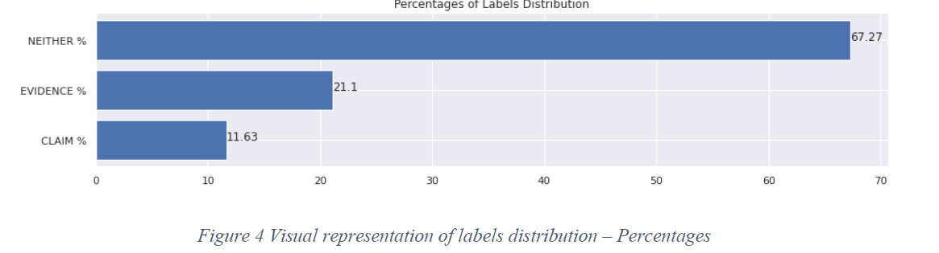
Data Transformations
Transforming actions displayed below:
Conversion of the ‘NONE’ to NEITHER in the labels of the sentences
Removing the titles of the abstracts
Data shuffling before splitting the dataset into train, test and validation sub datasets
Explode the initial dataset, in order to be analyzed in a more granular level
Identify the labels distribution, to get a first view of our data

Slide 6
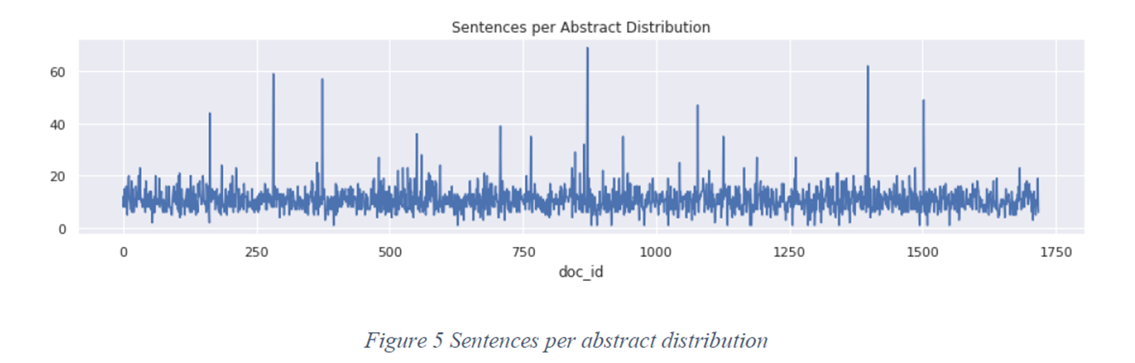
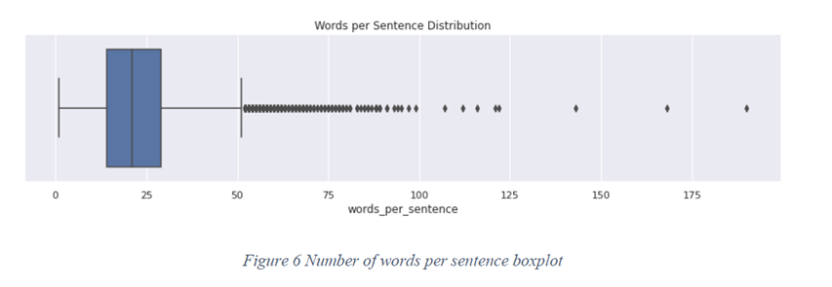
Exploratory Data Analysis
Getting a deeper view, analyzing the data at a more granular, we observe:
Most of the abstracts, have less than 20 sentences
Regarding, the words per sentence distribution: the 50% of the sentences have less than 20 words
Cases with either more than 40 sentences per abstract or more than 50 words per sentence, characterized as outliers

Slide 7
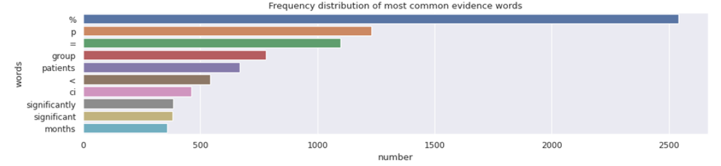
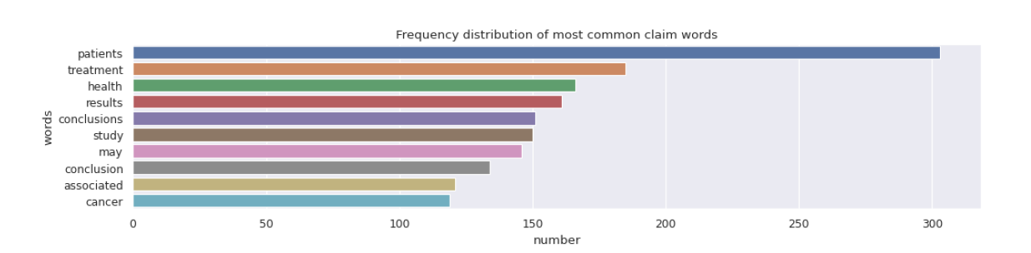
Claim & Evidence Words Analysis
Actions performed to proceed:
Words lowering case
Word tokenization
Stop words extraction
Numerical digits removed
Non intuitive words removal
Frequency distribution of the most common for evidence and claim words

Slide 8
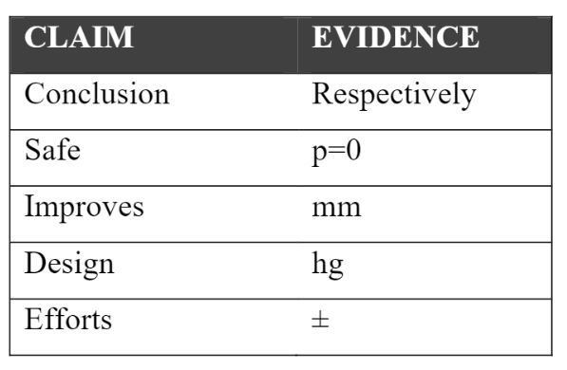
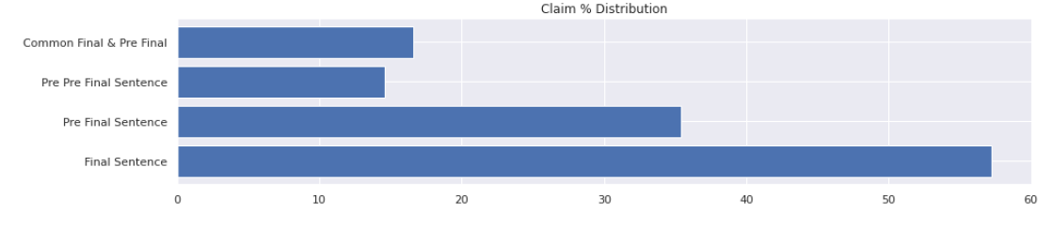
Heuristic Model - Rules
Built on the following rules:
80% highly appearing words kept
Unique claim and evidence words filtered
Claims positioning distribution across each abstract
Without the existence of an evidence, a claim cannot be assumed
3-claim per abstract threshold set
Our final word lists overview

Slide 9
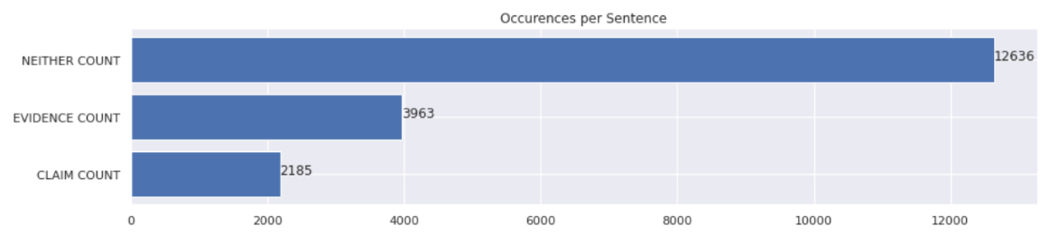
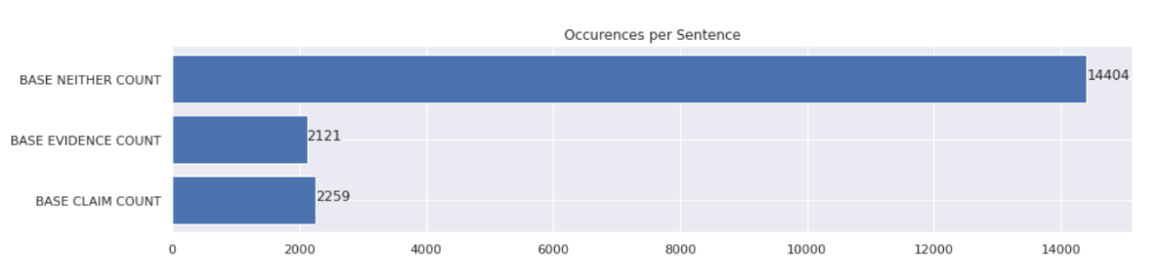
Heuristic Model - Results
Accuracy and F1-score metrics used to evaluate the performance of our heuristic model. The results of the classification presented below:
Accuracy at 58.4%
F1-score at 56.44%
Intense misclassification observed between evidence and neither labels
Adequately performing on claims
Actual
Predicted

Slide 10
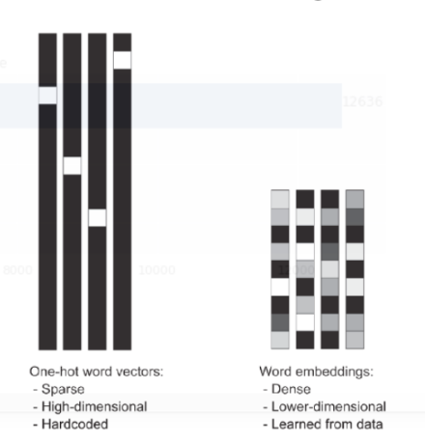
ML Sequence Model - Preparation
Data Preprocessing:
Dependent variable one hot encoded, since categorical
Keras Tokenizer used, to elicit the 22703 common words
Embeddings better describe the independent variable: we treat each word not as unique but as a vector in word space
Words of the same meaning will be closer
Pre-trained Embeddings GloVe 300 used

Slide 11

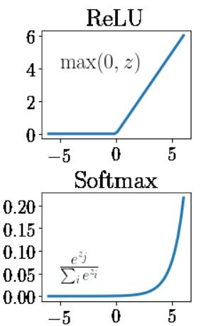
ML Sequence Model - Tuning
LSTM
Long Short-term Memory (LSTM) bidirectional
Dense Layer
32-dense layer
Dense Layer
3-dense layer
Layer of 64 size
Learning the input sequence and the reverse of that provided
ReLu activation function
SoftMax activation function
Model Configuration:
6 Epochs: Training the neural network with all the training data for one cycle
32 Batch size: Controls the number of training samples to work through before the model's internal parameters are updated
Categorical Cross entropy: Loss function that is used in multi-class classification tasks

Slide 12
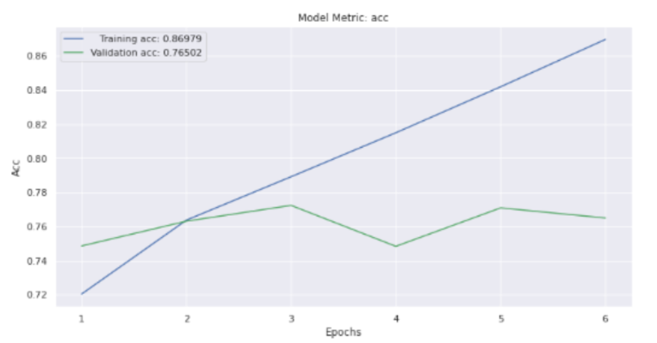
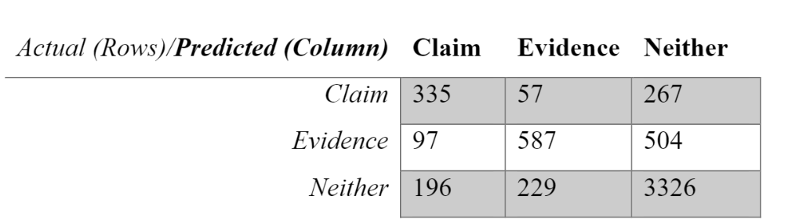
ML Sequence Model - Results
Accuracy and F1-score metrics used to evaluate the performance of our sequence model:
Accuracy at 76.41%
F1-score at 55.21% (weighted avg)
As the number of epochs increases, the difference between training and validation accuracy getting bigger
From the confusion matrix: Intense misclassification observed between evidence and neither labels

Slide 13
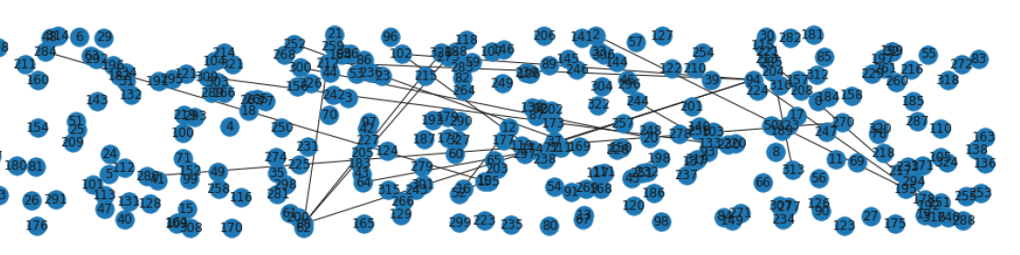
Embeddings Network Graph
Network graph created on ‘Claims’ embeddings
Nodes: Each abstract
Edges: short Euclidian distance among claim embeddings construct edges between abstracts
Cliques extracted
Subgraph presented below:
Clique that consists of 3 abstracts presented:
Claim of ‘Doc_Id’ 372:
These results have important implications for policymakers, since the discrepancies in these relationships mean that a country's renewable energy policies should be highly compatible with its development stage.
Claim of ‘Doc_Id’ 2681:
However, we have identified significant long-term relationships between foreign direct investment, renewable energy consumption and economic growth in some countries, and our study includes important policy implications, particularly for relationship among CO2 emissions and foreign direct investment inflows.'
Claim of ‘Doc_Id’ 2422:
Overall, our results echo other research indicating that non-climate-based frames for renewable energy are likely to garner broader public support, but we suggest that the significance of this finding is particularly important in certain political and geographical contexts.

Slide 14


