Slide 2
Melt Pool Width
Melt Pool
Height
Hatch Spacing
Layer Height
Build Plate

Slide 3
Build Plate

Slide 4
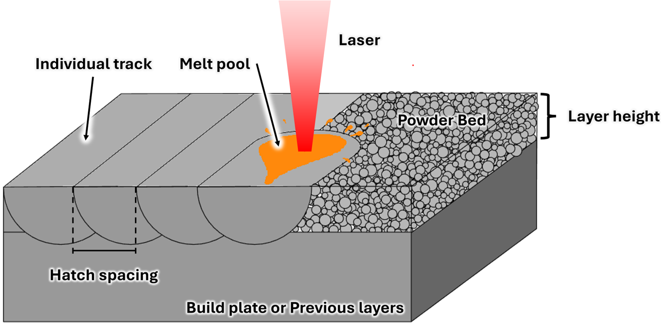

Slide 5
z
y
x
Melt Pool
Width
Melt Pool Length
z = 0
Scan
Direction
y
Melt Pool
Depth
Melt Pool
Width
|
|
Hatch Spacing

Slide 6
