Slide 1
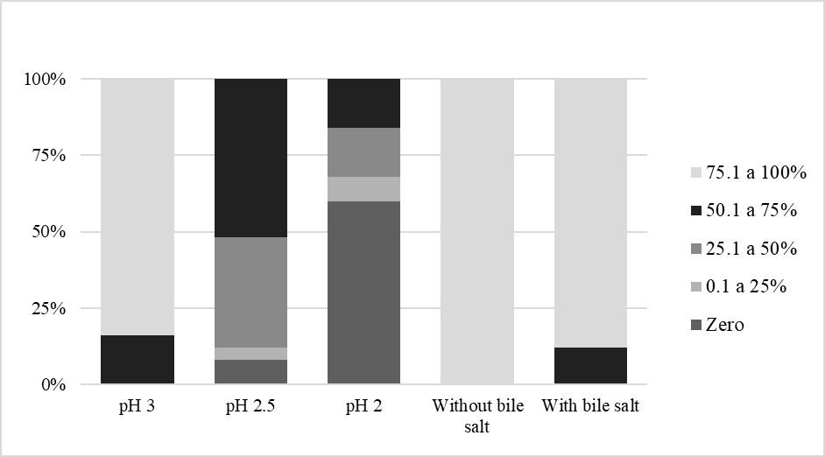
Figure S3. Survival rates of the 25 lactic acid bacteria exposed to simulated gastric (low pH values) and intestinal (without and with bile salts) juices.
Survival rate
Condition

