Slide 1
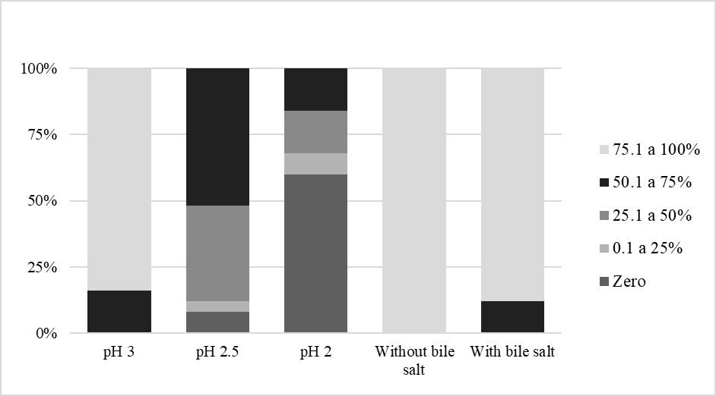
Figure S2. Survival rates of the 25 lactic acid bacteria exposed to simulated gastric (low pH values) and intestinal (without and with bile salts) conditions.
Survival rate
Condition

