Slide 1
EMBEDDED PHOTOMETRIC
VISUAL ODOMETRY
Samuel Bryner
Bachelor Thesis
Supervised by Jörn Rehder and Pascal Gohl.

Slide 2
MOTIVATION
demonstrating novel integration of FPGA and ARM trough photometric odometry
NOT the most efficient approach to embedded visual odometry
TODO: ref to Marcins Arbeit? http://students.asl.ethz.ch/upl_pdf/459-report.pdf

Slide 3
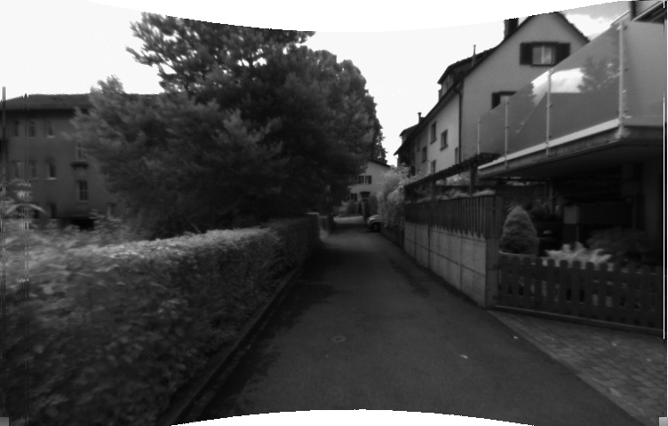
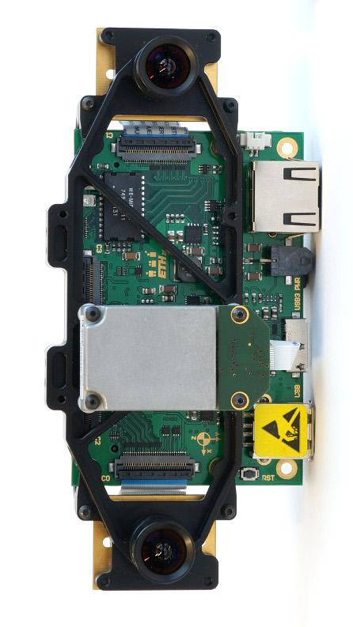
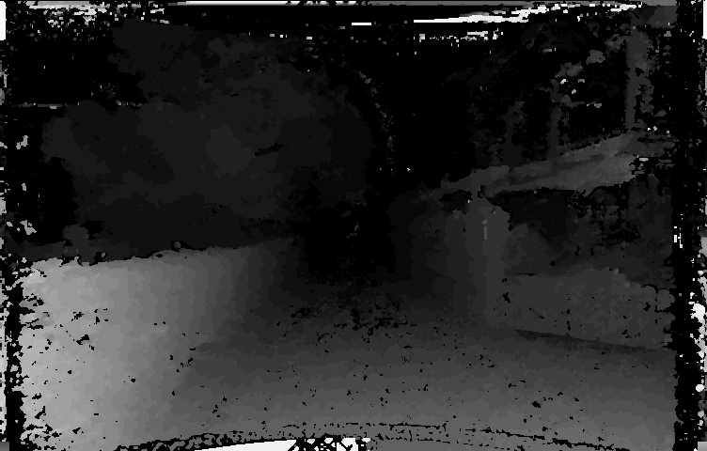
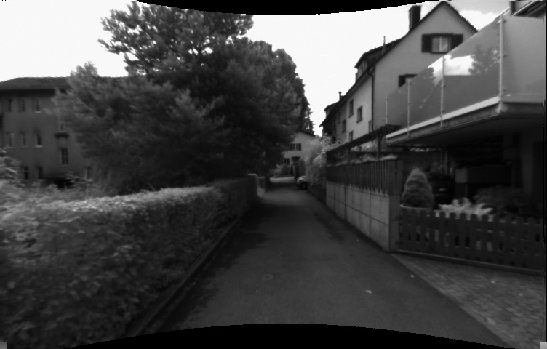
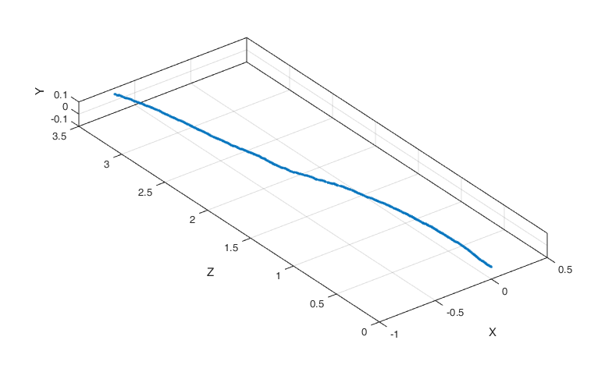
FPGA:
stereo matching
ARM:
photometric
odometry
todo: ref to IROS 2014

Slide 5
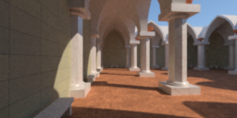
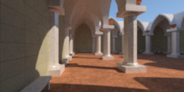
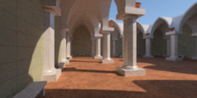
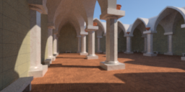




METHOD: the problem weglassen
t
ΔT?

Slide 6
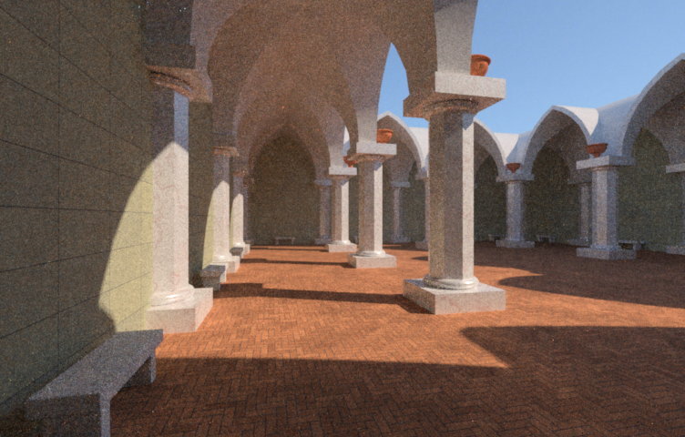
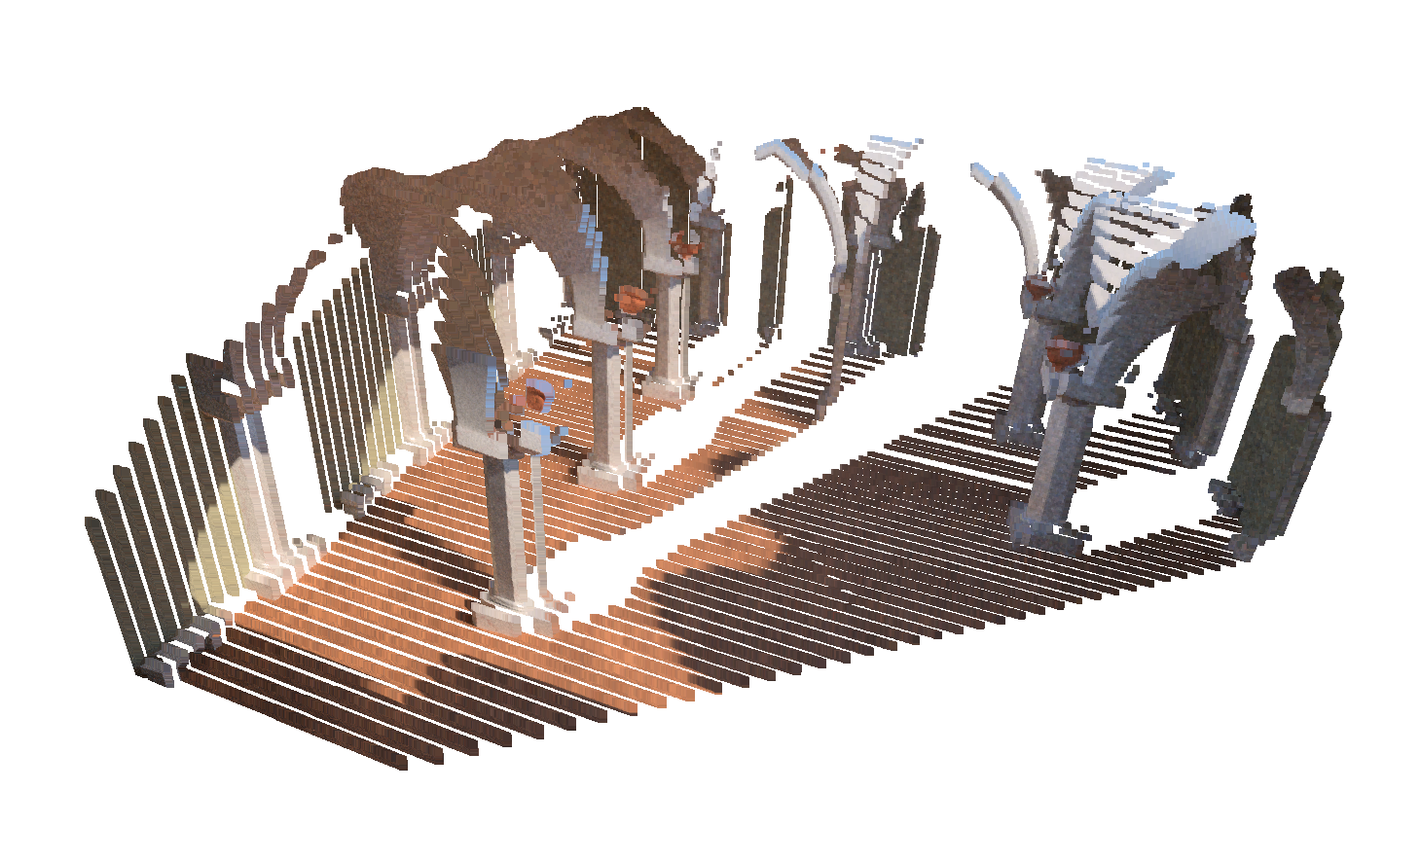

METHOD: 1. project into space
intensity
point cloud
+
=
disparity

Slide 7
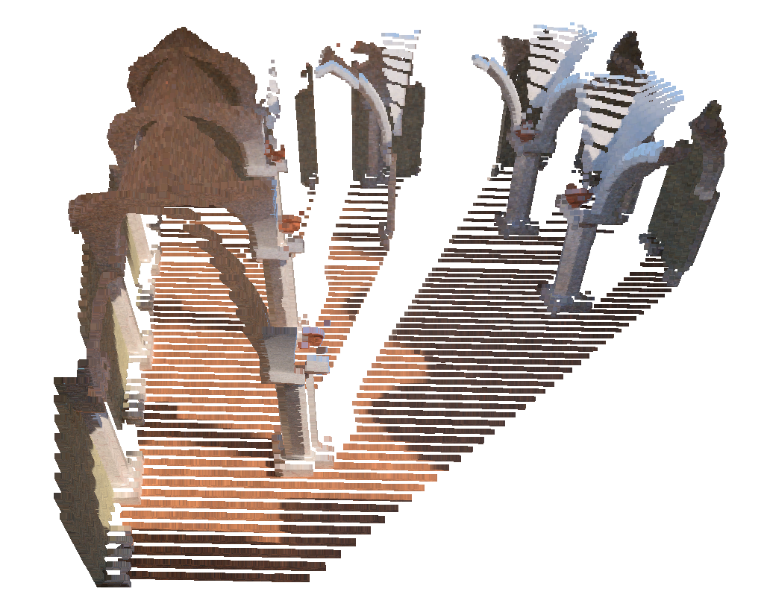
METHOD: 2. move camera trough space
original camera frame
transformed
camera frame
T
translation
& rotation
that's what we're
actually looking for

Slide 8
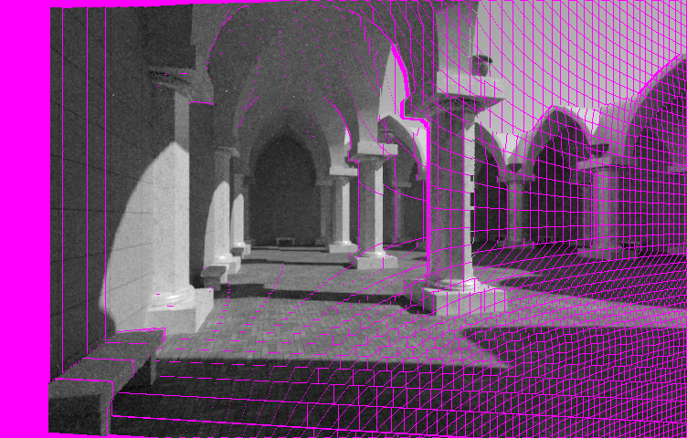
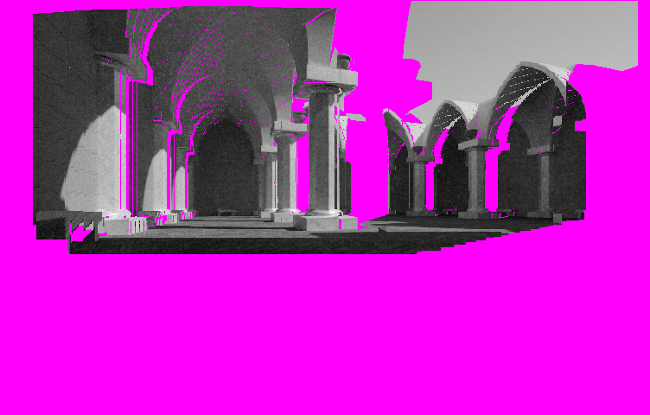
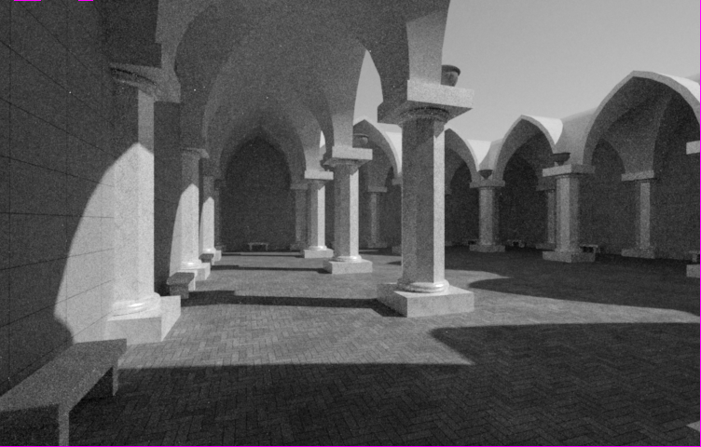
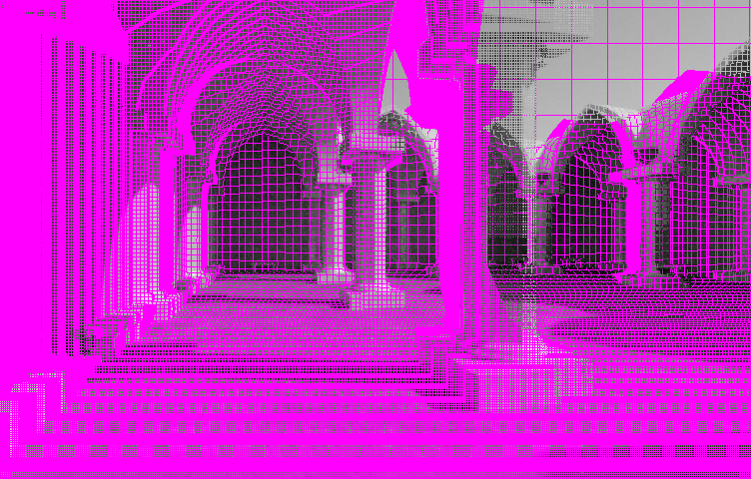
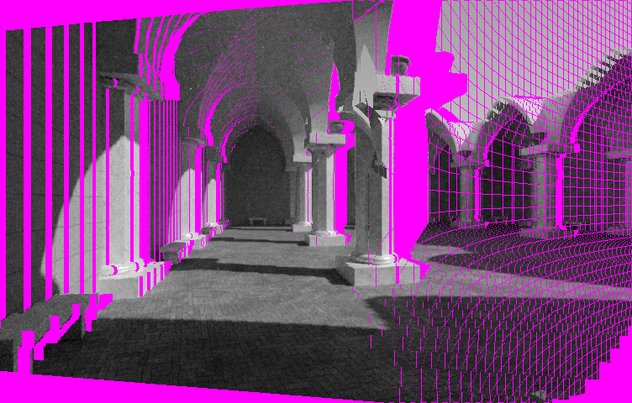
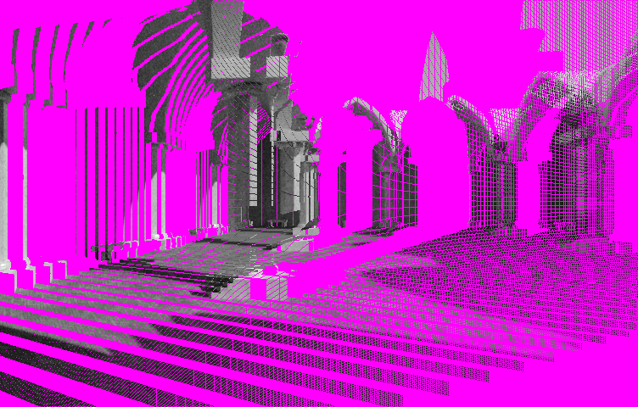
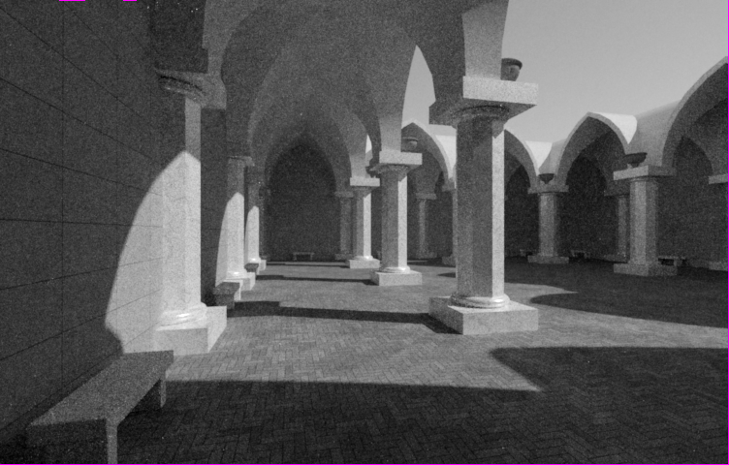
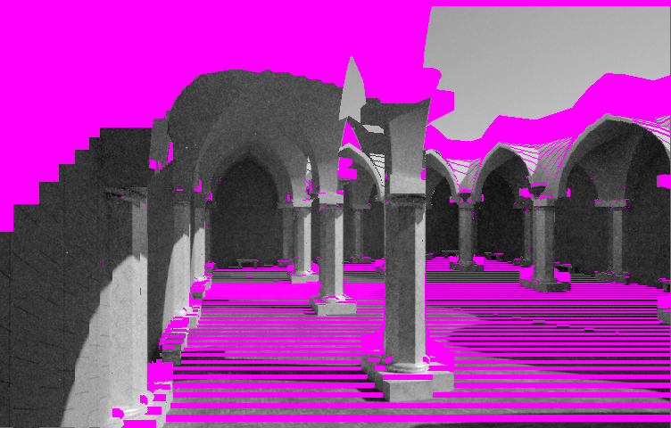
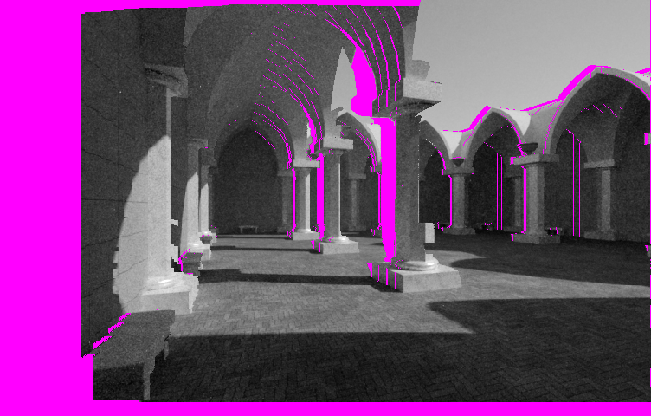
METHOD: 3. project back into camera
current frame
transformed
point cloud
previous frame

Slide 9
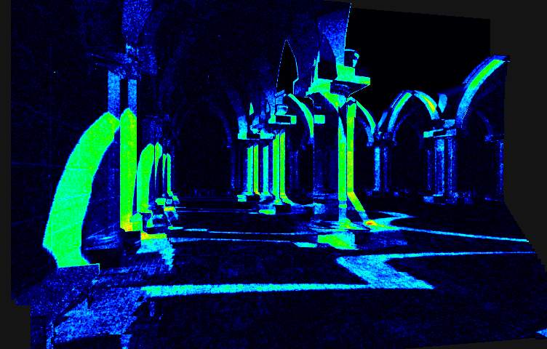
METHOD: 4. measure MSE
current frame
just minimize that!
transformation T
warped
previous frame
error(T)
-
=

Slide 10
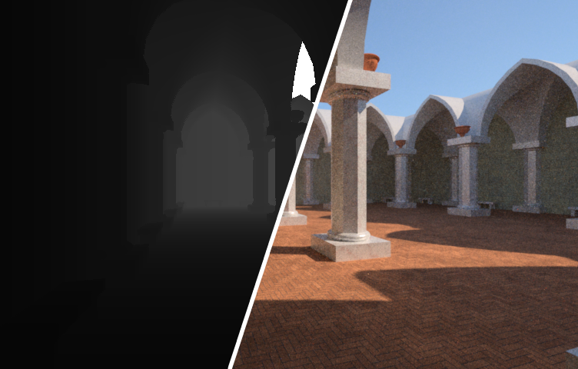
METHOD: formularizing the problem
point in image:
intensity:
disparity:

Slide 11
METHOD: warping pipeline
-
=
transformation T
A. Comport, E. Malis, and P. Rives, “Accurate quadrifocal
tracking for robust 3d visual odometry,” in IEEE Conference
on Robotics and Automation, April 2007, pp. 40–45.

Slide 12
therefore:
minimize
for every pixel:
using Gauss Newton:

Slide 13
Gauss-Newton In Action

Slide 14
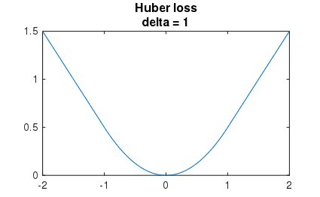
METHOD: optimizations
use image pyramid
only use pixels with strong gradient
Huber weights

Slide 15
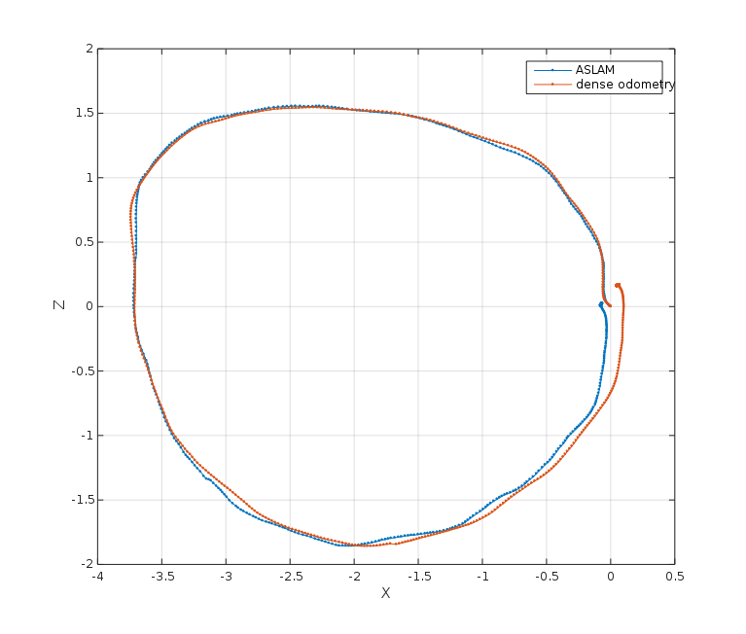
RESULTS: photometric odometry VS. ASLAM
offline with OpenCV SGM for stereo
units: meter

Slide 16
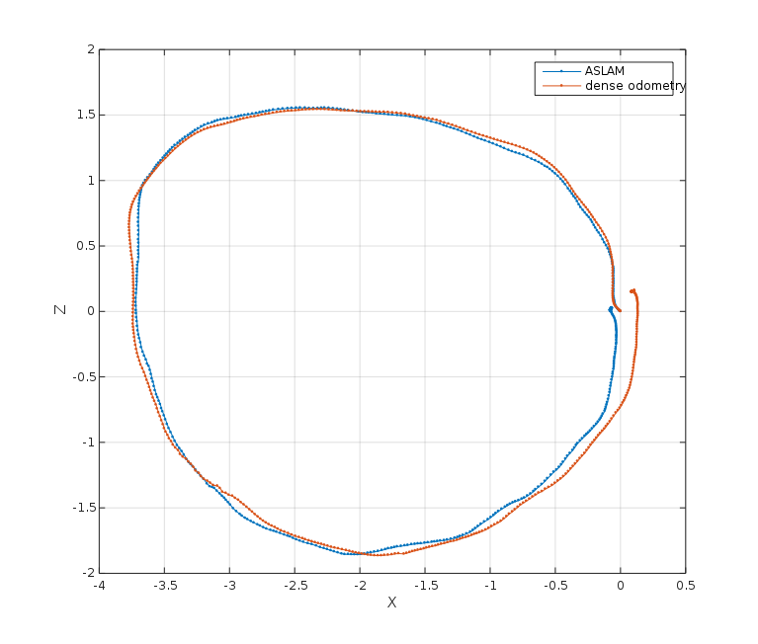
RESULTS: 1/16 of pixels (2x downscaled)
offline with OpenCV block matcher for stereo
units: meter

Slide 17
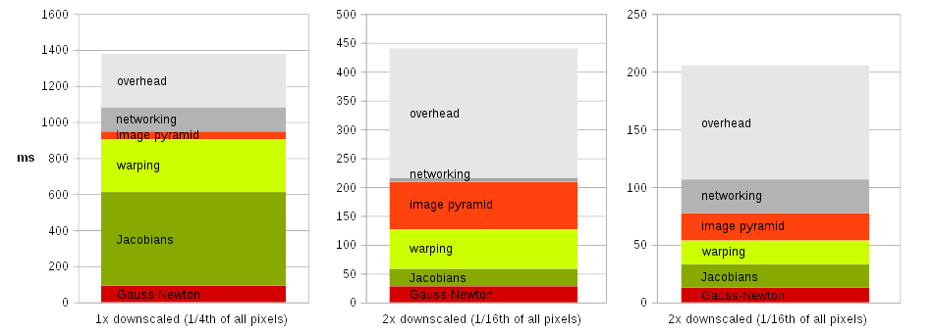
RESULTS: timing
TODO: throw out one of these last two graphs:

Slide 18
TODO: CONCLUSION
5 Hz possible, even with photometric approach
  leverage FPGA with stereo core
  early abort of image pyramid

Slide 19
QUESTIONS?
Live demo!

