Slide 1
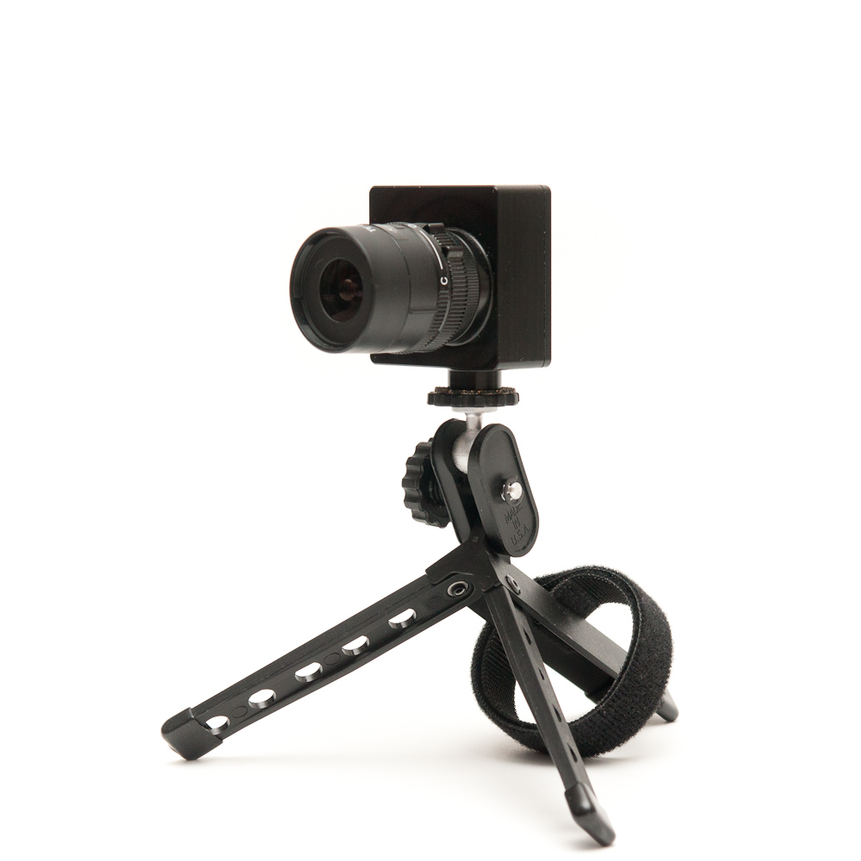
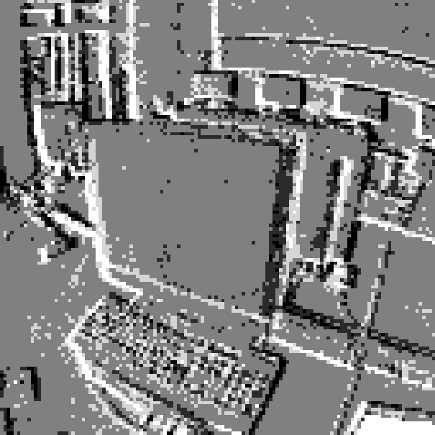
IMAGE RECONSTRUCTION
FROM
DYNAMIC VISION SENSOR
Marcel Geppert & Samuel Bryner

Slide 2
H. Kim, A. Handa, R. Benosman, S.-H. Ieng, A. J. Davison,
Simultaneous Mosaicing and Tracking with an Event Camera, BMVC, 2014

Slide 3
APPROACH
track camera motion by using gradient map
estimate gradient map from camera motion
use poisson reconstruc-tion in 2D to calculate image from gradient map

