Slide 1

HTML and CSS
Part 2: Introduction to HTML and CSS
By the end of this presentation, you will be able to describe the roles of HTML and CSS in a web page

Slide 2
CSS Introduction
Cascading Style Sheets (CSS) is a style sheet language used to describe the presentation of a web page. The language is designed to separate concerns. It allows the design, layout, and presentation of a web page to be defined separately from content semantics and structure. This separation helps keeps source code readable and it is important because a designer can update styles separately from a developer who is creating the page structure or a web editor who is changing content on a page.
A set of CSS rules in a style sheet determines how an HTML document is displayed to the user. It can determine whether elements in the document are rendered at all, whether they appear in some context but not others, how they are laid out on the web page, whether they are rendered in a different order to the order in which they appear within a document, and their aesthetic appearance.
We will begin by looking at the syntax of CSS.

Slide 3

Syntax
A CSS declaration is made of two parts: a property and a value. The property is the name for some aspect of style you want to change; the value is what you want to set it to.
Here is an example of a CSS declaration:
The property is color and the value is red. In CSS, color is the property name for the foreground color value of an element. That essentially means the color of the text and any text decoration (such as underline or strikethrough). It also sets a current color value.
For this declaration to have any effect on an HTML document, it must be applied to one or more elements in the document. We do this with a selector. For example, you can select all the <p> elements in a web page with the p selector. So, if you wanted to make the color of all text in all paragraph elements red, you would use the following CSS ruleset:

Slide 4
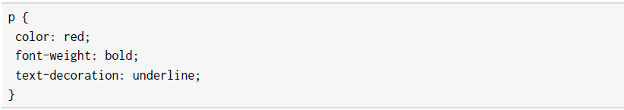
Syntax
The curly braces represent a declaration block and that means more than one CSS declaration can be added to this block. If you wanted to make the text in all paragraph elements red, bold, and underlined, you could do that with the following ruleset:
The result of this CSS ruleset applied to an HTML document can be seen in the following figure:
Figure 1.19: Several CSS declarations applied to <p> elements in HTML

Slide 5

Syntax
Multiple selectors can share a CSS ruleset. We can target these with a commaseparated list. For example, to apply the color red to p elements, h1 elements, and h2 elements, we could use the following ruleset:
Multiple CSS rulesets form a style sheet.
The order of these CSS rules in a style sheet is very
important as this is partly how the cascade or
specificity of a rule is determined. A more specific rule
will be ranked higher than a less specific rule and a
the higher-ranked rule will be the style shown to the
end-user. We will look at cascade and specificity later in
this presentation:
Figure 1.20: A CSS ruleset explained

Slide 6
Adding Styles to a Web Page
There are several ways to add your styles to a web page:
  You can use inline styles, which are applied directly to an element in the HTML document using the style attribute. The value of the style attribute is a CSS declaration block, meaning you can apply a semicolon-separated list of CSS declarations to the element.
  You can use a style element to add style information to an HTML document. The style element can be a child of either the head element or body element of a document. The head element tends to be preferable as the styles will be applied to your page more quickly.
  You can provide a style sheet as an external resource using the link element. One of the rationalities behind style sheets is the separation of concerns, which is why this approach is often recommended.
We will try out each of these methods in the following exercises.

Slide 7
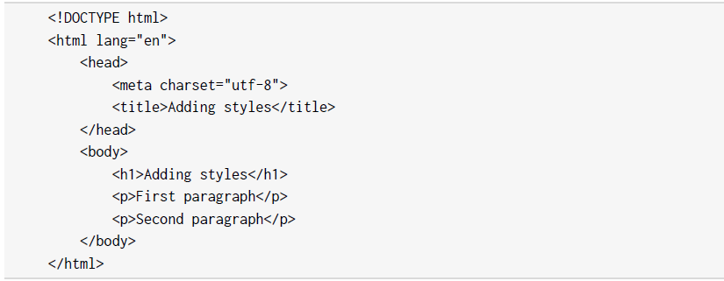
Exercise 1.05: Adding Styles
In this exercise, we will be styling web pages by adding styles within the HTML document itself.
Here are the steps:
  1. Open the chapter_1 folder in VSCode (File > Open Folder…) and we will create a new plain text file by clicking File > New File. Then, save it in HTML format, by clicking File > Save As... and enter the File name: Adding styles.html and start with the following web page:

Slide 8
Exercise 1.05: Adding Styles
Without any styles, this web page would look like the following:
Figure 1.21: The unstyled web page

Slide 9
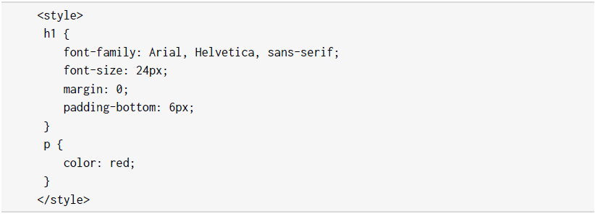
Exercise 1.05: Adding Styles
  2. We've decided to use a nicer font and make some of the text red. To do this, we will add a style element to the head element. We can add the following code under the title element:

Slide 10
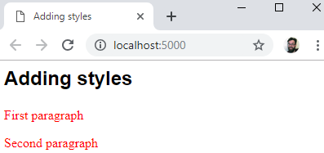
Exercise 1.05: Adding Styles
  The results of this code change are that we should now have styles applied to the h1 element and to both of the p elements, all of which will have red text. The result will look similar to the following figure:
Figure 1.22: The web page with styles applied

Slide 11
Exercise 1.05: Adding Styles
  3. Finally, we will give the first paragraph element a different style by overriding the style set in the head element. Let's add an inline style to the first paragraph, setting the color to blue and adding a line-through text decoration as follows:
  If you now right-click on the filename in VSCode on the left-hand side of the screen and select open in default browser, you will see the following web page in your browser:
Figure 1.23: The web page with inline style applied

Slide 12
Exercise 1.05: Adding Styles
  Something to note is that the inline style, applied to the first paragraph, takes precedence over the more general CSS rule applied to all p elements in the style element in the head element of the document. We will look at specificity and the rules of the cascade later in this chapter, but first, let's try moving these style rules into an external file.

Slide 13

Exercise 1.06: Styles in an External File
In this exercise, we will separate the concerns of presentation and structure of Exercise 1.05, Adding Styles, by moving all the styles to an external file.
The steps are as follows:
  1. Open the chapter_1 folder in VSCode (File > Open Folder…) and create a new plain text file by clicking File > New File. Then, save it in HTML format, by clicking File > Save As... and enter the File name: index-with-external-styles.html.
  2. Add the same web page as in Exercise 1.05, Adding Styles, to the file:

Slide 14
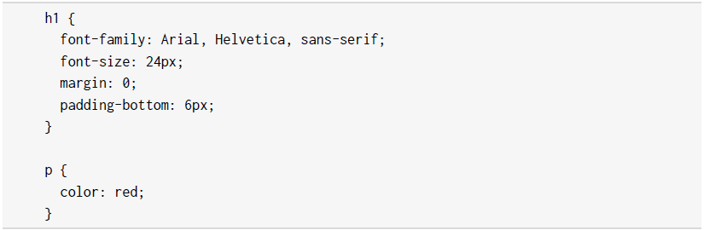
Exercise 1.06: Styles in an External File
3. We will add a link element to reference a .css file below the title element:
4. Next, we need to save a file named styles.css in the same directory as index-withexternal-styles.html.
5. Create a styles directory and add the following styles to Exercise_1.06.css:

Slide 15
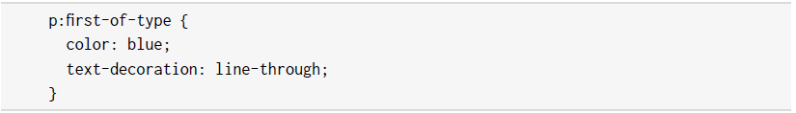
Exercise 1.06: Styles in an External File
  6. To get the equivalent styles that we had at the end of Exercise 1.05, Adding Styles, without using an inline style, we have to have a specific way of targeting the first p element. We will use the :first-of-type pseudo-class. You will learn more about CSS selectors later in this chapter. For now, add this CSS rule to the bottom of styles.css:
The result will be as seen in Figure 1.23 – the same result as in Exercise 1.05, Adding Styles. The difference is that we have removed all references to styles from the HTML document into their own external resources. We have successfully separated concerns.
Both these methods add styles to the HTML document when it loads. Similar to the HTML DOM, we can manipulate CSS programmatically with JavaScript. This is because the styles are also represented as an object model called the CSSOM.

Slide 16
CSSOM
The CSS Object Model (CSSOM) is similar to the HTML DOM, which we described earlier. The CSSOM is an in-memory representation of the styles in the document as they are computed on elements. It is a tree-structure with nodes that mirror those in the HTML DOM, and the objects associated have a list of style properties where all CSS rules have been applied.
The CSSOM represents all the styles that have been created in the document as objects with properties that we can change with JavaScript. We can access these styles and change the values of style properties.
We mostly access these styles via the styles property of a DOM element, as here:

Slide 17
CSSOM
In JavaScript, we can also access the CSSOM with the getComputedStyles method on the
window object; for example:
This will return a computed styles object for an element with the aBoldElement class attribute. This method returns a read-only styles object with all computed styles for the element.
In the next section, we will look at the different CSS selectors we can use to apply our styles to a web page.

Slide 18

CSS Selectors
To target elements in the HTML document with CSS, we use selectors. There are a lot of options available to help you select a wide range of elements or very specific elements in certain states.
Selectors are a powerful tool and we will look at them in some detail as the different options available can help with both web page performance and making your CSS more maintainable.
For example, you can use a selector to target the first letter of a heading, like you might expect to see in a medieval book:

Slide 19
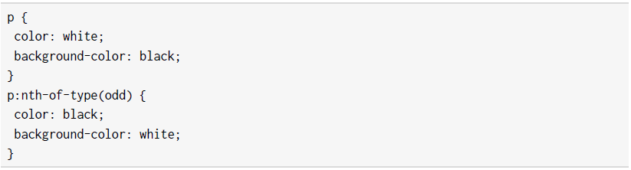
CSS Selectors
Or you could use a selector to invert the colors of every odd paragraph in an article:
We will explore a variety of the options available to us when creating selectors.

Slide 20
Element, ID, and Class
Three commonly used selectors are:
  Element type: For example, to select all p elements in an HTML document, we use the p selector in a CSS ruleset. Other examples are h1, ul, and div.
  A class attribute: The class selector starts with a dot. For example, given the HTML snippet
  <h1 class="heading">Heading</h1>, you could target that element with the .heading selector. Other examples are .post and .sub-heading.
  An id attribute: The id selector starts with a hash symbol. For example, given the HTML snippet
  <div id="login"> <!-- login content --> </div>, you could target this element with the #login selector. Other examples include #page-footer and #site-logo.

Slide 21
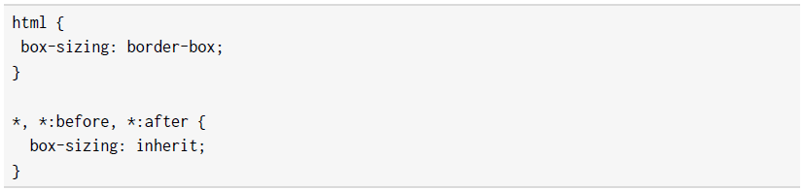
The Universal Selector (*)
To select all elements throughout an HTML document, you can use the universal selector, which is the asterisk symbol (*). Here is an example snippet of CSS that is often added to web pages; a value is set on the html element and then inherited by all descendant elements:
Using the inherit keyword and the universal selector, we can pass a value on to all the descendants of the html element. This snippet will universally apply the border-box model to all elements and their pseudo-elements (that's the reason for :before and :after). You'll learn more about the box model and layout in the next chapter.

Slide 22
Attribute Selectors
Attribute selectors let you select elements based on the presence of an attribute or based on the value of an attribute. The syntax is square brackets, [], with the suitable attribute inside. There are several variations that you can use to make matches:
  [attribute] will select all elements with an attribute present; for example, [href] will select all elements with an href attribute.
  [attribute=value] will select all elements with an attribute with an exact value; for example, [lang="en"] will select all elements with a lang attribute set to en.
  [attribute^=value] will select all elements with an attribute with a value that begins with the matching value; for example, [href^="https://"] will select all elements with an href attribute beginning with https://, which links to a secure URL.
  [attribute$=value] will select elements with an attribute with a value that ends with the matching value; for example, [href$=".com"] will select all elements with an href attribute that ends with .com.
  [attribute*=valule] will select elements with an attribute with a value that has a match somewhere in the string; for example, [href*="co.uk"] will select all elements with an href attribute matching .co.uk. http://www.example.co.uk?test=true would be a match, as would https://www.example.co.uk.

Slide 23
Pseudo-classes
To select an element when it is in a particular state, we have several pseudo-classes defined. The syntax of a pseudo-class is a colon, :, followed by a keyword.
There are a great number of pseudo-classes, but most developers' first experience of them is when styling links. A link has several states associated with it:
    When an anchor element has an href attribute, it will have the :link pseudo-class applied to it.
    When a user hovers over the link, the :hover pseudo-class is applied to it.
    When the link has been visited, it has the :visited pseudo-class applied to it.
    When the link is being clicked, it has the :active pseudo-class applied to it.

Slide 24
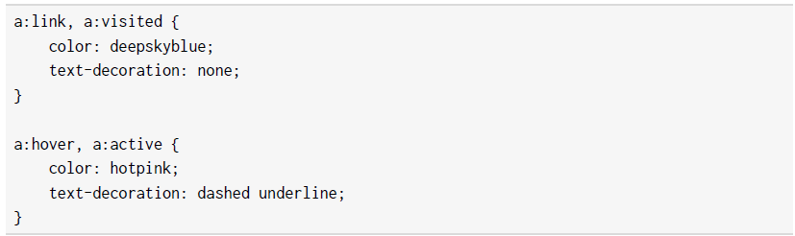
Pseudo-classes
Here is an example of applying styling to the various pseudo-class states of an anchor element:

Slide 25
Pseudo-classes
In the following figure, we can see the first link with the :link or :visited styles applied and the second link with the :hover or :active styles applied:
Figure 1.24: Link with and without the hover state

Slide 26
Pseudo-classes
The cascade can cause some issues with styling links. The order in which you specify your CSS rules for each state of the link is important. If, for example, we applied the a:hover rule before the a:link rule in the previous example, we would not see the hover effect. A mnemonic exists for remembering the order: love-hate. The l is for :link, the v is for :visited, the h is for :hover, and the a is for :active.
Some other useful pseudo-classes for selecting elements in a particular interactive state include :checked, :disabled, and :focus.
There are several pseudo-classes that help us select a pattern of children nested under an element. These include :first-child, :last-child, :nth-child, :nth-last-child, :first-of-type, :last-of-type, :nth-of-type, and :nth-last-of-type.

Slide 27
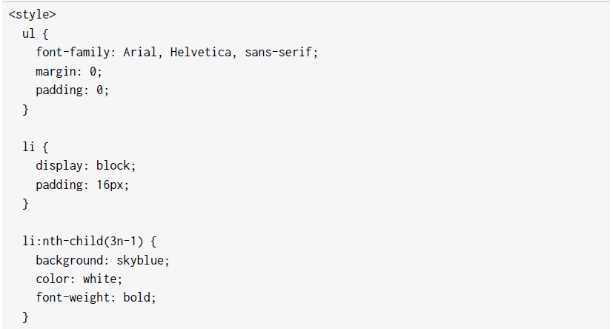
Pseudo-classes
For example, we can use :nth-child with an unordered list to give a different style to list items based on their position in the list:
Continues on the other slide

Slide 28
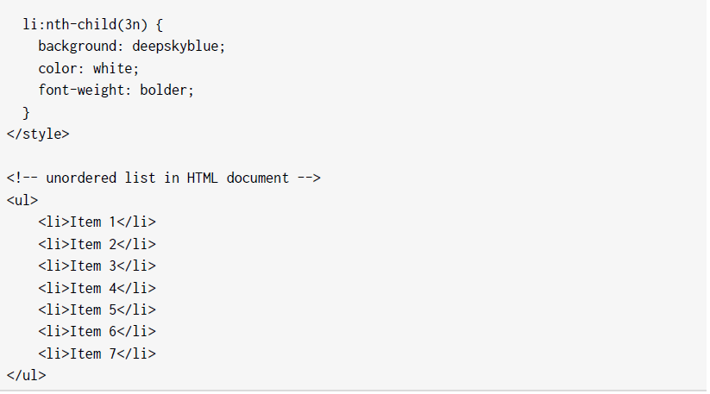
Pseudo-classes

Slide 29
Pseudo-classes
The following figure shows the result. The :nth-child pseudo-class gives you a lot of flexibility because you can use keywords such as odd and even or functional notation such as 3n - 1:
Figure 1.25: Using the :nth-child pseudo-class

Slide 30
Pseudo-elements
Pseudo-element selectors are preceded by two colons (::) and they are used to select part of an element. The available pseudo-elements include ::after, ::before, ::firstletter, ::first-line, ::selection, and ::backdrop.
These pseudo-elements give us a handle we can use to add stylistic elements without adding to the HTML document. This can be a good thing if the pseudo-element has no semantic value and is purely presentational, but it should be used with care.

Slide 31
Combining Selectors
What makes CSS selectors particularly powerful is that we can combine them in several ways to refine our selections. For example, we can select a subset of li elements in an HTML document that also has a .primary class selector with li.primary.
We also have several options, sometimes called combinators, for making selections based on the relationships of elements:
  To select all the li elements that are descendants of a ul element, we could use ul li.
  To select all the li elements that are direct children of a ul element with the primary class, we might use
  ul.primary > li. This would select only the direct children of ul.primary and not any li elements that are nested.
  To select an li element that is the next sibling of li elements with the selected class, we could use
  li.selected + li.
  To select all of the li elements that are the next siblings of li elements with the selected class, we could use li.selected ~ li.

Slide 32
Combining Selectors
The following figure shows the difference between using li.selected + li and li.selected ~ li:
Figure 1.26: Selecting the next adjacent sibling compared to selecting all of the next siblings

Slide 33
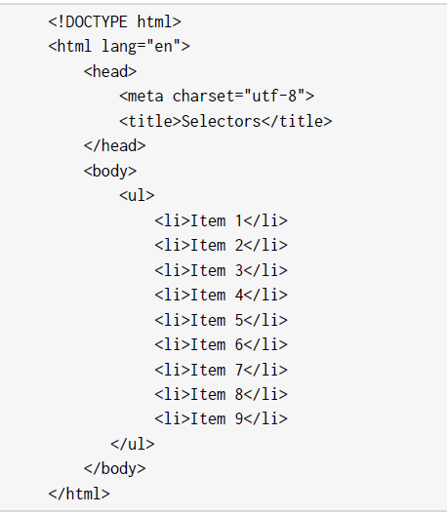
Exercise 1.07: Selecting Elements
In this exercise, we will differentiate list items by styling the odd items. We will use a class selector to style a selected item and a next-siblings combinator to style the elements after the selected item.
The steps are as follows:
  1. Open the chapter_1 folder in VSCode (File > Open Folder…) and we will create a new plain text file by clicking File > New File. Then, save it in HTML format, by clicking File > Save As... and enter the File name: Selectors.html. Now, copy the following simple web page with a ul list element and nine list items:

Slide 34
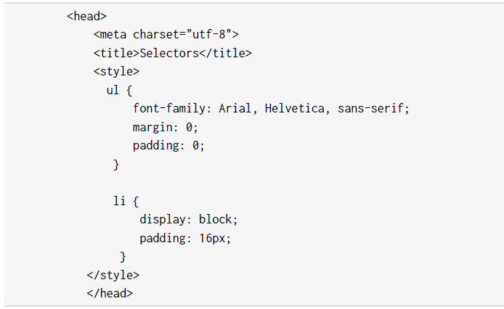
Exercise 1.07: Selecting Elements
  2. So that we can style a selected item differently, we will add a selected class to the fifth list item:
  3. Next, we will add a style element to the head element with the following CSS:
  This will remove some of the default styling of the unordered list in the browser. It will remove margins and padding on the list and set the font style to Arial (with Helvetica and sans-serif as a fallback).

Slide 35
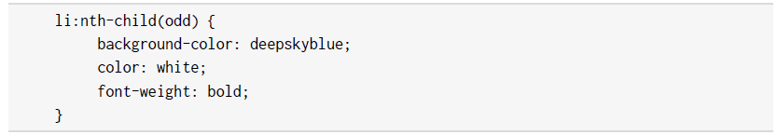
Exercise 1.07: Selecting Elements
  4. Next, we will style the odd list items with the :nth-child pseudo-class. We can use the odd keyword for this. With this style, any odd list item will have a blue background and white text:

Slide 36
Exercise 1.07: Selecting Elements
This gives us the stripy effect that we can see in the following figure:
Figure 1.27: Stripy list using :nth-child(odd)

Slide 37

Exercise 1.07: Selecting Elements
  5. We can style the selected class selector:

Slide 38
Exercise 1.07: Selecting Elements
This overrides the striped effect for the selected item as seen in the following figure:
Figure 1.28: Stripy list with a selected item

Slide 39

Exercise 1.07: Selecting Elements
  6. Finally, we will style the odd list items after the selected item using the all-next-siblings combinator:

Slide 40
Exercise 1.07: Selecting Elements
If you now right-click on the filename in VSCode on the left-hand side of the screen and select open in default browser, you will see the following web page in your browser:
Figure 1.29: Combining selectors to style a list

Slide 41
Exercise 1.07: Selecting Elements
Style sheets can have a large number of style rules and combinations of selectors. It is good to understand why one rule takes precedence over another one. This is where CSS specificity comes in

Slide 42
CSS Specificity
If we have two CSS declarations that have an effect on the same style property of an element, how do we know which of those declarations will take precedent?
There are several factors that decide the ranking of a CSS declaration and whether it is the style the browser will apply. The term for these factors is specificity. A style attribute that adds inline styles to an element has the highest specificity value. An ID selector has a greater specificity value than a class selector and a class selector or attribute selector has a greater specificity value than an element type. We can calculate the specificity value by giving points to each of these specificity values.
The most common way of representing this is as a comma-separated list of integers, where the leftmost integer represents the highest specificity. In other words, the leftmost value is the inline style attribute; next is an ID selector; next is a class selector, pseudo-class, or attribute selector; and the rightmost value is an element.
An inline style would have the value 1, 0, 0, 0. An ID selector would have the value 0, 1, 0, 0. A class selector would have the value 0, 0, 1, 0, and an h1 element selector would have the value 0, 0, 0, 1.

Slide 43
CSS Specificity
Let's look at a few examples with more complex selectors:
  li.selected a[href] has two element selectors (li and a), a class selector (.selected) and an attribute selector ([href]), so its specificity value would be 0, 0, 2, 2:
Figure 1.30: Calculating the specificity of li.selected a[href]

Slide 44
CSS Specificity
  #newItem #mainHeading span.smallPrint has two ID selectors, a class selector (.smallPrint), and a span element, so its specificity value would be 0, 2, 1, 1:
Comparing the two selectors, we can see that the selector in the second example is more specific than the selector in the first example.
Figure 1.31: Calculating the specificity of #newItem #mainHeading span.smallPrint

Slide 45

The Special Case of !important
The !important value can be appended to the value of any CSS declaration. It is a special keyword that can be applied to selectors to override the specificity value. It trumps any other specificity value. In terms of specificity value, it would add another column to become the value 1, 0, 0, 0, 0. It would even take precedence over an inline style.
For example, we might want to create a style rule that is reusable and lets us hide content on a web page. Something like this:

Slide 46
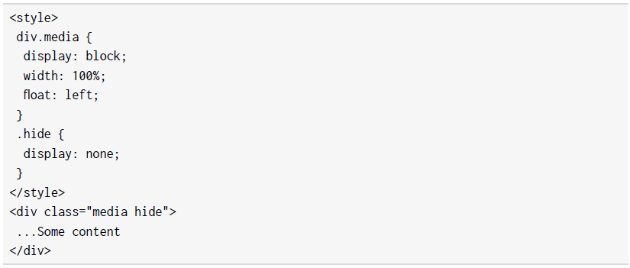
The Special Case of !important
If we apply this class to an element, we want that element to be hidden and to not be rendered on the web page. We might use this to later reveal the element using JavaScript. However, consider the following example:

Slide 47

The Special Case of !important
We might expect our div element to be hidden because the .hide class appears second in the style sheet. However, if we apply the specificity calculations we've learned about, we can see that div.media scores 0, 0, 1, 1 and .hide only scores 0, 0, 1, 0. The div.media rule for the display property with block value will override the none value of the .hide class. We can't really use this instance of the .hide class as we don't know whether it will have any effect.
Now consider the same .hide class but using the !important keyword:
Adding the !important keyword will make this .hide class much more reusable and useful as we can pretty much guarantee that it will hide content as we desire.
We've learned a lot about CSS in this part of the chapter. Let's apply some of this knowledge to an activity.

Slide 48
Activity 1.02: Styling the Video Store Template Page
In the previous activity, we were tasked with creating boilerplate HTML for a web page for the Films On Demand website. In this activity, we are going to add some style to that template page.
The following figure shows the expected output for this activity:
Figure 1.32: Expected output for styling the video store template page

Slide 49
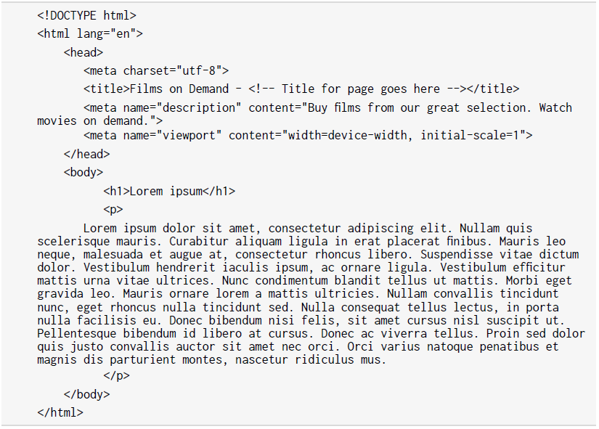
Activity 1.02: Styling the Video Store Template Page
The steps are as follows:
  1. We will start with the template from Activity 1.01, Video Store Page Template, which we will save as template.html:

Slide 50
Activity 1.02: Styling the Video Store Template Page
  2. We are going to link to an external CSS file. One of the difficulties with styling web pages is handling differences between browsers. We are going to do this by adding a file to normalize our default styles. We will use the open source normalize.css for this. Download the file from https://packt.live/34zqxty. Add the file to a styles folder and link to it from the template.html web page.
  3. We are going to add a style element to the head element of template.html. In the style element, we want to set some styles used across all pages. We want to do the following:
  Set box-sizing to border-box for all elements using the universal selector (*).
  Add a font family with the Arial, Helvetica, sans-serif values and a font size of 16px to the whole page.
  Add the background color #eeeae4 for the whole page. To do this, we will add a div element wrapper with the pageWrapper ID, where we will set the background color and padding of 16px, and a full-page class, where we will set the minimum height to 100vh (100% of the viewport height).
  Add an h1 element selector that sets the margin to 0 and adds padding of 16px to the bottom of the h1 element.

Slide 51
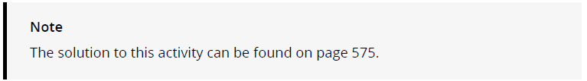
Activity 1.02: Styling the Video Store Template Page
  We've learned a lot about HTML and CSS in this chapter. In the next section, we will learn a little bit about the Chrome developer tools and how we can use them to better understand our web page.

Slide 52
Dev Tools
Most browsers come with some tools to help web developers create and change web pages. One of the most useful of these tools is the built-in developer tools that come with the Chrome browser.
You can access the developer tools on any web page with the Command + Option + I keyboard shortcut (on Mac) and F12 or Control + Shift + I (on Linux and Windows).

Slide 53
The Top Bar
On opening the developer tools, you should see something similar to the following figure:
There are a lot of options available in the developer tools. We will not cover all of them here but will focus on the top bar and the Elements tab in this chapter.
Figure 1.33: Chrome developer tools (Elements tab)

Slide 54

Dev Tools
The top bar gives you access to several options and tools, including access to all the other sections of the developer tools via the tabs:
The top bar has the following tools and options:
    Select tool – You can use this tool to select an element from within the web page.
    Devices toolbar – Changes the view so you can select the view size of various devices.
    Tabs – We can access various tools from the top bar menu such as Console, Elements, Sources, Network, and Performance. We will focus on the Elements tab.
    Configuration – Gives you access to various settings for the developer tools.
    Close – Closes the developer tools.
While developing the HTML and CSS for a web page, one of the tabs we use the most is the Elements tab.
Figure 1.34: Chrome DevTools top bar

Slide 55
The Elements Tab
The Elements tab has two areas – the left-hand panel shows the current HTML DOM and the right-hand panel shows details about the selected element.
You can use the left-hand panel to select an element from the HTML DOM and you can also edit an element to change its attributes:
Figure 1.35: Selectable HTML DOM in the left-hand panel of the Elements tab

Slide 56
The Elements Tab
Once you have an element selected, you can see a lot of information about the element in the right-hand panel. This information is divided into tabs and the first tab shows the styles:
Figure 1.36: The Styles tab of the right-hand panel of the Elements tab

Slide 57
The Elements Tab
Essentially, the Styles tab shows a representation of the CSSOM. You can look at the styles associated with the element, including the cascade of styles, showing you where a style is inherited from and where it has been set but overridden. The topmost element is the most specific. You can also use this tab to edit the styles of an element and to check different states, such as the hover state.
The Computed tab shows styles as they have been computed for the element.
There are also tabs to show you the event listeners and properties associated with an element.
Having had a glimpse at the power of Chrome's developer tools, let's finally consider how the browser works with HTML and CSS technologies to render a web page.

Slide 58
How a Web Page Renders
How does a web page render in the browser? We've learned a lot about HTML and CSS in this chapter, but let's see how these technologies are put together by the browser to render our web page.
The following figure shows a flowchart of the process, which is further explained below:

Slide 59
How a Web Page Renders
To summarize the process:
  1. The user starts by navigating to a URL, possibly via a hyperlink or by typing the URL into the address bar of their browser.
  2. The browser will make a GET request to the disk or a network. It will read the raw bytes from that location and convert them to characters (based on character encoding such as UTF-8).
  3. The browser then parses these characters according to the HTML standard to find the tokens that are familiar as HTML elements, such as <html> and <body>.

Slide 60
How a Web Page Renders
To summarize the process:
  4. Another parse is then made to take these tokens and construct objects with their properties and based on the rules appropriate to that token. At this point, the objects are defined.
  5. Finally, the browser can define the relationships between these objects and construct the HTML DOM for the web page.
  6. At this point, we have a DOM but not a rendered web page. The next task is to construct the CSSOM. Again the browser will load any style sheet resources it needs to, which were found while parsing the document. It will then construct the styles associated with nodes in the tree structure, which gives us the CSSOM.

Slide 61
How a Web Page Renders
To summarize the process:
  7. With the information gathered in the DOM and the CSSOM, the browser can create a render tree. The render tree is constructed by combining information from the CSSOM and the HTML DOM. Nodes in the HTML DOM that will not be rendered (for instance, those with the display: none; style) are excluded from the render tree. Those that are rendered are enriched with their computed style rules.

Slide 62
How a Web Page Renders
To summarize the process:
  8. Now the browser has all the information it needs, it can begin to calculate the positions of elements in the rendered viewport. This is called the layout stage. The browser lays elements out based on their size and position within the browser viewport. This stage is often also called reflow. It means the browser must recalculate the positions of elements in the viewport when elements are added to or removed from the page or when the viewport size is changed.
  9. Finally, the browser will rasterize or paint each element on the page, depending on their styles, shadows, and filters to render the page the user will see.

Slide 63
How a Web Page Renders
That is a brief and simplified summary of the rendering of a web page. Think about how many resources might be loaded on a relatively complicated website and with JavaScript running events and we can see that much of this process happens frequently and not in such a linear manner. We can start to see the complexities of what a browser is doing when it renders your web page.

Slide 64
Summary
In this chapter, we have looked at how we write HTML and CSS and their roles in structuring and presenting a web page. We've looked at how to make sure our HTML document is working as we expect and is understandable to a web browser, and we’ve looked at how to target elements in the HTML document so we can style them.
To demonstrate our understanding, we have created a web page that we will use as a template for the pages of a website and we have added CSS to normalize the style and add some initial styles for the site.
In the next chapter, we will look at the options for structuring and laying out a web page and elements within it and how we can style these for different web page layouts.

