Slide 1

AMBIENT INTELLIGENCE · WEARABLE SENSING
Food and Drink Detection Using a
Fine-Tuned YOLO26 Model
Single-class food detection
Ilijana Simonovska · Petar Trajkovski
Faculty of Electrical Engineering and Information Technologies (FEEIT) · Ss. Cyril and Methodius University, Skopje
Notes:
Title slide. Conference paper for IEEE ETAI. Food and drink detection from smart-glasses imagery, framed within Ambient Intelligence.

Slide 2



MOTIVATION
Diet is hard to track — and that limits care
Diet drives health
Logging is manual
Glasses can watch
Poor dietary habits are a leading risk factor for obesity, type 2 diabetes, and cardiovascular disease.
Intake is still recorded by hand via diaries and photos — time-consuming, easily forgotten, error-prone.
Wearable smart glasses capture egocentric images of eating, enabling automatic, unobtrusive monitoring.
The detection of food in this image stream is the sensing-and-reasoning step that lets an ambient system act automatically.
02
Notes:
Motivation: diet drives chronic disease; logging is manual and unreliable; smart glasses offer automatic egocentric capture. Food detection is the sensing-and-reasoning step.

Slide 3




THE AMBIENT INTELLIGENCE PARADIGM
A continuous loop of sensing, reasoning, and acting
SENSE
REASON
ACT
Smart glasses capture egocentric images of everyday eating from the wearer's point of view.
A fine-tuned YOLO detector recognizes food in the image stream under real-world conditions.
The system logs the eating event and can deliver timely, context-aware dietary feedback.
…and the cycle repeats — continuous, unobtrusive support with little effort from the user.
03
Notes:
The AmI loop: sense (glasses) -> reason (YOLO detector) -> act (log intake / feedback), then repeats.

Slide 4
OUR APPROACH
Food as a single class, detected in real time
We treat food and drink detection as a single-class problem: every food or drink item is labelled food, and everything else is background.
01
A reproducible pipeline
Annotation → YOLO-format conversion → Multi-Source Merging → Fine-Tuning → Evaluation, as an AmI sensing component.
Start from a YOLO26s model pre-trained on public Kaggle food / no-food images.
Fine-tune on egocentric + conventional photographs for wider viewpoint coverage.
Single-stage YOLO runs fast enough for resource-constrained wearable hardware.
02
A comparative evaluation
Detection performance of fine-tuned YOLO26 reported and compared against alternative detection and segmentation architectures.
The contribution is twofold.
04
Notes:
Single-class formulation. Pre-train on Kaggle, fine-tune on egocentric + conventional photos. Twofold contribution: reproducible pipeline and comparative evaluation.

Slide 5


DATA
2,339 images merged from three sources
2,339
1,870
233
236
TOTAL IMAGES
TRAINING
VALIDATION
TEST
≈ 80 / 10 / 10 split
AFL Egocentric
FoodID Conventional
Kaggle Extension
Real images from Emteq smart glasses — natural lighting, varied angles, partial occlusion.
Food & drink photographs taken with a standard mobile camera.
No-food negatives plus high-resolution food images for diversity.
All regions annotated in VGG Image Annotator (VIA), exported to CSV, and converted to YOLO label format.
05
Notes:
Data: 2,339 images from AFL (egocentric, Emteq glasses), foodID (conventional), and Kaggle extension. 80/10/10 split. Annotated in VIA, converted to YOLO format.

Slide 6



METHOD
One pass through YOLOv26 — three stages
Backbone
Neck
Detect head
Convolutional layers + C3k2, SPPF and attention (C2PSA) extract visual features at increasing depth.
Upsampling + Concat fuse deep semantic features with earlier geometric detail across three scales.
Predicts bounding boxes & class probability. NMS-free, simplified direct regression for faster inference.
EVALUATION METRIC
MODEL VARIANTS
Intersection over Union (IoU)
YOLO26 n · s · m · l · x
Ratio of the intersection to the union of the predicted and ground-truth boxes (0–1). Higher IoU = more accurate localization.
We use YOLO26s — a small model balancing accuracy and speed, suited to wearable deployment.
06
Notes:
YOLO26 architecture: backbone, neck, detect head. NMS-free, DFL-free simplified head. Evaluated with IoU. We use the small (s) variant for wearable deployment.

Slide 7
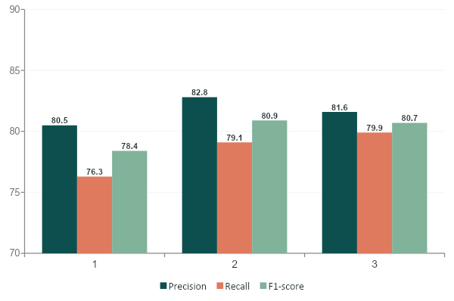

RESULTS & DISCUSSION
768×768 gives the best precision–recall balance
Detection metrics by input resolution
BEST CONFIGURATION
768 × 768 input
82.8% precision · 79.1% recall · 80.9% F1 - score
Confusion counts (test set)
Input | TP | FP | FN
640x640 | 190 | 46 | 59
768x768 | 197 | 41 | 52
960x960 | 199 | 45 | 50
768² minimizes false positives and yields the highest F1 — the most stable choice for general use.
07
Notes:
Results: tested at 640, 768, 960. 768 gives best F1 (80.9%) and fewest false positives (41). 960 misses slightly fewer but more false positives. 768 best for general use.

Slide 8


CONCLUSION
A fine-tuned YOLO can reliably sense food across wearable and conventional cameras
It works
Best at 768²
Open challenge
Fine-tuned YOLO26s detects food well across mixed egocentric and conventional imagery.
Optimal input size given the variety of image dimensions in the merged dataset.
The model still occasionally fails to ignore non-edible objects in the scene.
Next: tighter false-positive suppression and on-device deployment as a real-time AmI sensing component.
Notes:
Conclusion: fine-tuned YOLO detects food reliably; best at 768; still struggles with non-edible objects. Future: false-positive suppression, on-device real-time deployment.

