Slide 1
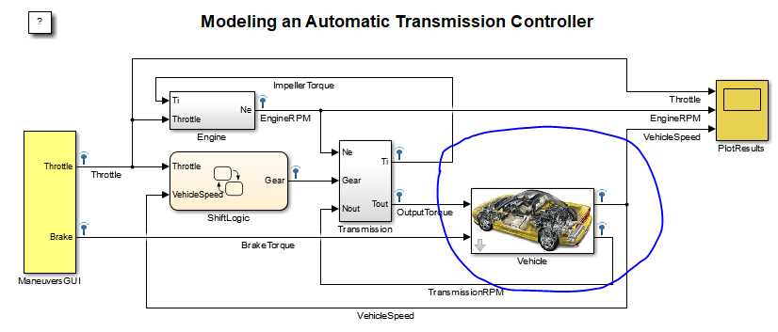
Title :Vehicle
Path :sldemo_autotrans/Vehicle
Classification :Info
Comments : Change the vehicle image

Slide 2
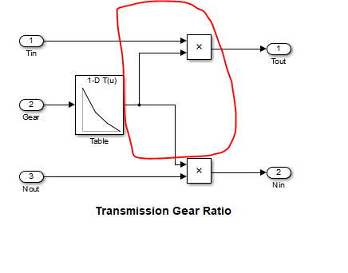
Title :TransmissionGear Wiring
Path :sldemo_autotrans/Transmission/TransmissionRatio
Classification :Warning
Comments :Wirng can be improved.

