Slide 1
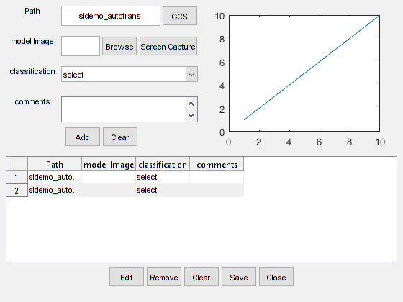
Scale = maxfixed

