Slide 1



An Introduction to Spring
Getting started with Spring

Slide 2
Agenda
Lets start with the Why
Introducing Spring
Spring has Sprung
Bean factory and the Application Context
AHA

Slide 3
Why Spring?
Reminiscing the good old days, NOT
Java Evolves. J2EE
EJB, CORBA, IIOP
PAIN
Complex programming model
Hard to maintain or extend
Hart to test
Extremely high learning curve

Slide 4
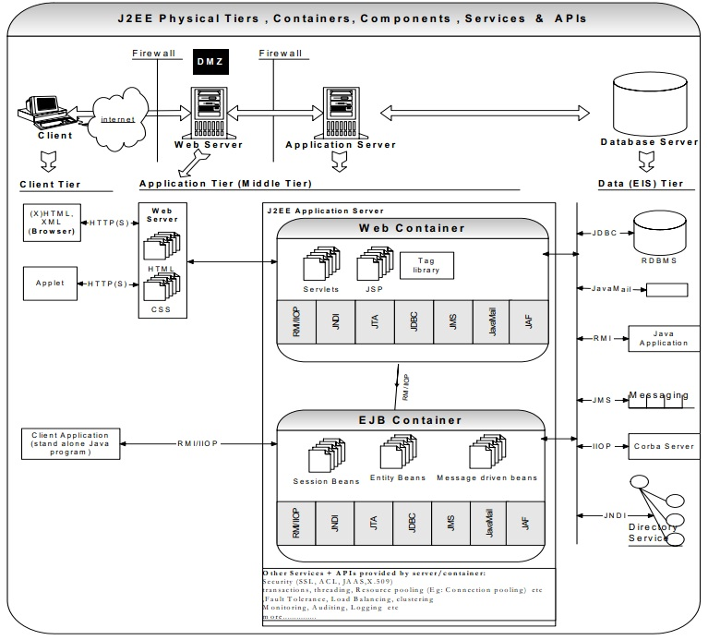

Slide 5
Spring has Sprung
The Spring Framework is a Java platform that provides comprehensive infrastructure support for developing Java applications.
Spring handles the infrastructure so you can focus on your application.
Dependency Injection and Inversion of Control
"The question is, what aspect of control are [they] inverting?" Martin Fowler

Slide 6
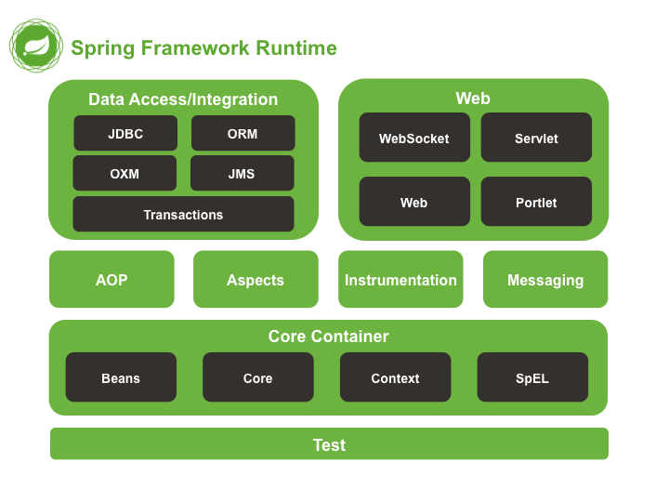

Slide 7
Modules
Core Container
AOP
Messaging
Data Access
Web
Test

Slide 8
BeanFactory and the ApplicationContext
Whats a bean? A bean is an object that is instantiated, assembled, and otherwise managed by a Spring container
BeanFactory provides the configuration framework and basic functionality
ApplicationContext adds more enterprise-specific functionality.
WebApplicationContext
ClassPathXmlApplicationContext

Slide 9
Bean Factory and the Application Context
Most common: top level of class path
Instantiate container with new ClassPathXmlApplicationContext("/file.xml");
Subdirectory of class path Subdirectory of class path
Instantiate container with new ClassPathXmlApplicationContext( ) "/dir/file.xml");
Anywhere on file system
Instantiate container with new FileSystemXmlApplicationContext("/usr/hall/file.xml");
In WEB-INF (Web applications only)
Instantiate container with special listener when app loads.
Access container with static methods in WebApplicationContextUtils

Slide 10
Bean Factory and the Application Context
Instantiate the container
ApplicationContext context = new ClassPathXmlApplicationContext("/applicationContext.xml");
Instantiating the container is expensive
Container should be instantiated once only
Get instance from the container
SomeType myBean = (SomeType)context.getBean("bean-name");
You normally treat bean as the abstract type
Instantiating a bean is inexpensive
You often instantiate beans many times
By default, calling getBean on the same name multiple times returns the same instance.
See later section on bean scopes.

Slide 11
Bean Factory and the Application Context
<beans xmlns="http://www.springframework.org/schema/beans"
xmlns:xsi="http://www.w3.org/2001/XMLSchema-instance"
xsi:schemaLocation="http://www.springframework.org/schema/beans
http://www.springframework.org/schema/beans/spring-beans-2.5.xsd”>
<bean id="helloBean" class="com.nbcu.common.HelloWorld">
<property name="name" value=”NBCU" />
</bean>
</beans>

Slide 12
Bean Factory and the Application Context
package com.nbcu.common;
public class HelloWorld {
private String name;
public void setName(String name) {
this.name = name;
}
public void printHello() {
System.out.println("Hello ! " + name);
}
}

Slide 13
Bean Factory and the Application Context
<bean id=”SalesTax" class=”salesTax">
<property name=”percentage" value="10"/>
</bean>
<bean id=”VatTax" class=”vatTax">
<constructor-arg value=”11"/>
</bean>
…
</beans>

Slide 14
What’s so great about that
public class ShoppingCart{
public ShoppingCart(User user, Address address, Account account)
public ArrayList<Item> getItems(){ return this.items; }
public void calculateTax(Item item){ Tax tax = context.getBean(“salesTax”);
item.taxAmount = tax.calculate(item.amount)
} }
// Now what if we add different currencies? What if we add different Tax types (VAT)
“Program to an interface, not an implementation”
“Favor object composition over class inheritance”
GOF.

Slide 15

Lab

