Slide 1
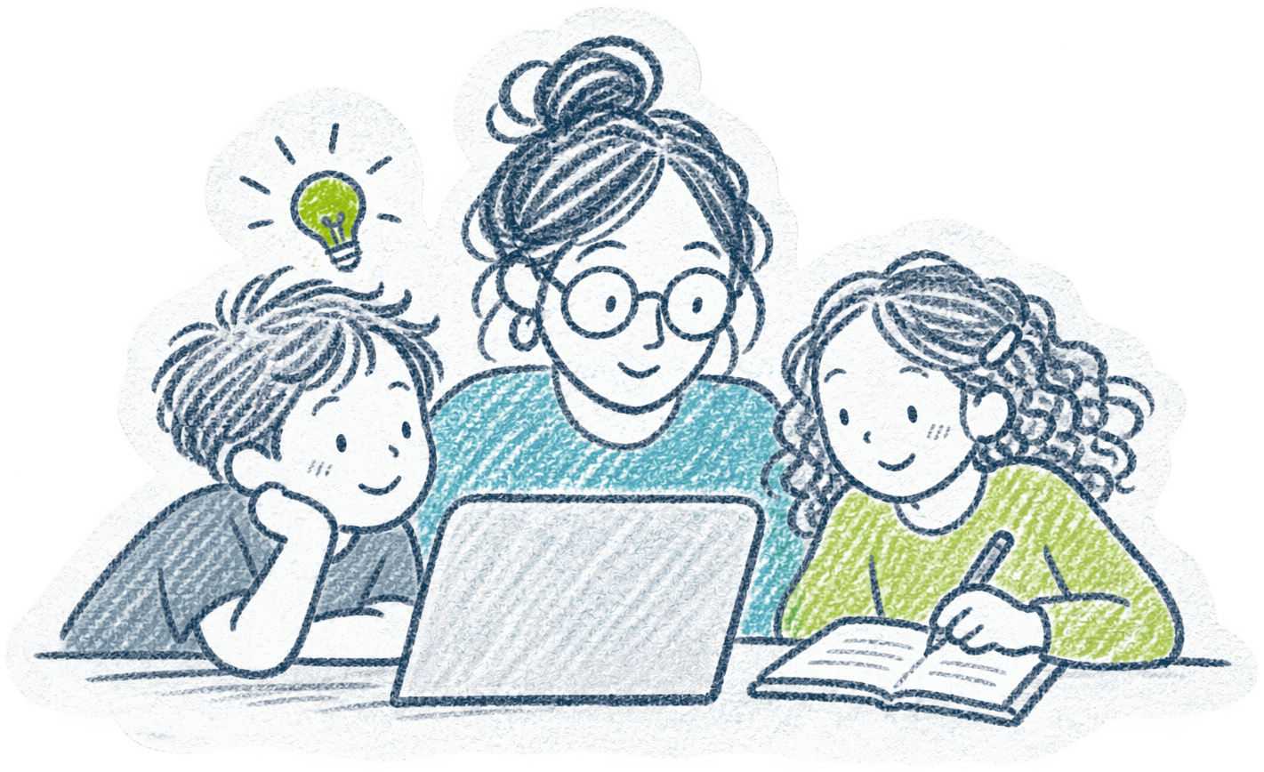






Klick 1: Where we stand (Zoom-Ansicht, liegt außerhalb der Folie)
Klick 2: The problem (Zoom-Ansicht, liegt außerhalb der Folie)
WHAT IF …
THERE WAS A
LEARNING GUIDE
THAT …
BRINGS TOGETHER
all learning opportunities
WHERE WE STAND
Great learning opportunities.
Scattered across different websites.
THE PROBLEM
It's hard to find the right opportunities
and keep track of them.
KEEPS FAMILIES COMING BACK
beyond events,
SHOWS US
what young people want and what's missing
YOUR CHALLENGE
BUILD A
LEARNING
GUIDE
THE PROBLEM
It's hard to find the right opportunities
and keep track of them.
A digital tool that makes
Heilbronn’s learning opportunities
easy to discover for families.
WHERE WE STAND
Great learning opportunities.
Scattered across different websites.
Klick 3: What if (Zoom-Ansicht, liegt außerhalb der Folie)
Klick 4: Your challenge (Zoom-Ansicht, liegt außerhalb der Folie)
WHAT IF …
THERE WAS A
LEARNING GUIDE
THAT …
YOUR CHALLENGE
BUILD A
LEARNING
GUIDE
A digital tool that makes
Heilbronn’s learning opportunities
easy to discover for families.
BRINGS TOGETHER
all learning opportunities
KEEPS FAMILIES COMING BACK
beyond events,
SHOWS US
what young people want and what's missing

