Slide 1
DDR3 Config Recommendations
August 2009
Notes:
[Enter any extra notes here; leave the item ID line at the bottom]
Avitage Item ID: {{6897D6F0-CEA2-4767-8412-99344CC5A453}}

Slide 2
Memory technology cheat sheet
DDR3 is the third generation of Double Data Rate (DDR) SDRAM memory. It is a continuing evolution of DDR memory technology that delivers higher speeds, lower power consumption and heat dissipation. It is an ideal memory solution for bandwidth hungry systems equipped with dual and quad core processors.
Capacities available include 1, 2, 4 & 8GB (16GB available in the future). HP DDR3 option kits consist of single dimms.
DIMM type
  UDIMMs with ECC offer lower latency and power consumption than RDIMMs, but are limited in capacity. Unbuffered with ECC identified with an E in the manufacturer’s module name (example PC3-8500E).
  RDIMMs also have ECC and offer larger capacities than UDIMMs and include address parity protection. Registered identified with an R in the module manufacturer’s name (example PC3-8500R).
Speed indicates the data rate of the DRAM chips and the Memory Module that uses those chips. HP offers two base speeds;
  DDR3-1066 DRAM operates at 1066 MT/s. A DIMM with DDR3-1066 DRAM is called PC3-8500 (1066 x 8 Bytes ~= 8500 MBytes/s)
  DDR3-1333 DRAM operates at 1333 MT/s. A DIMM with DDR3-1333 DRAM is called PC3-10600 (1333 x 8 Bytes ~=10600 MBytes/s)
  System realized speeds will depend on how the server is populated with memory.
Rank – DDR3 will support Single, Dual and Quad rank DIMMs. Rank refers to DRAM chips that are ganged together to provide 64 bits (8 Bytes) of data on the memory bus. All chips in a rank are controlled simultaneously by the same Chip Select, Address and Command signals.
Data width – x4 and x8 indicate the number of data outputs per DRAM. Eight x8 DRAMs make one rank. Sixteen x4 DRAMs make one rank. 64 bits in each case.
  Unbuffered ECC as well as Registered DIMMs will have: 9 DRAMs (x8) or 18 DRAMs (x4) per rank.
Density – Describes the number of storage locations in a DRAM chip. DDR3 will launch with 1Gb and 2Gb-based DRAM. No 512Mb in DDR3.
Voltage – Over time, DDR3 memory will consist of three voltage ratings;
  Standard at announce (1.5V); future plans call for Low Voltage (1.35V) and Ultra Low Voltage (TBD; ~1.25V)
  DDR3 has lower power architecture, due to lower core voltage
    >25% power savings over DDR2 (DDR2-800 vs. DDR3-800)
    DDR3-1066 consumes less power than DDR2-800.
CAS latency - Column Address Strobe latency refers to the DRAM read response time in number of bus clocks from the Column Address to the DRAM providing data on the memory bus. A lower number will yield a performance increase for most applications.

Slide 3
Memory Technology Comparison
 | DDR2 | FB-DIMM | DDR3 @Launch
Data Rates (MT/s) | 400, 533, 667, 800 | 533, 667, 800 | 800, 1067, 1333
Clock Rate (MHz) | 200, 266, 333, 400 | 266, 333, 400 | 400, 533, 667
Names | PC2-3200R PC2-4200R PC2-5300R PC2-6400R | PC2-4200F PC2-5300F PC2-6400F | PC3-8500R PC3-10600R PC3-10600E
Bandwidth (GB/s) | 3.2 – 6.4 | 4.2 – 6.4 | 6.4 – 10.6
Operating Voltage | 1.8V | 1.8V & 1.5V | 1.5V
Burst Length | 4, 8 | 4, 8 | Chopped 4, 8
Ranks | 1, 2 & 4 | 1, 2 & 4 | 1, 2 & 4
Capacities (GB) | 0.5, 1, 2, 4, 8 | 0.5, 1, 2, 4, 8 | 1, 2, 4, 8
DRAM Densities | 512Mb, 1Gb & 2Gb | 512Mb, 1Gb & 2Gb | 1Gb, 2Gb
Temp sensor | No | On AMB (Not used) | On DIMM
Max DRAM temp | 85 °C at 1x Refresh 95 °C at 2x Refresh | 85 °C at 1x Refresh 95 °C at 2x Refresh | 85 °C at 1x Refresh 95 °C at 2x Refresh
HP Restricted. May not be shared externally – HP TekTalk Training.
Notes:
[Enter any extra notes here; leave the item ID line at the bottom]
Avitage Item ID: {{960FE3B7-1726-43E4-92D0-E90C458B39E1}}

Slide 4
DDR3 DIMM population rules
www.hp.com/go/ddr3memory-configurator
Loading goes from heaviest load (quad-rank) to lightest load (single-rank) within a channel.
Heaviest load (DIMM with most ranks) within a channel goes furthest from the chipset.
You can only install two quad-rank DIMMs per channel.
You can only have up to 8 ranks installed per channel.
It is not required, but it is recommended to load the channels similarly if possible.
Only two UDIMMs per channel can be installed. The third socket in the channel will remain empty.
UDIMMs and RDIMMs cannot be mixed within a system - even on the other processor.
Also, when QR DIMMs are installed, all channels are limited to 2 DIMMs per channel.
If only one processor is installed, only 1/2 of the DIMM sockets are available.
For mirroring, channel 2 remains unpopulated. Channels 0 and 1 are populated identically
All three channels per processor are populated identically when using online spare mode.
ML330 supports up to 18 DIMMs only with optional processor riser card and 2nd processor installed
If using lock-step mode, channel 2 must be unpopulated. DIMMs in channels 0 and 1 will be installed in pairs. The paired slots will be 1,4; 2,5; 3;6 on a 3DPC system or 1,4; 2,5; on a 2DPC system.
No mixing voltage.
No mixing clock rates.
Efficiency: If possible, use UDIMMs unless you can't for desired system capacity. Otherwise, fewer DIMMs is better. Also, if possible, use LP or LV DIMMs when available.
Virtualization: Load as few high-capacity DIMMs as possible to meet the memory requirement.
Lowest latency: Load DIMMs in sets of 3 keeping the channels balanced. Load all sockets with identical memory part numbers. Overall, this will provide the lowest latency.
Quad rank can be mixed within a channel with other RDIMMs.
95 Watt processors needed to run 1333MHz.
Online spares not supported at initial announce; expected with Westmere updates.
Subject to change and update.

Slide 5
Intel G6 Population Rules
For 1R and 2R RDIMMs (2, 4, 8GB)
  1 DPC @ DDR3-1333 (HP supports 2 DPC @ 1333 req. RBSU setting)
  2 DPC @ DDR3-1067
  3 DPC @ DDR3-800
For 4R RDIMMs (4, 8 GB)
  1 DPC @ DDR3-1067
  2 DPC @ DDR3-800
For 1R and 2R UDIMMs (1, 2 GB)
  1 DPC @ DDR3-1333
  2 DPC @ DDR3-1067
HP Restricted. May not be shared externally – HP TekTalk Training.
Notes:
[Enter any extra notes here; leave the item ID line at the bottom]
Avitage Item ID: {{4C4294AE-4457-4714-A5A3-F45DCD35A41E}}

Slide 6
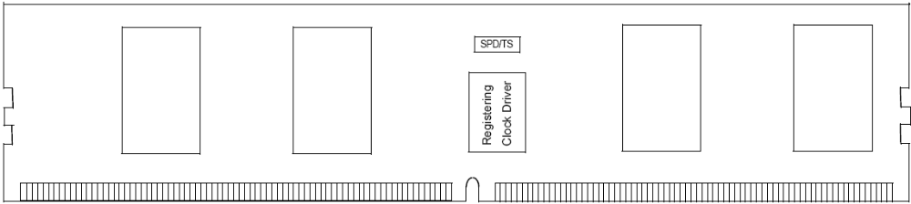
DDR3 SDRAM DIMM Introduction
DDR3
  3rd Generation of Double Data Rate Memory
  Data rate is 2x the clock
    One data phase in each half of the memory bus clock
Synchronous Dynamic Random Access Memory
  Memory Chips that are ganged together to form DIMMs
DIMM
  Dual In-line Memory Module
  Independent signal contacts on both sides of the PCB
Clock#
Clock
Data
T0 T1 T2 T3 T4
D0
D1
D2
D3
D4
D5
D6
D7
SPD with Temp Sensor
Signal Contacts
Optional Register & Clock Driver
SDRAM Chip
SDRAM Chip
SDRAM Chip
SDRAM Chip
HP Restricted. May not be shared externally – HP TekTalk Training.
Notes:
[Enter any extra notes here; leave the item ID line at the bottom
SPD = Serial Presence Detect refers to a standardized way to automatically access information about a computer memory module. ]
Avitage Item ID: {{3D27F76E-F103-408C-B633-A7CF63CBD64C}}

Slide 7
Memory Ranking Considerations
Definition of memory rank:
  A unique, independently addressable 64-bit data area of a memory module.
  DDR3 is offered as Single rank (SR), Dual rank (DR), or Quad rank (QR)
For NHM-EP: As number of ranks increase, DIMMs/ch support decreases
DIMMs/channel Memory Speed | The higher the ranking, the more limitations on DPC and speed (See Memory Support POR tables)
Cost | QR DIMMs may be lower cost for same capacity DR or SR DIMMs based on lower-density DRAM chips As costs come down, QR cost advantage will likely decline
Performance | As a general rule, the greater the number of DIMM ranks, the better the performance (assuming same clock frequency) However this is application dependent – for some applications, there is no advantage
Power | Generally, the more ranks, the less power it consumes. Power consumption varies from supplier to supplier
Future upgradeability | If you install QR initially, this may limit the number of additional DIMMs you can install per channel in the future If you expect to want to add memory, consider ranking and how many DIMMs you may end up needing

Slide 8

Customer choice with DDR3
If uncertain, go with RDIMM for more flexibility
DDR3 Technology Comparison
 | RDIMMs Higher capacity, memory register, address parity | UDIMMs Smaller capacity, lower price points, basic ECC
Maximum capacity | 144GB max capacity (18 slots, dual rank) | 24GB max capacity (12 slots)
Capacities at launch | 2GB, 4GB, 8GB | 1GB, 2GB
Max. DIMMs/channel | 3 Dual Rank | 2 Dual Rank
Low power option | 4GB Quad-Rank
Address parity | (memory register)
Lower cost |  | (smaller capacities)
Ranks/DIMM support | 1, 2, 4 | 1, 2
DRAM support | x4, x8 | x8
Latency |  | 1 clock advantage
DIMM power |  | 1 watt less (no register)
Notes:
Performance differences will vary depending on system configurations and application.

Slide 9
More channels & more slots
Platform configurations (18 DIMMs)
  Up to 3 channels per CPU
  Up to 3 DIMMS per channel
Memory types supported
  DDR3 1333, 1066 & 800MHz
  Registered (RDIMM)
  Unbuffered (UDIMM)
  Single-rank, dual-rank, quad-rank
System memory speed set by BIOS depending on
  CPU capability
  DIMM types used
    memory speed, U/RDIMM, SR/DR/QR)
  DIMMs populated per channel
18-slot configuration
1
Up to 3 channels per CPU
CPU
CPU
2
3
1 2 3
Up to 3 DIMMs per channel
CPU
CPU
12-slot configuration also available
Note that UDIMMs are limited to 2 DIMMs/channel & 24GB maximum.

Slide 10
DDR3 population scenarios
Maximum capacity
  800MHz across 3 channels (38GB/s)
  Up to 3 DPC (18 DIMMs total)
  Capacity: 144GB (w/ 8GB)
  Virtualization environments
Balanced performance
  1066MHz across 3 channels (51GB/s)
  Up to 2 DPC (12 DIMMs)
  Capacity: 96GB
  General purpose enterprise workload
Maximum bandwidth
  1333MHz across 3 channels (64GB/s)
  1 DPC (6 DIMMs)
  Capacity: 48GB
  HPC technical computing
6.4 GB/s
CPU
CPU
6.4
6.4
8.5 GB/s
CPU
CPU
8.5
8.5
10.6 GB/s
CPU
CPU
10.6
10.6
Note that UDIMMs are limited to 2 DIMMs/channel & 24GB maximum.

Slide 11

New memory technology with G6;
DDR-3
Energy efficiency
Thermal temperature sensors
  powers down when idle
Voltage reduced from 1.8V to 1.5V
Bandwidth doubles
667 to 1333MHz
DDR2; 4 channels
DDR3; 6 channels
Lower latency
DDR2
  DDR2 667 CL5 = 15.0ns
DDR3; 10-13% lower
  DDR3 1333 CL9 = 13.5ns
  DDR3 1066 CL7 = 13.1ns
  DDR3 800 CL6 = 15.0ns
Flexibility
Unbuffered DIMMs
Registered DIMMs
DDR-3
Larger memory footprints
Increased slot counts with G6
24GB with UDIMMs
144GB with RDIMMs
Address parity detection
Enabled with DDR3 (RDIMMs)
Notes:
Bandwidth doubles from 667 MHz (DDR-2) up to 1333MHz (DDR-3). With 6 channels for DDR-3, this is like driving faster & having more lanes to drive in.
U-dimm and R-dimm options for the same servers gives customers the choice.
Larger footprints allow customers to realize larger memory capacities than with DDR-2.
Energy efficiency – improved thermal temperature sensors; more finely tuned fans; when memory is idle it powers down.
DDR-2 voltage was 1.8V. DDR-3 will be 1.5V at announce, with low voltage 1.35 to come late 2009. Low Voltage does not equal Low Power; two different things.
Lower latency with DDR-3, leading to faster throughput (theoretical values shown).
DDR3 800 CL6 = 15 ns
DDR3 1067 CL7 = 13.12ns
DDR3 1333 CL9 = 13.5 ns
Regarding "faster", there is "fast" and there is "quick". DDR3 1333 will be the fastest (top speed), but DDR3 1067 will be the quickest (lowest latency). 3DPC is neither the fastest or the quickest. When you go to 3DPC, you are making a capacity play.
Address parity detection allows extra confirmation that correct addresses are being communicated to/from; versus no detection which does not confirm/transmit back.

Slide 12
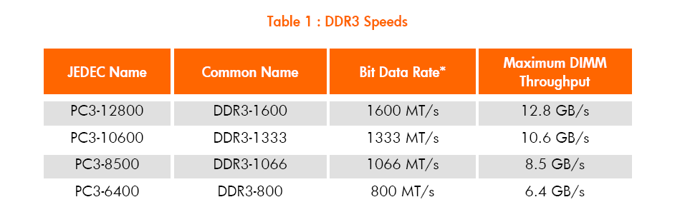
DDR3- Overview
DDR3
  DIMM uses the same 240-pin connector as DDR2 DIMMS, but the notch key is located differently.
  Thermal sensor integrated onto the DIMM module.
  PC3-8500 describes the data rate of the entire DIMM
    8500 MB/s
    1067 Mb/s x 64 bits = 1067 MT/s x 8 Bytes = 8536 MB/s
    Rounded down

Slide 13
General Population Recommendations
Populate all 3 channels of each processor.
  This means for a 2-processor config, populate in groups of 6 identical DIMMs.
Use DIMMs with the lowest number of ranks
For 24GB or less use UDIMMs
Memory can be optimized for:
  Capacity, Performance, Power & Cost

Slide 14
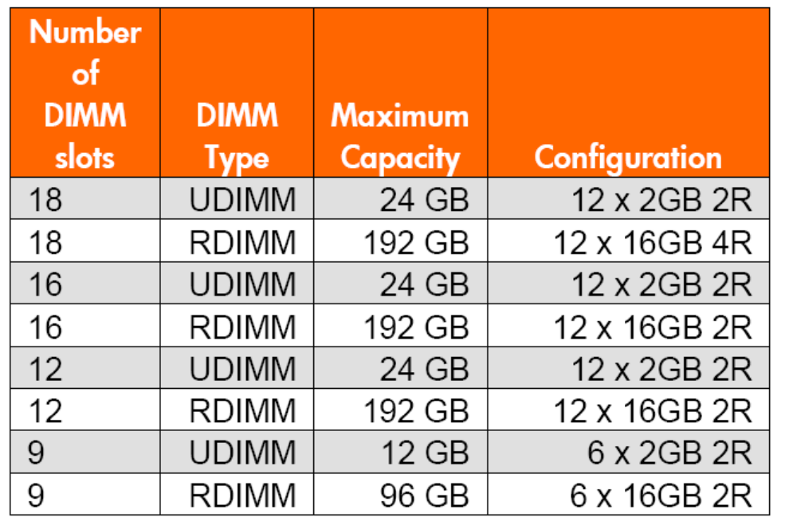
Optimizing for Capacity
Maximum capacity is achieved using RDIMMS.

Slide 15
Optimizing for Performance
The two primary measurements of Memory Subsystem performance are:
Latency
  Factors: DIMM type, speed, ranks and CAS timing
Throughput
  Factors: Number of memory channels populated and speed at which the memory runs.

Slide 16
Optimizing for Performance: Latency
Speed: Refers to the frequency of the memory clock. Memory clock speed affected by 5 factors:
  Rated Memory speed of the processor
    X5570-50 series = 1333MHz, E5540-20 series = 1066MHz E5504-02 series = 800MHz
  Rated Memory speed of the DIMM
    HP offers 2 speeds DDR3-1333 & DDR3-1066
  Number of Ranks on the DIMM
    Each rank on a memory channel adds 1 electrical load. To maintain signal integrity as electric load increases, memory channel may run at a lower speed.
  Number of DIMMS populated
    More DIMMS on a channel impact electrical loading and signal integrity. DIMMS may operate at a lower speed.

Slide 17
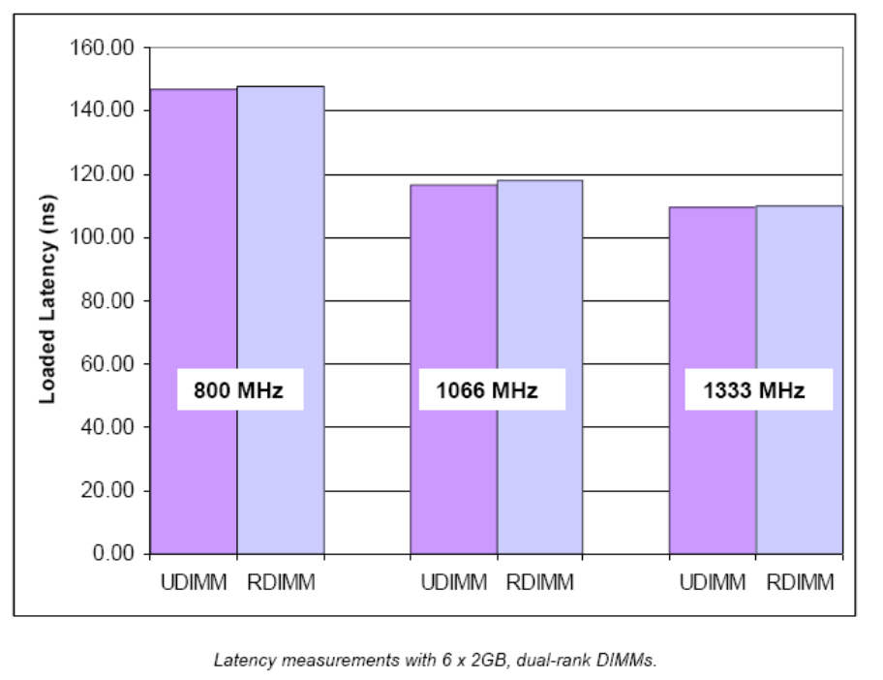
Optimizing for Performance: Latency
Speed:
  Use the fastest DIMMs available. 1333Mhz DIMMS achieve the lowest latency.
  Latency nearly identical for UDIMMS vs RDIMMS

Slide 18
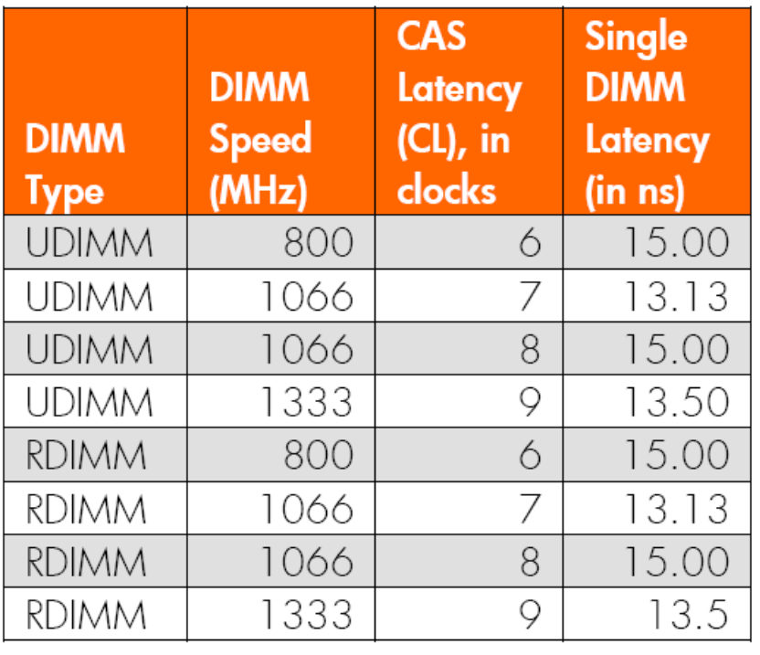
Optimizing for Performance: Latency
CAS Latency: Latency (CL) is the DRAM response time from the Column Addr Strobe to 1st Data on the bus
  9 => CL of 9 bus clocks @667 MHz => 13.5ns => 70ns from CPU core
  7 => CL of 7 bus clocks @533 MHz => 13.1ns => 70ns from CPU core
  6 => CL of 6 bus clocks @400 MHz => 15.0ns => 80ns from CPU core

Slide 19
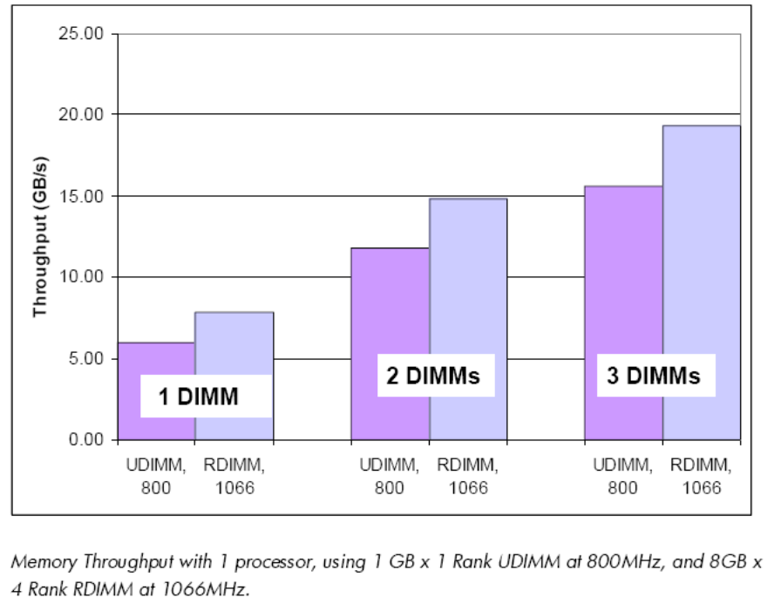
Optimizing for Performance: Throughput
Memory Channels:
    The BIGGEST impact on throughput is the number of memory channels populated.
    HP recommends always populating all three channels per installed processor.
    Adding a 2nd DIMM increases bandwidth by 85-90%, 3rd DIMM adds 30-35%.

Slide 20
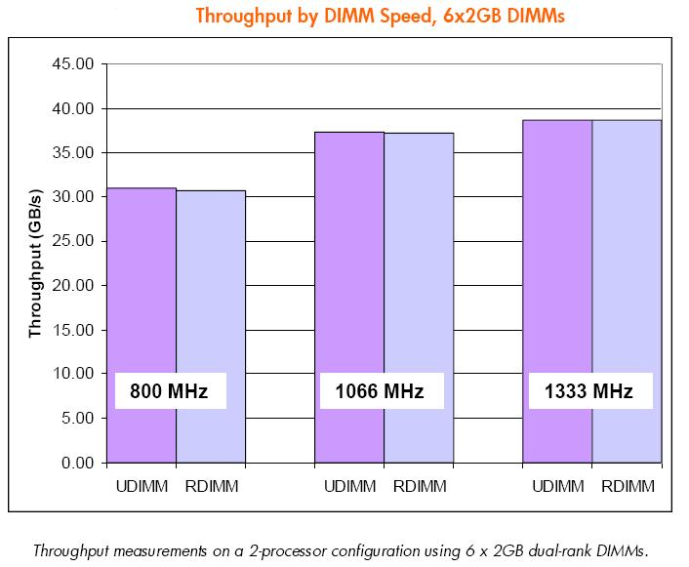
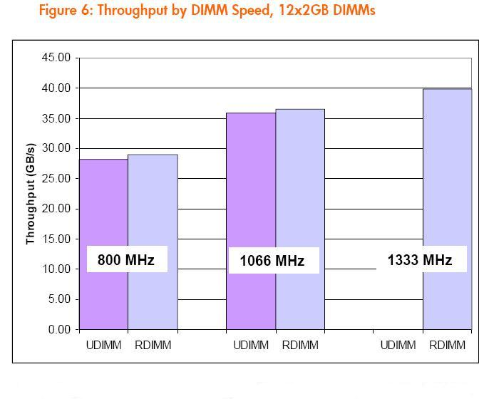
Optimizing for Performance: Throughput
Memory Speed
    1066MHz is 20 to 25% higher than 800MHz. 1333MHz is 3.5-9% higher than 1066MHz.

