Slide 1

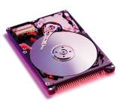

Western Digital
Drive Basic
西部数据认证工程师
26/11/8

Slide 2
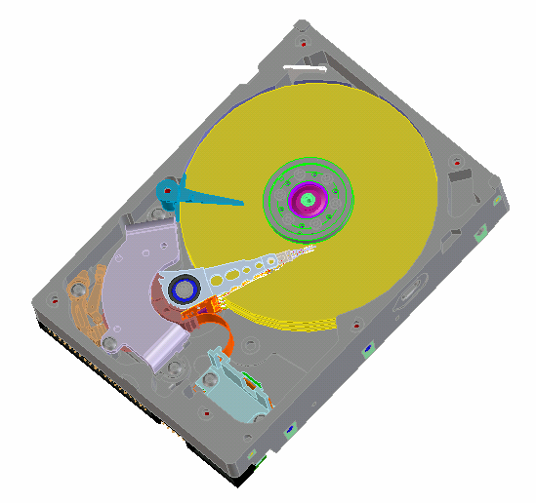
硬盤 – 主要部件介紹(1)
Air Circulation Filter
空氣過濾器
Spindle Motor
旋轉馬達
VCM Magnet
音圈馬達磁鐵
Latch
音圈卡鎖
Disk Media
記錄數據碟片
Base Casting
鑄件之底座

Slide 3
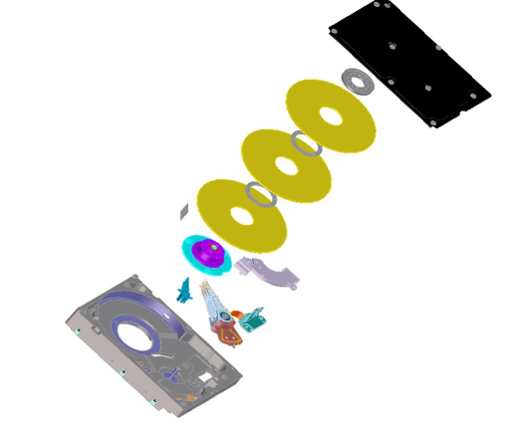
硬盤 – 主要部件介紹(2)
Clamp
固定銷
Cover
頂蓋
Spacer
間隔圈
Disk
碟片
Spindle Motor
旋轉馬達
VCM (Voice Coil Magnet)
HSA (Headstack Assembly)
Base

Slide 4
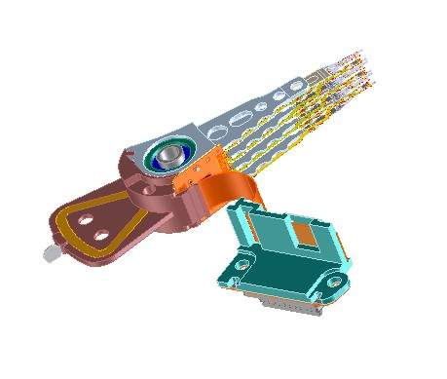
硬盘– Headstack Assembly (HSA-头堆)
Slider / Head
滑片/磁頭
Actuator
Pivot
軸
Suspension
懸臂
Flex Circuit
撓性電纜
Voice Coil
Bracket/Connector
托架/連接器

Slide 5
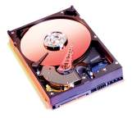
數據記錄原理基礎

Slide 6
硬盤容量的增長歷史
1990
2004
14 YEARS
Caviar
Caviar
250 GB (250,000 MB!)
Physical Parameters:
Cylinders = 74,686
Heads = 6
Sectors/track = 506 – 945
Sectors/drive = 488,397,168
RPM = 7200
Data Density:
Bits/inch (BPI) = 660Kb
Tracks/inch(TPI) = 76,000
20 MB Technical Specs...
Physical Parameters:
Cylinders = 782
Heads = 2
Sectors/track = 27
Sectors/drive = 42,228
RPM = 4500
Data Density:
Bits/inch (BPI) = 22Kb
Tracks/inch(TPI) = 1021
同樣是3.5”的結構,現在的硬盤能存儲超過90年的
20M硬盤12,500倍的數據

Slide 7
數據被集合到了有 512字節的扇區
Tracks
- 指一個單環形
Cylinders 同半徑同
心圓在所有碟片面
上的集合
Sectors
- 軌被512字節的扇區分割開來
這就是數據存儲的地方
head 3
head 2
head 1
head 0
底部和頂部都可記錄數據

Slide 8
Zoned Bit Recording
506 Sectors per Track
752 Sectors per Track
945 Sectors per Track
Landing Zone
碟片以 7200 RPM的恆定速度轉動
硬盤被分成了不同的同心區域
內部的區域包含了較少的物理空間,也就包含較少的扇區數
外圈有更多的空間,也包含了更多的扇區
對於 3.5”硬盤,著陸區位於直徑的中間部分

Slide 9
Data and Servo Wedge Recording
Servo Wedge – 特別的非數據區域
用於定位磁頭在軌道上的恰當位置
DATA (512 bytes)
one sector / one LBA

Slide 10
Using Servo Wedges to Stay Track Center
D
A
Track Center
C
B
data
servo
data
rotation

Slide 11
移動磁頭到正確的軌道
COIL
HSA (Head Stack Assembly)
頭堆(HSA)接到一個通過線纜傳來的電流信號以後, 其上面的線圈將會產生電磁場,他的末端將會在電磁場的作用下做做環形移動ctromagnet.
電流的大小由伺服電路的計算得出
在不同電流的作用下,很精確的加速度和負加速度可以被編程增強了性能和伺服的準確性
VCM (Voice Coil Magnet)
Disk
COIL
HSA (Head Stack Assembly)
Disk
VCM (Voice Coil Magnet)

Slide 12
平均尋道時間
一般認為這指碟片與主機之間在收到寫或者讀請求
的所花費的時間
Avg. Access Time = Seek Time + Latency + Transfer Time + Controller Overhead
Seek Time: 將磁頭移動到希望到達的位置之間距離所用的時間. 距離的典型的值為碟片半徑的1/3
Latency: 在數據到達讀寫磁頭下面之前硬盤多等待的時間.
Transfer Time: 數據與主機之間傳送所需要的時間
Controller Overhead: 將主機端發來的命令解碼所花費的時間
7200 RPM 硬盤要比轉速比其慢的硬盤有更快的平均尋道時間,原因是7200RPM的硬盤有更短的Latency 和 Seek times
1/3
1/3
1/3
disk rotation
requested
sector
DISK

Slide 13
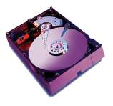
讀寫磁頭基礎

Slide 14
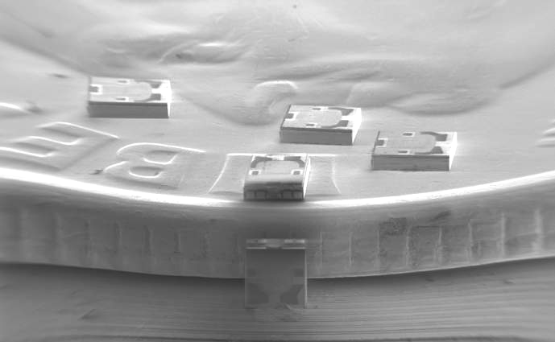
滑板/磁頭放置在1角硬幣上的大小(US$.01)

Slide 15
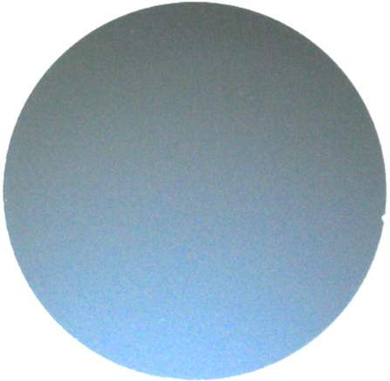
空白的磁頭晶圓

Slide 16
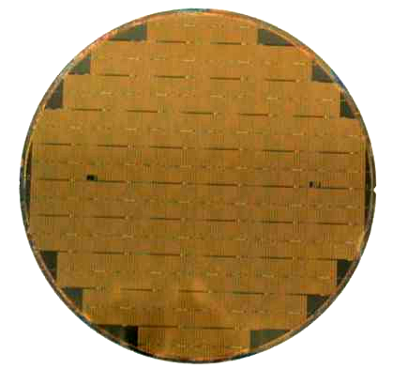
加工後的磁頭晶圓
>>20K Heads
  6.4 kilometers traveled
  2.7 gms of mass added
  .038 mm of height added
    Au, Cu, PtMn, NiFeCr, Ta, CoNiFe, Cr, AlO, Ti, Ru, NiNb, CoFe, CoPt, NiFe, CoFeN, plus various photo-resists

Slide 17
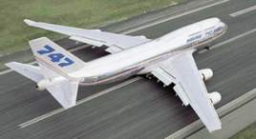
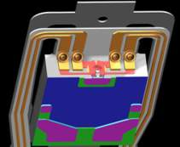
Heads – Celebrating 52 years of Flight
磁頭- 慶祝飛行52 年
In 1974, the head flying height was equivalent to a Boeing 747 airliner flying at 15 cm above the ground
– in 2004, the 747 has to fly at 0.05 cm
1974 年, 磁頭飛行高度與波音747 班機飛行在地面之上的比效是在15 cm,而在2004, 是在0.05 cm
The load on the slider is equivalent to 100,000 passengers
相當於載100,000 位乘客
The speed of the disk under the head is up to 92 km per hour for a 7200 RPM drive
相對於747班機飛行在地面之上磁頭在7200 轉硬盤之下的速度是92每小時公里
The head can survive repeated lateral accelerations of 1000 Gs and vertical accelerations of 300 Gs – humans black out at 9 Gs
磁頭能承受1000 Gs 的側向加速和300 Gs 的垂直加速- 人只能夠承受9 Gs
The 747 is designed for 30,000 take offs and landings, the head 100,000
747 被設計作為30,000 次的升降, 但磁頭為100,000次

Slide 18
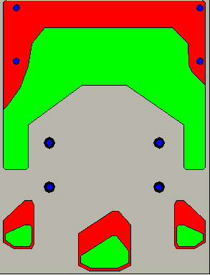
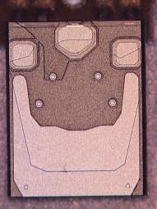
典型的硬盤磁頭設計
Air Bearing Surfaces空氣軸承表面
Slider滑子
Read/write sensors讀寫傳感器

Slide 19
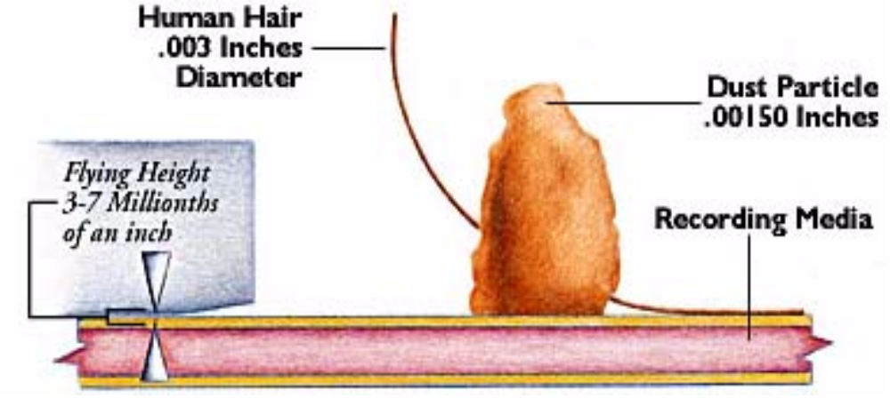
磁頭/碟片飛行高度和污染物的比較
Today's hard drive heads typically “fly” at around 100Å above the media
今天典型的磁頭“飛行” 在碟片上100Å
For comparison:為比較:
Head Fly Height
~100Å

Slide 20
磁頭和碟片的尺寸
The geometry of the head media interface consists of:磁頭媒介接口包括:
1 meter equals 10,000,000,000Å(100億)/1 米= 10,000,000,000Å(100億)
Radius of the media’s data zone資料區的半徑 ~300,000,000 Å
Size of the Slider滑子的大小 ~ 10,000,000 Å
Head Media mechanical spacing磁頭架構的間隔 ~ 100 Å
Disk surface roughness ~ 3 Å
Compare to:
Human hair頭髮~ 1,000,000 Å
Bacteria細菌~ 5000 Å
Tobacco smoke煙草的煙~ 2500 Å
Virus病毒~ 100 Å = Head Fly Height !磁頭飛行高度

Slide 21
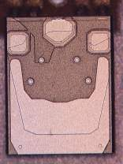
典型的硬盤磁頭的設計
WRITE
SIGNALS
READ
SIGNALS
今天的硬盤都已經使用(G)MR磁頭從碟片上讀寫資料
MR
READING
element
Inductive
WRITING
element

Slide 22
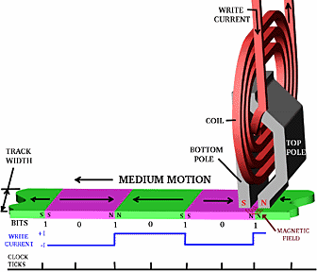
在碟片上寫數據的原理
Inductive
Head
由于碟片在磁头下面转动,磁头产生短暂的脉冲磁场,这个磁场经过碟片上的鍍磁层的时候,磁单元被磁化从而进行重新的排列.

Slide 23
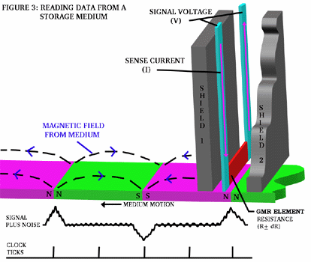
從碟片上讀數據的原理
碟片上磁单元的磁场将经过磁头下面,这将引起GMR磁头电阻的急速变化, 这些信号将会被硬盘电子电路获得,从而读去到数据.

Slide 24
碟片上的數據
在磁盤被寫之後,上面有數十億的小的磁極化因子
The little magnets are decoded as the data written to disk
Future technology will include Perpendicular Recording
magnetic fields
S
N
N
S
N
S
S
N
N
S
magnetic layer of the disk
disk rotation

Slide 25
Consumers Wants Bigger Capacity Drives消費者想要更大的容量
Maximize Areal Density最大化地區密度
Capacity is measured by Areal Density容量由地區密度測量
Areal Density = TPI x BPI (Gbits/in²)
where: TPI = tracks per inch每英寸磁道數
BPI = bits per inch位元每英寸
To hold more data, need more TPI and BPI
須要更多資料, 需要更多TPI 和BPI
As capacity increases, bit sizes must decrease, making
It more difficult to write and read the magnetic signal當容量增大, 位元體積必須減少, 使它更難寫和讀磁性信號

Slide 26
Higher Areal Density is Always a Challenge密度的挑戰
1989
Today
tracks磁道
bits
Less magnetic
signal to read
比較上磁力信號弱

Slide 27
Current Areal Density當前的地區密度
76,000 Tracks / inch (TPI)
~660,000 data bits / inch
also defined as (660 Kbpi)
~660,000 資料位元/英寸並且
被定義和(660 Kbpi)
Disk spins at
7200 RPM
In one inch, the Read/Write head can differentiate 660,000 data bits磁頭能在一吋的磁片上讀到660,000bits資料
Also in one inch, it can place about 76,000 tracks在一吋的磁片上有76000磁軌

Slide 28
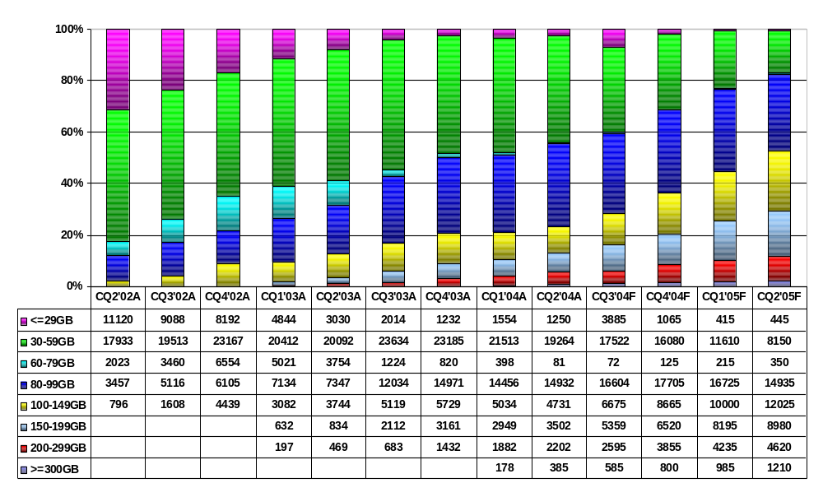
台式机市场趋势 – 容量
16%
42%
29%
32%
24%
18%
10%
8%
Trend Focus, August 2004

Slide 29
硬盘碟片 Basics

Slide 30
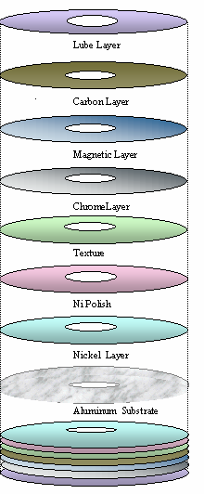
Disk Media Basics磁片的基本構造
Hard disk media is made up of several layers of material – all with very important functions
Base material used for media are:
  Aluminum for 3.5” hard drives
  Glass for 2.5” hard drives
  Goal is to be strong and very smooth / flat
Most important layer is Magnetic layer that actually records the user data
Top layers offer protection as head fly height is ~100Å
硬碟片是用幾層不同材料造成- 每層都有非常重要作用
基本材料是:
3.5“硬碟為鋁
2.5“ 硬碟為玻璃
目的是強化/光滑/扁平
最重要層是magnetic層用作記錄用戶資料
頂層提供保護因為磁頭飛行高度是~100Å

Slide 31
硬盘磁头 Basics

Slide 32
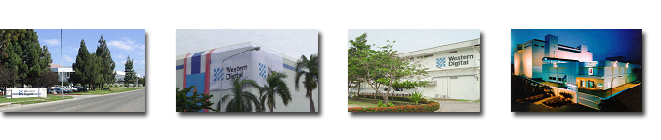

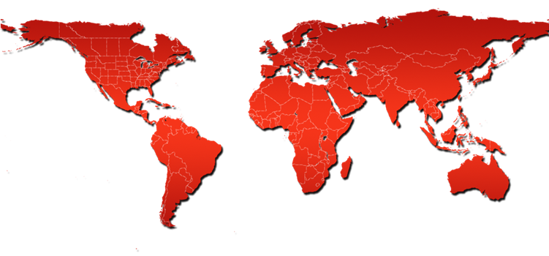
HDS Operations – 制造基地
Fremont, CA
Thailand
Thailand
Malaysia
Head R&D
Wafer Fab
Slider
HGA
HSA
HD
HD
PCBA

Slide 33
Head Manufacturing Flow磁头制造流程
Wafer
Under-Coating
Wafer Fab
Slider Fab
HGA
HSA
Cycle Time from wafer start to HSA = 46 days
WD Fremont
WD Thailand
FGI
HD
Total Cycle Time: 49-52 days to completed HD
Comparative Wafer Start to HSA Cycle Times
WD
Mfr A
Mfr B
46 days
63 days
59 days

Slide 34
Fremont Resources – Professional Staff
Management
Experience: 20 Years
New staff (non-RR): 16%
Exempt Staff
Experience: 18 Years
New staff (non-RR): 13%
Diploma
7%
Diploma
PhD
PhD
20%
34%
24%
BS/BA
MS/MA
34%
23%
MS/MA
BS/BA
25%
33%

Slide 35
WD Head Technology

Slide 36
研发任务
利用领先技术为西部数据创造价值
  Best-of-breed reliability
  Design for manufacturability
  High-yielding, low-cost products

Slide 37
西部数据磁头技术状况
侧重于于台式机市场
Current generation overall assessment
  Significant progress since Aug. 2003
  Best-in-class reliability, lowest failure rate
  Yields competitive with best-in-class vendor
  Continued engagement by R&D during production phase
Failure Rates
Yields
1.2
CY 2003
1.6
1.0
1.4
1.2
0.8
1.0
0.6
0.8
Normalized Reliability Failure Rate
Normalized Drive Yields
0.4
0.6
0.4
0.2
0.2
0.0
0.0
WD
Best-in-Class
WD Aug. 2003
WD Current
Best-in-Class
Vendor
Vendor

Slide 38
Roadmap Overview
HD Industry Areal Density Growth Slowing
1000
167 GB
CPP Read Head
Perpendicular Writer
Advanced Materials
Dynamic Controls
GB/disk
100
40 GB
Enhanced GMR
125-133 GB
Advanced GMR
Advanced Deposition
High Moment Write Pole
Planar Write Head
Thin Overcoats
Dynamic Controls
10 GB
GMR heads
80 GB
Specular GMR
Deep UV Lithography
10
2000
2001
2002
2003
2004
2005

Slide 39
技术发展里程
80 GB
120 GB
160 GB
>240 GB
Writer
Longitudinal
Perpendicular
GMR
Reader
Advanced GMR
CPP-GMR
TMR
,
GMR Giant Magneto Resistance
TMR Tunneling Magneto Resistance
CPP Current Perpendicular to Plane

Slide 40
长期的技术进步
Timeframe | Leading Competitor | Western Digital
2003-2004 | Longitudinal | Longitudinal
2004-2011 | Perpendicular | Perpendicular, Discrete track
2008-2014 | Thermal Assist, Probe | Perpendicular, Discrete track, Thermal Assist

Slide 41
什麼是Firmware（ 固件）
Firmware（ 固件）介于软件(Software)与硬件(Hardware)之间，可以翻译为韧件是控制机器底层基本操作的机器培训指令集。WD公司通过不断修改及升级步骤发布最新韧件。
BIOS是Basic Input and Output System的缩写，是一种写在ROM（只读存储器）里面的软件，用来搭配各种硬件的设置、启动、测试等等。所以不同的硬件就必须搭配不同的BIOS，才能进行各自特有的指令与设置。
SCSI/IDE BIOS一般都被储存在SCSI卡/IDE PCBA上的ROM里面，由于目前大部分都采用Flash ROM，因此可以从网站上下载同型号的固件（Firmware），或由WD公司提供固件来更新ROM版本。

Slide 42
什麼是Firmware（固件）
What is FirmWare :
FW is the bridge between physical H/W design and the functional specification.
It will depend on the feature of the CPU to simplify the H/W design.
You may say that F/W is a list of the procedures and decision which will be followed by the specific H/W for getting the desired functional result.
When power on, F/W will be loaded to memory and executed by CPU. There will be initialization, I/O control, memory management, command execution....
If the H/W is designed for resident F/W, you must have the code to function the H/W.

Slide 43
什麼是Firmware（固件）
F/W design reference:
Functional specification
Operational flow chart
CPU used and command supported.
Controlling devices interface.
Chipset registers - functional definition
Address map of the H/W - I/O and Memory layout.
Memory capacity.

Slide 44
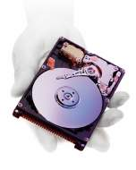
Thank You

