Slide 1
Distributed Computing on a Two-processor Computer
Network Optimization Applications 6.05 by 成大工資管

Slide 2










Introduction
Computer computation system
Processor 1
Large Program
Done
Processor 2
Program & Modules
Module 1
Module 2
Processor 1
Large Program
．．．
Processor 2
Module i
Network Optimization Applications 6.05 by 成大工資管

Slide 3
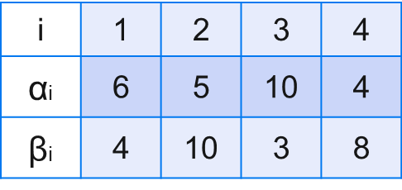
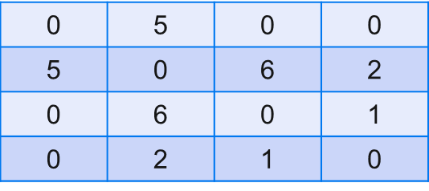

Introduction
Cost
  Processors’ memory , speed,….etc.
Computation Cost
Interprocessor communication Cost
1
2
3
4
1
1
2
3
5
6
4
4
2
5
10
S
t
3
2
10
6
Processor 2
Processor 1
3
8
4
1
4
Program modules
Network Optimization Applications 6.05 by 成大工資管

Slide 4
Given
  Costs
    Interprocessor communication(cij)
    Computation(α,β)
  # of Modules
  # of Processors
Decision
  Allocate modules to different Processors
Objective
  Min The Collective Cost
Network Optimization Applications 6.05 by 成大工資管

Slide 5








Related Problem/Literature
HAROLD S. STONE “Multiprocessor Scheduling with the Aid of Network Flow Algorithms”
  Commodity flow problem
5
7
10
S1
A
F
S4
8
D
10
8
7
14
S
S2
S5
t
B
G
6
7
7
S6
S3
C
E
H
9
4
12
6
Solving Max Flow Problem by Max-flow Min-cut Theorem
Network Optimization Applications 6.05 by 成大工資管

Slide 6
Solving Method
Formulate as Min Cut Problem
  Max-flow Min-cut Theorem(Ch6)
1
s-t Cut :
6+5+3+8+2+6 = 30
A1∪{s}
5
6
4
2
5
10
t
S
10
3
6
2
8
3
4
1
A2∪{t}
4
Network Optimization Applications 6.05 by 成大工資管

Slide 7
Thanks for Listening
Network Optimization Applications 6.05 by 成大工資管

