Slide 1
Scheduling with Deferral Costs

Slide 2
Contents
Introduction
Related problems
How the problem may be solved?

Slide 3



Introduction
Problem statement:
One of q identical processors (machine) need to process each of p jobs.
Each job has a fixed processing time $α_{j}$.
Job j has a deferral cost $c_{j}\left(τ\right).$
Relative DeadLine
Absolute Deadline
Deferral cost $c_{j}\left(τ\right)$
Time of arrival
Completion time $τ$

Slide 4

Introduction
Objective:
Wish to find a schedule for the jobs, with completion times denoted by $τ_{1}$, $τ_{2}$, . . . , $τ_{p}$, that minimizes the total deferral cost .

Slide 5
Related problems
LAWLER, E. L.1964. On scheduling problems with deferral costs. Management Science Vol. 11, No. 2, 280-287.

Slide 6




How the problem may be solved?
Can be modeled as a minimum cost flow problem for situations with uniform processing times (i.e., $α_{j}$ = $α$, for each j = 1, . . . , p)
$$α$$
$$2α$$
$$3α$$
Job 1
Job 2
Job 3

Slide 7




How the problem may be solved?
For simplicity, define r=p/q is an integer.
Assign exactly r jobs to each machine.
That means we can think that there are r position that one position can do q jobs.
(position可以轉成是時間序段, 因為有q台機器, 所以在每個時段可以做q個jobs)
Each Machine
$$α$$
$$2α$$
$$3α$$
$$rα$$
Job 1
Job 2
Job 3
Job r

Slide 8
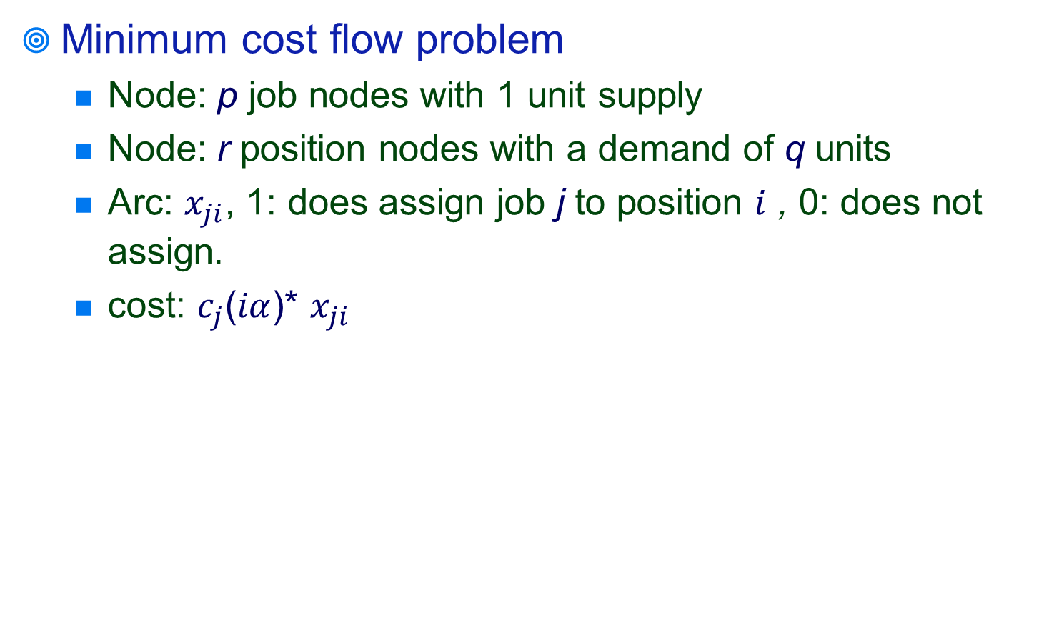
How the problem may be solved?
Minimum cost flow problem
Node: p job nodes with 1 unit supply
Node: r position nodes with a demand of q units
Arc: $x_{ji}$, 1: does assign job j to position $i$ , 0: does not assign.
cost: $c_{j}$($iα$)* $x_{ji}$

Slide 9
How the problem may be solved?
The problem becomes
Minimize
Subject to
for i = 1, . . .,r
for j = 1, . . .,p
for all j = 1, . . .,p , for i = 1, . . .,r

Slide 10





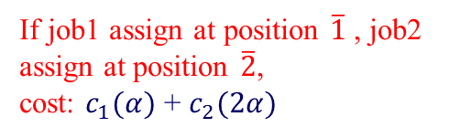









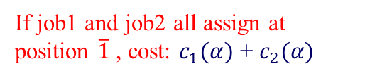
How the problem may be solved?
b(j)
b(i)
$$c_{ji}$$
j
$$\overline{i}$$
If job1 and job2 all assign at position $\overline{1}$ , cost: $c_{1}(α)$ + $c_{2}(α)$
$$c_{1}(α)$$
1
1
$$\overline{1}$$
-q
$$c_{1}(rα)$$
$$c_{1}(2α)$$
$$c_{2}(α)$$
If job1 assign at position $\overline{1}$ , job2 assign at position $\overline{2}$,
cost: $c_{1}(α)$ + $c_{2}(2α)$
1
2
$$\overline{2}$$
-q
$$c_{2}(2α)$$
$$c_{2}(rα)$$
$$c_{p}(α)$$
$$c_{p}(2α)$$
1
p
$$\overline{r}$$
-q
$$c_{p}(rα)$$

Slide 11
Q&A

