Slide 1
All-Pairs Minimax Path Problem

Slide 2
Contents
Introduction
Minimax Path
All-pairs minimax path problem
Related problems
How the problem may be solved?

Slide 3
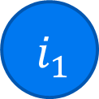

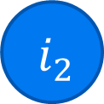
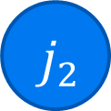
Introduction
Minimax Path
In a network G = (N, A) with arc costs , we define the value of a path from node to node as the maximum cost arc in .
2
4
1
3
k
l
1
1
5
4<5 yellow one

Slide 4
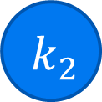
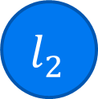
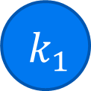

Introduction
All-pairs minimax path problem
For every pair [k, l] of nodes, a minimum value path from node k to node l.
2
4
1
3
2
3
1
1
5

Slide 5
Related problems
Hu, T. C. 1961. The Maximum Capacity Route Problem. Operation Research 9, 898-900.

Slide 6
Related problems
Craft passes different pressure
Arcs: different pressure and temperature
Nodes: different zones
Objective: minimize the maximum deceleration during the descent.
Traveling through a desert
Traveling in a wheelchair

Slide 7
Related problems
Craft passes different pressure
Traveling through a desert
Arcs: distances
Nodes: rest areas
Objective: minimize the length of the longest stretch between rest areas.
Traveling in a wheelchair

Slide 8
Related problems
Craft passes different pressure
Traveling through a desert
Traveling in a wheelchair
Arcs: ascents
Nodes: segments
Objective: minimize the maximum ascent along the path segments

Slide 9
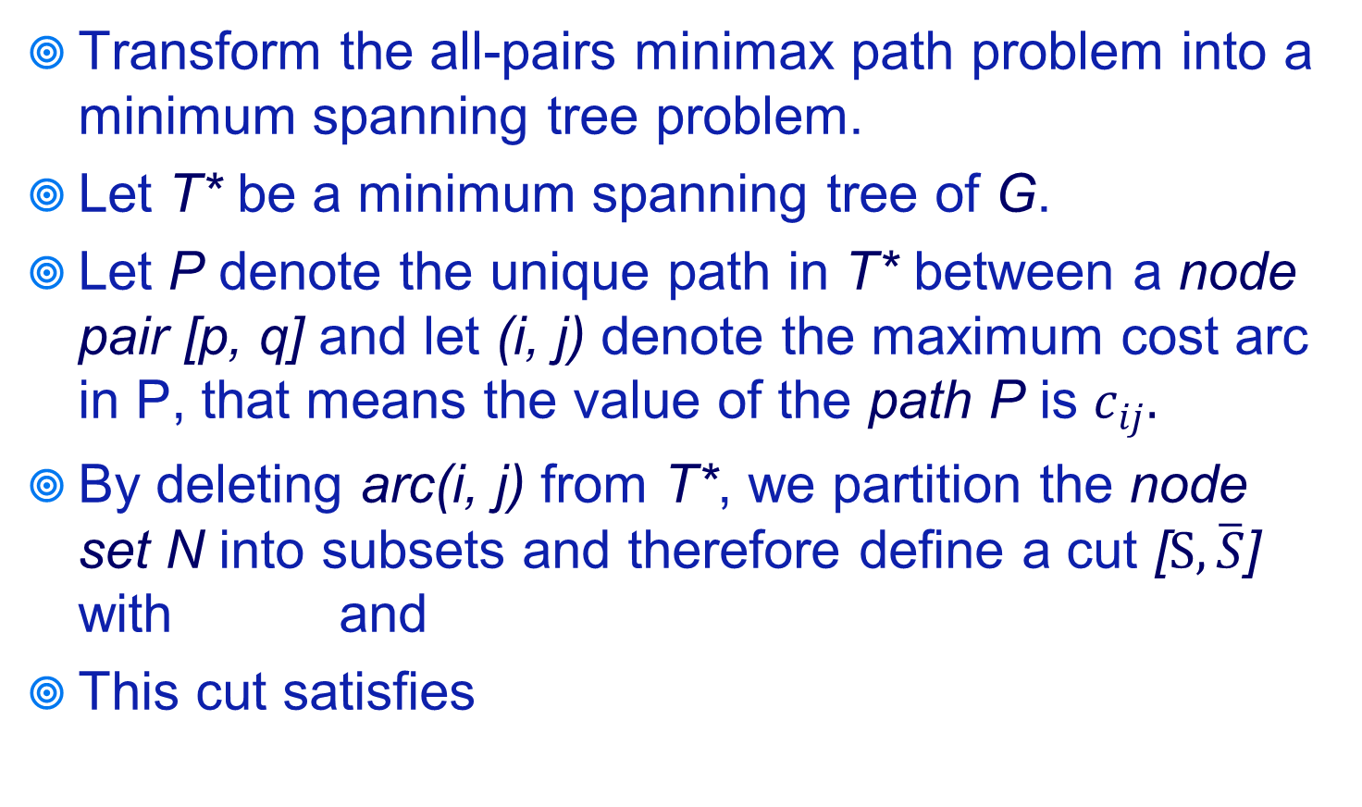
How the problem may be solved?
Transform the all-pairs minimax path problem into a minimum spanning tree problem.
Let T* be a minimum spanning tree of G.
Let P denote the unique path in T* between a node pair [p, q] and let (i, j) denote the maximum cost arc in P, that means the value of the path P is $c_{ij}.$
By deleting arc(i, j) from T*, we partition the node set N into subsets and therefore define a cut [$S, \overline{S}$] with and
This cut satisfies
for each arc
(13.1)

Slide 10
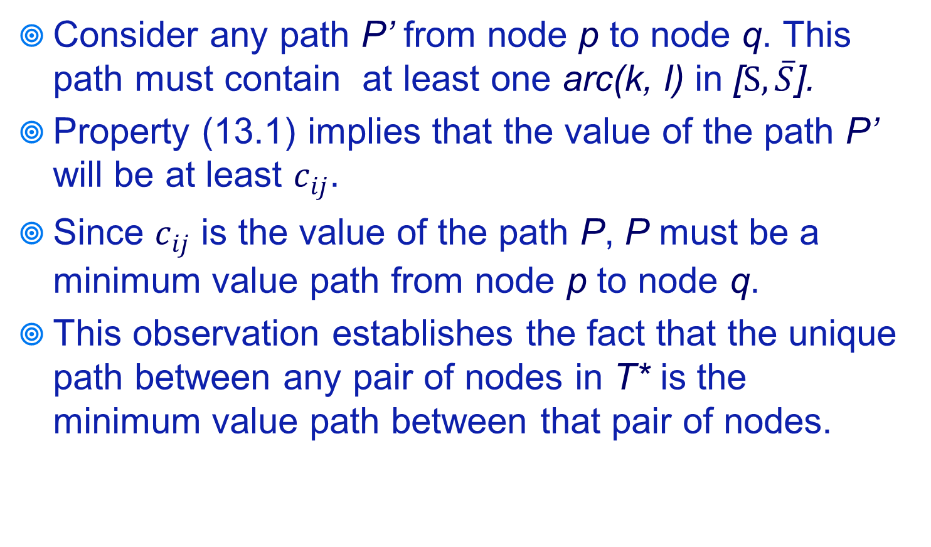
How the problem may be solved?
Consider any path P’ from node p to node q. This path must contain at least one arc(k, l) in [$S, \overline{S}$].
Property (13.1) implies that the value of the path P’ will be at least $c_{ij}$.
Since $c_{ij}$ is the value of the path P, P must be a minimum value path from node p to node q.
This observation establishes the fact that the unique path between any pair of nodes in T* is the minimum value path between that pair of nodes.

Slide 11
How the problem may be solved?
p
i
j
q
k
l
for each arc

Slide 12
Q&A

