Slide 1
Selecting Freight Handing Terminals
Network Optimization Applications 19.02 by 成大工資管

Slide 2

Introduction
J. M. W. Rhys , ”A Selection Problem of Shared Fixed Costs and Network Flows”
運輸公司選址問題
2 Nodes
1 Service
(Cost)
(Profit)
Combinatorial Problem
Profit 20
1
1
2
2
-8
-6
Satisfy
Demand
Net Profit = 20+(-8)+(-6) = +6
Network Optimization Applications 19.02 by 成大工資管

Slide 3
Introduction
Given
  Profit
  Cost
  Potential locations
Decision
  Installation Location
Object
  Maximize Net Profit
-6
-4
2
4
6
4
3
5
1
3
10
-8
-2
Network Optimization Applications 19.02 by 成大工資管

Slide 4
Related Problem(Shared Fixed Cost)
International Trade Financing Between Countries
Machine/Product Selection
  Any activity requires particular facilities
  At most one machine of any one type is to be purchased
  At rationalising a range of products may fail
Office
Office
A
Trade financing
B
Products
Cost : Allocate machine
M1
M2
Profit : Products
Network Optimization Applications 19.02 by 成大工資管

Slide 5


Problem Solving
4
1-2
-6
-4
1
-8
2
4
10
1-3
6
2
-6
4
5
1-4
3
5
3
-2
1
3
6
2-3
10
-8
-2
4
-4
3
3-4
Terminal Locations
Bipartite Network
Demand to be Served
Network Optimization Applications 19.02 by 成大工資管

Slide 6

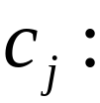
Parameters
Profit of activity a
Cost of Node j
Network Optimization Applications 19.02 by 成大工資管

Slide 7
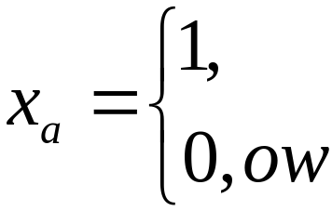
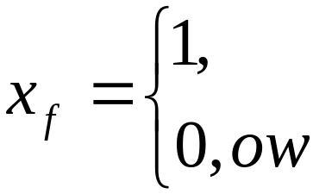
Decision Variables
The fraction of the activity a in Demand Node that is to be selected
The fraction of facility f in Terminal Node to be selected
Network Optimization Applications 19.02 by 成大工資管

Slide 8
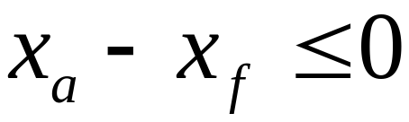
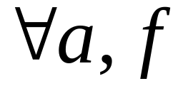
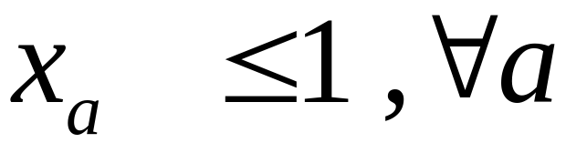
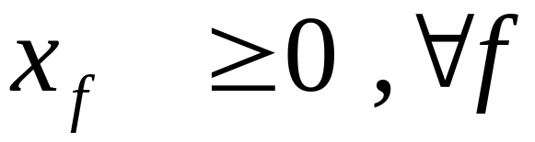
Constraints
Xa | Xf | RHS
1 | 1 | 0
1 | 0 | 1
0 | 1 | -1
0 | 0 | 0
1
1-2
2
3
2-3
Sufficient to ensure that for a maximum solution.
Xa ≤ 1 implies Xf ≤ 1
Xf ≥ 0 implies Xa ≥ 0
Network Optimization Applications 19.02 by 成大工資管

Slide 9
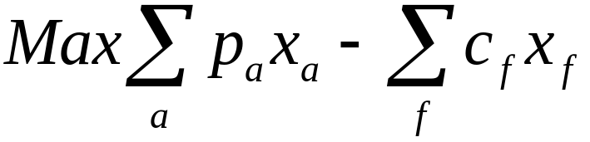

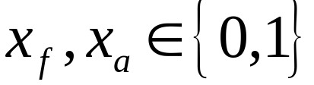
Formulation
Max Weight Closure Problem
4
1-2
1
8
10
1-3
2
6
S
5
1-4
t
2
6
3
2-3
3
4
4
3-4
Network Optimization Applications 19.02 by 成大工資管

Slide 10
Solving Method
Coefficient matrix to be unimodular.(Incidence Matrix)
Linear Programming Form
Easy to Solve
Network Optimization Applications 19.02 by 成大工資管

Slide 11
Thanks For Listening
Network Optimization Applications 19.02 by 成大工資管

