Slide 1
Optimal Destruction of Military Targets
Orlin, D.
Optimal weapons allocation against layered defenses.
Naval Res. Logist. 34 605–616. 1987.

Slide 2
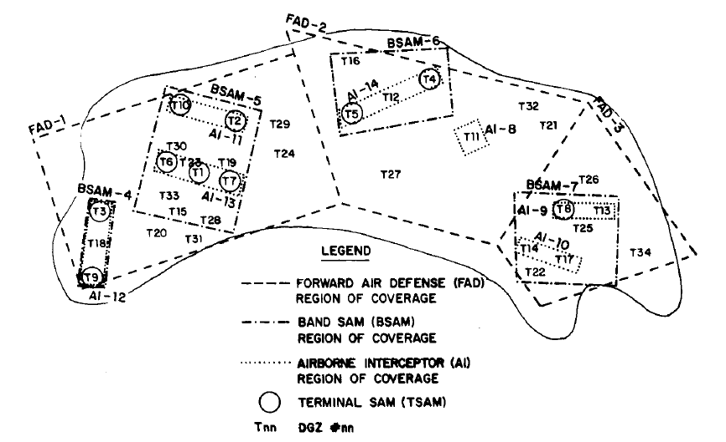
Introduction
Target
FAD
TSAM
BSAM
AI

Slide 3
Introduction
Determine an allocation scheme for weapons to targets in the presence of layered regional defense.
To destroy a target, it must first destroy all the defense sites that protect it.
Destroy the target or defense site has a certain military benefit but also incurs some loss.
Objective
Maximum the # of target we destroyed.
Minimum the # of weapon we used.

Slide 4
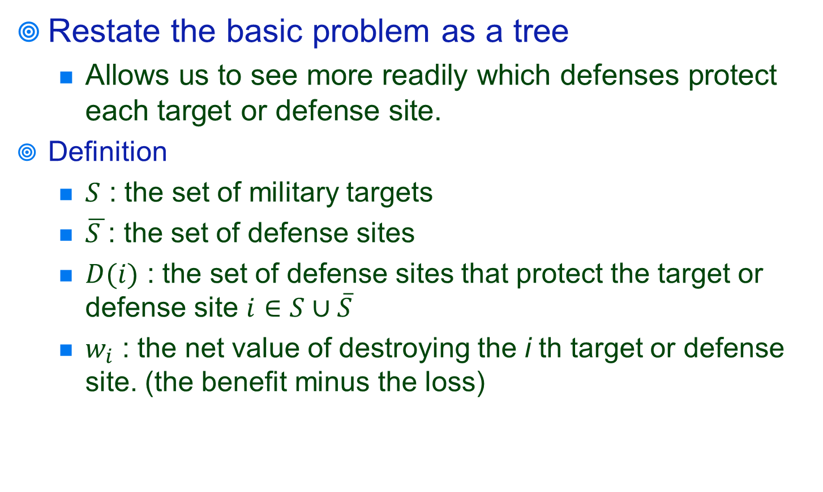
Restate the basic problem as a tree
Allows us to see more readily which defenses protect each target or defense site.
Definition
$S$ : the set of military targets
$\overline{S }$: the set of defense sites
$D(i)$ : the set of defense sites that protect the target or defense site $i∈S∪\overline{S}$
$w_{i}$ : the net value of destroying the i th target or defense site. (the benefit minus the loss)

Slide 5
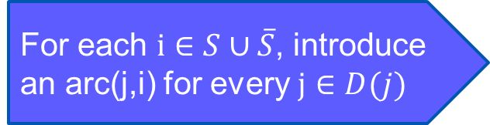



Associate a node i with
i th target or defense site.
For each $i∈S∪\overline{S}$, introduce an arc(j,i) for every $j∈D(j)$
Each node i has a weight $w_{i}$.
Each arc has no cost.
Layer 1
Layer 2
Layer 3
Layer 4
Targets
4
8
11
15
$$w_{1}$$
1
16
Missiles
5
$$w_{2}$$
12
17
2
9
6
18
13
10
3
19
7
14

Slide 6
Linear Programming
Layer 1
Layer 2
j
i

Slide 7
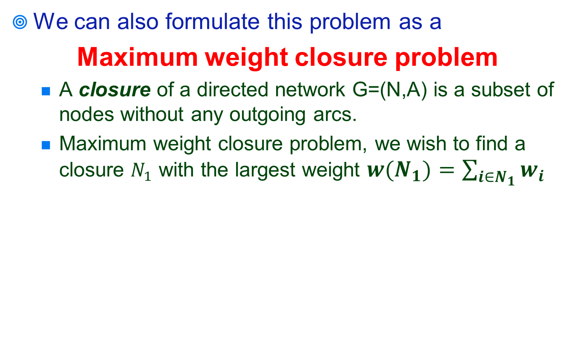
Transformation
We can also formulate this problem as a
Maximum weight closure problem
A closure of a directed network G=(N,A) is a subset of nodes without any outgoing arcs.
Maximum weight closure problem, we wish to find a closure $N_{1}$ with the largest weight ${w(N}_{1})=\sum_{i∈N_{1}}{w_{i}}$
-9
8
1
2
5
-10
7
3
4
0

Slide 8
Layer 1
FADS
Layer 2
BSAM
Layer 3
AI
Layer 4
TSAM
Layer 5
Targets
4
8
11
15
1
16
Missiles
5
12
17
2
9
6
18
13
10
3
19
7
14
Every feasible destruction of targets and defense sites corresponds to a closure of the network.
The best scheme is the closure with the largest weight.

Slide 9
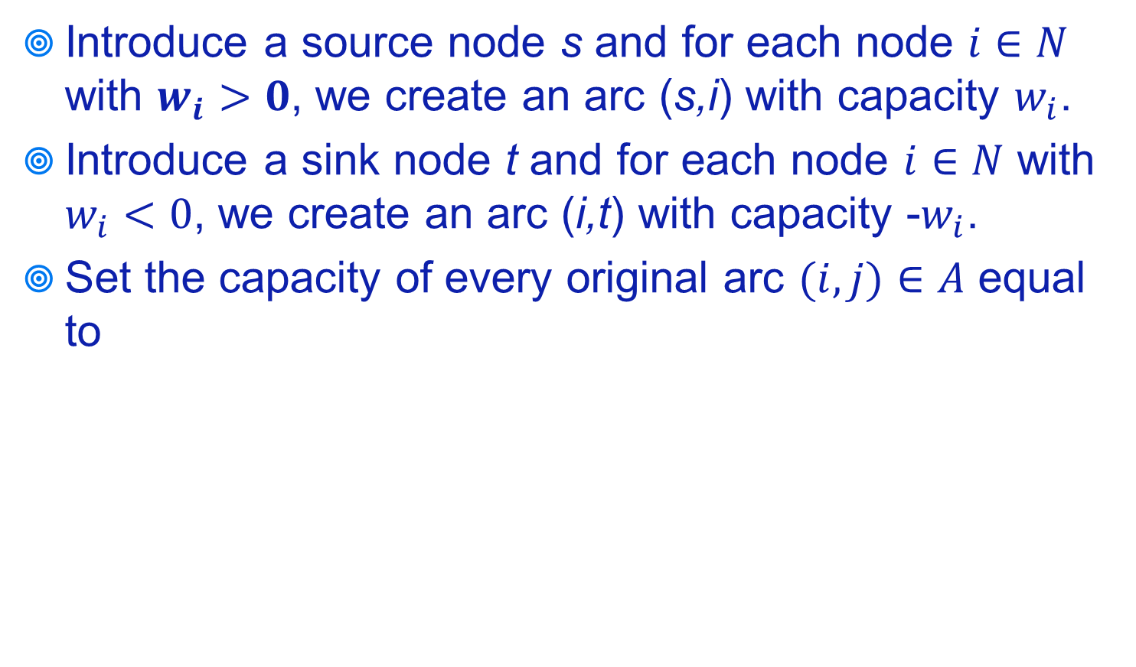
Solution Method
Introduce a source node s and for each node $i∈N$ with $w_{i}>0$, we create an arc (s,i) with capacity $w_{i}$.
Introduce a sink node t and for each node $i∈N$ with $w_{i}<0$, we create an arc (i,t) with capacity -$w_{i}$.
Set the capacity of every original arc $(i,j)∈A$ equal to
8
-9
-9
1
2
t
8
5
-10
-10
s
3
4
7
Maximum Flow Problem
7
0

Slide 10

Maximum Flow Problem
Solution Method
Capacity Scaling Algorithm
Generic Preflow-Push Algorithm
Highest-Label Preflow-Push Algorithms

