Slide 1
Application 19.09
Determining Minimum Project Duration
Network Optimization Applications 19.09 by 成大資管所

Slide 2
Introduction
Problem type : Shortest path problem
Reference : The Economic Lot Scheduling Problem (ELSP): Review and Extensions
[S. E. Elmasraby, Management Science, Volume 24
Issue 6, February 1978, pp. 587-598]
The ELSP is a time-honored problem that “has been around” since 1915
Network Optimization Applications 19.09 by 成大資管所
Notes:
ELSP問題從1915年開始被廣泛討論
是幾個產品在單一機器做週期性生產的問題
每批為每個商品
每批應如何生產(安排時間)
假設生產速率固定

Slide 3
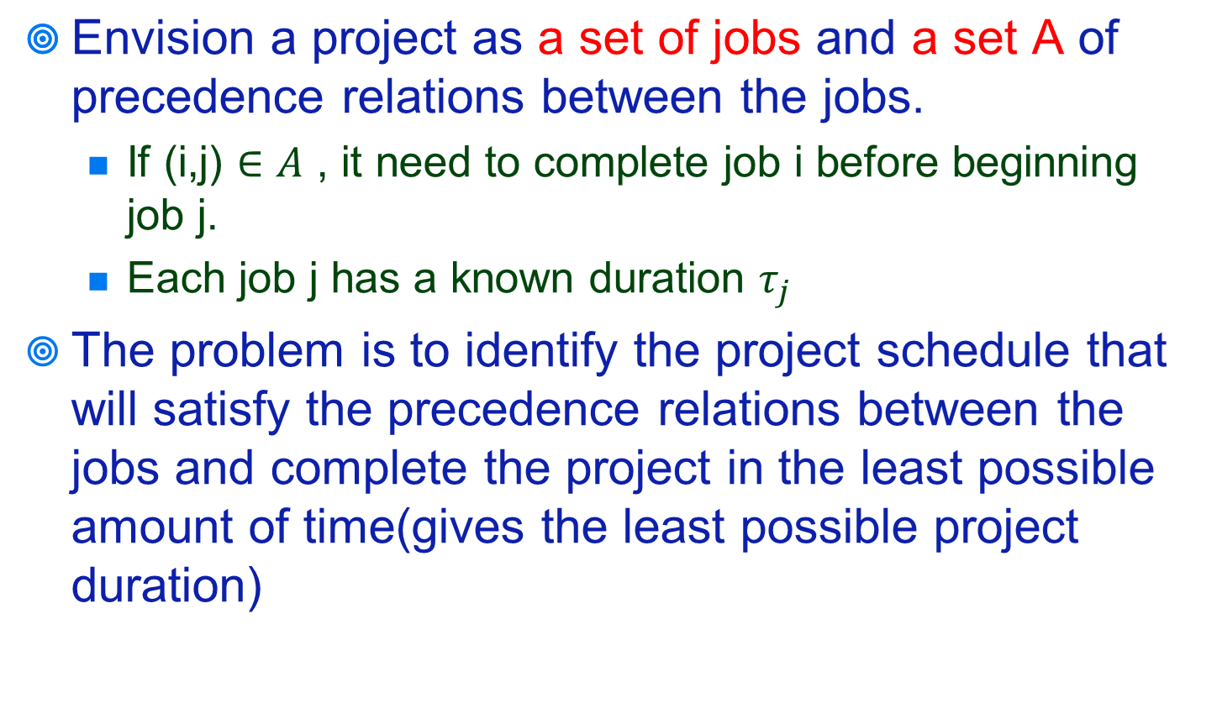
Introduction
Network Optimization Applications 19.09 by 成大資管所

Slide 4
Related Word
There are two alternative method to solve the problem :
1. represent jobs by arcs
2. represent jobs by nodes
* the first approach is more popular in the literature
* the application adopt the second approach in the
discussion(it is conceptually simpler)
Network Optimization Applications 19.09 by 成大資管所

Slide 5
Solution
Node j : job j
Arc(i,j) : job i is immediate predecessor of job j
Cij : the length of arc(i,j), equal to Ti, the duration of
job i
s: source node, the beginning of the project
t : sink node
u(j) : the earliest possible start time of job j
Xij : the dual variable with the constraints (2)
Network Optimization Applications 19.09 by 成大資管所

Slide 6
Solution
Objective function:
Minimize u(t)-u(s) (1)
Subject to :
u(j)-u(i)>= Cij for all (i,j) belong A (2)
u(j) unrestricted (3)
Network Optimization Applications 19.09 by 成大資管所
Notes:
Function u 是每個工作的開始時間

Slide 7
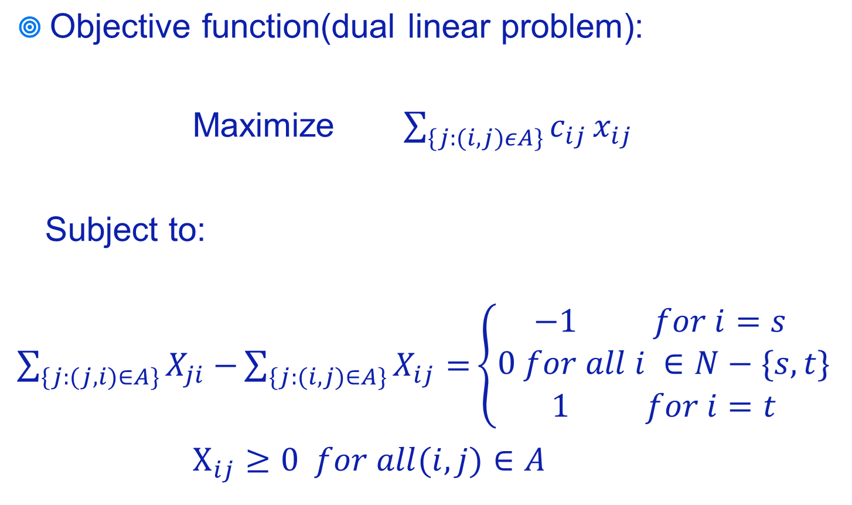
Solution
Network Optimization Applications 19.09 by 成大資管所

