Slide 1
Application 19.13 – Models for Building Evacuation
Network Optimization Applications 19.13 by 成大工資管

Slide 2
Introduction
Reference:
L. G. Chalmet, R. L. Francis, P. B. Saunders, Network models for building evacuation. Management Science 28(1), 86-105.
Network Optimization Applications 19.13 by 成大工資管

Slide 3
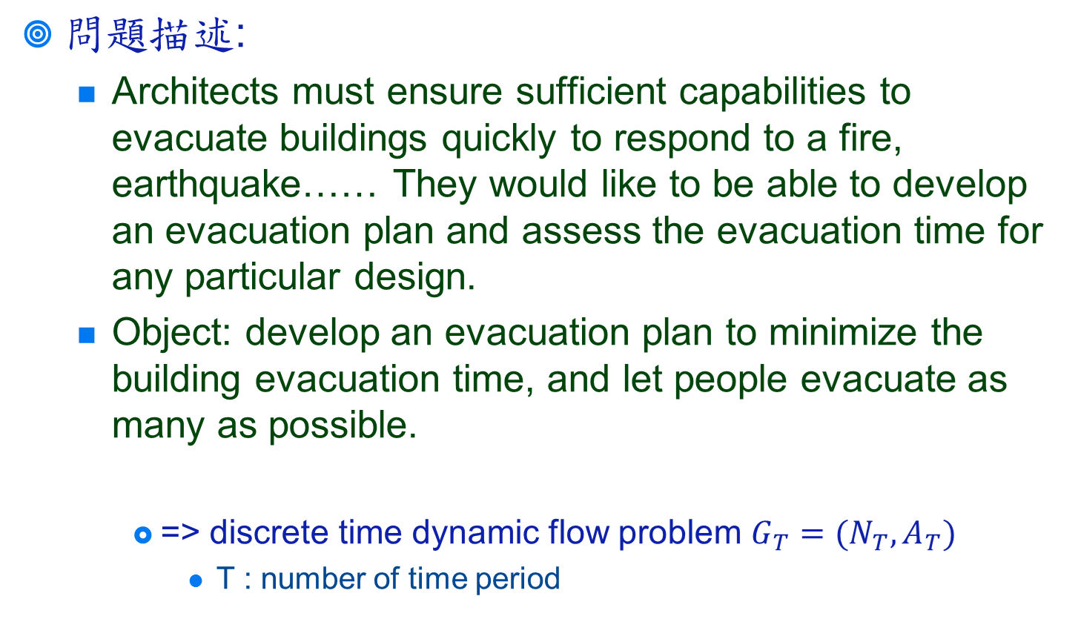
Introduction
Network Optimization Applications 19.13 by 成大工資管

Slide 4
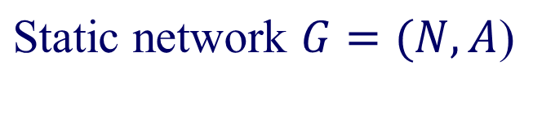
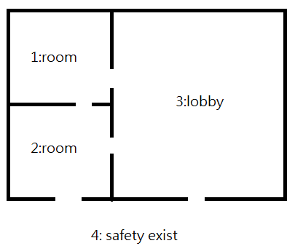

Transfer to network problem
{3,5}
1
(1,2)
{3,20}
(1,2)
3
(1,2)
4
(1,2)
(2,3)
2
{4,8}
node is a component of the building
{initial capacity, node capacity}
(travel time, arc capacity per unit time)
Network Optimization Applications 19.13 by 成大工資管

Slide 5

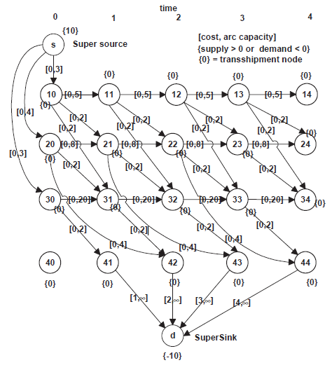


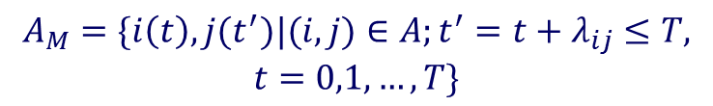
Transfer to network problem
Assign a cost of t to the flow in the copy of arc (i(t),d)
Network Optimization Applications 19.13 by 成大工資管

Slide 6
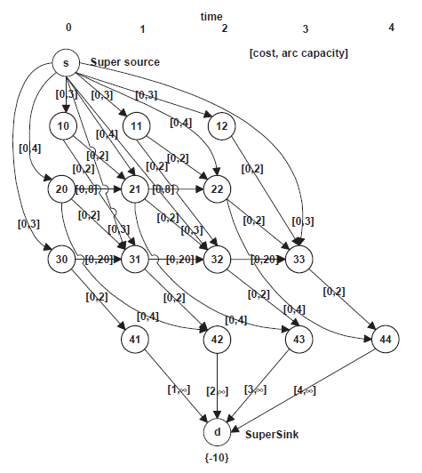
Transfer to network problem
Assign a cost of t to the flow in the copy of arc (i(t),d)
Network Optimization Applications 19.13 by 成大工資管

Slide 7
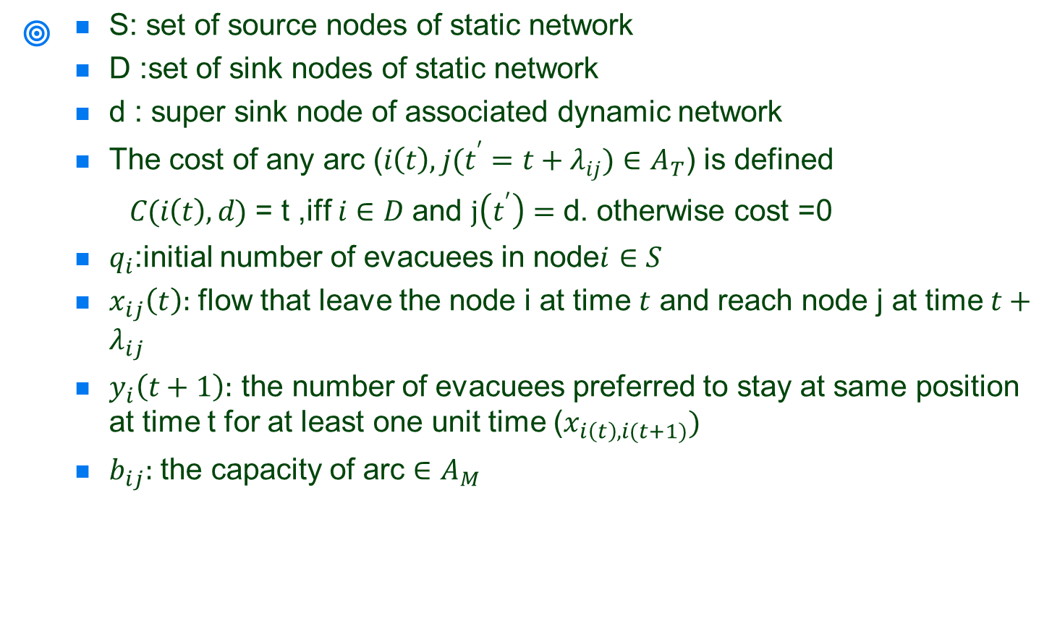
Solution
Network Optimization Applications 19.13 by 成大工資管

Slide 8
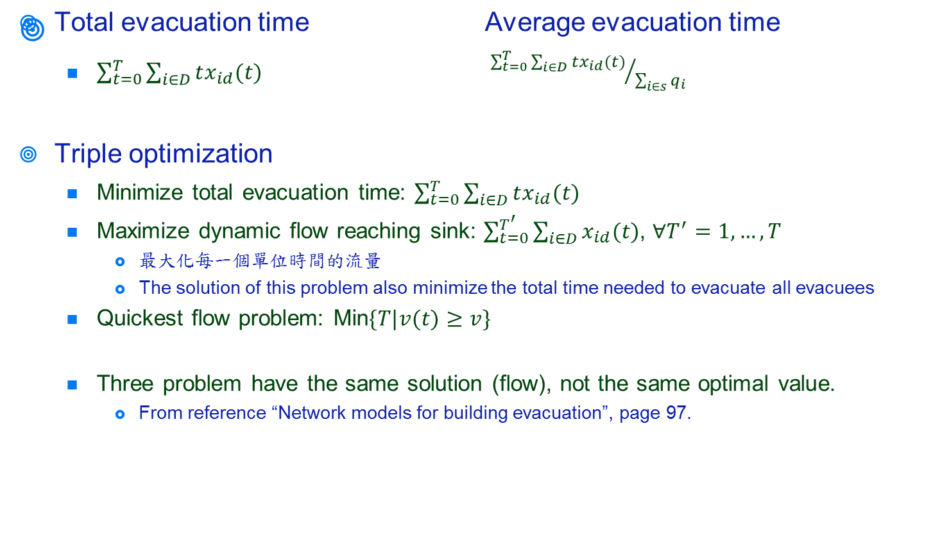
Solution
Network Optimization Applications 19.13 by 成大工資管

Slide 9
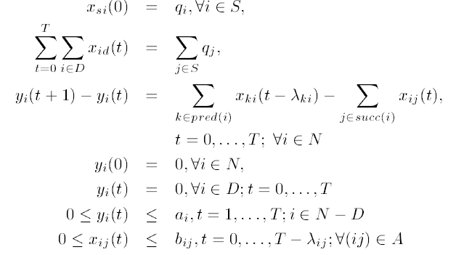
Solution
Network Optimization Applications 19.13 by 成大工資管

