Slide 1
Warehouse Layout

Slide 2
Contents
Introduction
Related problem
How the problem may be solved?

Slide 3
Introduction
Warehouse:
is configured with docks for loading and unloading goods and with open areas(or bins) for storing the goods.
In managing the warehouse, the operating staff must decide where to locate each of the goods----the closer a good is to any dock, the lower is the cost of
accessing that good and transferring it to the dock for loading.
unloading the good from the dock and transporting it to its storage area.

Slide 4


Introduction
Suppose a warehouse store p items, and has r loading and uploading docks.
Let $w_{ik}$ be known total cost per foot incurred in transporting item i between dock k and its storage region.
i
Dock k
Storage region
d

Slide 5
Introduction
Objective:
The warehouse layout problem is to determine the region(s) for storing each of the p items that will minimize the total transportation cost between the items and the docks.

Slide 6
Related problem
FRANCIS, R. L., and J. A. WHITE. 1976. Facility Layout and Location. Prentice Hall, Englewood Cliffs, NJ.

Slide 7
How the problem may be solved?
First, subdividing the floor area into q square grids of equal size, numbered in manner from 1 to q.
When q=16
1 | 2 | 3 | 4
5 | 6 | 7 | 8
9 | 10 | 11 | 12
13 | 14 | 15 | 16
Notes:
Q越大,精準度越高，但是

Slide 8


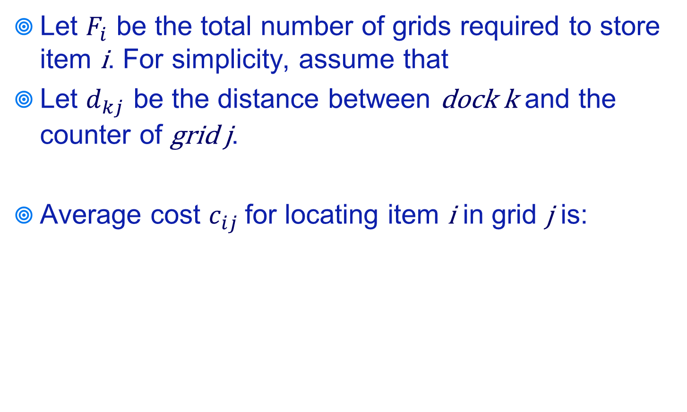
How the problem may be solved?
Let $F_{i}$ be the total number of grids required to store item i. For simplicity, assume that
Let $d_{kj}$ be the distance between dock k and the counter of grid j.
Average cost $c_{ij}$ for locating item i in grid j is:
i
Dock k
Grid j
d

Slide 9
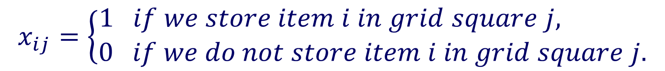

How the problem may be solved?
Convert the warehousing problem to a standard transportation problem by defining the variables $x_{ij}$.
For all i = 1, 2, . . ., p and j = 1, 2, . . ., q, as follows:
p: items 數
q: grids 數

Slide 10
How the problem may be solved?
The warehouse layout problem becomes
Minimize
Subject to
for i = 1, . . .,p
for j = 1, . . .,q
for all i = 1, . . .,p , for j = 1, . . .,q

Slide 11
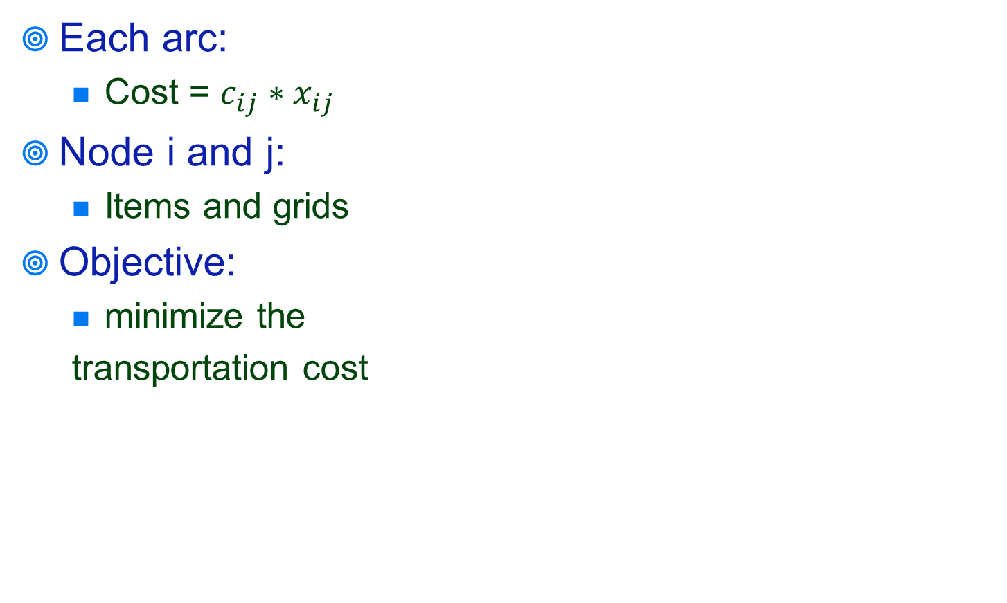






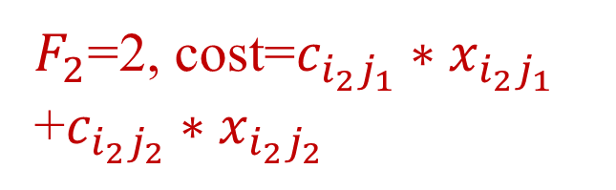
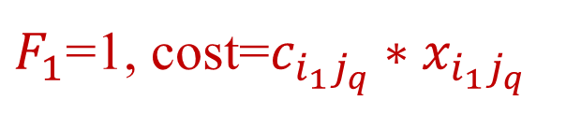
How the problem may be solved?
$F_{2}$=2, cost=$c_{i_{2}j_{1}}∗x_{i_{2}j_{1}}$ +$c_{i_{2}j_{2}}∗x_{i_{2}j_{2}}$
$F_{1}$=1, cost=$c_{i_{1}j_{q}}∗x_{i_{1}j_{q}}$

Slide 12
Q&A

