Slide 1
19.18 Rectilinear Distance Facility Location
Cabot, A.V.,R.L.Francis, and M.A.Stary. 1970. A network flow solution to a rectilinear distance facility location problem, Taylor & Francis, Volume II, No.2

Slide 2

Introduction
transform the rectilinear distance facility location problem as the dual of a minimum cost flow problem
A
1
2
B
3

Slide 3
rectilinear distance
(manhattan distance)
= | x2 - x3 | + | y2 - y3|
(x1, y1)
1
(x2, y2)
2
(x3, y3)
|x2-x3|
3
|y2-y3|

Slide 4
|x1-xB| + |y1-yB| +|x2-xB| + |y2-yB| +|x3-xB| + |y3-yB|
A
|x1-xA| + |y1-yA| +|x2-xA| + |y2-yA| +|x3-xA| + |y3-yA|
1
(x1, y1)
2
(x2, y2)
B
3
(x3, y3)

Slide 5
|xA-xB| + |yA-yB|
A
1
(x1, y1)
2
(x2, y2)
B
3
(x3, y3)

Slide 6
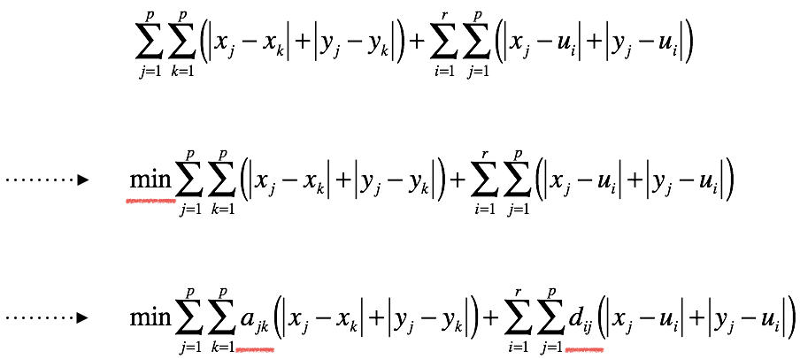

Slide 7
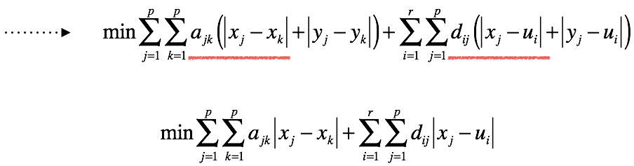

min ∣ 𝛼 - 𝛽 ∣ = min( c + d );
s.t. 𝛼 - 𝛽 = c - d; c ≥ 0 ; d ≥ 0

Slide 8
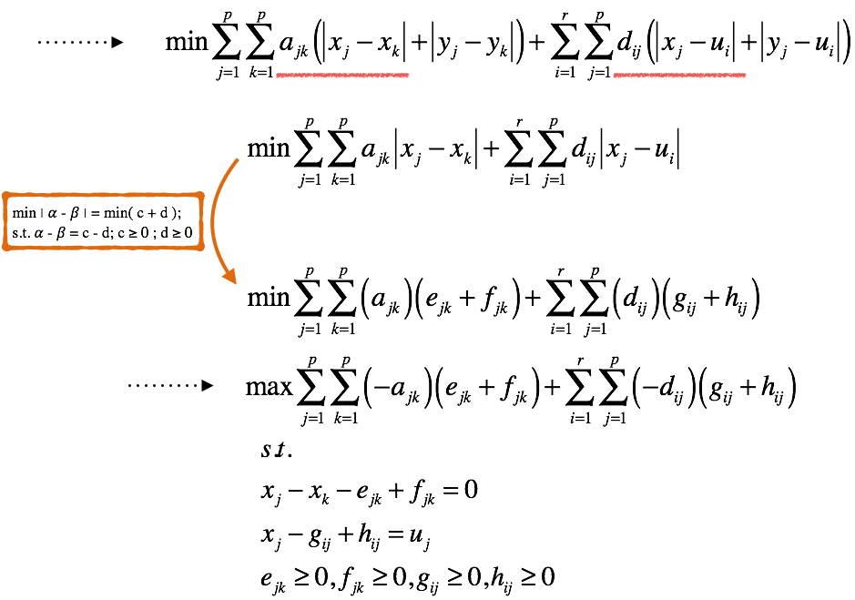

Slide 9
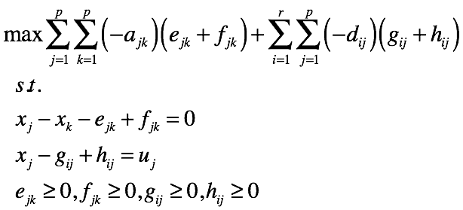
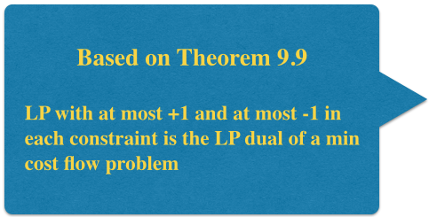
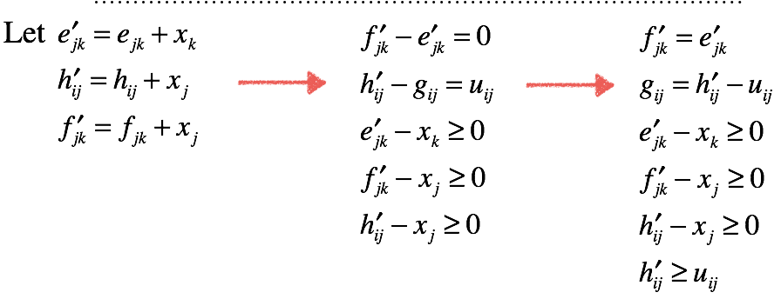

Slide 10
Thanks for listening

Slide 11
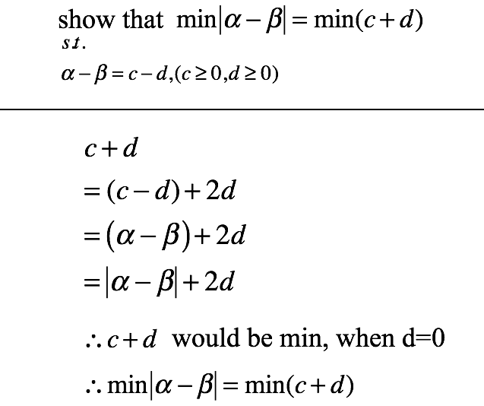
Backup

