Slide 1
Edmonds-Karp Algorithm Maximum Flow Problem
Edmonds, J., & Karp, R. M. (1972).
Theoretical improvements in algorithmic efficiency for network flow problems.
Journal of the ACM (JACM), 19(2), 248-264.
NETFLOW2202 Paper Presentation
IIM112 李宗霖

Slide 2
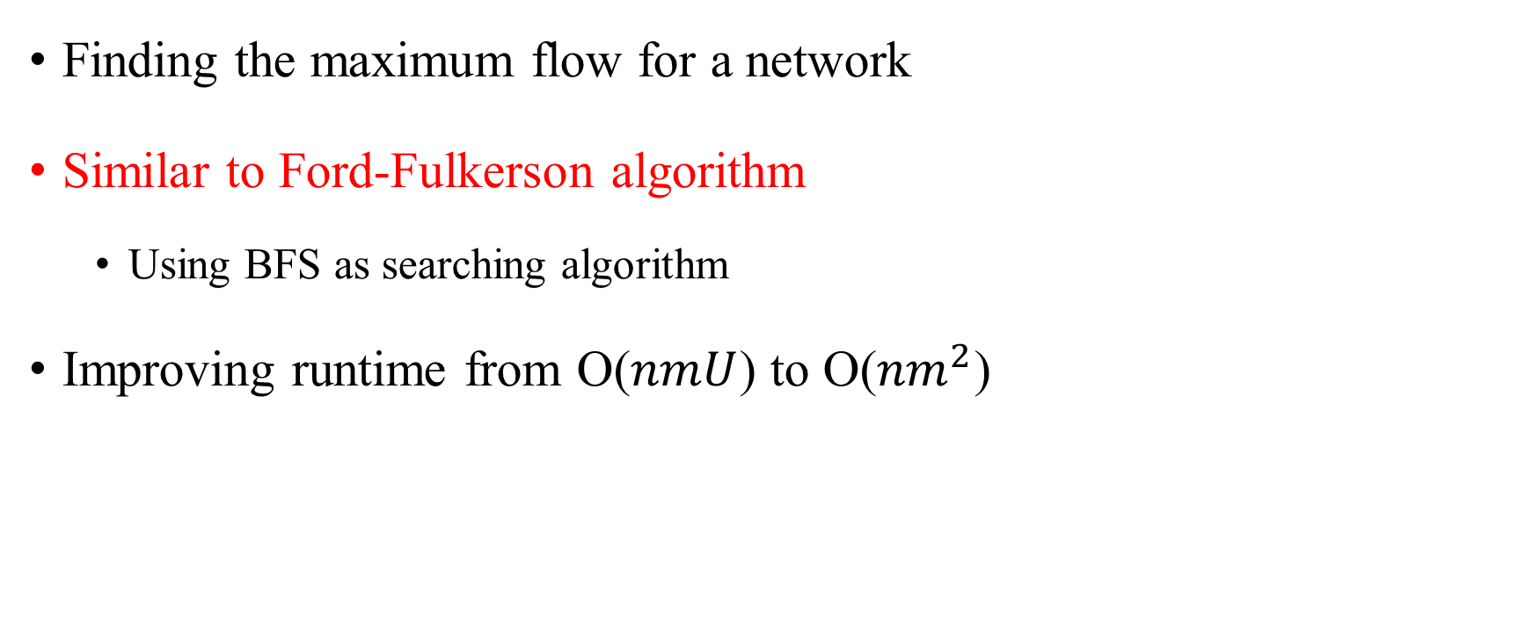
Overview
Finding the maximum flow for a network
Similar to Ford-Fulkerson algorithm
Using BFS as searching algorithm
Improving runtime from O($nmU$) to O(${nm}^{2}$)

Slide 3
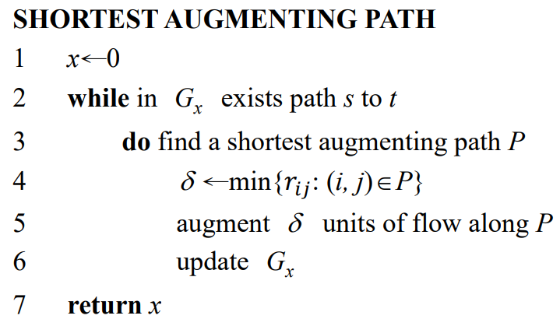
Edmonds-Karp Algorithm
Also known as shortest augmenting path algorithm
Choosing path via breadth first search

Slide 4
Example (1/8)
6
a
t
3
s
2
7
G
5
b
c
2
x = 0

Slide 5
Example (2/8)
Searching for the shortest augmenting path
6
a
t
3
s
2
7
5
b
c
2
x = 0

Slide 6
Example (3/8)
Augmenting flow and updating residual network
3
a
t
3
3
s
2
7
5
b
c
2
x = 0 + 3 = 3

Slide 7
Example (4/8)
Searching for the shortest augmenting path
3
a
t
3
3
s
2
7
5
b
c
2
x = 3

Slide 8
Example (5/8)
Augmenting flow and updating residual network
3
a
t
3
3
s
2
5
2
3
2
b
c
2
x = 3 + 2 = 5

Slide 9
Example (6/8)
Searching for the shortest augmenting path
3
a
t
3
3
s
2
5
2
3
2
b
c
2
x = 5

Slide 10
Example (7/8)
Augmenting flow and updating residual network
5
a
t
3
1
s
2
5
2
1
6
b
c
2
x = 5 + 2 = 7

Slide 11
Example (8/8)
No existing augmenting path
5
a
t
3
1
s
2
5
2
1
6
b
c
2
Maximum flow = 7

Slide 12
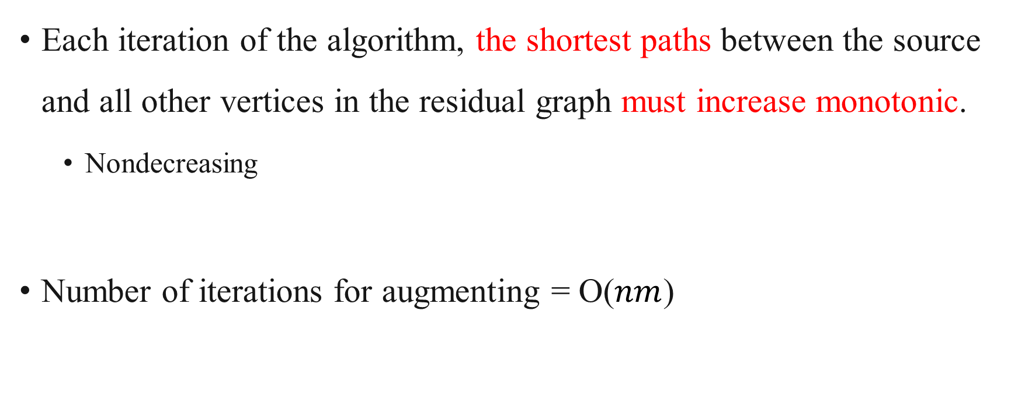
Complexity (1/4)
Each iteration of the algorithm, the shortest paths between the source and all other vertices in the residual graph must increase monotonic.
Nondecreasing
Number of iterations for augmenting = O($nm$)

Slide 13
Complexity (2/4)
In every iteration, at least one edge reaches its capacity.
Critical edge
If (u, v) is a critical edge, it can only be critical again when distance(s, u) is increased at least 2.
distance
k
k + 1
k + 2
k + 3
iterations
u
v
u
v
........................

Slide 14
Complexity (3/4)
iterations
k + 1
k + 1
distance(s, u) = k
(u, v) is critical
u
v
critical again
k
k + 1
k + 2
k + 1
k + 2
k + 3
u
v
u
v
u
v
k + 2
k + 2
u
v

Slide 15
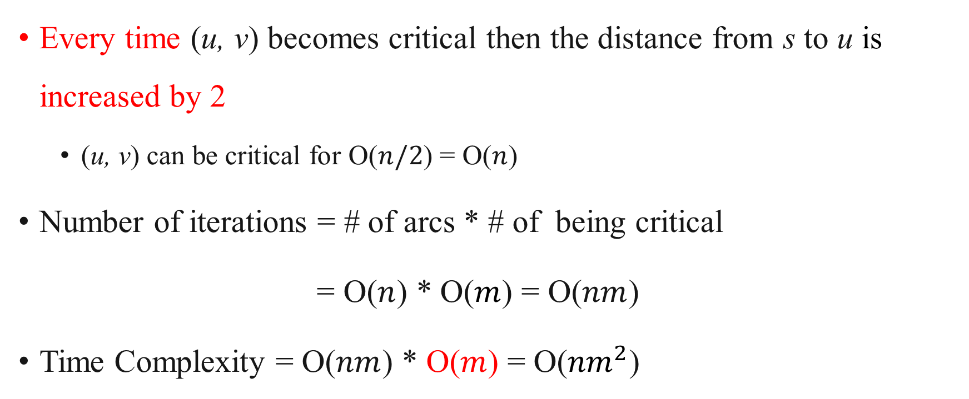
Complexity (4/4)
Every time (u, v) becomes critical then the distance from s to u is increased by 2
(u, v) can be critical for O($n/2$) = O($n$)
Number of iterations = # of arcs * # of being critical
= O($n$) * O($m$) = O($nm$)
Time Complexity = O($nm$) * O($m$) = O(${nm}^{2}$)

Slide 16
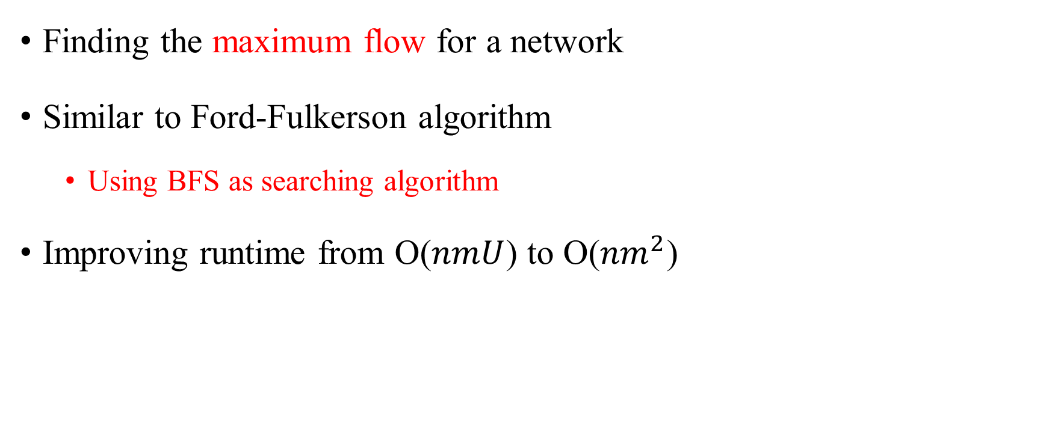
Edmonds-Karp Algorithm
Finding the maximum flow for a network
Similar to Ford-Fulkerson algorithm
Using BFS as searching algorithm
Improving runtime from O($nmU$) to O(${nm}^{2}$)

Slide 17
Thank you for listening!

