Slide 1
shortest feasibility algorithms: an experimental evaluation
工資112 林宏諭
0

Slide 2
Introduction
The shortest-path feasibility problem (FP) is to find a negative-length cycle in a given directed, weighted graph.
is closely related to the problem of finding shortest-path distances in a network.
A solution to the shortest-path problem is also a solution to FP.
Notes:
The shortest-path feasibility problem (FP) is to find a negative-length cycle in a given directed, weighted graph, or to present a proof (a set of feasible potentials) that no such cycle exists. This is closely related to the problem of finding shortest-path distances in a network. A solution to the shortest-path problem is also a solution to FP.

Slide 3
Contribution
design an algorithm framework that generalizes BFM and is a natural basis for new algorithms
implemented several new algorithms and reimplemented existing ones
we propose a new set of benchmark instances that is more extensive than existing ones

Slide 4

Definition and notation
a directed graph G = (V, E)
a length function l : E → R
reduced cost function $l_{d}:E→R∪\{−∞,∞\}$ as $l_{d}\left(v,w\right)=l\left(v,w\right)+d\left(v\right)−d(w)$

Slide 5
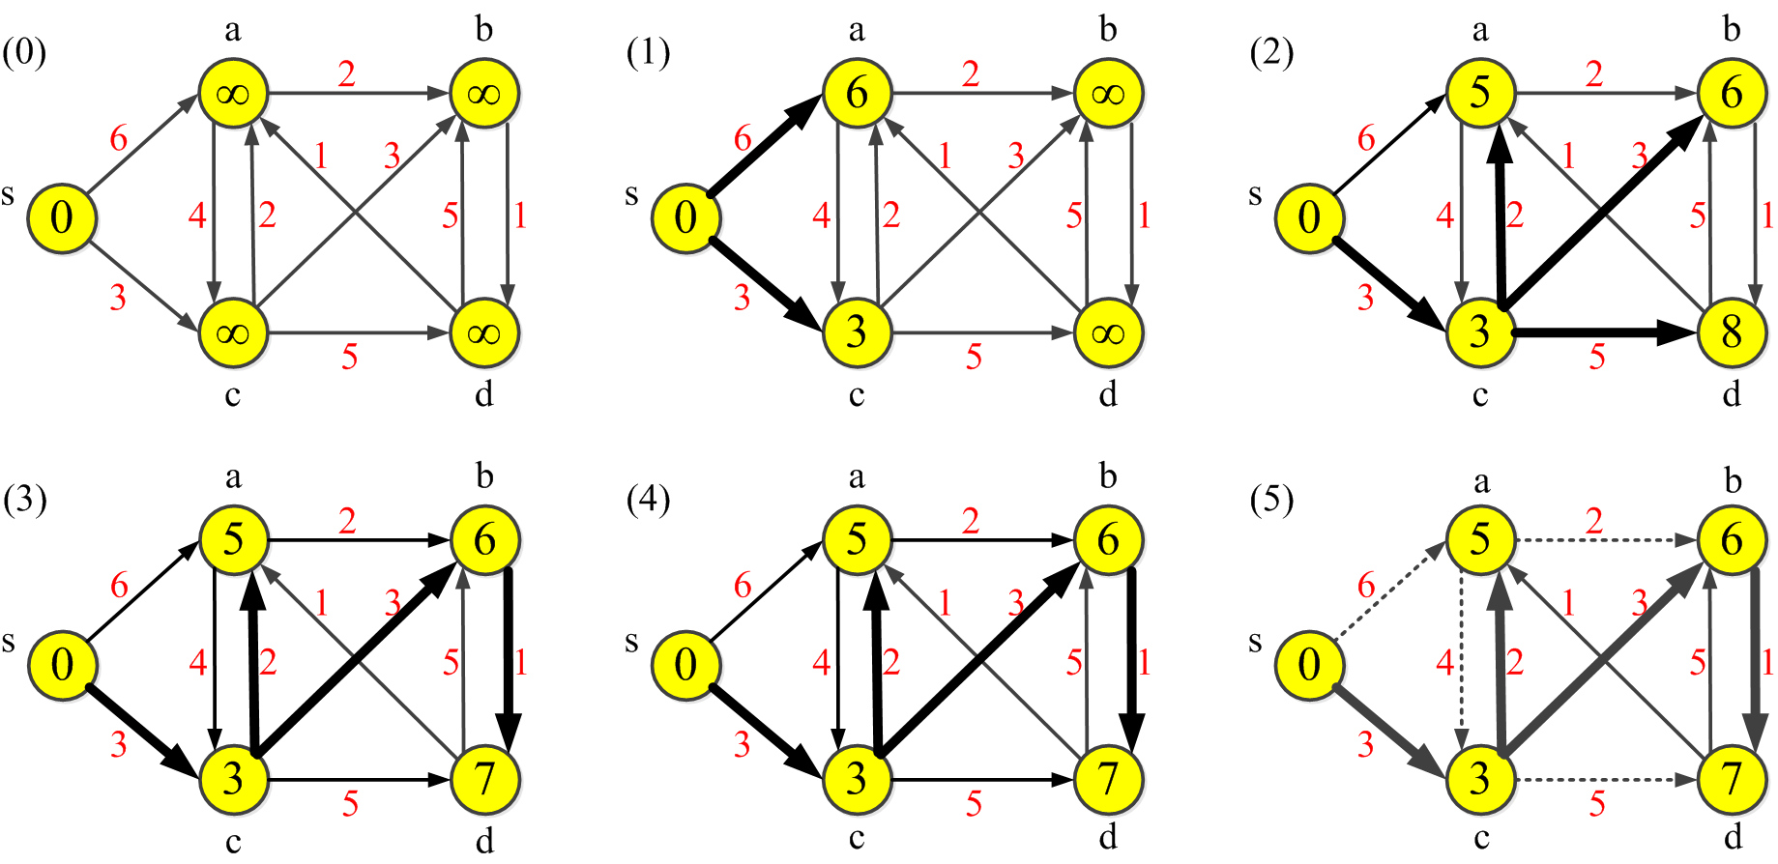
General BFM

Slide 6
General BFM

Slide 7
General BFM

Slide 8
General BFM

Slide 9
General BFM

Slide 10
General BFM

Slide 11
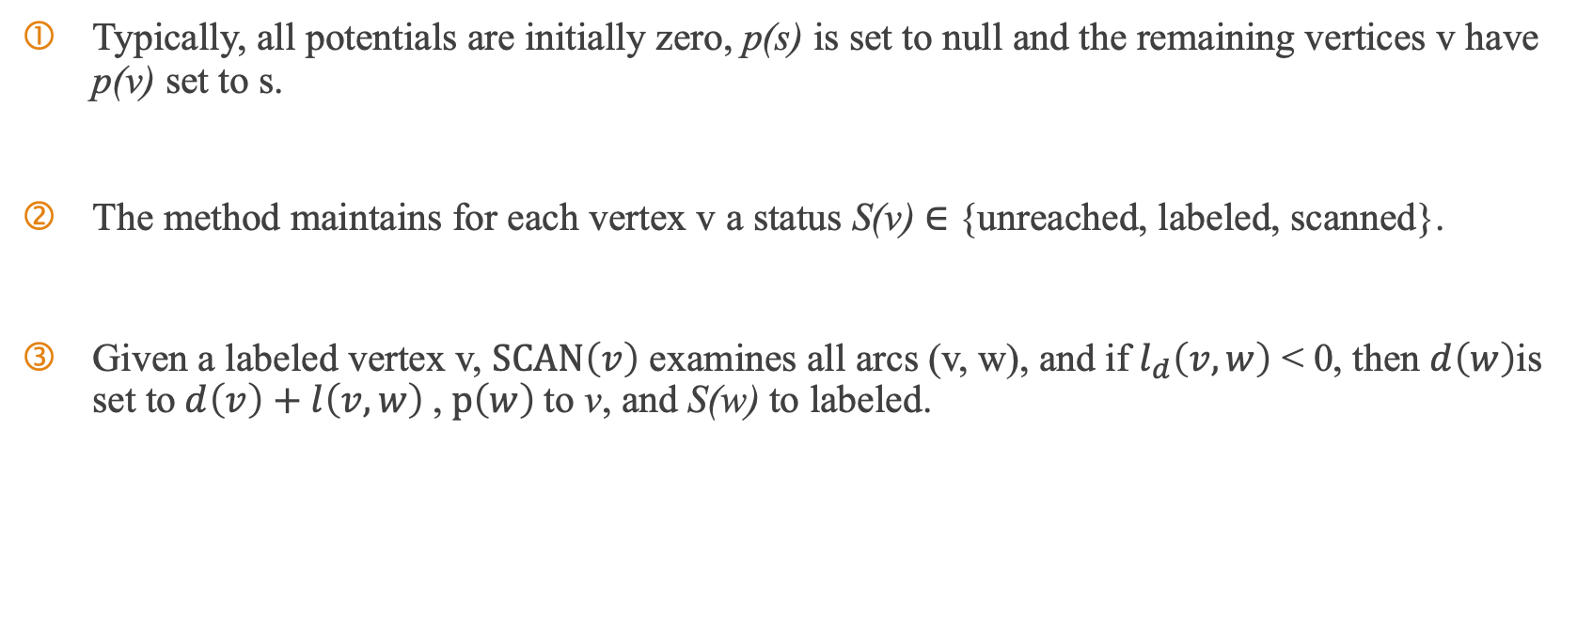
Scanning Algorithm
Typically, all potentials are initially zero, p(s) is set to null and the remaining vertices v have p(v) set to s.
The method maintains for each vertex v a status S(v) ∈ {unreached, labeled, scanned}.
Given a labeled vertex v, $SCAN\left(v\right)$ examines all arcs (v, w), and if $l_{d}\left(v,w\right)$ < 0, then $d\left(w\right)$is set to $d\left(v\right)+l\left(v,w\right)$, $p\left(w\right)$to v, and S(w) to labeled.

Slide 12
Scanning Algorithm
Because the scanning algorithm does not necessarily run in polynomial time, they partition the sequence of vertex scans into passes (subsequences of scans) with the following properties:
each vertex is scanned at most once during a pass
each vertex that is already labeled when the pass begins must be scanned during the pass

Slide 13
Negative cycle detection
Apply subtree disassembly and it with update
Another alternative to methods based on subtree traversal is admissible graph search proposed by Goldberg

Slide 14
Algorithm-BFCT
BFM algorithm with subtree disassembly, including updates.
runs in O(nm) worst-case time.

Slide 15
Stacked-based Algorithm-LS
very similar to BFCT
change the FIFO queue to stack
maintain two stacks of labeled vertices, one for the current pass
run in O(nm) time in the worst case.

Slide 16
Stacked-based Algorithm-LSG
adopts a greedier approach, in the sense that it tries to scan labeled vertices as early as possible
this algorithm requires that we explicitly keep track of the last pass in which each vertex was scanned.
run in O(nm) time in the worst case.

Slide 17
Stacked-based Algorithm-DFS
very similar to LSG
if every arc scan improved the potential of its head and there were no subtree disassembly, vertices would be scanned in depth-first order.
run in O(nm) time in the worst case.

Slide 18
Hybrid Algorithm-HYB
DFS is indeed very fast at detecting obvious cycles. In general, however, it seems to be much less robust than BFCT
works as DFS during the first pass only, then behaves as BFCT.
At the end of the first pass, stack T (created by DFS) becomes the first queue used by BFCT
run in O(nm) time in the worst case.

Slide 19
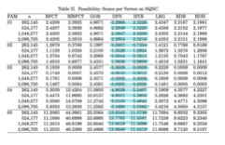
Computational results

Slide 20
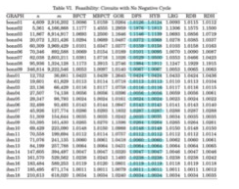
Computational results

Slide 21
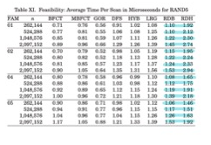
Computational results

Slide 22
Thank you

