Slide 1
Final report
A faster algorithm for the single source shortest path problem with few distinct positive lengths
R36101059 董柏源

Slide 2
Contents
Introduction
How the problem may be solved?

Slide 3
Introduction
Single Source Shortest Path Problem
SSSPP with distinct positive lengths
The “gossip” problem for social network
3
1
3
1
1
3
S
5
1
1
2
4
3

Slide 4
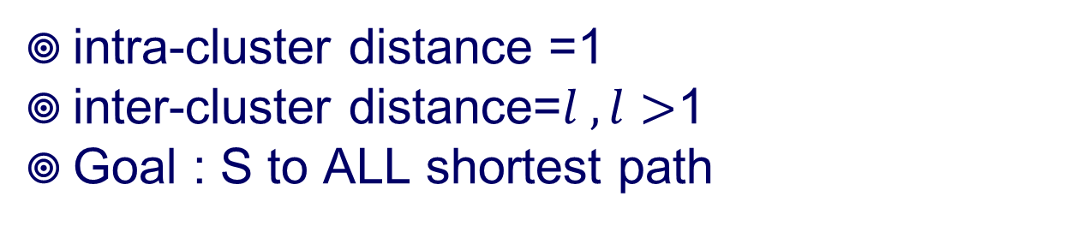
Introduction
intra-cluster distance =1
inter-cluster distance=$l , l>$1
Goal : S to ALL shortest path
3
1
3
1
1
3
S
5
1
1
2
4
3

Slide 5
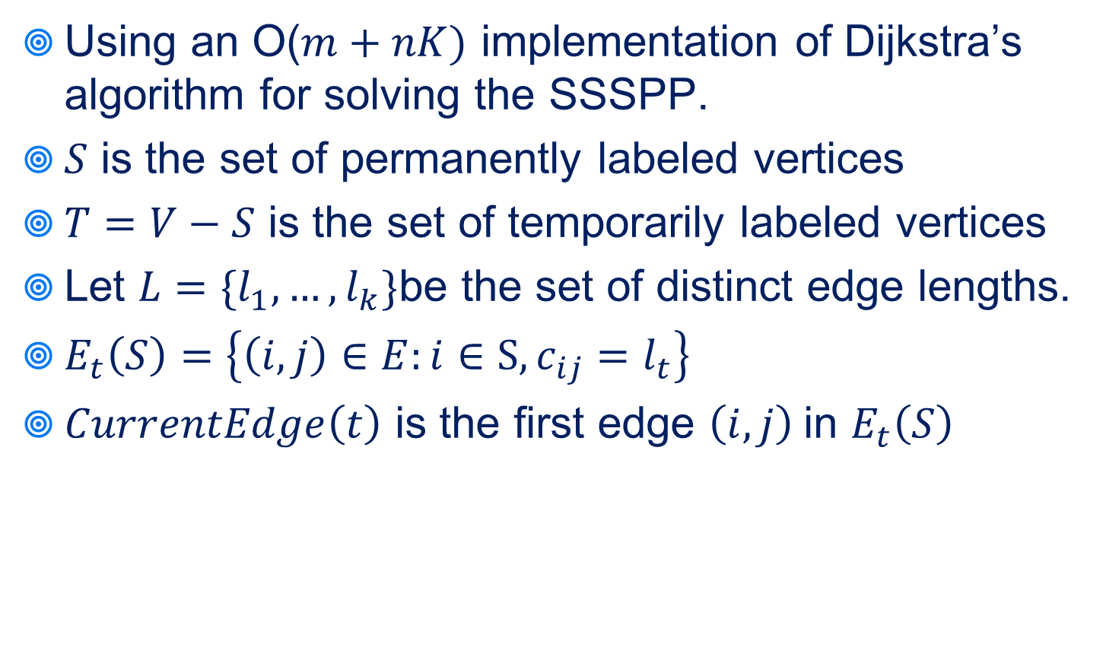
How the problem may be solved?
Using an O($m+nK)$ implementation of Dijkstra’s algorithm for solving the SSSPP.
$S$ is the set of permanently labeled vertices
$T=V−S$ is the set of temporarily labeled vertices
Let $L=\{l_{1}, …, l_{k}\}$be the set of distinct edge lengths.
$E_{t}\left(S\right)=\left\{\left(i,j\right)∈E:i∈S, c_{ij}=l_{t}\right\}$
$CurrentEdge\left(t\right)$ is the first edge $\left(i,j\right)$in $E_{t}\left(S\right)$

Slide 6
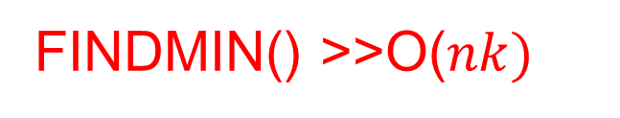
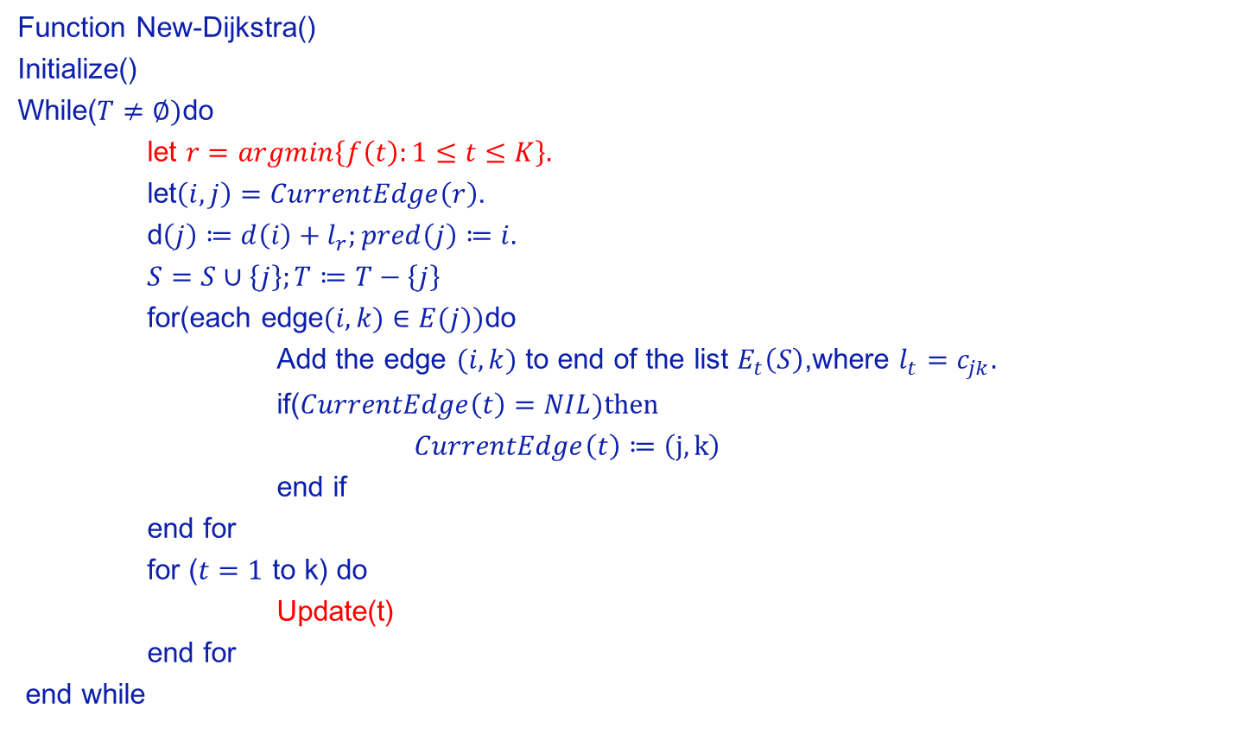
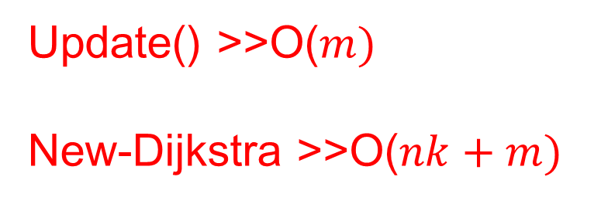
New-Dijkstra
Function New-Dijkstra()
Initialize()
While($T≠∅)$do
let $r=argmin\left\{f\left(t\right):1≤t≤K\right\}.$
let$\left(i,j\right)=CurrentEdge\left(r\right)$.
d$\left(j\right)≔d\left(i\right)+l_{r};pred\left(j\right)≔i.$
$S=S∪\left\{j\right\};T≔T−\left\{j\right\}$
for(each edge$(i,k)∈E(j))$do
Add the edge $(i,k)$ to end of the list $E_{t}\left(S\right)$,where $l_{t}=c_{jk}.$
if($CurrentEdge\left(t\right)=NIL)then$
$CurrentEdge\left(t\right)≔\left(j,k\right)$
end if
end for
for ($t=1$ to k) do
Update(t)
end for
end while
FINDMIN() >>O($nk)$
Update() >>O($m)$
New-Dijkstra >>O($nk+m)$

Slide 7
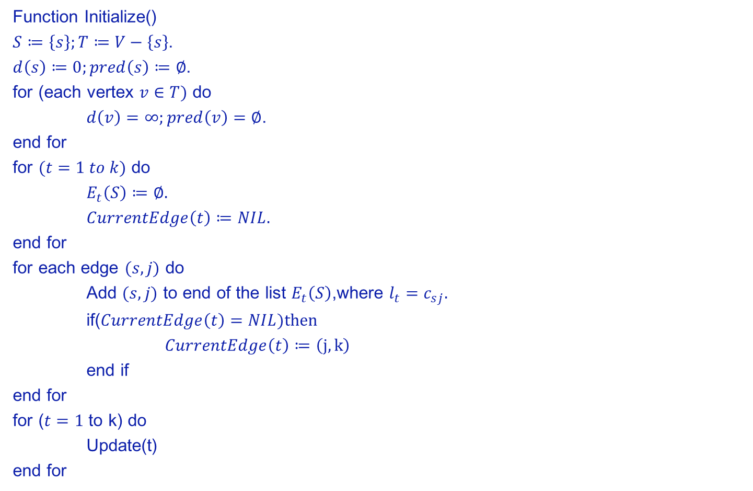
New-Dijkstra
Function Initialize()
$S≔\left\{s\right\};T≔V−\left\{s\right\}$.
$d\left(s\right)≔0;pred\left(s\right)≔∅$.
for (each vertex $v∈T)$ do
$d\left(v\right)=∞;pred\left(v\right)=∅$.
end for
for $(t=1 to k)$ do
$E_{t}\left(S\right)≔∅.$
$CurrentEdge\left(t\right)≔NIL.$
end for
for each edge $(s,j)$ do
Add $(s,j)$ to end of the list $E_{t}\left(S\right)$,where $l_{t}=c_{sj}.$
if($CurrentEdge\left(t\right)=NIL)then$
$CurrentEdge\left(t\right)≔\left(j,k\right)$
end if
end for
for ($t=1$ to k) do
Update(t)
end for

Slide 8

New-Dijkstra
Function Update()
Let$\left(i,j\right)=CurrentEdge\left(t\right)$.
if $(j∈T)$ then
$f\left(t\right)=d\left(i\right)+c_{ij}$.
return
end if
While($\left(j∉T\right) and (CurrentEdge\left(t\right).next≠NIL))$ do
Let$\left(i,j\right)=CurrentEdge\left(r\right).next$.
$CurrentEdge\left(t\right)=\left(i,j\right).$
end while
if ($\left(j∈T\right)$then
$f\left(t\right)=d\left(i\right)+c_{ij}$.
else
Set $CurrentEdge\left(t\right)$ to $∅$
$f\left(t\right)=∞$.
end if

Slide 9
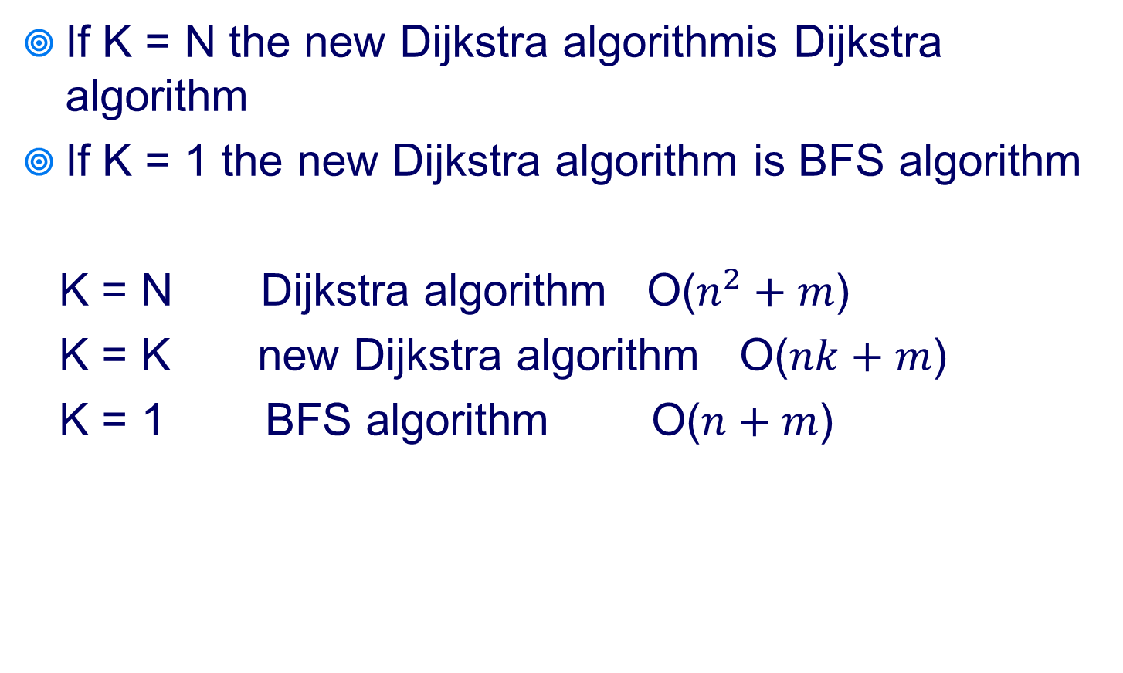
How the problem may be solved?
If K = N the new Dijkstra algorithmis Dijkstra algorithm
If K = 1 the new Dijkstra algorithm is BFS algorithm
K = N Dijkstra algorithm O($n^{2}+m$)
K = K new Dijkstra algorithm O($nk+m$)
K = 1 BFS algorithm O($n+m$)

Slide 10
Thanks for listening

