Slide 1
A Practical Shortest Path Algorithm With Linear Expected Time

Slide 2
Abstract
Present an improvement of the multilevel bucket shortest path algorithm.
For integral arc lengths that fit into a word of today’s computers, the performance is close to that of breadth-first search

Slide 3
Introduction
The shortest path problem with nonnegative arc lengths(the NSP problem) is very common in practice.
Efficient implementations of Dijkstra’s algorithm,in particular,have received a lot of attention.

Slide 4
Suppose that the input graph has n vertices and m arcs.
Let U denote the biggest arc length, define C to be the ratio between U and the smallest nonzero arc length, δ.
A natural improvement of the multilevel bucket (MLB) shortest path algorithm has an average running time that is linear and a worstcase time of O(m+n log C).

Slide 5
Preliminaries
The input to the NSP problem is a directed graph G = (V,A) with n vertices, m arcs, a source vertex s, and nonnegative arc lengths l(a).
The goal is to find shortest paths from the source to all vertices of the graph.

Slide 6
To efficiently implement the MLB data structure, we need array addressing and the following unit-time word operations: addition, subtraction, comparison, and the arbitrary shifts.
To allow a higher-level description of the algorithm, we use a strong RAM computation model that also allows word operations including bitwise logical operations and the operation of finding the index of the most significant bit in which two words differ.

Slide 7
Labeling method and related results
The method maintains for every vertex v its distance label d(v), parent p(v),and status S(v) ∈ {unreached,labeled,scanned}.
The method starts by setting d(s)=0 ans S(s)=labeled.
To scan an arc (v,w),one checks if d(w) > d(v)+l(v,w) and, if true,sets d(w)=d(v)+l(v,w),p(w)=v,and S(w)=labeled
We say that d(v) is exact if the distance from s to v is equal to d(v).

Slide 8
LEMMA 3.1(caliber lemma)
Suppose l is nonnegative, and let μ be a lower bound on distance labels of labeled vertices. Let v be a vertex such that μ+c(v) ≥ d(v).Then d(v) is exact.
The lemma follows from the observation that for any labeled vertex u,such that (u,v) ∈A,d(u)+l(u,v) ≥ μ+c(v) ≥ d(v)

Slide 9
Algorithm description and correctness
The algorithm is based on the MLB implementation of Dijkstra’s algorithm modified to use Lemma 3.1 to detect and scan vertices with exact(but not necessarily minimum) distance labels.
The algorithm keeps labeled vertices in one of two places: a set F and a priority queue B.
The priority queue supports operations insert,delete,decrease-key,and extract-min.

Slide 10
Algorithm works as follows
Vertices in F have exact distance labels and if F is nonempty, we remove and scan a vertex from F.
If F is empty, we remove and scan a vertex from B with the minimum distance label.

Slide 11
Next we describe the bucket structure B.
For a given integer parameter Δ ≥ 2, B contains k+1 levels of buckets, where k= log_{Δ} U .
Except for the top level, a level contains Δ buckets
We denote bucket j at level i by B(i,j); i ranges from 0(bottom level) to k(top), and j ranges from 0 to Δ-1,except at the top level.
A bucket contains a set of vertices maintained in a way that allows constant-time insertion and deletion

Slide 12
We maintain μ such that μ is a lower bound on the distance labels of labeled vertices. Initially μ =0.
Every time an extract-min operation removes a vertex v from B, we set μ=d(v).
Let μ_{i,j} denote the ith through jth least significant digit of μ, and let μi denote the ith least significant digit.
Similary, d_{i}(u) denotes the ith least significant digit of d(u)
Note that μ and the k+1 least significant digits of the base Δ representation of d(u) uniquely determine d(u): d(u) = μ + (d_{0,k} − μ_{0,k}) if d_{0,k} > μ_{0,k} and d(u) = μ + Δ^{k} + (d_{0,k} − μ_{0,k}) otherwise

Slide 13
Let i be the index of the most significant digit in which d(u) and μ_{0,k} differ, or 0 if they match.
Given μ and u with d(u) ≥ μ, we define the position of u by (i, di(u)) if i i<k and B(k, (d(u) − μ)/Δk) otherwise.
If u is inserted into B, it is inserted into B(i, j), where (i, j) is the position of u.

Slide 14
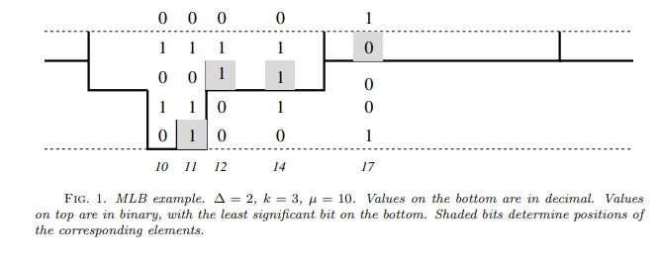
Notes:
Figure 1 gives an example of the bucket structure. In this example, Δ = 2, k = 3, and μ = 10. For instance, to find the position of a vertex v with d(v) = 14, we note that the binary representations of 10 and 14 differ in bit 2 (remember that we start counting from 0) and the bit value is 1. Thus v belongs to bucket 1 at level 2.

Slide 15
Insert
If μ + c(u) ≥ d(u), put u into F. Otherwise compute u’s position (i, j) in B and add u to B(i, j).

Slide 16
Decrease-key
Decrease the key of an element u in position (i, j) as follows. Remove u from B(i, j). Set d(u) to the new value and insert u as described above

Slide 17
Extract-min
Find the lowest nonempty level i.

Slide 18
Lemma 4.1.
At any point of the execution, all labeled vertices are in the range of at most three consecutive top-level buckets.

Slide 19
Worst-case analysis
Lemma 5.1.
• Given μ and u, we can compute the position of u with respect to μ in constant time.
• We can find the lowest nonempty level of B in constant time.

Slide 20
Lemma 5.2. The algorithm runs in O(m + n + Φ1 + Φ2) time, where Φ1 is the total number of times a vertex moves from a bucket of B to a lower-level bucket and Φ2 is the number of empty buckets examined by the algorithm.

Slide 21
Lemma 5.3. Buckets at level k and below are never used.

Slide 22
Theorem 5.4.
The worst-case running time of the algorithm is O(m+n (log C /log log C )).

Slide 23
Average-case analysis
Lemma 6.1. The algorithm never inserts a vertex v into a bucket at a level less than or equal to log c(v) − 1

Slide 24
Theorem 6.2.
If arc lengths are uniformly distributed on [1,...,M], then the average running time of the algorithm is linear.

Slide 25
Lemma 6.3
W.h.p., U ≥ M/2.

Slide 26
Lemma 6.4.
W.h.p., δ ≥ Mm^{−4/3}. If M ≥ m^{2/3}, then w.h.p. δ ≤ Mm^{−2/3}

Slide 27
Lemma 6.5.
∑_{A1}w(a) = O(m) w.h.p

Slide 28
Lemma 6.6
∑_{A2}w(a) = O(m) w.h.p

Slide 29
Theorem 6.7
If arc lengths are independent and uniformly distributed on [1,...,M], then w.h.p., the algorithm runs in linear time.

Slide 30
Algorithm implementation
The MB code implements the algorithm MLB algorithm, and the SQ code implements the smart queue algorithm
MB and SQ compute the vertex position with respect to μ.
We always set Δ to a power of two. This allows us to use bit shifts instead of divisions.
One can give MB either k or Δ as a parameter.

Slide 31
We refer to the code with the number of levels k set to two by mb2l, and to the code with Δ set to two by mb2d. These are the two extreme cases that we study.
Alternatively, one can let MB choose the values of both k and Δ based on the input. We refer to this adaptive variant as MB-A.

Slide 32
In more detail, MB-A sets k and Δ as follows.
. First we find the smallest value of k such that k is a power of two and (16k)^{k} ≥ U/w.
Then we set Δ to 16k.
While (Δ/2)^{k} ≥ U/w we reduce Δ.
Finally, while (Δ)^{k−1} ≥ U/w we reduce k. This typically leads to 16k ≤ Δ ≤ 128k and works well in our tests.

Slide 33
Experimental methodology and setup
We use a baseline code—breadth-first search (bfs) in our case—and measure running times of our shortest path codes on an input relative to the bfs running time on this input.
Baseline running times give a good indication of how close to optimal the running times are and reduces dependency on low-level implementation and architecture details

Slide 34
Problem families
SPRAND
SPGRID
SPHARD

Slide 35
Experimental results
Caliber heuristic effectiveness.

Slide 36
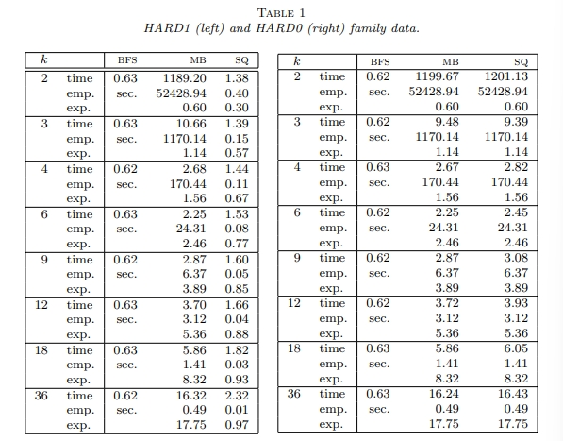

Slide 37
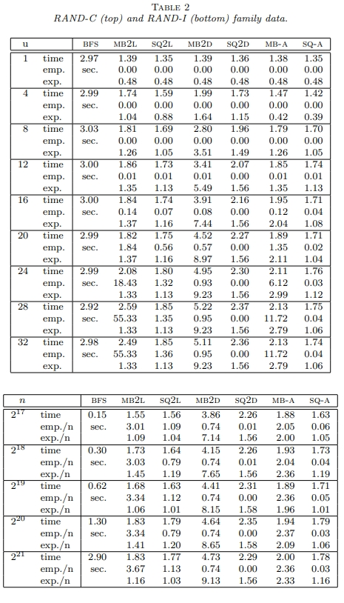

Slide 38
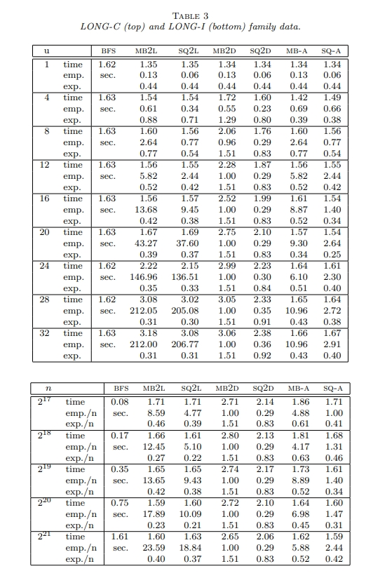

Slide 39
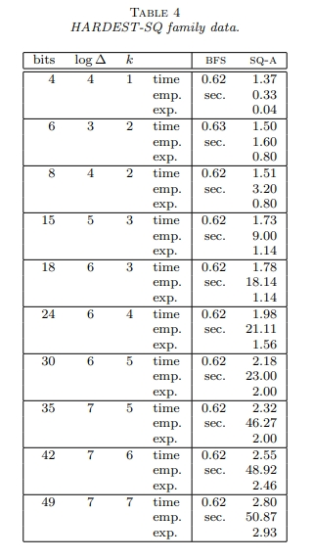

Slide 40
Conclusion
Our optimization is to detect vertices with exact distance labels before these vertices reach the bottom level of buckets and place them into F.

