Slide 1
The Partial Augment–Relabel Algorithm for the Maximum Flow Problem
Author : Andrew V. Goldberg
Presenter : NF6101036 陳俊安

Slide 2
Content
Introduction
The Push-Relabel Method
HI-PR Implementation
PAR Algorithm
Experimental results
Conclusion
Notes:
highest-label push-relabel algorithm
partial augment-relabel (PAR) algorithm

Slide 3
Introduction
Methods for solving the maximum flow problem
augmenting path
network simplex
blocking flow
push-relabel methods.
Push-relabel methods was quickly recognized as practical and outperformed the blocking flow method from Dinic.
This study proposed a Partial Augment-Relabel(PAR)Algorithm which is a variant of the push-relabel method.

Slide 4
The Push-Relabel Method
The push-relabel method maintains a preflow and a distance labeling, which are modified using two basic operations:
Push : Push excess flow to adjacent vertices
Relabel : Increase the label of a vertex (height) to make adjacent vertices available to push to (vertices can only push to adjacent vertices with lesser labels)
Preflow allows vertices to accept more inflow than outflow (active nodes), then resolves these active nodes by either pushing excess flow to adjacent vertices or relabeling the vertex so that this is possible. Continues doing this until there are no active nodes left and all unusable flow is pushed back to source.

Slide 5
The Push-Relabel Method
Graph G
a
5
c
10
4
s
t
3
5
b
6
Notes:
Initialize the preflow: Set the flow on the edges incident to the source node to their capacities, and set the flow on all other edges to zero. Also, initialize the excess flow at each node (except the source) as the sum of incoming flows minus the sum of outgoing flows.

Slide 6
The Push-Relabel Method
Initialization
Push the flow from s to a and b
e(a) = 10
d(a) = 1
d(c) = 1
Node with excess flow
a
b
a
5
c
d(s) = 5
4
d(t) = 0
10
s
t
3
5
b
6
e(b) = 5
d(b) = 1
Notes:
Initialize the preflow: Set the flow on the edges incident to the source node to their capacities, and set the flow on all other edges to zero. Also, initialize the excess flow at each node (except the source) as the sum of incoming flows minus the sum of outgoing flows.

Slide 7
The Push-Relabel Method
e(a) = 0
d(a) = 6
e(c) = 5
d(c) = 1
Node with excess flow
a
b
a
5
c
d(s) = 5
4
d(t) = 0
5
s
5
t
Select a
Relabel a to 2
Push 5 units to c, e(a) = 5
Relabel a to 6
Push 5 units to s, e(a) = 0
3
5
b
6
e(b) = 5
d(b) = 1
Notes:
Initialize the preflow: Set the flow on the edges incident to the source node to their capacities, and set the flow on all other edges to zero. Also, initialize the excess flow at each node (except the source) as the sum of incoming flows minus the sum of outgoing flows.

Slide 8
The Push-Relabel Method
e(a) = 0
d(a) = 6
e(c) = 5
d(c) = 1
Node with excess flow
b
c
a
5
c
d(s) = 5
4
e(t) = 5
d(t) = 0
5
s
5
t
3
Select b
Push 5 units to t, e(b) = 1
Relabel b to 6
Push 1 unit to s, e(b) = 0
5
1
4
b
1
e(b) = 0
d(b) = 1
Notes:
Initialize the preflow: Set the flow on the edges incident to the source node to their capacities, and set the flow on all other edges to zero. Also, initialize the excess flow at each node (except the source) as the sum of incoming flows minus the sum of outgoing flows.

Slide 9
The Push-Relabel Method
e(a) = 1
d(a) = 6
e(c) = 0
d(c) = 7
Node with excess flow
c
a
4
c
d(s) = 5
4
e(t) = 9
d(t) = 0
5
1
s
5
t
Select c
Push 4 unit to t, e(c) =1
Relabel c to 7
Push 1 unit to a, e(c) = 0
3
5
5
b
1
e(b) = 0
d(b) = 1
Notes:
Initialize the preflow: Set the flow on the edges incident to the source node to their capacities, and set the flow on all other edges to zero. Also, initialize the excess flow at each node (except the source) as the sum of incoming flows minus the sum of outgoing flows.

Slide 10
The Push-Relabel Method
e(a) = 0
d(a) = 6
e(c) = 0
d(c) = 7
Node with excess flow
a
a
4
c
d(s) = 5
4
e(t) = 9
d(t) = 0
4
1
s
6
t
3
Select a
Push 1 unit to s, e(a) = 0
All e(v) = 0
Stop
5
5
b
1
e(b) = 0
d(b) = 1
Notes:
Initialize the preflow: Set the flow on the edges incident to the source node to their capacities, and set the flow on all other edges to zero. Also, initialize the excess flow at each node (except the source) as the sum of incoming flows minus the sum of outgoing flows.

Slide 11
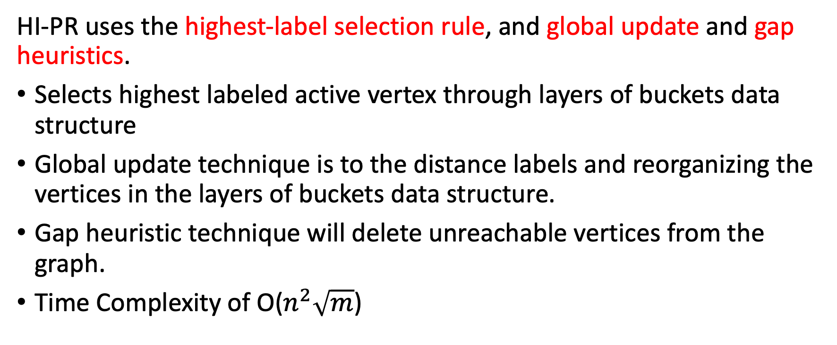
HI-PR Implementation
HI-PR uses the highest-label selection rule, and global update and gap heuristics.
﻿﻿Selects highest labeled active vertex through layers of buckets data structure
Global update technique is to the distance labels and reorganizing the vertices in the layers of buckets data structure.
Gap heuristic technique will delete unreachable vertices from the graph.
﻿﻿Time Complexity of O($n^{2}\sqrt{m}$)
Notes:
HI-PR Implementation:
Implement the highest-label selection rule.
Use a layers of buckets data structure for efficient management of vertices.
Implement the gap heuristic to delete unreachable vertices.
Perform push and relabel operations locally.
Optionally, perform global relabeling for improved performance.
Apply global updates after a certain amount of work has been done.
Run the algorithm until completion, maintaining the time complexity of $O\left(n^{2} \sqrt{m}\right)$.
The layers of buckets data structure provides an efficient way to organize and manage the vertices based on their distance labels and excess flow. It allows for easy selection of the highest-label vertex and facilitates the gap heuristic by ensuring that the sequence of non-empty layers has no gaps. This data structure contributes to the overall efficiency of the HI-PR implementation of the push-relabel algorithm.
By periodically performing global updates, the push-relabel algorithm adjusts the distance labels, organizes the vertices in the layers of buckets data structure, and eliminates unreachable vertices. This optimization helps the algorithm converge faster towards the maximum flow solution by maintaining an accurate representation of the graph and focusing its operations on the relevant parts of the residual graph.
By applying the gap heuristic, the push-relabel algorithm dynamically adjusts the graph structure, removing unreachable vertices and optimizing its performance. This technique ensures that the algorithm focuses its operations on the relevant parts of the graph, leading to improved efficiency and faster convergence towards the maximum flow solution.

Slide 12
PAR Algorithm
The PAR (Partial Augment-Relabel) algorithm is a variation of the push-relabel method that maintains a preflow and a distance labeling.
k : the length of the augmenting paths explored by the algorithm
The PAR algorithm follows the same basic steps as the augment-relabel (AR) algorithm but with modifications.
Notes:
The PAR (Partial Augment-Relabel) algorithm is a variation of the push-relabel method that maintains a preflow and a distance labeling. It introduces a parameter, k, which determines the length of the augmenting paths explored by the algorithm. The PAR algorithm follows the same basic steps as the augment-relabel (AR) algorithm but with modifications.
Here is a summary of the steps involved in the PAR algorithm:
Initialization: Start with any feasible preflow and distance labeling. Choose an initial vertex, v, as the active vertex.
Active Vertex Selection: Choose the active vertex v using the highest-label selection rule. This means selecting the vertex with the highest distance label among the active vertices (i.e., vertices with excess flow and distance less than n).
Augmenting Path Search: Start with an admissible path from s to v. Explore the admissible graph in a depth-first search manner to find an augmenting path of length k starting from v.
Path Extension: Check if the current vertex, x, has an admissible arc (x, y). If such an arc exists, extend the path by adding y to the path, making y the new current vertex.
Path Shrinkage and Relabeling: If there is no admissible arc from the current vertex x, shrink the path by making the predecessor of x on the path the new current vertex. Relabel the current vertex x to adjust its distance label.
Augmentation: If the current vertex becomes the sink vertex t, an augmenting path has been found. Perform k push operations along the path, pushing as much flow as possible.
Search Restart: After the augmentation, start a new search from either the source vertex s or the last vertex on the augmenting path that is reachable from s in the residual graph Gf.
Termination: Repeat steps 2-7 until no more augmenting paths can be found.
Implementation Details:
The PAR algorithm uses a layers of buckets data structure, similar to HI-PR, to efficiently manage vertices based on their distance labels.
The gap heuristic is employed to delete unreachable vertices and maintain the invariant that the sequence of non-empty layers has no gaps.
The algorithm incorporates global relabeling, which performs a backward breadth-first search from the sink vertex t to update the distance labels and place vertices in appropriate buckets.
Incremental restart is used during global relabeling to start the update from a certain layer if flows from vertices at a certain distance have not changed since the previous global update.
The early termination heuristic stops the breadth-first search in global relabeling when all active vertices have been placed in their respective layers, potentially saving computational effort.
Adaptive amortization strategies based on a threshold value are applied to determine when to perform the next global update. The threshold is adjusted based on the work done by the previous global update and the remaining number of vertices in the graph.
By incorporating these techniques, the PAR algorithm aims to improve the efficiency and running time of the push-relabel method. The choice of the parameter k can affect the algorithm's performance, and it may need to be experimentally tuned for specific applications.
It's worth noting that the PAR algorithm achieves the same time complexity as HI-PR, with both algorithms having an upper bound of O(n^2√m).

Slide 13
PAR Algorithm
The PAR algorithm follows the same basic steps as the augment-relabel (AR) algorithm but with modifications.
Initialization
Active Vertex Selection
Augmenting Path Search
Path Extension
Path Shrinkage and Relabeling
Augmentation
Search Restart
Termination
Notes:
The PAR (Partial Augment-Relabel) algorithm is a variation of the push-relabel method that maintains a preflow and a distance labeling. It introduces a parameter, k, which determines the length of the augmenting paths explored by the algorithm. The PAR algorithm follows the same basic steps as the augment-relabel (AR) algorithm but with modifications.
Here is a summary of the steps involved in the PAR algorithm:
Initialization: Start with any feasible preflow and distance labeling. Choose an initial vertex, v, as the active vertex.
Active Vertex Selection: Choose the active vertex v using the highest-label selection rule. This means selecting the vertex with the highest distance label among the active vertices (i.e., vertices with excess flow and distance less than n).
Augmenting Path Search: Start with an admissible path from s to v. Explore the admissible graph in a depth-first search manner to find an augmenting path of length k starting from v.
Path Extension: Check if the current vertex, x, has an admissible arc (x, y). If such an arc exists, extend the path by adding y to the path, making y the new current vertex.
Path Shrinkage and Relabeling: If there is no admissible arc from the current vertex x, shrink the path by making the predecessor of x on the path the new current vertex. Relabel the current vertex x to adjust its distance label.
Augmentation: If the current vertex becomes the sink vertex t, an augmenting path has been found. Perform k push operations along the path, pushing as much flow as possible.
Search Restart: After the augmentation, start a new search from either the source vertex s or the last vertex on the augmenting path that is reachable from s in the residual graph Gf.
Termination: Repeat steps 2-7 until no more augmenting paths can be found.

Slide 14
PAR Algorithm
Technique used in implementation :
The PAR algorithm uses a layers of buckets data structure
The gap heuristic is employed
The algorithm incorporates global relabeling
Incremental restart
early termination heuristic
Adaptive amortization strategies based on a threshold value
Notes:
Implementation Details:
The PAR algorithm uses a layers of buckets data structure, similar to HI-PR, to efficiently manage vertices based on their distance labels.
The gap heuristic is employed to delete unreachable vertices and maintain the invariant that the sequence of non-empty layers has no gaps.
The algorithm incorporates global relabeling, which performs a backward breadth-first search from the sink vertex t to update the distance labels and place vertices in appropriate buckets.
Incremental restart is used during global relabeling to start the update from a certain layer if flows from vertices at a certain distance have not changed since the previous global update.
The early termination heuristic stops the breadth-first search in global relabeling when all active vertices have been placed in their respective layers, potentially saving computational effort.
Adaptive amortization strategies based on a threshold value are applied to determine when to perform the next global update. The threshold is adjusted based on the work done by the previous global update and the remaining number of vertices in the graph.
By incorporating these techniques, the PAR algorithm aims to improve the efficiency and running time of the push-relabel method. The choice of the parameter k can affect the algorithm's performance, and it may need to be experimentally tuned for specific applications.
It's worth noting that the PAR algorithm achieves the same time complexity as HI-PR, with both algorithms having an upper bound of O(n^2√m).

Slide 15
Experimental Results
Experimental results compare PAR (Push-Relabel algorithm) with HI-PR (Highest Index Pre-labeling algorithm) and two versions of the Chandran and Hochbaum algorithm (CH and CHn) on various problems.
2 focused problems : DIMACS problem families, vision application problems
Units : average running seconds(time) of 10 instance, scan count per vertex (sc/n), standard deviation in percent (sd%).
Notes:
The experiments focused on DIMACS problem families and vision application problems. The DIMACS families included RMF-Long, RMF-Wide, Washington, and Acyclic-Dense. The vision problems were from stereo vision, image segmentation, and multiview reconstruction.

Slide 16
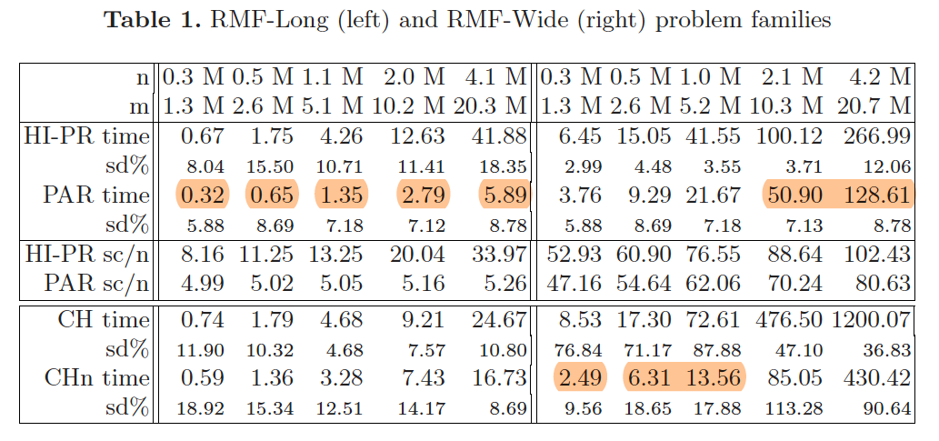
Experimental Results
DIMACS problem families
Notes:
For the DIMACS families, PAR generally outperformed HI-PR. On the RMF-Long family, PAR showed an asymptotic improvement, with its running time nearly linearly increasing as the problem size increased. On the RMF-Wide family, PAR was approximately twice as fast as HI-PR for larger problems. Similarly, on the Washington problem families, PAR outperformed HI-PR by less than a factor of two.
Comparisons with the CH algorithm showed that PAR was asymptotically the fastest on the RMF-Long and RMF-Wide families. The CH algorithm exhibited high variance in running time, indicating lack of robustness. On the Wash-Wide problems, CHn was the fastest, while PAR was slower by about a factor of two.

Slide 17
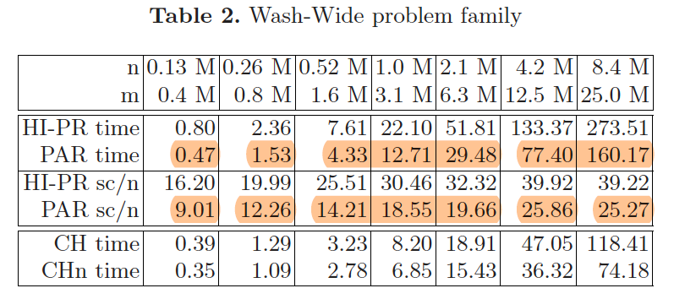
Experimental Results
DIMACS problem families

Slide 18
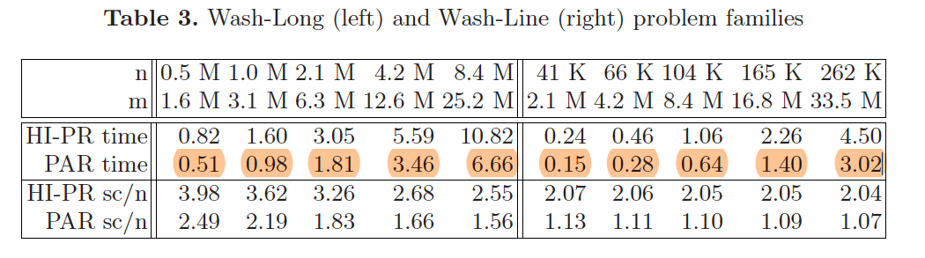
Experimental Results
DIMACS problem families

Slide 19
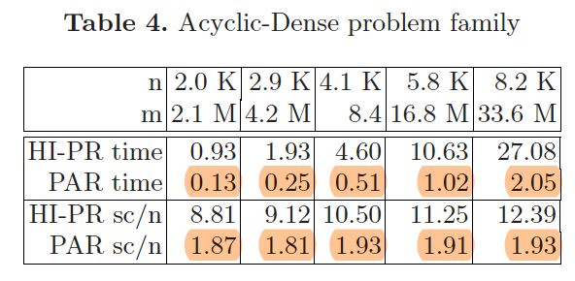
Experimental Results
DIMACS problem families

Slide 20
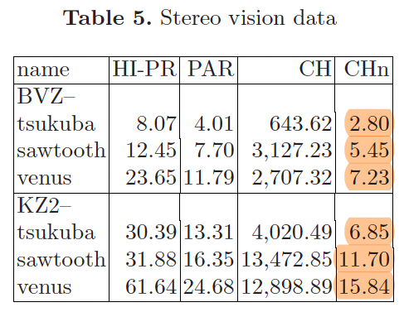
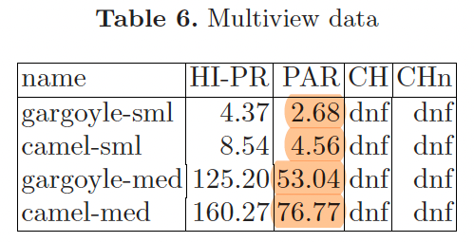
Experimental Results
Vision application problems
Notes:
In the vision instances, PAR performed well, with the second fastest running time after CHn. HI-PR was approximately twice as slow as PAR, while CH had significantly poorer performance.

Slide 21
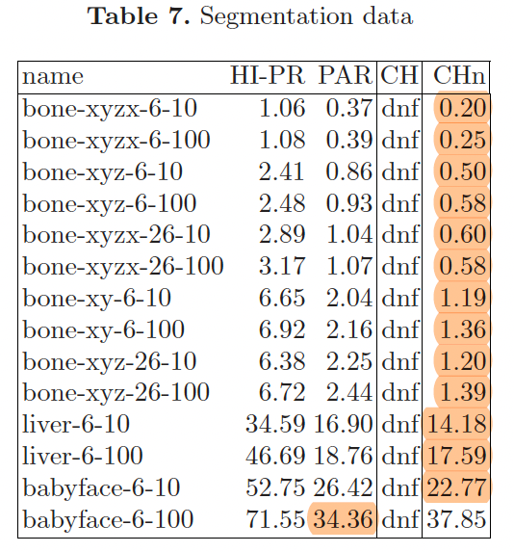
Experimental Results
Vision application problems
Notes:
Overall, the experiments demonstrated that PAR generally outperformed HI-PR on the tested problem families, with improved asymptotic performance on certain families. Additionally, PAR showed competitive performance compared to the CH algorithm in vision instances.

Slide 22
Conclusion
The PAR (Partial Augment-Relabel) algorithm is found to be more robust than the HI-PR algorithm
PAR outperforms HI-PR on all tested problem families
The CH (Capacity Heuristic) algorithm is slower than HI-PR on large RMF-Wide problems and significantly slower on stereo vision problems.
CHn (a variation of CH) is more robust but noticeably slower on large RMF-Wide instances.

