Slide 1
07_PRACTICAL EFFICIENCY OF MAXIMUM FLOW ALGORITHMS USING MA ORDERINGS AND PREFLOWS
工資112 陳奕蓁

Slide 2
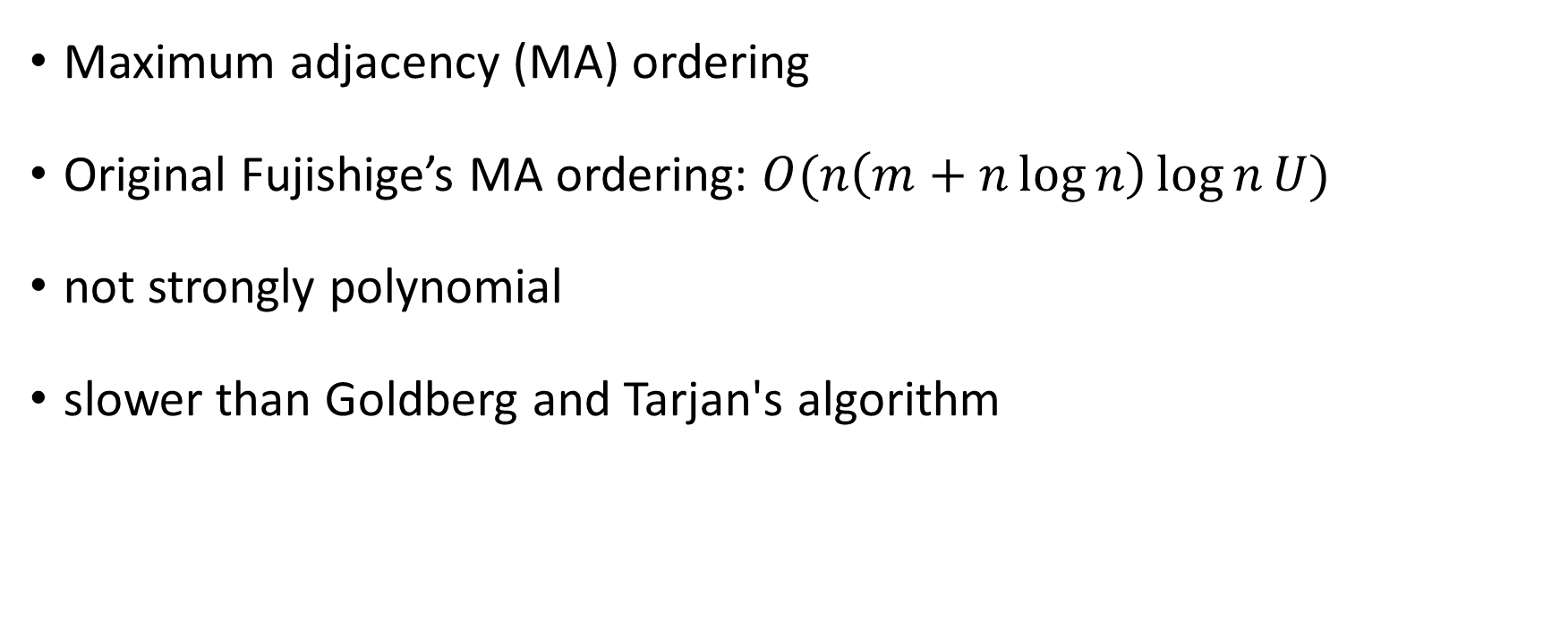
Introduction
Maximum adjacency (MA) ordering
Original Fujishige’s MA ordering: $O(n\left(m+n\log{n}\right)\log{n}U)$
not strongly polynomial
slower than Goldberg and Tarjan's algorithm
Notes:
Maximum adjacency (MA) ordering has effectively been applied to graph connectivitiy problems.
Fujishige presented an application of MA ordering to the maximum flow problem to devise new polynomial-time algorithm.
For a capacitated network with n vertices, m arcs, and the maximum capacity U
Fujishige's algorithm finds a maximum flow in O(n(m+n logn) IognU) time.
However, this complexity is not the best running time bound for the maximum flow problem.
In addition, it is proved that the time complexity of Fujishige’s algorithrn is not strongly
In practice, computational results in other research show that Fujishige's algorithm is lower than Goldberg and Tarjan's algorithm

Slide 3
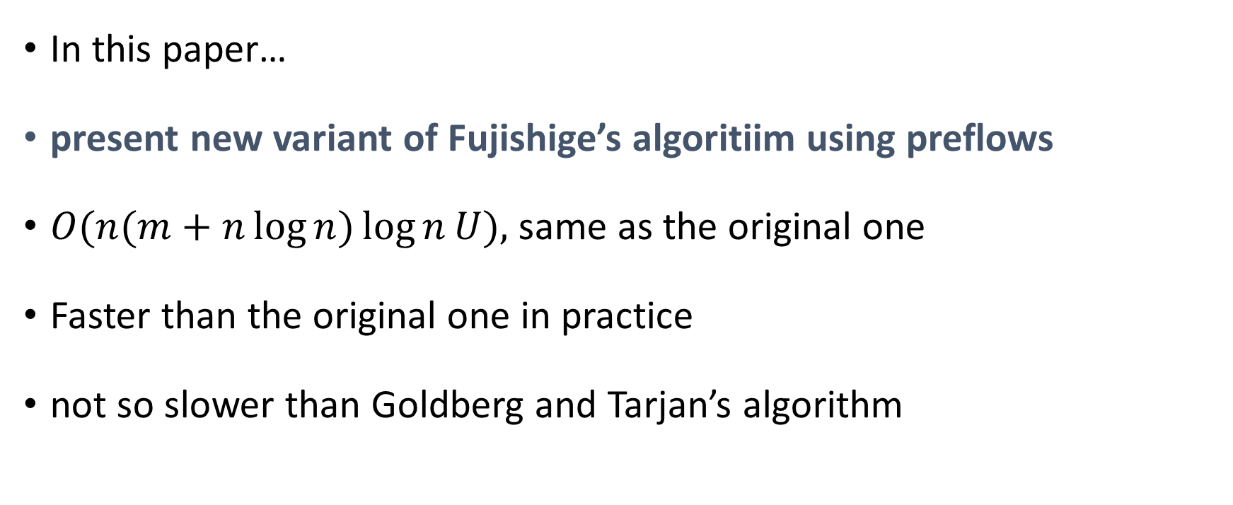
Introduction
In this paper…
present new variant of Fujishige’s algoritiim using preflows
$O(n(m+n\log{n})\log{n}U),$same as the original one
Faster than the original one in practice
not so slower than Goldberg and Tarjan’s algorithm
Notes:
In this paper, we present a new variant of Fujishige’s algoritiim using preflows.
We prove that, its complexity is O(n(m + nlogn) lognU), which is the same as the original one.
We compare it with the original version of Flijishige’s algorithm and Goldberg and Tarjan's algorithm.
Our computational experiments on six problem faimilies reveal that the new version is faster than the original one for all the problem families.
In comparison with two codes of Goldberg and Tarjan’s algorithm, our algorithm is not so slower than them.
We may conclude that the new version of Fujishige’s algorithm is practically efficient.

Slide 4
Contents
Section 2: definitions of Maximum Flow and Residual Network
Section 3: the new version of Fujishige's algorithm.
Section 4: results comparing
Section 5: conclusion
Notes:
The present paper is organized as follows.
Seetion2 gives definitions concerning flows and networks.
In Section 3 we give a full description of the new version of Fujishige's algorithm.
In Section 4 we show computational results comparing the new version with the original version and Goldberg and Tarjan'salgorithm.
Section 5 provides our conclusion,

Slide 5
Definitions of Maximum Flow and Residual Network

Slide 6
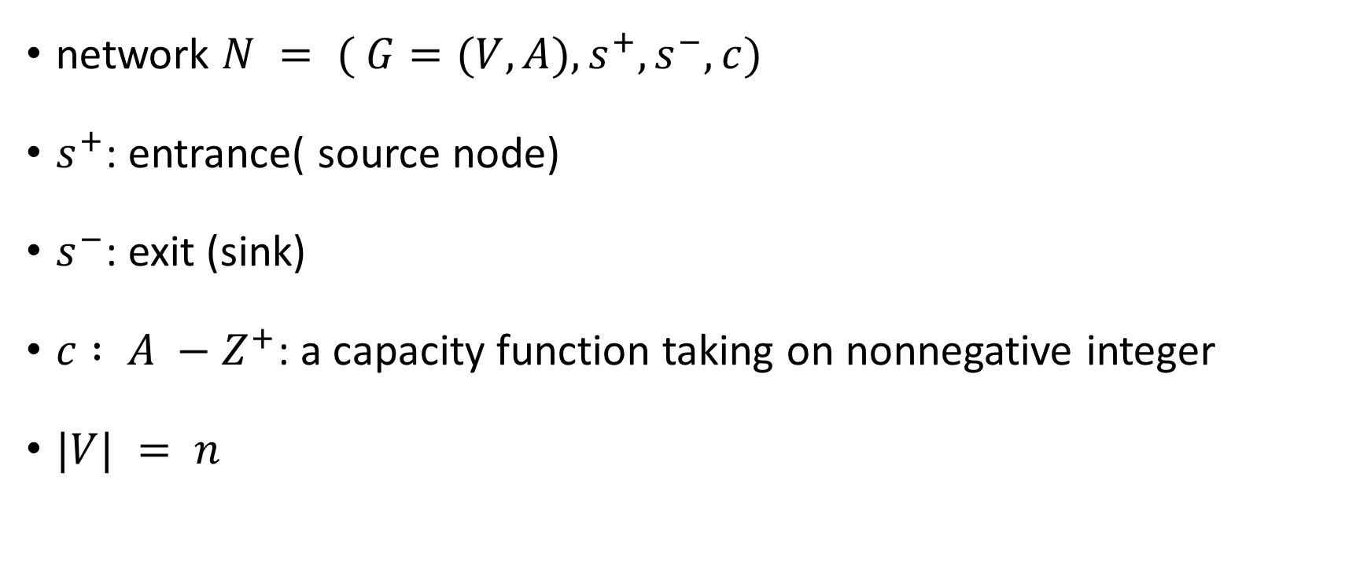
Network
network $N = ( G=(V,A), s^{+}, s^{−}, c)$
$s^{+}$: entrance( source node)
$s^{−}$: exit (sink)
$c : A −Z^{+}$: a capacity function taking on nonnegative integer
$|V| = n$
Notes:
A network N is consist of a Graph G with vertex set V and arc set A.
S plus is the entrance, or you can say source node
And s minus is the exit node
C is the capacity of each arc

Slide 7






Network
$φ$: $A − Z^{+},$a flow in N:
(Capacity constraints$) ∀ a ∈ A :$
(Flow conservation$) ∀v∈V \{s^{+},s^{−}\} : ∂φ(v)= O$, $∀ v∈V$
Notes:
Phi is a flow of each arc
And need to satisfy two constraints
First is capacity constraint, and the second is flow balance constraint

Slide 8
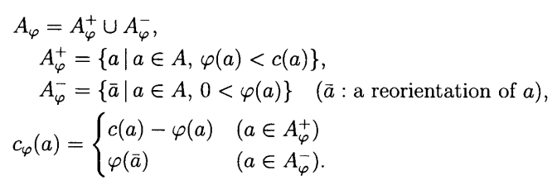
Residual Network
residual network $N_{φ}= (G_{φ}= (V,A_{φ}), s^{+}, s^{−}, c_{φ})$
Notes:
The residual network is consist of A phi , which is the arc of the residual network
A phi is the union of A-phi+ and A-phi-
When the flow of arc(a) is small than c(a), than a belongs to A-phi+
When the flow of arc(a) is bigger than 0, than a-bar belongs to A-phi-, a-Bar is a reorientation of a
And we can get the capacity of the residual network c-phi by this function

Slide 9
New Version of Fujishige’s Algorithm

Slide 10
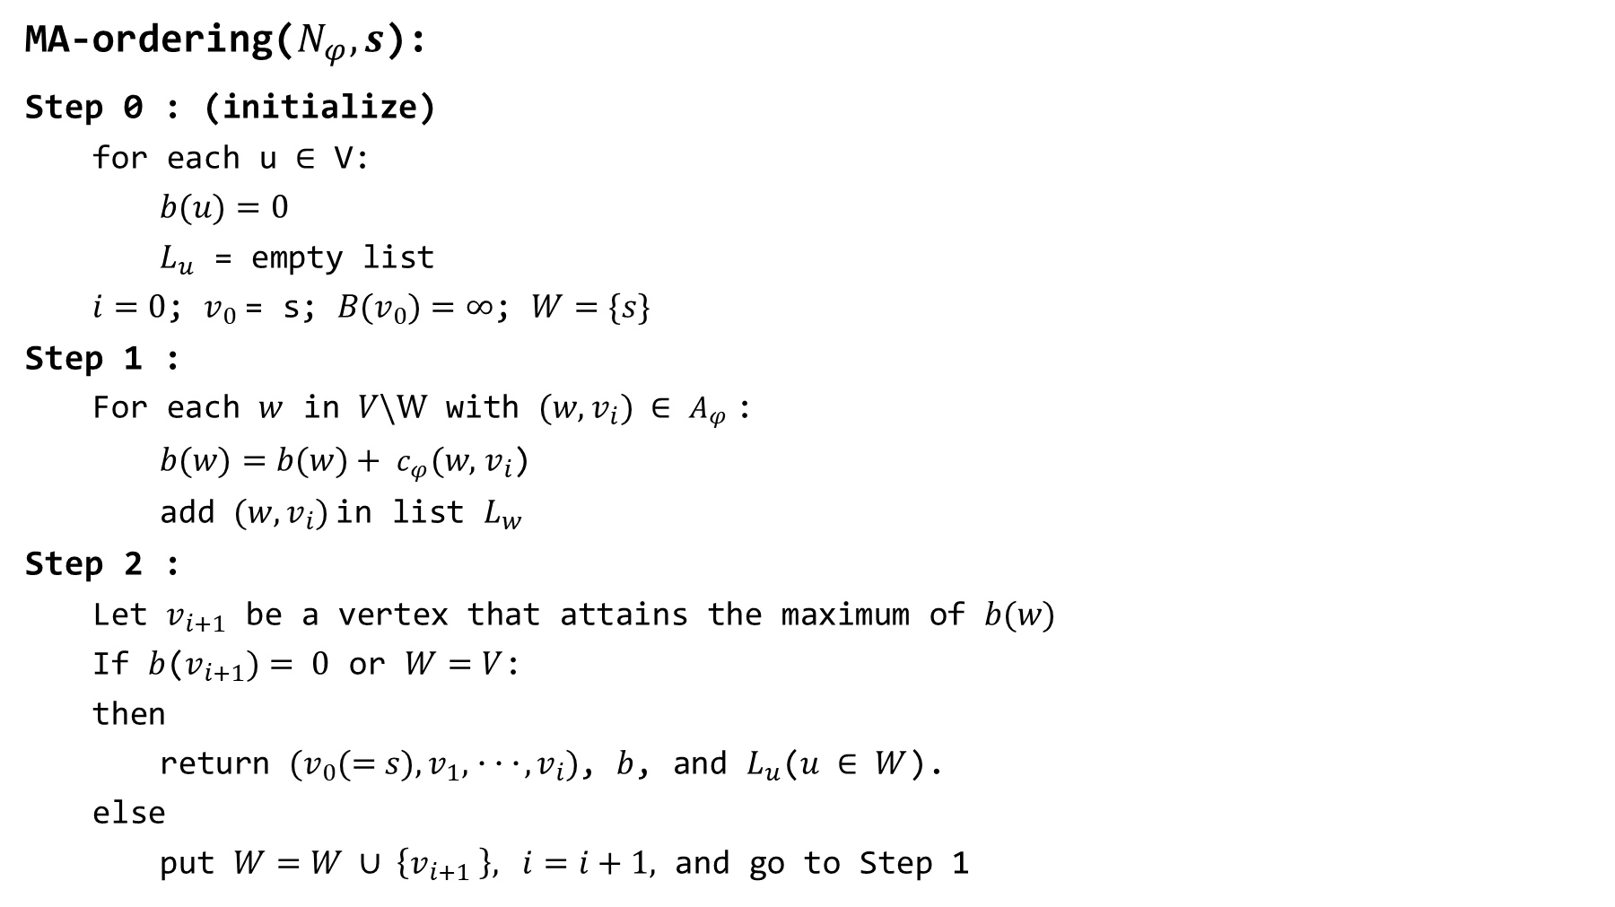

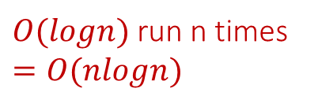


MA-ordering($N_{φ},s$):
Step 0 : (initialize)
for each u $∈$ V:
$b(u)=0$
$L_{u}$ = empty list
$i=0$; $v_{0}$= s; $B(v_{0})=∞$; $W=\{s\}$
Step 1 :
For each $w$ in $V\backslash W$ with $(w, v_{i}) ∈$ $A_{φ}$:
$b(w)=b(w)+ c_{φ}(w,$ $v_{i}$)
add $(w, v_{i})$in list $L_{w}$
Step 2 :
Let $v_{i+1}$ be a vertex that attains the maximum of $b(w)$
If $b$($v_{i+1})= 0$ or $W=V$:
then
return $(v_{0}(=s), v_{1},･･･, v_{i})$, $b$, and $L_{u}$($u ∈ W$).
else
put $W=W ∪ \left\{v_{i+1} \right\}, i=i+1,$ and go to Step 1
$$O(m+n logn)$$
$$O(n)$$
$$O(m)$$
$O(logn)$ run n times
$$=O(nlogn)$$
Notes:
MA-ordering is a Subroutine in the algorithm
In step 0 : we initialize some variable
For each node u in vertex set V
Let b(u) be 0 and Lu be empty list
And let I be 0, v0 be s
In step 1, we want to find a node w that is reachable to node v0
And update b(w), add arc(w,vi) to list Lw
In step 2:
We check that if there are any node that can reach to v0
So let vi+1 be a vertex that attains the maximum of b(w) where w in W
If b(vi+1) equals 0 means that there is no node reachable to node v0
If W=V means that there is no node we can select
if any of these condition are met, return v0 to vi
If not
Update set W and I, and go to step 1
This time we will find a node that is reachable to v1
And continue these process until there is no arc to select from
The time complexity of step 0 is O(n),
Because each vertex is initialized, it takes n time to finish
In step 1, we select arcs in A-phi until there are no arc to select,
So this step runs m times, the time complexity is O(m)
Un this paper, we use Fibonacci heap to find the miximum value in b,
And it take O(nlogn) to do it.
And because we will select at most all the nodes in the network, step 2 will run n times
the time complexity of step 2 is O(nlogn)
So the total time complexity of MA-ordering is $O(m+n logn)$

Slide 11

FMAP:
Step 0: (Preflow Initialization)
for each $a = (s^{+}, u) ∈ A$:
$φ(a) = c(a)$
for each $a = (v, w)∈A with v ≠s^{+}:$
$φ(a) = 0$
Notes:
Next, I will start to explain the main program of this paper
In step 0, we fill the arcs that start from the source node
For each arc a be (s+,u): let phi(a) be c(a)
and let phi(a) be 0 for other arcs

Slide 12
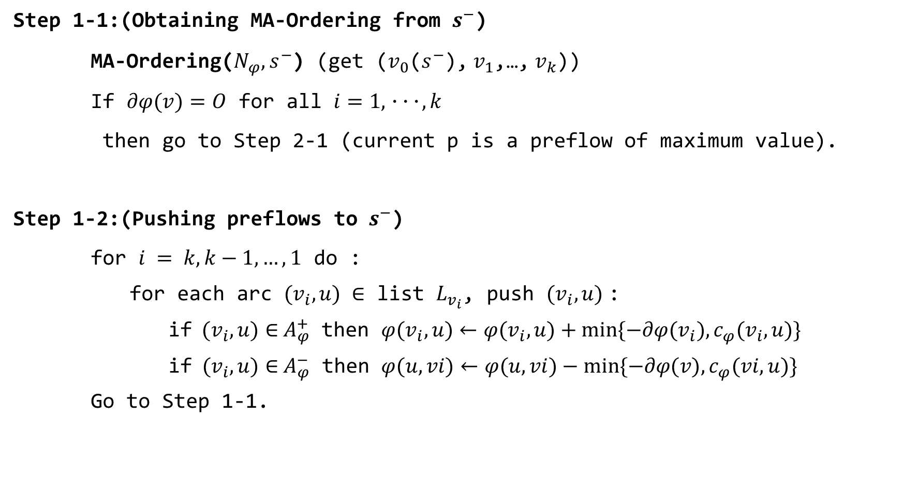
Step 1-1:(Obtaining MA-Ordering from $s^{−}$)
MA-Ordering($N_{φ},$ $s^{−}$) (get ($v_{0}$($s^{−}$), $v_{1}$,…, $v_{k}$))
If $∂φ(v)=O$ for all $i=1,･･･,k$
then go to Step 2-1 (current p is a preflow of maximum value).
Step 1-2:(Pushing preflows to $s^{−}$)
for $i = k, k−1,…, 1$ do :
for each arc $(v_{i},u) ∈$ list $L_{v_{i}}$, push $(v_{i},u)$:
if $(v_{i},u)∈$ $A_{φ}^{+}$ then $φ(v_{i},u)←φ(v_{i},u)+min⁡\{−∂φ(v_{i}), c_{φ}(v_{i},u)\}$
if $(v_{i},u)∈$ $A_{φ}^{−}$ then $φ(u, vi)←φ(u,vi)−min⁡\{−∂φ(v),c_{φ}(vi,u)\}$
Go to Step 1-1.
Notes:
In step 1
We obtain MA-ordering from sink node, which means that we select arcs backwards
After the ma-ordering, we will get a list of v and L
First, we check that if the flow balance equals to 0 for all node in list v
If they do, then we can skip to step 2-1
If not, we will go to step 1-2
In step 1-2, we push the preflow to the sink node
We follow the sequence and check that which set they belong to
If arc belongs to A-phi+, then update flow of arc by add the minimum of the input-flow and c-phi
If arc belongs to A-phi-, then update flow of arc by minus the minimum of the output-flow and c-phi
After this process, we go back to step 1-1
And do these until the flow balance is 0 for all node

Slide 13
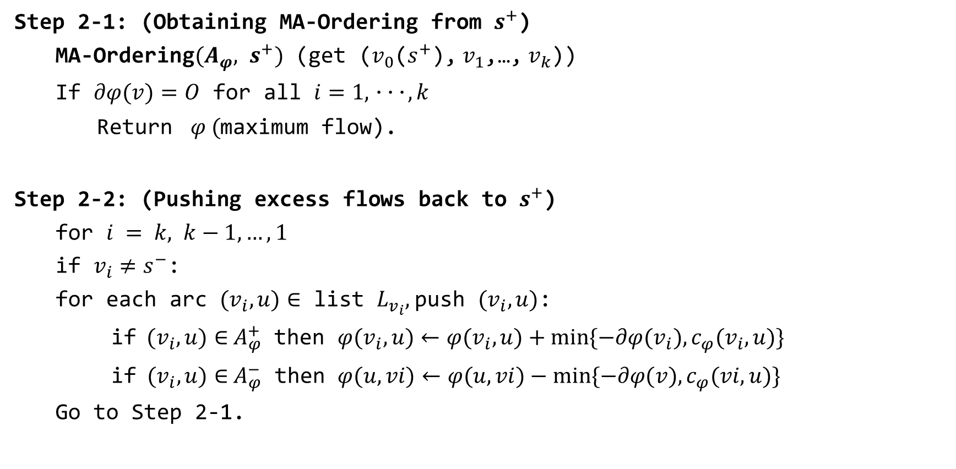
Step 2-1: (Obtaining MA-Ordering from $s^{+}$)
MA-Ordering$(A_{φ}, s^{+})$ (get ($v_{0}$($s^{+}$), $v_{1}$,…, $v_{k}$))
If $∂φ(v)=O$ for all $i=1,･･･,k$
Return $φ ($maximum flow).
Step 2-2: (Pushing excess flows back to $s^{+}$)
for $i = k, k−1,…, 1$
if $v_{i}≠s^{−}$:
for each arc $(v_{i},u)∈$ list $L_{v_{i}},$push $(v_{i},u)$:
if $(v_{i},u)∈$ $A_{φ}^{+}$ then $φ(v_{i},u)←φ(v_{i},u)+min⁡\{−∂φ(v_{i}), c_{φ}(v_{i},u)\}$
if $(v_{i},u)∈$ $A_{φ}^{−}$ then $φ(u, vi)←φ(u,vi)−min⁡\{−∂φ(v),c_{φ}(vi,u)\}$
Go to Step 2-1.
Notes:
In step 2
We obtain MA-ordering again.
But the difference is that this time we start from source node, which means that we select arcs forewards
After the ma-ordering
Again , we check that if the flow balance equals to 0 for all node in list v
If they do, then we get the maximum flow if the network
If not, we will go to step 2-2
Step 2-2 is almost the same
So I won’t go into too much detail on this part

Slide 14
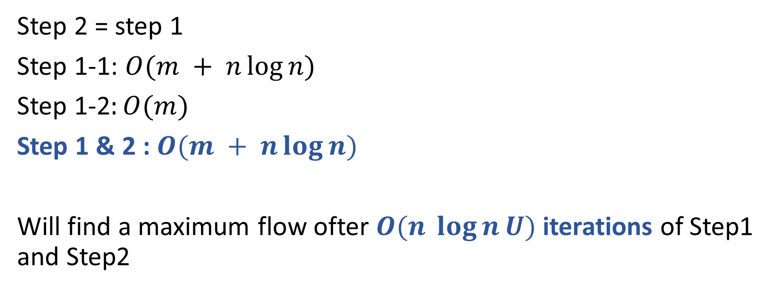
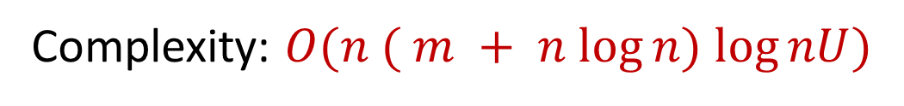
Step 2 = step 1
Step 1-1: $O(m + n\log{n})$
Step 1-2$:O(m)$
Step 1 & 2 : $O(m + n\log{n})$
Will find a maximum flow ofter $O(n \log{n}U)$iterations of Step1 and Step2
Complexity: $O(n ( m + n log⁡n) log⁡nU)$
Notes:
Now, we examine the complexity of the algorithm.
First, Step 2 is at most the same complexity as Step 1, so we only have to examine Step 1.
Since Step 1-1 requires O(m + nlogn) time and Step 1-2 requires O(m) time, each iteration of Step 1 requires O(mn +nlogn) time.
So the total time complexity of step1 and step 2 is $O(m + n\log{n})$
This algorithm finds a maximum flow after O(n lognU) iterations of Step1 and Step2
So the total time complexity of this algorithm is $O(n ( m + n logn) lognU)$

Slide 15
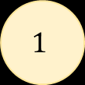
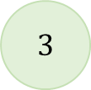
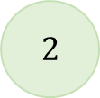
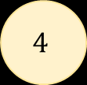
Example
$$2$$
6
4
$$1$$
3
$$4$$
4
$$3$$
7
Notes:
Now I will use this small network as example and demo the algorithm

Slide 16
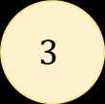
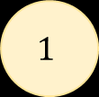
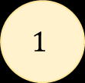
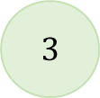
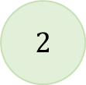
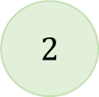
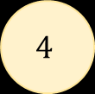
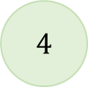
Step 0: (Preflow Initialization)
Network
Residual Network
$$2$$
$$4$$
6/6
/4
6
4
$$1$$
$$4$$
$$1$$
3
$$3$$
/3
4/4
$$3$$
/7
4
$$2$$
7
Notes:
The first step is preflow initialization
For those arc which start from source node, such as arc (1,2) and arc(1,3)
Let those flow equal to their capacity
This graph at the right side is the residual network

Slide 17
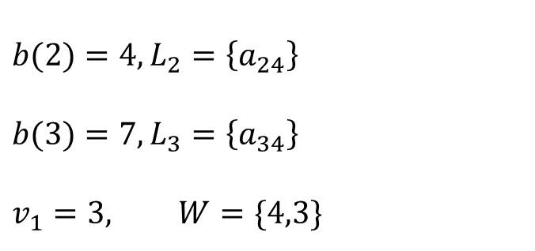
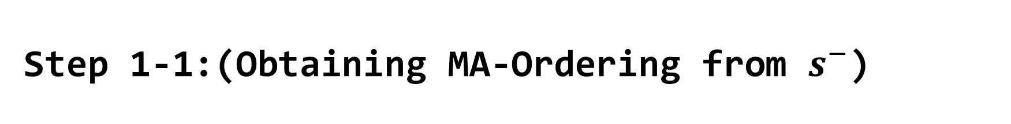
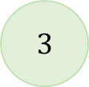
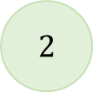
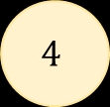
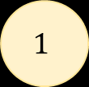
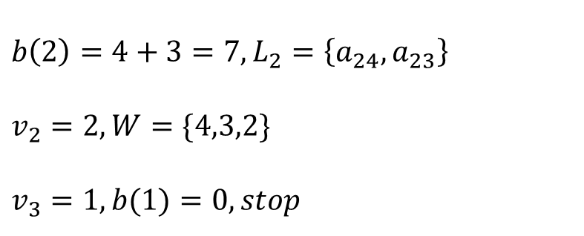
Step 1-1:(Obtaining MA-Ordering from $s^{−}$)
4
$$b(2)=4, L_{2}=\left\{a_{24}\right\}$$
$$b(3)=7, L_{3}=\left\{a_{34}\right\}$$
$$v_{1}=3, W=\{4,3\}$$
0
7
$$2$$
6
4
0
$$1$$
$$4$$
0
3
$$b\left(2\right)=4+3=7,L_{2}=\left\{a_{24}, a_{23}\right\}$$
$$v_{2}=2, W=\{4,3,2\}$$
$$v_{3}=1, b(1)=0, stop$$
4
$$3$$
7
7
0
Notes:
Next step is to obtain MA-ordering from s-,
In this case, node 4 is sink node
We need to find arcs that is reachable to node 4
(點) We select arc(2,4) and arc(3,4)
(點) Then we update b value of node 2 and 3.
Next, we select the maximum value in b, which is 7
So v1 will be node 3, and we put node 3 into set W
Now we need to find arcs that is reachable to node 3
(點) We select arc(2,3)
And update b(2) again
And repeat this process
We will get the maximum order of the capacity of arcs

Slide 18
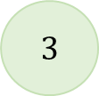

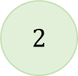
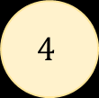
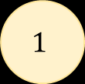
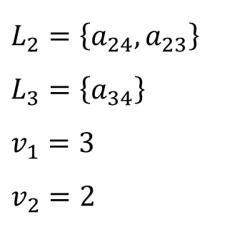
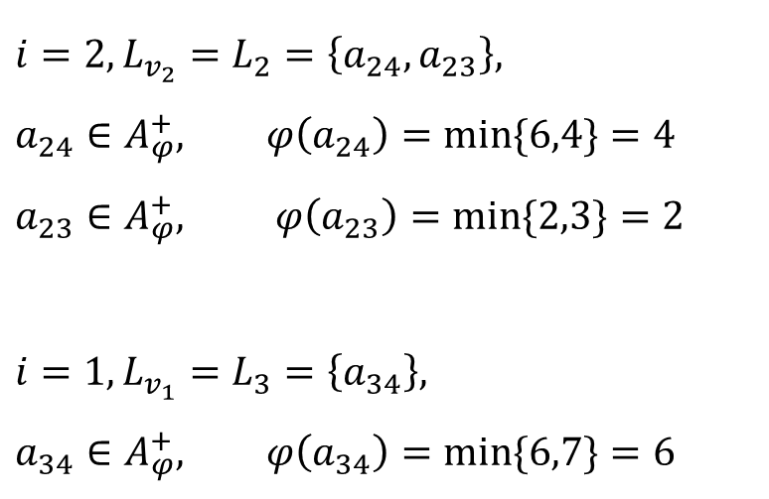
Step 1-2:(Pushing preflows to $s^{−}$)
-2
-6
$$L_{2}=\left\{a_{24}, a_{23}\right\}$$
$$L_{3}=\left\{a_{34}\right\}$$
$$v_{1}=3$$
$$v_{2}=2$$
0
$$i=2, L_{v_{2}}=L_{2}=\left\{a_{24}, a_{23}\right\},$$
$$a_{24}∈A_{φ}^{+}, φ\left(a_{24}\right)=min⁡\{6,4\}=4$$
$$a_{23}∈A_{φ}^{+}, φ\left(a_{23}\right)=min⁡\{2,3\}=2$$
$$i=1, L_{v_{1}}=L_{3}=\left\{a_{34}\right\},$$
$$a_{34}∈A_{φ}^{+}, φ\left(a_{34}\right)=min⁡\{6,7\}=6$$
$$2$$
6/6
4
/4
$$1$$
2
$$4$$
/3
4/4
$$3$$
6
/7
-6
-4
0
Notes:
In step 1-2, we update the flow of each arc
We start from i=2,
Select list L2,
A24 is in A-phi+, so we update flow of arc(2,4) to 4
We also need to update the flow balance function
The flow balance of node 2 turn from -6 to negative 2
And when we finish this process,
the flow balance of every node is 0
So we can move on to step 2

Slide 19
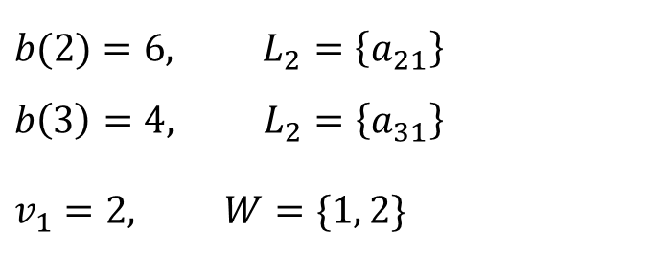

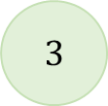

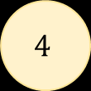

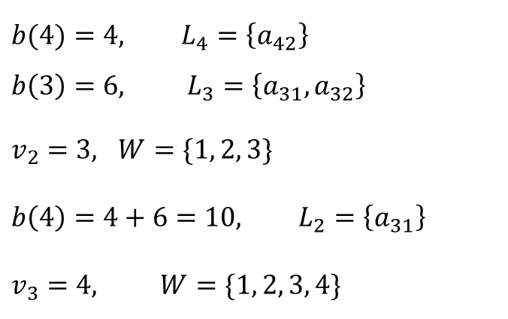
Step 2-1: (Obtaining MA-Ordering from $s^{+}$)
$$b(2)=6, L_{2}=\left\{a_{21}\right\}$$
$$b\left(3\right)=4, L_{2}=\left\{a_{31}\right\}$$
$$v_{1}=2, W=\{1, 2\}$$
$$2$$
6
4
$$1$$
$$4$$
1
2
6
$$b(4)=4, L_{4}=\left\{a_{42}\right\}$$
$$b\left(3\right)=6, L_{3}=\left\{a_{31},a_{32}\right\}$$
$v_{2}=3, W=\{1, 2, 3\}$
$$b\left(4\right)=4+6=10, L_{2}=\left\{a_{31}\right\}$$
$$v_{3}=4, W=\{1, 2, 3, 4\}$$
4
$$3$$
1
Notes:
In step 2, we obtain the MA-ordering from s+
In this case, s+ is node 1
First, we find arc that is reachable to 1,
We select arc(2,1) and arc(3,1)
Then we update b(2) and b(3)
Because the process is same as step 1 , I will skip this part.

Slide 20
Step 2-1: (Obtaining MA-Ordering from $s^{+}$)
0
$$2$$
6/6
4
/4
$$1$$
$$4$$
2
/3
4/4
$$3$$
6
/7
0
Notes:
As we finish step 2-1,
We can see that the flow balance are 0 for all nodes
So this is the maximum flow og this net work
Because I use a very small case to demo
So it doesn’t need to go through step 2-2
But if the network became bigger,
the process will be very complicated

Slide 21
Computational Results
Notes:
In this section we describe computational results on our new version of Fujishige’s algorithm,

Slide 22
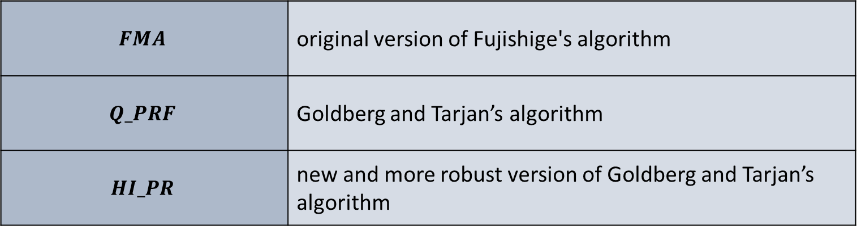
Computational setup
$$FMA$$ | original version of Fujishige's algorithm
$$Q_PRF$$ | Goldberg and Tarjan’s algorithm
$$HI_PR$$ | new and more robust version of Goldberg and Tarjan’s algorithm
Probleminstances
We used six problem families
produced by three generators: GENRMF, WASHINGTON, and AK
Notes:
We compare it with the original version and Goldberg and Tarjan's algorithm.
FMA implements the original version of Fujishige’s algorithm
Q_PRF is Goldberg and Tarjan’s algorithm using a queue to select active vertices
HI-PR is a new and more robust version of Goldberg and Tarjan’s algorithm

Slide 23
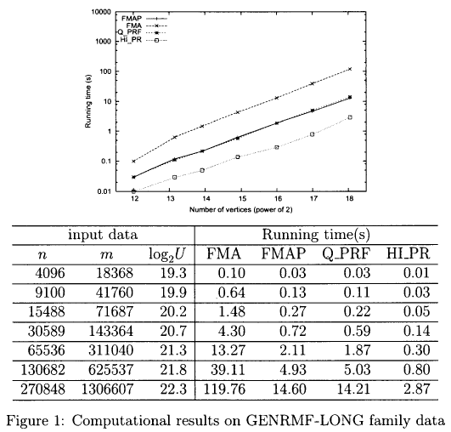
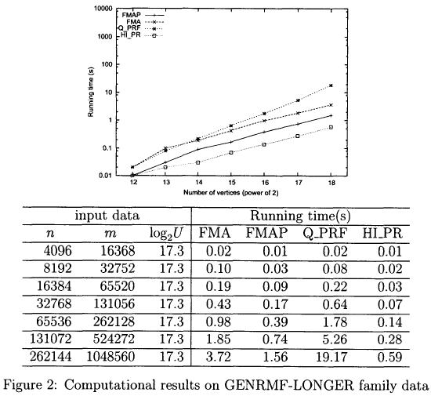
Experiments
GENRMF-LONG
GENRMF-LONGER
Notes:
Figure1 shows The new version is faster than the original version and is almost as fast as Q-PRF.
Figure2 shows Our proposed algorithm is faster than Q-PRF.

Slide 24
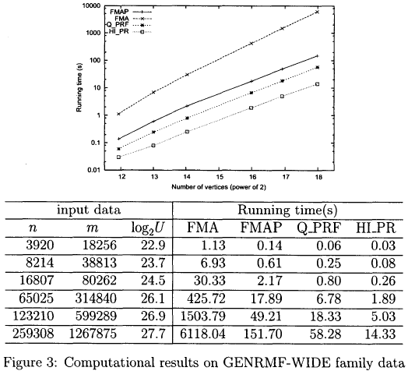
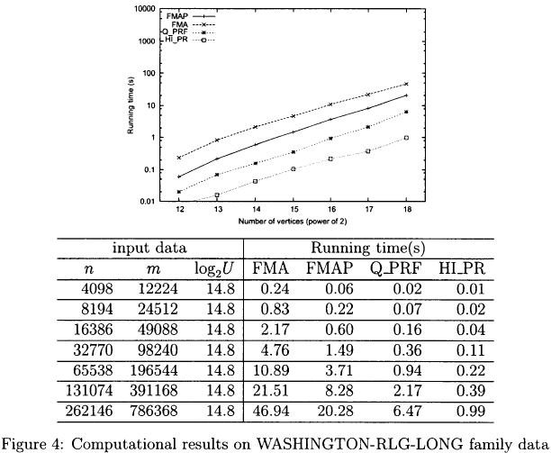
Experiments
GENRMF-WIDE
WASHINGTON-RLG-LONG
Notes:
Figure 3 shows The new version is much faster than the original version.
However it is slower than both codes of Goldbergand Taijan's algorithm.
Figure4 .The new version is slower than both codes of Goldberg and Targan’s algorithm.

Slide 25
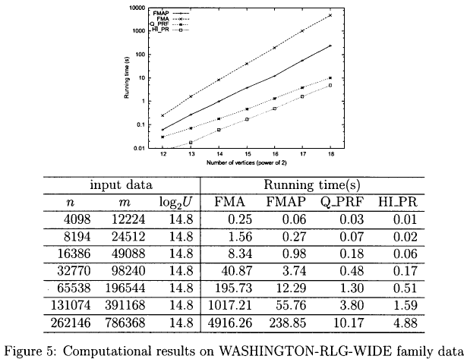
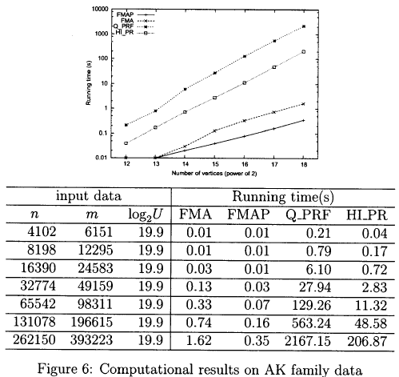
Experiments
WASHINGTON-RLG-WIDE
AK
Notes:
Figure 5 For this family our proposed algorithm performs much better than the original version.
Figure 6 show this special data family our proposed algorithm outperforms the others,

Slide 26
conclusion
This paper presented an improved version of Fujishige’s algorithm using preflows and showed its behavior by giving computational results.
The improved version is faster than the original version for all problem instances of our experiments.

