Slide 1
Application 4.2 – Allocating Inspection Effort on a Production Line
Network Optimization Applications 4.3 by 成大工資管

Slide 2
Introduction
出處:
Leon S. White, Shortest Route Models for the Allocation of Inspection Effort on a Production Line. Management Science 15(5), 249-259.
Network Optimization Applications 4.3 by 成大工資管

Slide 3
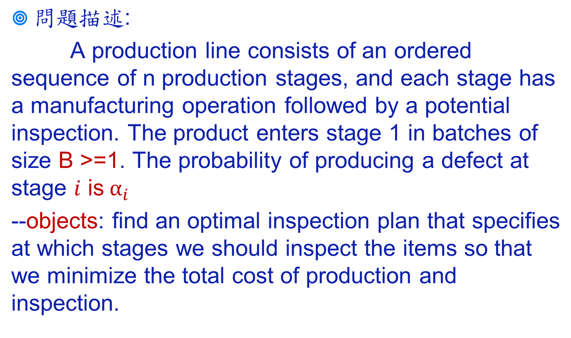
Introduction
Network Optimization Applications 4.3 by 成大工資管

Slide 4
Introduction
問題假設:
  損壞為不可維修
  每個階段結束後只有檢查或是不檢察所有產品(無抽樣)
  生產線結束前需要通過檢查站，以避免蝦疵品流出
Network Optimization Applications 4.3 by 成大工資管

Slide 5
Introduction
Manufacture Operations
B
1
2
3
4
5
Potential Inspection Stations
Network Optimization Applications 4.3 by 成大工資管

Slide 6
Transfer to network problem
0
1
2
3
4
5
Network Optimization Applications 4.3 by 成大工資管

Slide 7
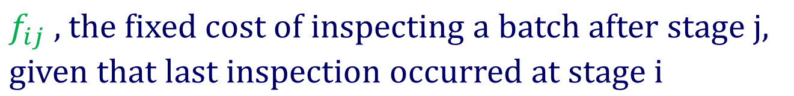
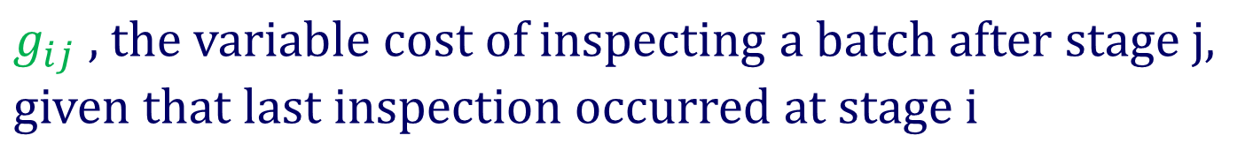

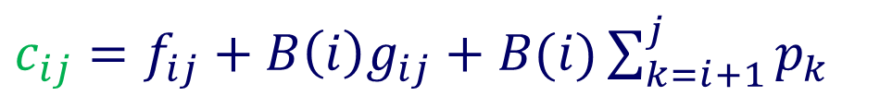
Transfer to network problem
Network Optimization Applications 4.3 by 成大工資管

Slide 8
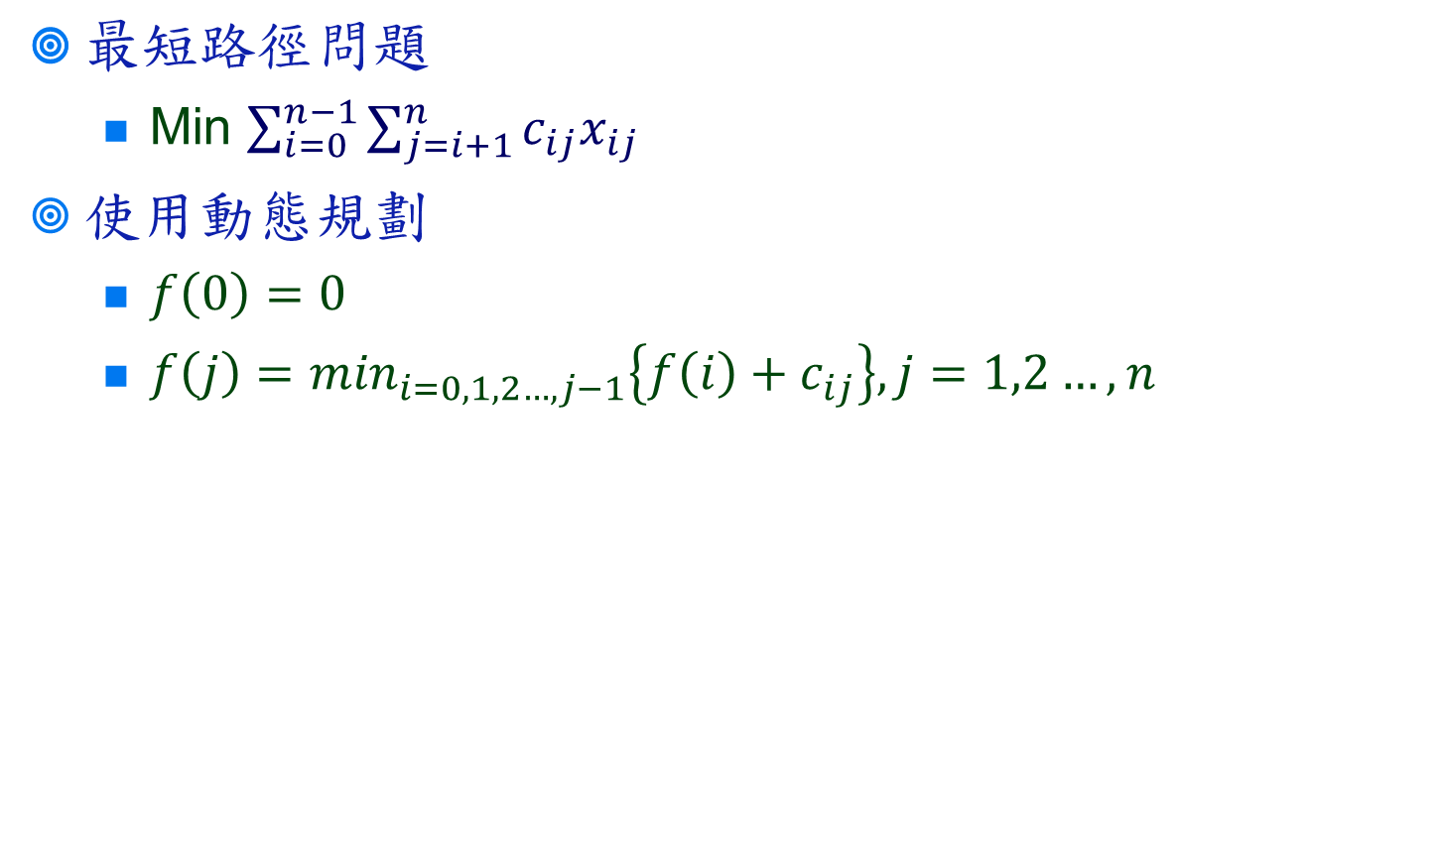
Solution
Network Optimization Applications 4.3 by 成大工資管

