Slide 1
19.02 Selecting Freight Handing Terminals

Slide 2
Introduction
J. M. W. Rhys , ”A Selection Problem of Shared Fixed Costs and Network Flows”
Service
Terminal 1
Terminal 2
Profit 20
1
1
2
2
Cost -8
Cost -6
Satisfy Demand

Slide 3
Introduction
-6
-4
Given
Profit
Cost
Objext
Maximize net profit
2
4
6
4
3
5
1
3
10
-8
-2
Total profit :28
Total cost : -20
Net profit : 8

Slide 4
Related Problem
International Trade Financing Between Countries
Machine/Product Selection
Office
Office
A
Trade financing
B
M1
Products
M2

Slide 5
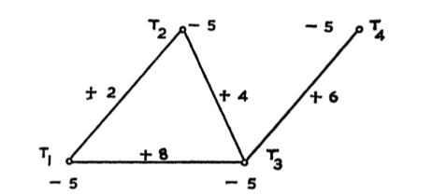
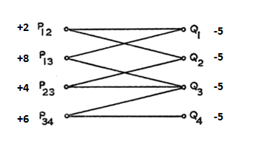
Problem Solving
P implies Q
Profit of arc(I,j)
Cost of terminal
Bipartite Network

Slide 6
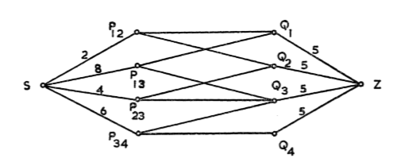
Problem Solving
Add source and sink
{SP} : profit , {QZ} : cost
maximum flow/minimum cut problem

Slide 7
Formulation
: Profit of activity a
: Cost of Node j
The fraction of the activity a in Demand Node that is to be selected
The fraction of facility f in Terminal Node to be selected

Slide 8
Formulation
P implies Q
Xa ≤ 1 implies Xf ≤ 1
Xf ≥ 0 implies Xa ≥ 0

Slide 9
Thanks For Your Listening

