Slide 1
Optimal Destruction of Military Target
Application 19.3
Orlin, D.
Optimal weapons allocation against layered defenses
Naval Res. Logist. 34 605–616. 1987

Slide 2
Index
Title
PENETRATION ALGORITHM (SCHULTIS)
EXHAUSTION ALGORITHM (ORLIN)
Attrition Versus Exhaustion Algorithm
Purpose Math model
Conclusion

Slide 3
Title
The military commander has identified of military targets that he wants to destroy .This model assumes the defense has perfect weapons.
To destroy a target , the military commander must first destroy all the defense sites that protect it. He must destroy defense sites as well as targets.
We solve the problem of optimal allocation of weapons to targets in the presence of layered regional defenses.
Network Optimization Applications 19.03 by 成大工資管

Slide 4
PENETRATION ALGORITHM
These targets are heavily defended by four different layers of defense.
1.FADS : Forward air defense sites
2.BSAM: Band surface to air missiles
3.AI : Airborne interceptors
4.TSAM: Terminal surface to air missiles
5.Military targets
Objective :
1. Maximum the # of target we destroyed.
2. Minimum the # of weapon we used.
Definition:
1.S : the set of military target
2. : the set of defense site
3.D(i) denote the set of defense sites that protect the target i S
4.wi : denote the benefit minus the loss , which is the net value of destroying
the ith target or defense site

Slide 5
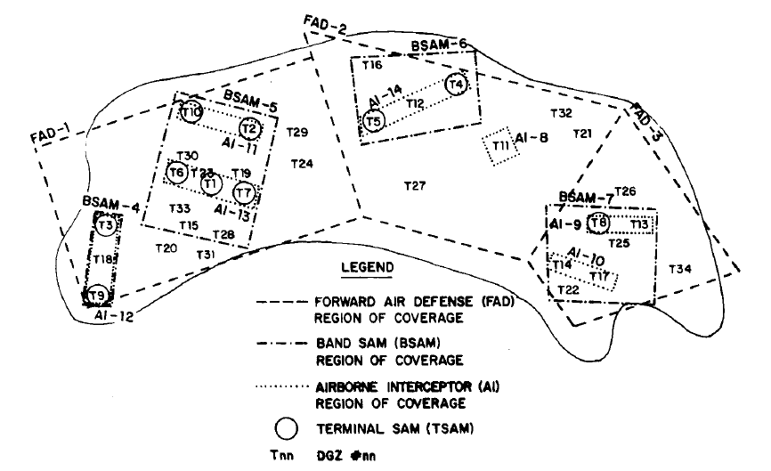
Problem Description
Target
FAD
TSAM
BSAM
AI

Slide 6
Methodology
Network Optimization Applications 19.03 by 成大工資管

Slide 7
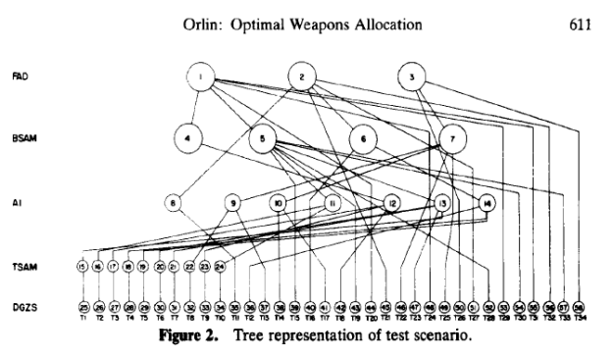
EXHAUSTION ALGORITHM

Slide 8
EXHAUSTION ALGORITHM
Objective : is to maximize the net value , which is the total value extracted from the attack minus cost in weapons for extracting that value
If xi=1 , then defense region i is exhausted;X1=0 otherwise.
To attack BSAM 6 , the offense must first exhaust FAD2.
1. If X2=1 , then X6 can be either 0 or 1.
2. If X2 =0 , X6 is constrained to be 0.
3. 1X6<=1X2 means -1X2+1X6<=0

Slide 9
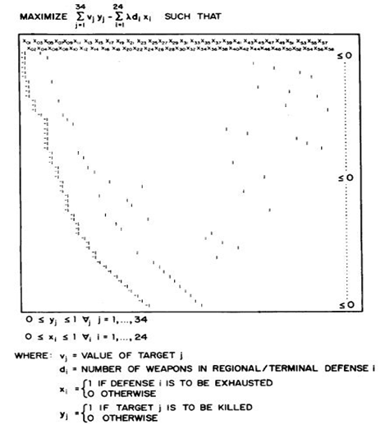
Purpose solution method
list the objective function along with constraints for the sample case.
These linear programs are network-flow problems and have the property that the optimal solution has integer values.

Slide 10
Attrition Versus Exhaustion Algorithm
Network Optimization Applications 19.03 by 成大工資管

Slide 11
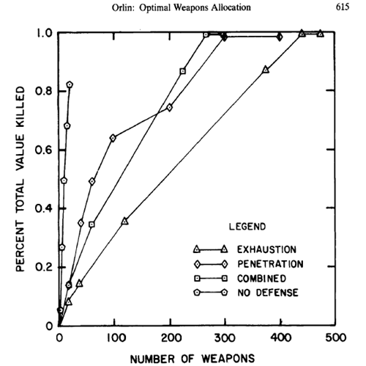
Purpose solution method
Below Figure illustrates the change due to combining techniques.
Given the probability parameters, we find an approximate 40% decrease in the number of weapons needed for a maximum-value attack.

Slide 12
maximum weight closure problem
Layer 1
FADS
Layer 2
BSAM
Layer 3
AI
Layer 4
TSAM
Layer 5
Targets
4
8
11
15
1
16
Missiles
5
12
17
2
9
6
18
13
10
3
19
7
14
Network Optimization Applications 19.03 by 成大工資管

Slide 13

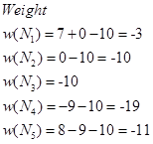
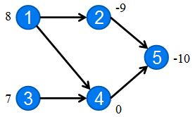
Purpose Math model
To formulate this problem as a maximum weight closure problem , we associate a node I with a weight of wi with the ith target of defense site. Every feasible destruction of targets and defense sites corresponds to a closure of the network
Definition:
1. For each i S
2. An arc(I,j) for every j D(i)
3. A closure of of a directed network G=(N,A) is a subset of nodes without any
outgoing arcs
4. A closure N1 with the largest weight w(N1)= Wi

Slide 14
Conclusion
Every feasible destruction of targets and defense sites corresponds to a closure of the network. Therefore , the military commander’s problem is a maximum weight closure problem.
The user should be aware of the accuracy of the information necessary for calculating attrition. Should defense capabilities be underestimated, a worst-case analysis results in zero value accumulation.

