Slide 1
Optimal Destruction of Military Targets
Related Paper:
Exact and Heuristic Algorithms for the Weapon-Target Assignment Problem
(Author: Ravindra K. Ahuja, Arvind Kumar, Krishna C. Jha, James B. Orlin)

Slide 2
Outline
Introduction – Problem
Mathematical Model
Solution

Slide 3
Introduction
A military commander wants to find the best scheme to destroy the targets.
These targets are heavily defended by four different layers of defense.
1. FADS
forward air defense sites
2. BSAM
band surface to air missiles
3. AI
airborne interceptors
4. TSAM
terminal surface to air missiles
FADS
BSAM
AI
TSAM
target

Slide 4
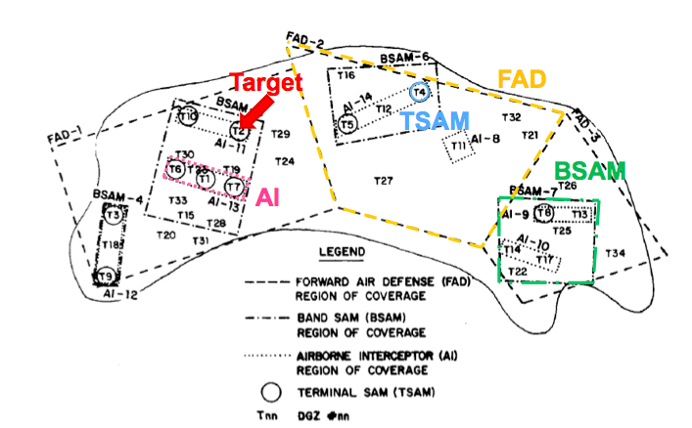

Slide 5
Introduction
Destroy the target or defense site has a certain military benefit but also incurs some loss.
Objective:
Maximum the # of target we destroyed
Definition:
: the set of military targets
: the set of defense sites
: the set of defense sites that protect target or defense site
: the net value of destroying the i th target or defense site. (Benefit minus Loss)

Slide 6
Mathematical Model

Slide 7
Solution
Formulate this problem as Maximum weight closure problem
Definition. Closure
A closure of directed network is a subset of vertices without any outgoing arcs.
In this kind of problem, we want to find the largest weight closure

Slide 8
Maximum weight closure Example
8
-9
1
2
5
-10
3
4
7
0

Slide 9
Layer 1
FADS
Layer 2
BSAM
Layer 3
AI
Layer 4
TSAM
Layer 5
Targets
4
8
11
15
1
16
Missiles
5
12
17
2
9
6
18
13
10
3
19
7
14
Every feasible destruction of targets and defense sites corresponds to a closure of the network.
The best scheme is the closure with the largest weight.

Slide 10
Solution Method
Introduce a source node s and for each node with , we create an arc (s,i) with capacity .
Introduce a sink node t and for each node with , we create an arc (i,t) with capacity .
Set the capacity of every original arc equal to
8
-9
-9
1
2
t
8
5
-10
-10
Maximum Flow Problem
s
3
4
7
7
0

Slide 11
Maximum Flow Problem
Possible Solution :
1. Capacity Scaling Algorithm
2. Generic Preflow-Push Algorithm
3. Highest-Label Preflow-Push Algorithm
4. EdmondsKarp Algorithm

Slide 12

Thank you

