Slide 1
Applications 19.04
Flyaway Kit Problem
Network Optimization Applications 19.04 by 成大工資管

Slide 2
Introduction
Some equipment needs to be repaired and maintained, and the replacement parts are carried to the job by repair crews.
Overstocking increases inventory holding costs, while understocking decreases service efficiency.
Service crews are able to replenish inventory between jobs; however, there will be a high cost if a given job could not be completed due to unavailable parts.
We want to determine the appropriate collection of parts to be carried to make total cost minimum.
Network Optimization Applications 19.04 by 成大工資管

Slide 3
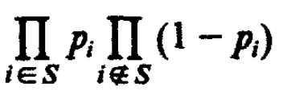
Problem Formulation
n : number of possible parts
N : number of jobs per year
p_{i} : the fraction of jobs that require part i
L : penalty for a broken job
H_{i} : inventory cost when part i is carried
P {parts S and no other parts are required for a given job} =
Network Optimization Applications 19.04 by 成大工資管

Slide 4
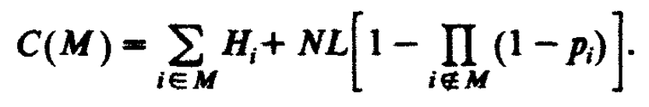
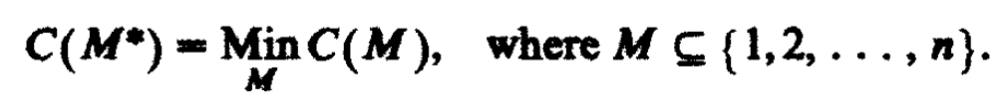
Problem Formulation
The expected cost with the set of indices M
Therefore optimal policy M*
Network Optimization Applications 19.04 by 成大工資管

Slide 5

Solution
Renumber the parts so that they are ranked by the ratios of holding cost to usage frequency (the order of the most preferred to the least preferred part)
Network Optimization Applications 19.04 by 成大工資管

Slide 6
Solution
Then one of the following n+1 policies is optimal
Complexity: O(n+1)
Network Optimization Applications 19.04 by 成大工資管

Slide 7
Proof
If there is a minimum cost policy M' that is not one of the M_{k} policies, then there must exist m, with 1≤m≤n-1, such that m∉M', but m+1∈M'.
Since M' is cost optimal, neither part m is added to M' nor part m+1 is removed from M' decreases the cost.
Network Optimization Applications 19.04 by 成大工資管

Slide 8
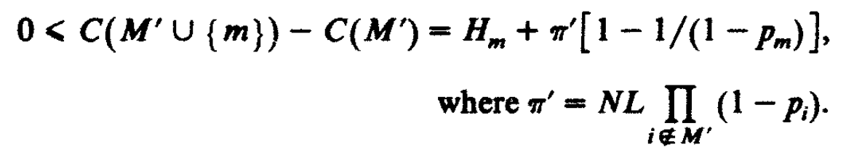

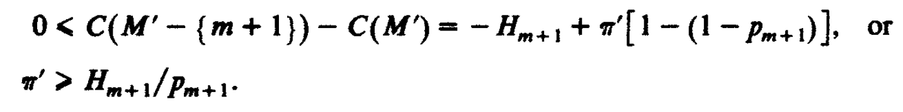

Proof
Network Optimization Applications 19.04 by 成大工資管

Slide 9
References
Smith, SA, Chambers, JC, & Shlifer, E 1980, 'OPTIMAL INVENTORIES BASED ON JOB COMPLETION RATE FOR REPAIRS REQUIRING MULTIPLE ITEMS', Management Science, vol. 26, no. 8, pp. 849-852.
Network Optimization Applications 19.04 by 成大工資管

