Slide 1
Application19.5 Asymmetric Data Scaling with Lower and Upper Bounds

Slide 2
Content
Introduction
Data scaling
Min-max-ratio Asymmetric Data Scaling
Solution methods

Slide 3
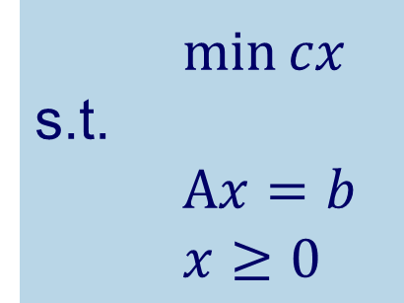
Introduction
Data Scaling
Linear programming problem
Matrix data
Desired objective
$\min{cx}$
s.t.
$Αx=b$
$x≥0$
Problem !
Round-off error
small
A = {a_{ij}}
Elements are close as possible to each other!
relative sizes of the numbers
↓
Simplex method
Round-off error small

Slide 4

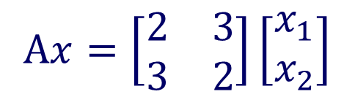
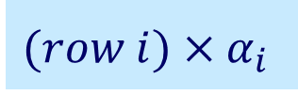


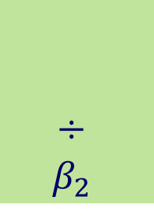

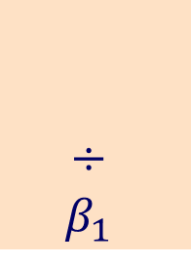

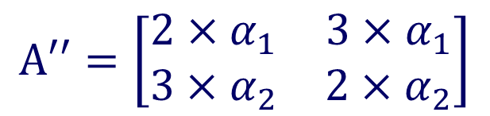
Introduction
Data Scaling
$$Αx=\left[\begin{matrix}2 & 3 \\ 3 & 2\end{matrix}\right]\left[\begin{matrix}x_{1} \\ x_{2}\end{matrix}\right]$$
$$Α′=\left[\begin{matrix}2 & 3 \\ 3 & 2\end{matrix}\right]$$
Doesn’t affect
the feasible solution
$$(row i)×α_{i}$$
$$×α_{1}$$
$$×α_{2}$$
$$Α′′=\left[\begin{matrix}2×α_{1} & 3×α_{1} \\ 3×α_{2} & 2×α_{2}\end{matrix}\right]$$
$$÷$$
$$β_{1}$$
$$÷$$
$$β_{2}$$
$$(colum j)÷β_{j}$$
$$x_{j}′= x_{j}β_{j}$$
A = {a_{ij}}
Elements are close as possible to each other!

Slide 5
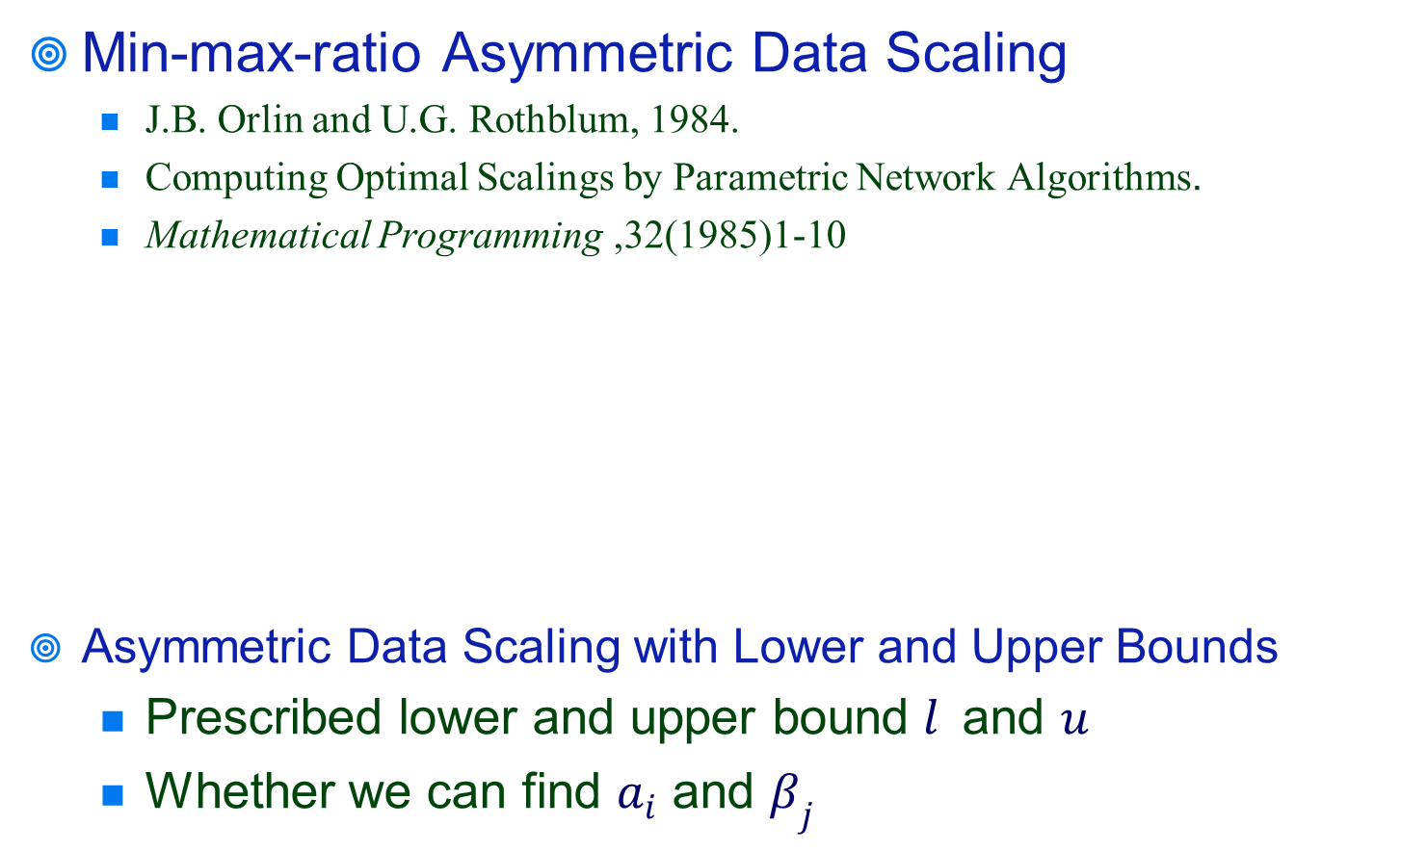

Introduction
Min-max-ratio Asymmetric Data Scaling
J.B. Orlin and U.G. Rothblum, 1984.
Computing Optimal Scalings by Parametric Network Algorithms.
Mathematical Programming ,32(1985)1-10
Asymmetric Data Scaling with Lower and Upper Bounds
Prescribed lower and upper bound $l$ and $u$
Whether we can find $a_{i}$ and $β_{j}$
$\min{u/l}$
s.t.
$$l≤ a_{i}\frac{\left|a_{ij}\right|}{β_{j}} ≤u$$

Slide 6
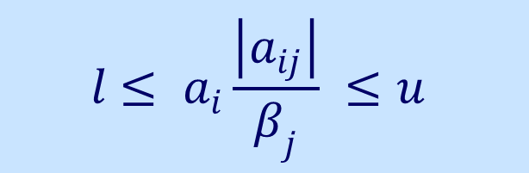

Solution method
$$l≤ a_{i}\frac{\left|a_{ij}\right|}{β_{j}} ≤u$$
Take the logarithms of both sides
$$\log{l }≤\log{a_{i} }+\log\left|a_{ij}\right|−\log{β_{j}} ≤\log{u}$$
New notation

Slide 7

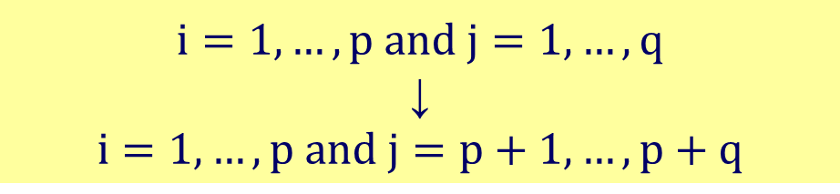


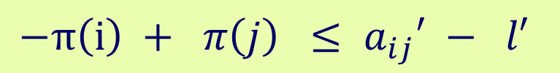

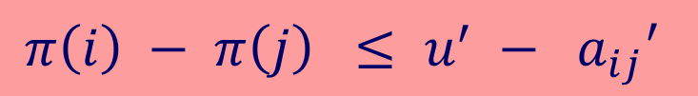
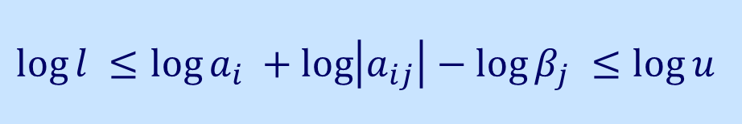

Solution method
New notation
$$i=1,…,p and j=1,…, q$$
↓
$$i=1,…,p and j=p+1,…, p+q$$
$$\log{l }≤\log{a_{i} }+\log\left|a_{ij}\right|−\log{β_{j}} ≤\log{u}$$
$${l }^{′}$$
$$π\left(i\right)$$
$${a_{ij}}^{′}$$
$$π\left(j\right)$$
$$u^{′}$$
$$−π\left(i\right) + π\left(j\right) ≤ a_{ij}′ − l′$$
$$π\left(i\right) − π\left(j\right) ≤ u^{′} − a_{ij}′$$

Slide 8
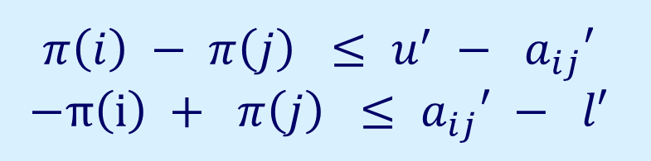

Solution method
$$π\left(i\right) − π\left(j\right) ≤ u^{′} − a_{ij}′$$
$$−π\left(i\right) + π\left(j\right) ≤ a_{ij}′ − l′$$
Identifying whether some vector $π$ satisfies the inequlities
Data Scaling

Slide 9

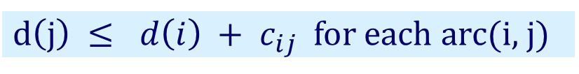
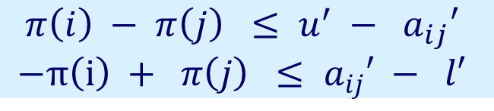


Solution method
Matrix A → complete bipartite network
$G = ( N_{1}∪N_{2} , A )$
${c_{ij}=u}^{′} − a_{ij}^{′} for arc (i, j)∈ N_{1}×N_{2}$
$c_{ji}=a_{ij}^{′}− l^{′} for arc (j, i) ∈ N_{2}×N_{1}$
let$d\left(j\right)=−π\left(j\right) for each j$
1
p+1
2
p+2
$$π\left(i\right) − π\left(j\right) ≤ u^{′} − a_{ij}′$$
$$−π\left(i\right) + π\left(j\right) ≤ a_{ij}′ − l′$$
……
……
$$c_{ij}$$
i
p+i
$d\left(j\right) ≤ d\left(i\right) + c_{ij}$ for each arc(i, j)
…
$$c_{ji}$$
…
Optimality condition of a shortest path problem!
p
p+q
N₁
N₂
Notes:
N₁ = {1, … , p}
N₂ = {p + 1, … , p + q}

Slide 10
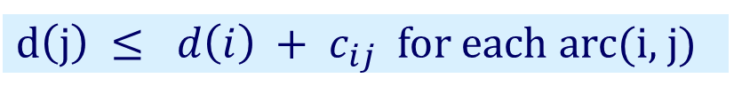
Solution method
No negative cycle →has a feasible solution
$d\left(j\right) ≤ d\left(i\right) + c_{ij}$ for each arc(i, j)
Optimality condition of a shortest path problem!
1
p+1
2
p+2
Using the negative cycle detection algorithm
→O(nm)
……
……
$$c_{ij}$$
i
p+i
…
$$c_{ji}$$
…
p
p+q
N₁
N₂
Notes:
N₁ = {1, … , p}
N₂ = {p + 1, … , p + q}

Slide 11
Thanks for your listening!!!
Q&A

