Slide 1
Application19.6
Minimum Ratio Asymmetric Data Scaling
Network Optimization Applications 19.6 by 成大工資管

Slide 2
Content
Introduction
  Data scaling
  Minimum Ratio Asymmetric Data Scaling
Related problems
Solution methods
Network Optimization Applications 19.6 by 成大工資管

Slide 3
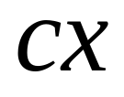
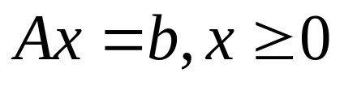
Introduction
Data scaling
objective Minimize
subject to
We incur round-off errors, because computers perform in floating-point arithmetic.
A={aij}has elements that are as close as possible
Network Optimization Applications 19.6 by 成大工資管

Slide 4
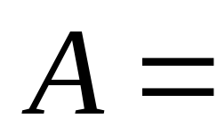
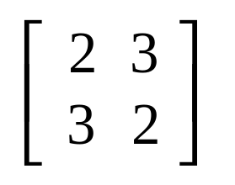
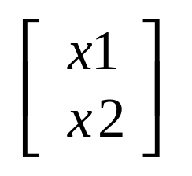
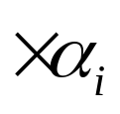
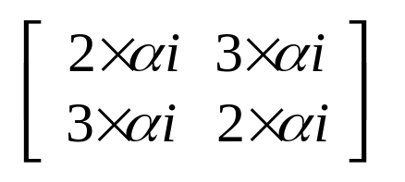
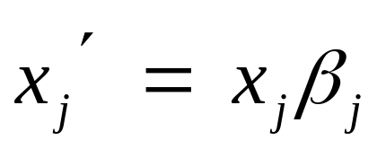

Introduction
Data scaling
Network Optimization Applications 19.6 by 成大工資管

Slide 5


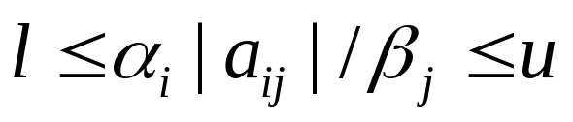
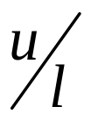
Introduction
Minimum Ratio Asymmetric Data Scaling
Identify lower and upper bounds of aij, row multipliers
and column divisors
With the smallest possible ratio solve this data scaling problems by solving a minimum mean cycle problem
Network Optimization Applications 19.6 by 成大工資管

Slide 6
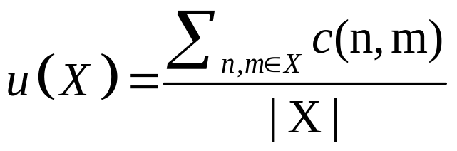
Related problem
minimum mean cycle problem
Given a strongly connected graph G = (n; m) , with edge weights c
Let |X| be the number of edges on the cycle
For any cycle X, the mean value of X is defined by
_x000f_
Network Optimization Applications 19.6 by 成大工資管

Slide 7
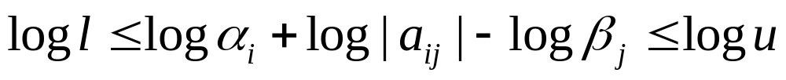
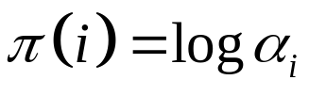
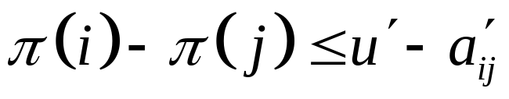
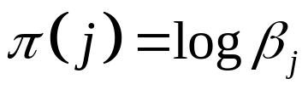

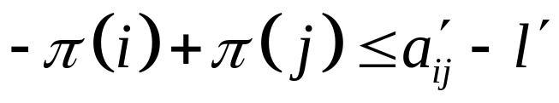
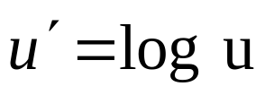
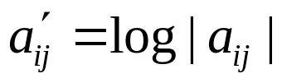
Solution methods
Take the logarithms of both sides
Let
Network Optimization Applications 19.6 by 成大工資管

Slide 8
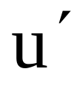
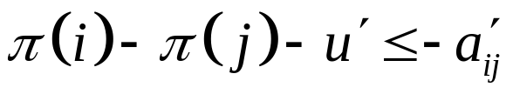
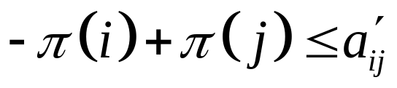




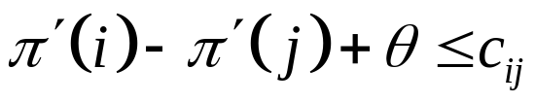
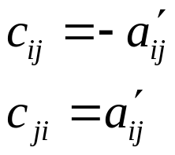
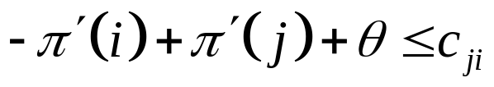
Solution methods
Minimum Ratio Asymmetric Data Scaling
Minimize
Subject to
To simplify, we redefine the variables.
Minimum
Subject to
Network Optimization Applications 19.6 by 成大工資管

Slide 9
Thanks for your listening!!!
Q&A
Network Optimization Applications 19.6 by 成大工資管

