Slide 1
Automatic Karyotyping of Chromosomes
Tso, M., P. Kleinschmidt, I. Mitterreiter and J. Graham.
An efficient transportation algorithm for automatic chromosome karyotyping.
Pattern Recognition Letters 12 (2), 117-126. 1991.

Slide 2
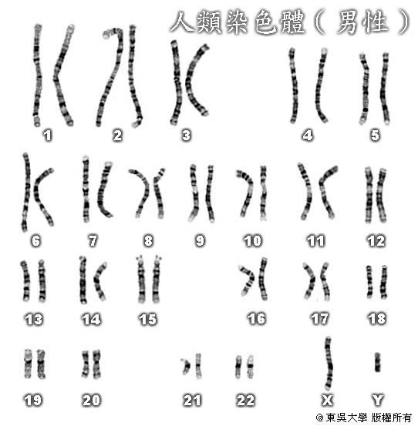
Introduction
Karyotyping (染色體核型分析)
A normal human cell has 46 chromosomes, usually subdivided into 23 groups.
To form a karyotype of the 46 chromosomes in a normal human cell, they are stained to exhibit a series of bands along their length.
Each group contains two identical
chromosomes, with the exception
of sex chromosomes groups X and Y.
Sex chromosomes groups
Female has XX
Male has XY

Slide 3
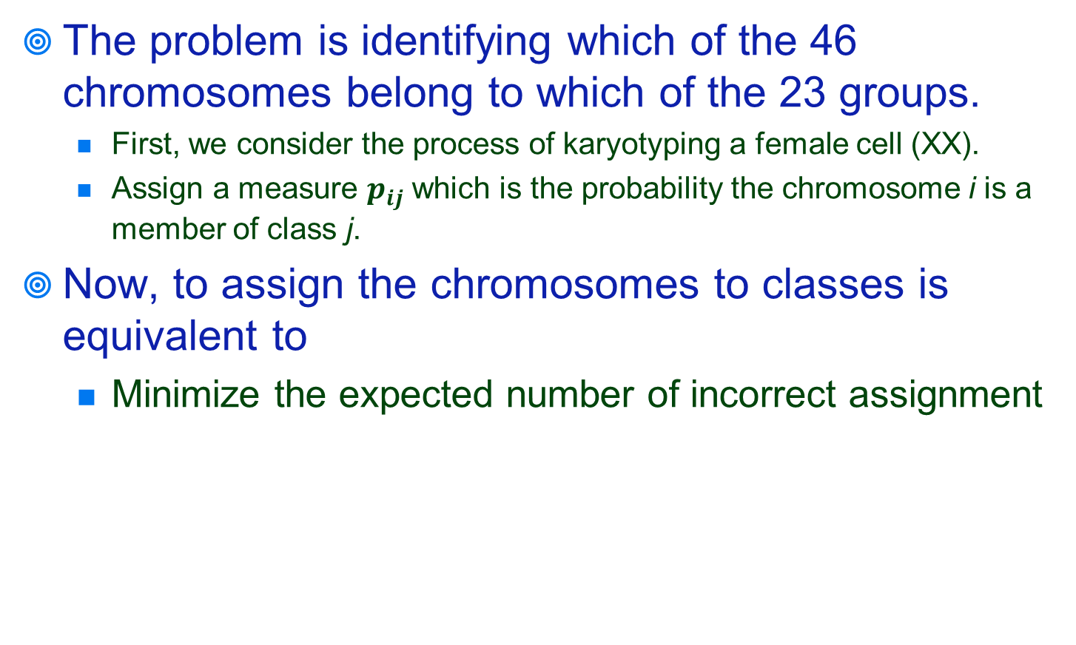
Introduction
The problem is identifying which of the 46 chromosomes belong to which of the 23 groups.
First, we consider the process of karyotyping a female cell (XX).
Assign a measure $p_{ij}$ which is the probability the chromosome i is a member of class j.
Now, to assign the chromosomes to classes is equivalent to
Minimize the expected number of incorrect assignment

Slide 4
Mathematical Formulation
Objective
Constraint
Each chromosome is assigned once only.
Precisely two chromosomes are assigned to each group.

Slide 5
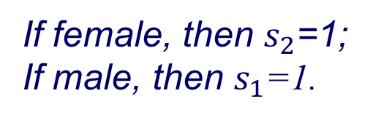
Now, we consider the process of karyotyping a male cell (XY).
Add a dummy chromosome 47.
Add a dummy group 24 which represent Y group.
Define the additional binary variables
Add two additional constraints
If female, then $s_{2}$=1;
If male, then $s_{1}$=1.

Slide 6
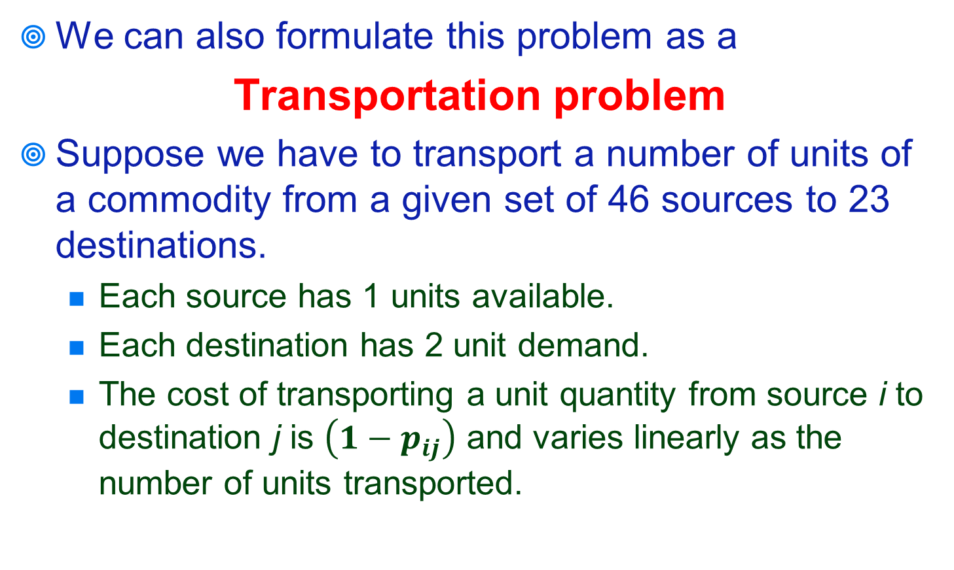
Transformation
We can also formulate this problem as a
Transportation problem
Suppose we have to transport a number of units of a commodity from a given set of 46 sources to 23 destinations.
Each source has 1 units available.
Each destination has 2 unit demand.
The cost of transporting a unit quantity from source i to destination j is $\left(1−p_{ij}\right)$ and varies linearly as the number of units transported.

Slide 7

Transportation problem
Chromosome
Group
$cost=\left(1−p_{ij}\right)$
1
1
1
-2
1
2
2
-2
1
3
3
-2
1
4
4
-2
1
5
…...
…...
23
-2
1
46

Slide 8
Solution Method
Network Simplex Method
Capacity Scaling Algorithm

