Slide 1
19.10 Just-in-time Scheduling
E.V. Levner, A.S. Nemirovsky, 1994, A network flow algorithm for
just-in-time project scheduling, European Journal of Operational
Research, 79, pp. 167-175

Slide 2
Introduction
To eliminate the waste of just-in-time scheduling
Related problem: project management, schedule
Notes:
及時制度（JIT）的想法很簡單：庫存是資源浪費。
讓正確的物資，在正確的時間，流動到正確的地方，數量是剛剛好的數量。

Slide 3

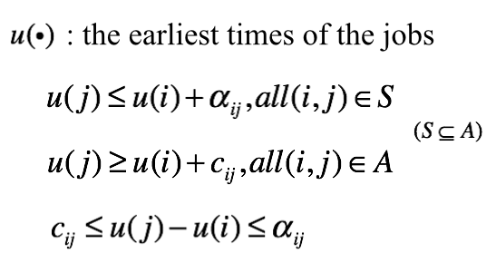
i
j

Slide 4
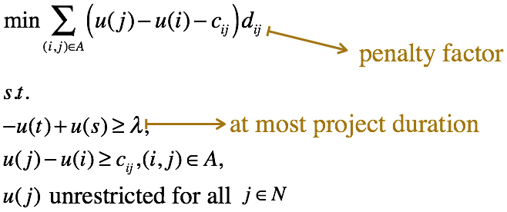
Transform to LP model
1
2
s
t
3
4

Slide 5
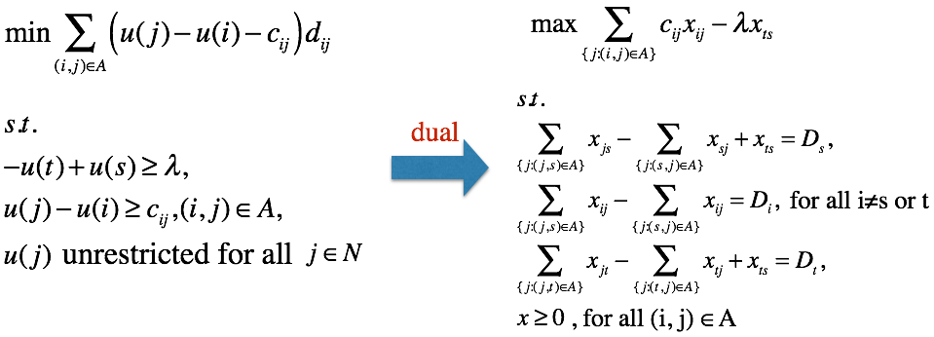
Transform to LP model

Slide 6
Thanks for listening

