Slide 1
Time-Cost Trade-off in Project Management
Network Optimization Applications 19.11 by 成大工資管

Slide 2
Introduction
Project Scheduling Problems
1
3
Node : job i
1 precedes 3,4
2 precedes 4
3,4 precede 5
Duration : λ
5
2
4
α
λ
Time-Cost trade-off curve of job i
ai : Normal Completion Time
di
Cost
bi : Crash Completion Time
di : Cost ($/Sortening job duration)
bi
ai
Time
Network Optimization Applications 19.11 by 成大工資管

Slide 3
Introduction
Given
  Cost ($/shorten the job duration)
  Project Completion Time (λ)
  Normal Completion Time (ai)
  Crash Completion Time (bi)
Decision
  Start Time of job i
  Reduction in Time required to complete job i
Object
  Minimize Cost to reduce project duration(λ) by reducing job durations
Network Optimization Applications 19.11 by 成大工資管

Slide 4
Related Problem/Literature
D.R.Fulkerson ,”A network Flow Computation for project cost curves”
1
3
3
1
5
5
2
2
4
4
Dummy job
Completion Time : 0
Cost : 0
Arc : jobs
Node : events in time
“beginning” , “terminal”
Network Optimization Applications 19.11 by 成大工資管

Slide 5
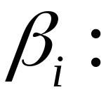


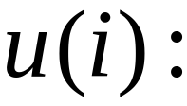
Decision Variables
The reduction in time required to complete job i
di
Cost
bi
ai
Time
The start time of job i
Network Optimization Applications 19.11 by 成大工資管

Slide 6

Constraints
(1)
s
1
2
．．．
t
Start
End
(2)
Time to Complete job i
a – b = 2 Days
1
2
u(1) = Day 3
u(2) >= Day 5
Network Optimization Applications 19.11 by 成大工資管

Slide 7
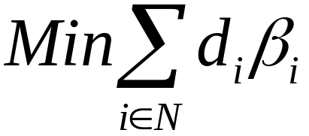



Formulation
(0)
(1)
(2)
(3)
Network Optimization Applications 19.11 by 成大工資管

Slide 8

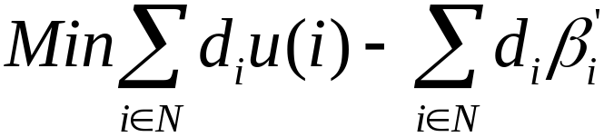
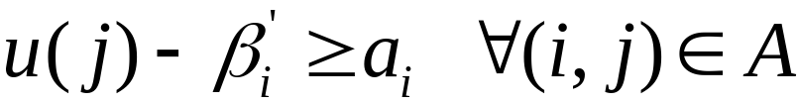
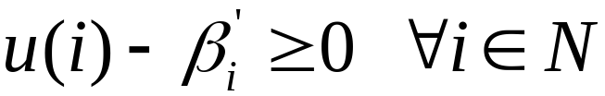
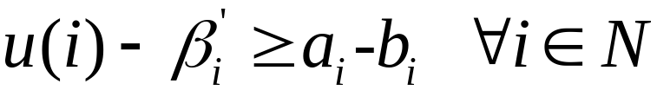
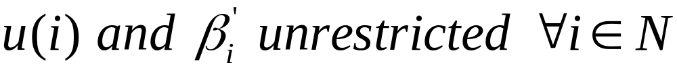
Solving Method
Dual of a Min Cost Flow Problem
Each row/column has at most +1 and -1
Theorem 9.9(p.315)
Obtain an optimal solution
using Min Cost Flow Algorithm
Network Optimization Applications 19.11 by 成大工資管

Slide 9
Thanks for Listening
Network Optimization Applications 19.11 by 成大工資管

