Slide 1
Application19.6
Discrete Location Problems
Network Optimization Applications 19.16 by 成大工資管

Slide 2
Content
Introduction
Related problems
Solution methods
Network Optimization Applications 19.6 by 成大工資管

Slide 3
Introduction
Problem description:
Objective:
cost
distance
distance
Assign each new facility to an available site, to minimize the total cost of transportation
Network Optimization Applications 19.16 by 成大工資管

Slide 4
Introduction
Notation:
p = number of new facilities
q = number of available sites
r = number of existing facilities
dkj = distance between existing
facility k and site j
Wik = the total transportation cost
per unit distance, between new
facility i and existing facility k
1
1
2
3
.…..
1
2
r
4
.…..
q
5
p
2
Network Optimization Applications 19.16 by 成大工資管

Slide 5
Related problems
Megiddo, Nimrod; Tamir, Arie (1982), "On the complexity of locating linear facilities in the plane", Operations Research Letters 1 (5): 194–197.
consider the computational complexity of linear facility location problems in the plane, given n demand points, one wishes to find r lines so as to minimize a certain objective-function reflecting the need of the points to be close to the lines.
Network Optimization Applications 19.22 by 成大工資管

Slide 6
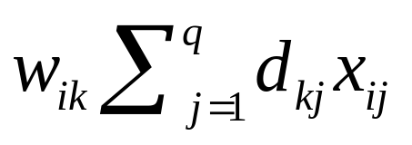
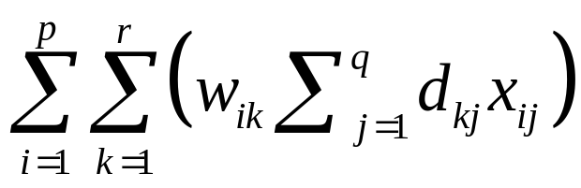
Solution methods
binary variable xij:
to assign each new facility i to an available site j
Cost of transportation:
Total transportation cost:
Network Optimization Applications 19.16 by 成大工資管

Slide 7
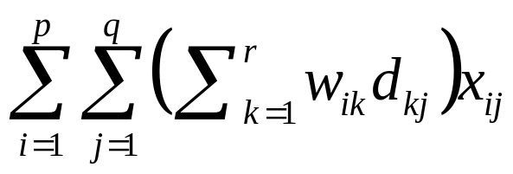
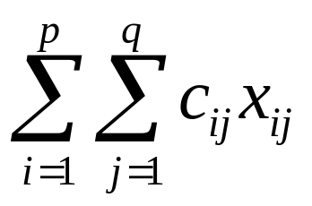
Solution methods
Total transportation cost:
Network Optimization Applications 19.16 by 成大工資管

Slide 8
Thanks for your listening!!!
Q&A
Network Optimization Applications 19.22 by 成大工資管

