Slide 1
Application 19.17-
Warehouse Layout
Network Optimization Applications 19.17 by 成大工資管

Slide 2
Agenda
Reference
Problem Description
Transfer to network problem
Network Optimization Applications 19.17 by 成大工資管

Slide 3
Reference
Facility layout and location: an analytical approach, R. L. Francis, John A. White, Prentice-Hall, 1974
Network Optimization Applications 19.17 by 成大工資管

Slide 4

Problem Description
A warehouse typically is configured with docks for loading and unloading goods and with open areas (or bins) for storing the goods.
The operating staff must decide where to locate each of the goods to lower the transporting cost.
The warehouse layout problem is to determine the region(s) for storing each of the p items that will minimize the total transportation cost between the items and the docks.
Network Optimization Applications 19.17 by 成大工資管

Slide 5


Problem Description
Warehouse
1 | 2 | 3 | 4 | 5
6 | 7 | 8 | 9 | 10
11 | 12 | 13 | 14 | 15
16 | 17 | 18 | 19 | 20
21 | 22 | 23 | 24 | 25
D1
D3
1
2
3
4
D2
5
Network Optimization Applications 19.17 by 成大工資管

Slide 6
Problem Description
Assumptions
  Each item is equally likely to be loaded and unloaded from each dock.
  The space occupied by an item should be equal to the space required for storing the item.
  In a particular storage area we can store only one item.
Network Optimization Applications 19.17 by 成大工資管

Slide 7
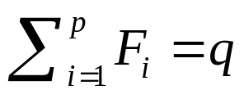
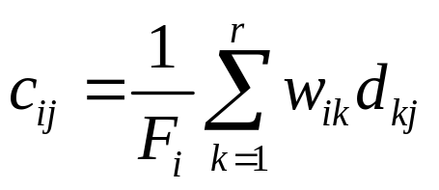
Transfer to network problem
p items ; r docks
The warehouse is subdivided into q grid squares of equal size, numbered from 1 to q.
Let Fi be the total number of grids required to store item i. For simplicity, assume that
Let d_{kj} be the distance between dock k and the center of grid j.
Let w_{ik} be the total cost per foot incurred in transporting item i to dock k and its storage region.
Average cost c_{ij} for loading item i in grid j is:
Network Optimization Applications 19.17 by 成大工資管

Slide 8
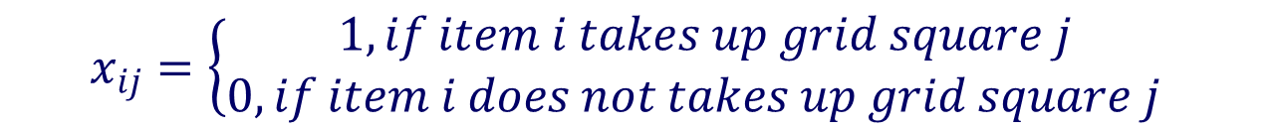
Transfer to network problem
Convert the warehouse layout problem to standard transportation problem by defining the variable x_{ij} .
For all i=1,2,…,p and j=1,2,…,q, as follows:
Network Optimization Applications 19.17 by 成大工資管

Slide 9

Transfer to network problem
Warehouse
1 | 2 | 3 | 4 | 5
6 | 7 | 8 | 9 | 10
11 | 12 | 13 | 14 | 15
16 | 17 | 18 | 19 | 20
21 | 22 | 23 | 24 | 25
D1
1
D3
2
3
4
5
D2
Network Optimization Applications 19.17 by 成大工資管

Slide 10
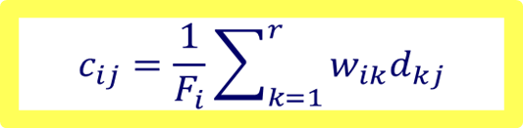
Transfer to network problem
Warehouse
1 | 2 | 3 | 4 | 5
6 | 7 | 8 | 9 | 10
11 | 12 | 13 | 14 | 15
16 | 17 | 18 | 19 | 20
21 | 22 | 23 | 24 | 25
w₁₁d₁₇
1
w₁₃d₃₇
D1
D3
2
3
4
w₁₂d₂₇
5
D2
Network Optimization Applications 19.17 by 成大工資管

Slide 11
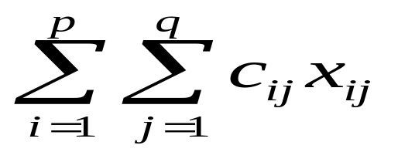
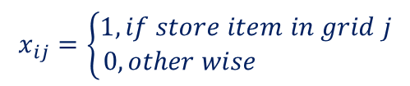
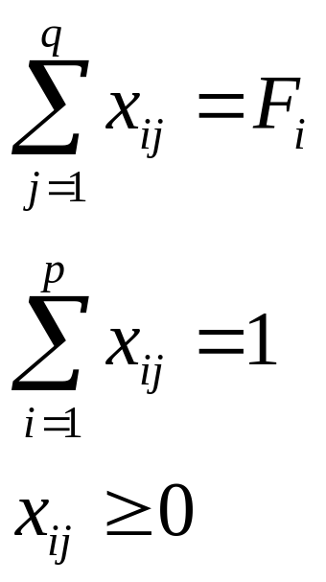
Transfer to network problem
The warehouse layout problem becomes
Minimize
Subject to
for i = 1, . . .,p
for j = 1, . . .,q
for all i = 1, . . .,p , for j = 1, . . .,q
Network Optimization Applications 19.17 by 成大工資管

Slide 12


















Transfer to network problem
Objective : Minimize the transportation cost
p items
q grids
c₁₁
F1=4
1
1
-1
c₂₁
c₁₂
F2=8
c₂₂
-1
2
2
c_{p1}
-1
F3=6
c_{2q}
-1
c_{p2}
c_{1q}
-1
F4=4
F5=3
p
c_{pq}
q
-1
ex. p = 5
ex. q = 25

Slide 13
Q&A
Network Optimization Applications 19.17 by 成大工資管

Slide 14


c₄₄
c₃₃
N5,5
c₂₂
N4,4
N3,3
c₄₄
c₁₁
c₃₃
N5,6
N2,2
N4,5
c₅₅
c₂₂
c₄₄
N3,4
c₃₃
c₁₁
N2,3
c₂₂
N1,1
c₁₁
N5,25
N4,25
N3,25
N2,25
N1,2
24 arcs/ each node
s
23 arcs/ each node
21 arcs/ each node
t
22 arcs/ each node
c_{1,25}
N2,1
N1,25
c_{1,25}
N2,3
25 nodes
N3,1
c_{1,25}
c_{2,24}
N4,1
c_{3,25}
N2,24
N3,2
c_{2,24}
N5,1
N4,2
c_{3,25}
c_{4,22}
c_{2,24}
N5,2
N3,23
c_{3,25}
c_{4,22}
c_{5,21}
N4,22
c_{4,22}
N5,21

