Slide 1
Application 19.17-warehouse layout
Network Optimization Applications 19.17 by 成大工資管

Slide 2
Introduction
Reference:
  Facility layout and location: an analytical approach,
  R. L. Francis, John A. White, Prentice-Hall, 1974
Network Optimization Applications 19.17 by 成大工資管

Slide 3
Introduction
問題描述:
  A warehouse typically is configured with docks for loading and unloading goods and with open areas for storing the goods. The staff must decide where to locate each of the goods to minimize the cost of transferring, unloading or loading goods between docks and storage areas.
Network Optimization Applications 19.17 by 成大工資管

Slide 4
Introduction
問題描述:
warehouse
1
5
3
D1
2
D3
4
D2
Network Optimization Applications 19.17 by 成大工資管

Slide 5
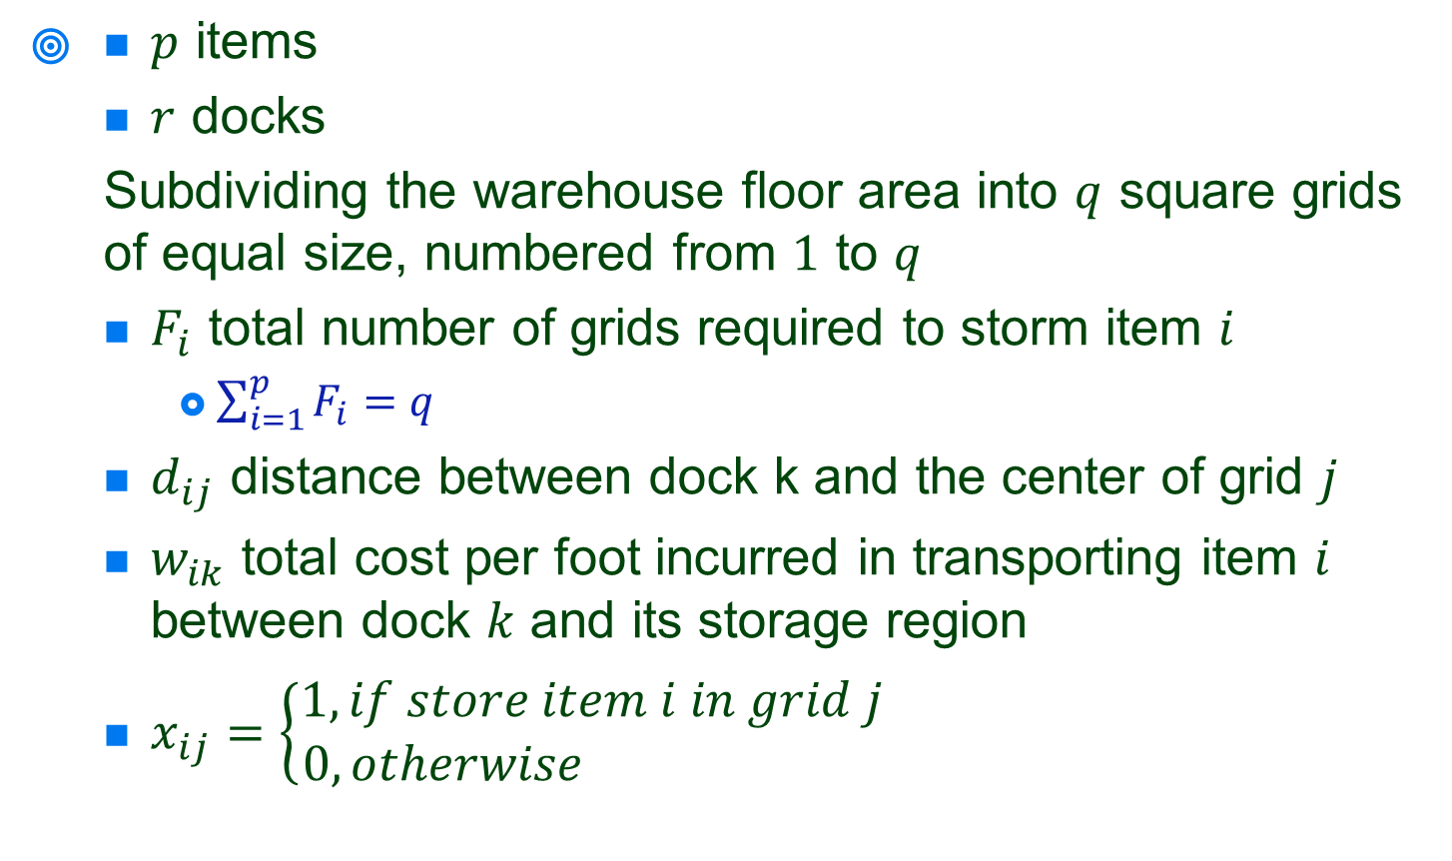
Transfer to network
Network Optimization Applications 19.17 by 成大工資管

Slide 6
Transfer to network problem
Assumption
  Each item is equally likely to be loaded and unloaded from each dock
  The space occupied by an item should be equal to the space required for storing the item.
  In a particular storage area we can store only one item
Network Optimization Applications 19.17 by 成大工資管

Slide 7

Transfer to network problem
1 | 2 | 3 | 4 | 5
6 | 7 | 8 | 9 | 10
11 | 12 | 13 | 14 | 15
16 | 17 | 18 | 19 | 20
21 | 22 | 23 | 24 | 25
D1
D2
D2
Network Optimization Applications 19.17 by 成大工資管

Slide 8



Transfer to network problem
1
 |  | 8
 | 17 |  | 19
D1
D2
D2
Network Optimization Applications 19.17 by 成大工資管

Slide 9
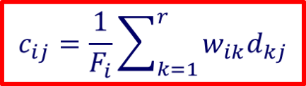
Transfer to network problem
1
 |  | 8
 | 17 |  | 19
D1
D2
D2
Network Optimization Applications 19.17 by 成大工資管

Slide 10
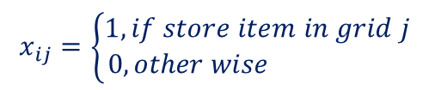
Transfer to network problem
Transportation problem
item
grid
1
1
2
2
3
3
p
q
Network Optimization Applications 19.17 by 成大工資管

Slide 11

Solution
Network Optimization Applications 19.17 by 成大工資管

