Slide 1
Applications 19.19
Dynamic Lot Sizing
Network Optimization Applications 19.19 by 成大工資管

Slide 2
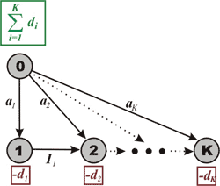
Introduction
Given some periods of time, each period has an amount demanded, interest charge for carrying inventory to the next period and an setup cost.
The amount demanded must be satisfied, and the initial inventory and final inventory should be zero.
Choose when to produce to minimize total cost.
Network Optimization Applications 19.19 by 成大工資管

Slide 3
Problem Formulation
In the t-th period
d_{t} : amount demanded
i_{t} : interest charge per unit of inventory carried forward to period t+1
s_{t} : setup cost
x_{t} : amount produced
I : the inventory entering the period
The problem is to find a program x_{t}≥0, t = 1,_x0006_ 2,..., N, such that all demands are met at a minimum total cost.
Network Optimization Applications 19.19 by 成大工資管

Slide 4
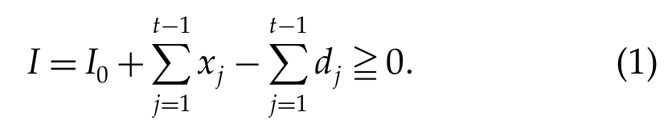
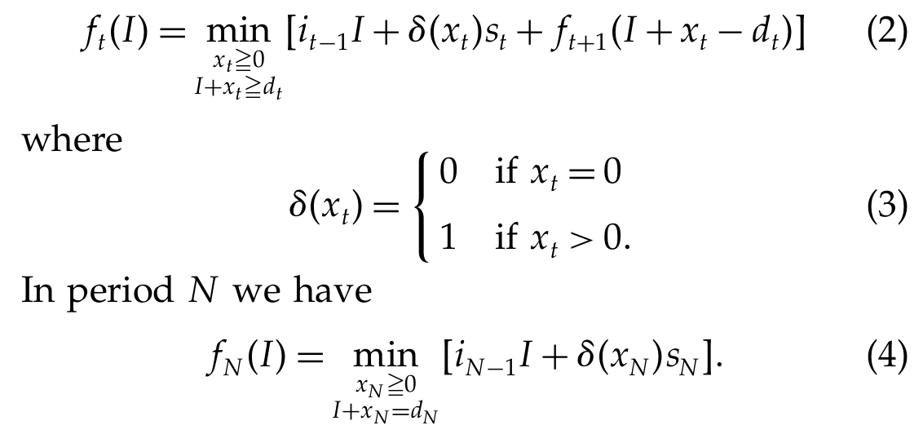
Problem Formulation
Network Optimization Applications 19.04 by 成大工資管

Slide 5
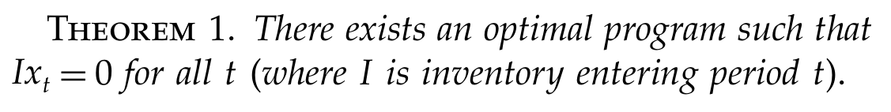
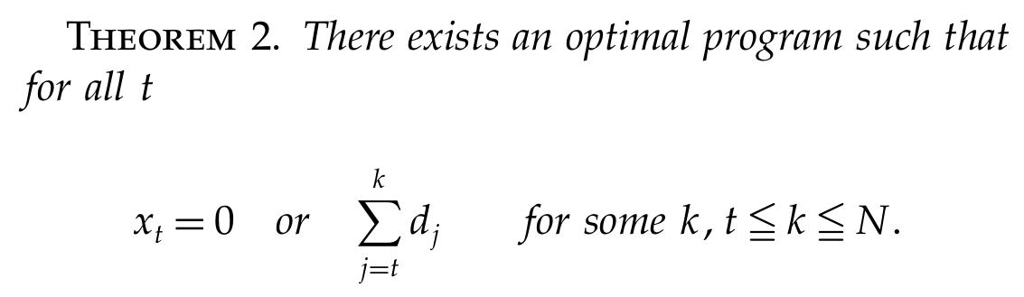
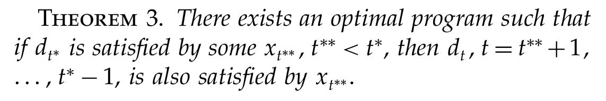
Problem Formulation
Network Optimization Applications 19.04 by 成大工資管

Slide 6
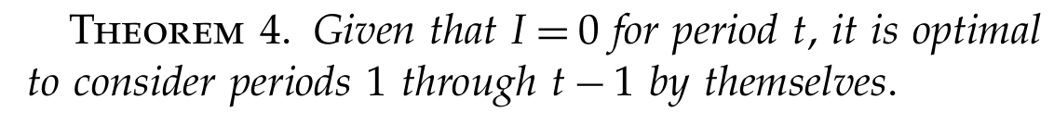
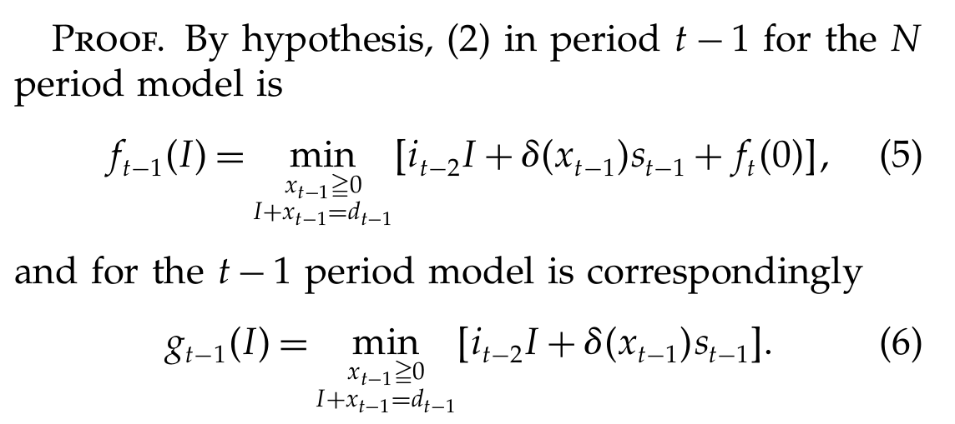
Problem Formulation
Network Optimization Applications 19.19 by 成大工資管

Slide 7
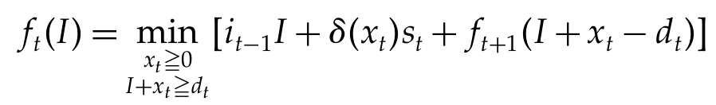
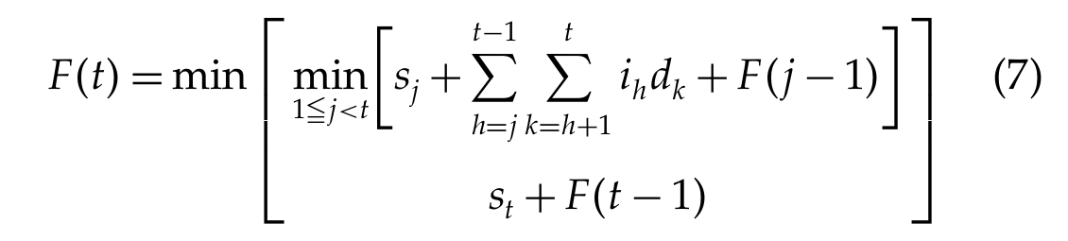
Problem Formulation
Network Optimization Applications 19.19 by 成大工資管

Slide 8
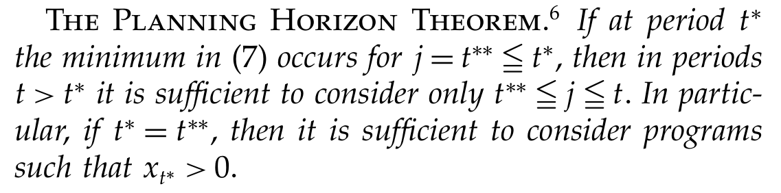
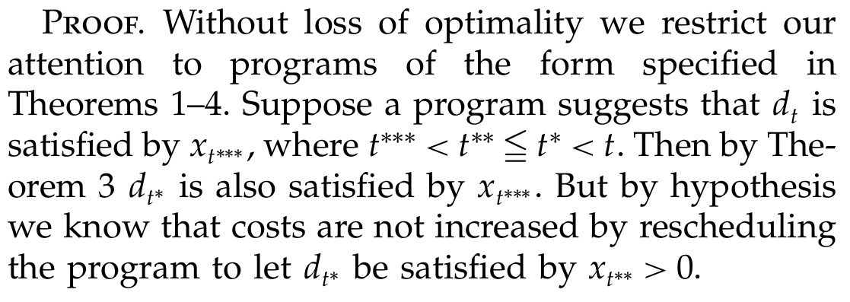
Problem Formulation
Network Optimization Applications 19.04 by 成大工資管

Slide 9
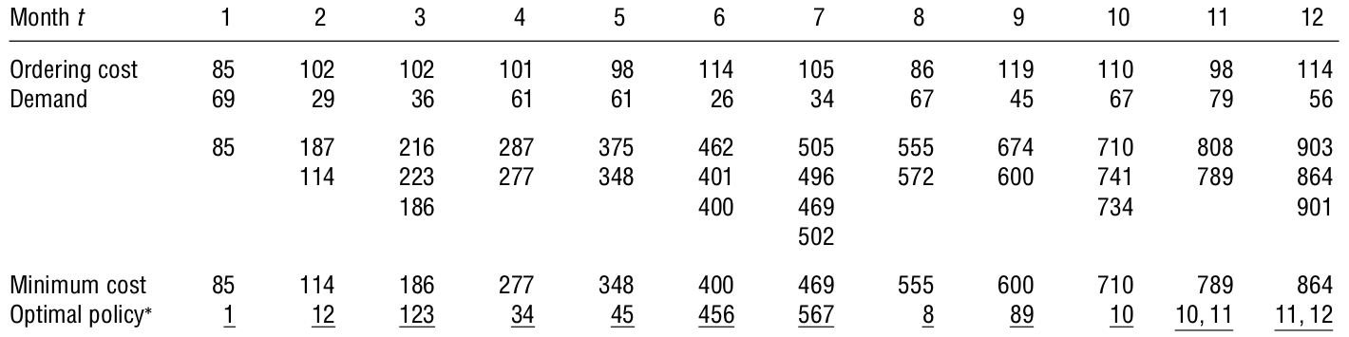
Example
Network Optimization Applications 19.19 by 成大工資管

Slide 10
References
Wagner, HM, & Whitin, TM 2004, 'Dynamic Version of the Economic Lot Size Model', Management Science, vol. 50, pp. 1770-1774.
Network Optimization Applications 19.19 by 成大工資管

