Slide 1
19.20 Dynamic Lot Sizing with Concave Costs
19.21 Dynamic Lot Sizing with Backorders

Slide 2
Introduction
Economic lot size models deal with a production and inventory system
A product is produced in batch quantities and then placed in stock. After the inventory has been sufficiently depleted, another batch is produced
the objective is to minimize cost

Slide 3
Dynamic Lot Sizing with Concave Costs
Problem type : Shortest path problem
Reference : A Backlogging Model and a Multi-Echelon Model of a Dynamic Economic Lot Size Production[ Williard I. Zangwill, 1969]

Slide 4
Dynamic Lot Sizing with Concave Costs
Concave costs:
In practice, the production(Xj) in a specific period(j) incurs a fixed cost(Fj)(independent of the level of production) and a per unit production cost(Cj).
1.the flow cost on the production arc(0,j) is 0, if Xj=0
2.Fj=CjXj , if Xj>0, which is a concave function

Slide 5
Dynamic Lot Sizing with Concave Costs
parameter
i : period
ri : the market requirement in period i
xi : the production completed in beginning of period i
Ii : the inventory at the end of period I
Pi(xi) : cost of producing xi units
Hi(Ii) : cost of handling Ii units

Slide 6
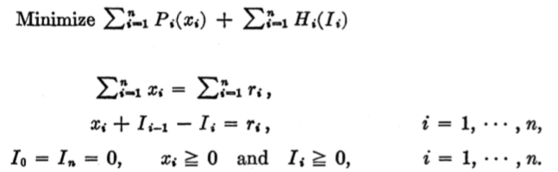
Dynamic Lot Sizing with Concave Costs
Formulation
最小化成本
生產量等於需求量

Slide 7
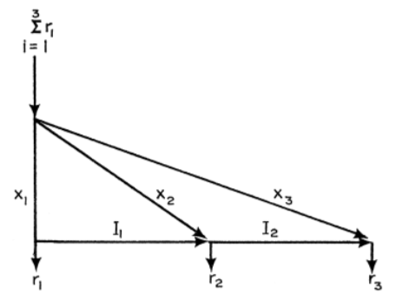
Dynamic Lot Sizing with Concave Costs

Slide 8

Dynamic Lot Sizing with Backorders
Permit backlogging of unsatisfied demand
Different
li+ as the amount of inventory held in stock at the end of period I
Ii- denote the amount of inventory shortage at the end of period i

Slide 9
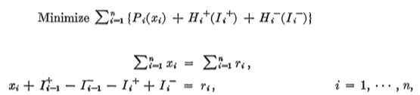
Dynamic Lot Sizing with Backorders
Obj:
st:
(1)
(2)
(3)

Slide 10
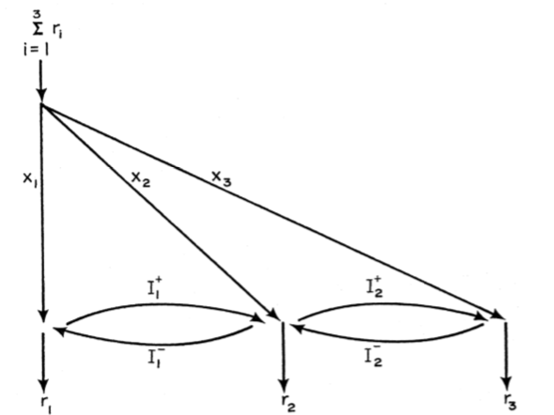
Dynamic Lot Sizing with Backorders

Slide 11
Thanks For Your Listening

