Slide 1
APP19.21 Dynamic Lot Sizing with Backorders

Slide 2
Introduction
Q
S
s
t

Slide 3
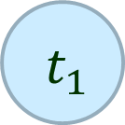
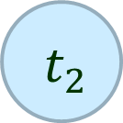
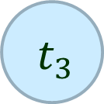
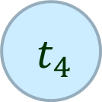
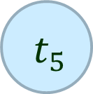
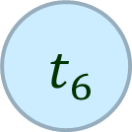
Introduction
F
R

Slide 4
References
Veinott, A. F. and H. M. Wanger
Optimal capacity Scheduling: Part Ⅰ and Ⅱ
Operations Research, 1962
Zangwill, W. I.
A Backlogging Model and a Multi-Echelon Model of a Dynamic Economic Lot Size Production System-A Network Approach
Management Science, 1969

Slide 5
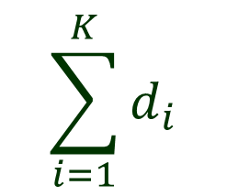
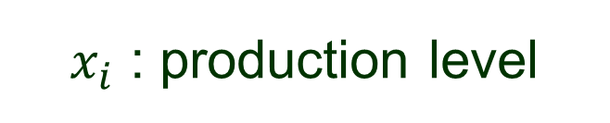
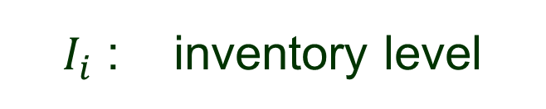

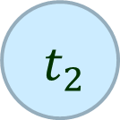

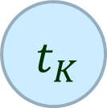










Problem
F
$$x_{K}$$
$$x_{1}$$
$$x_{2}$$
$$x_{3}$$
$$I_{1}$$
$$I_{2}$$
$$−d_{1}$$
$$−d_{2}$$
$$−d_{3}$$
$$−d_{K}$$

Slide 6





Problem
F
$$x_{K}$$
$$x_{1}$$
$$x_{2}$$
$$x_{3}$$
$$I_{1}$$
$$I_{2}$$
$$B_{2}$$
$$B_{3}$$
$$−d_{1}$$
$$−d_{2}$$
$$−d_{3}$$
$$−d_{K}$$

Slide 7

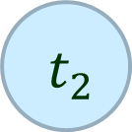


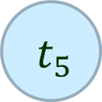

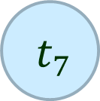














Problem
F
$$x_{7}$$
$$x_{2}$$
$$x_{4}$$
$$I_{2}$$
$$I_{4}$$
$$I_{5}$$
$$B_{2}$$
$$−d_{1}$$
$$−d_{2}$$
$$−d_{3}$$
$$−d_{4}$$
$$−d_{5}$$
$$−d_{6}$$
$$−d_{7}$$

Slide 8
Q & A

