Slide 1
Application19.22
Multistage Production-Inventory Planning
Network Optimization Applications 19.22 by 成大工資管

Slide 2
Content
Introduction
Multistage Production-Inventory Planning
  Dynamic lot-size model
  Minimum cost flow model
Relative problems
Solution methods
Network Optimization Applications 19.22 by 成大工資管

Slide 3
Introduction
Objective:
Obtaining a minimum cost production-inventory
schedule by finding a minimum cost flow in the
network.
Minimum cost flow problem
Network Optimization Applications 19.22 by 成大工資管

Slide 4
Introduction
Dynamic lot-size model
  Simple production process with a single stage of production.
  Demand, capacity, cost for the product varies over time.
  Different operations may performed on different machines at different times.
Network Optimization Applications 19.22 by 成大工資管

Slide 5
Relative problems
Lee, Chung-Yee, Sila Çetinkaya, and Albert PM Wagelmans. "A dynamic lot-sizing model with demand time windows." Management Science
This paper studies the dynamic lot-sizing problem with demand time
windows and provides polynomial time algorithms for computing its
solution.
the customer offers a grace period - we call it a demand time window -
during which a particular demand can be satisfied with no penalty. That
is, in association with each demand, the customer specifies an earliest
and a latest delivery time.
Network Optimization Applications 19.22 by 成大工資管

Slide 6
Solution method
Dynamic lot-size model
0
Notation:
dj = demand of the product in period j
Xkj = amount of the product produced at
stage k in period j
Ikj = inventory of the product carried from
period j to period j+1 at stage k
X11
X12
X1T
…….
I11
I1.T-1
X21
X22
X2T
…….
I21
I2.T-1
XK1
….
XK2
….
XKT
….
…….
Ik1
Ik.T-1
d1
d2
dT
Network Optimization Applications 19.22 by 成大工資管

Slide 7
Solution methods
Notation:
dj = demand of the product in period j
Xkj = amount of the product produced at
stage k in period j
Ikj = inventory of the product carried
from period j to period j+1 at stage k
0
X11
X12
X1T
…….
I11
I1.T-1
Pkj = production capacity at stage k
in period j
ckj = unit production cost at stage k in period j
ukj = upper limit on inventory holding from
period j to j+1 at stage k
hkj = inventory carrying cost from period j to
j+1
X21
X22
X2T
…….
I21
I2.T-1
XK1
….
XK2
….
XKT
….
…….
Ik1
Ik.T-1
d1
d2
dT
Network Optimization Applications 19.22 by 成大工資管

Slide 8
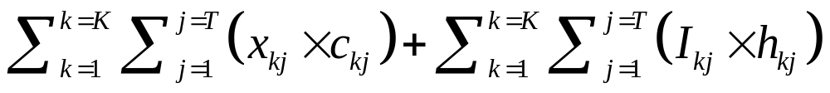

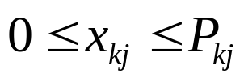
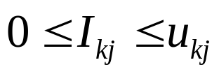

Solution methods
The minimum cost flow problem is an optimization model formulated as follow:
Minimize
subject to
(1)
j=1,….,T ,
(2)
k=1,…,K / j=1,…,T ,
(3)
k=1,…,K / j=1,…,T ,
(4)
k=1,…,K .
(5)
Network Optimization Applications 19.22 by 成大工資管

Slide 9
0
X11
X12
X1T
…….
I11
I1.T-1
X21
X22
X2T
…….
I21
I2.T-1
Xk1
….
Xk2
….
XkT
….
…….
Ik1
Ik.T-1
d1
d2
dT
Network Optimization Applications 19.22 by 成大工資管

Slide 10
Thanks for your listening!!!
Q&A
Network Optimization Applications 19.22 by 成大工資管

