Slide 1

Application19.22 & 23
Multiproduct / Multistage Production-
Inventory Planning
Network Optimization Applications 19.22 by 成大工資管

Slide 2
Contents
Introduction
Multistage Production-Inventory Planning - 多層級庫存規劃
    Dynamic lot-size model
    Minimum cost flow model

Slide 3
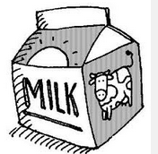
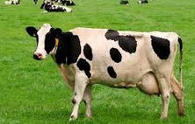

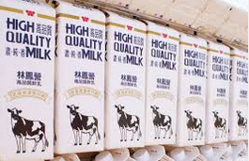







Introduction
Dynamic lot-size model
  Demand, capacity, cost for the product varies over time.
  Single stage - Simple production process with a single stage of production.
  Multistage model - If these machines have different production capacities that possibly vary from period to period.

Slide 4
Introduction
Objective:
If these machines have different production capacities that possibly vary from period to period
Goal :
Obtaining a minimum cost production-inventory schedule by finding a minimum cost flow in the network.
Minimum cost flow problem

Slide 5
Solution methods - 1
we treat each production operation as a separate stage and require that the product pass through each of the stages its production is complete
T
0
X11
X12
X13
X14
X1T
I11
I12
I1 T-1
K
X21
X22
X23
X2T
I21
I22
I2 T-1
X31
X32
X33
X3T
Xk1
Xk2
Xk3
XkT
d1
d2
d3
d4
d1
d2
I k1
I k2
I k T-1

Slide 6
Solution methods - 2
Notation:
dj = demand of the product in period j
Xkj = amount of the product produced at stage k in period j
Ikj = inventory of the product carried
from period j to period j+1 at stage k
(J to J +1 庫存週期)
0
X11
X12
X13
X14
X1T
I11
I12
I1 T-1
Pkj = production capacity at
stage k in period j
ckj = unit production cost at
stage k in period j
ukj = upper limit on inventory holding
from period j to j+1 at stage k
hkj = inventory carrying cost from
period j to j+1
X21
X22
X23
X2T
I21
I22
I2 T-1
X31
X32
X33
X3T
Xk1
Xk2
Xk3
XkT
d1
d2
d3
d4
d1
d2
I k1
I k2
I k T-1

Slide 7
Conclusion
1. There is one-to-one correspondence between feasible flows in the network and production schedules.
2. We can obtain a minimum cost production-inventory schedule by finding minimum cost flow in the network.
3. The model we have considered assumes that the production cost in each period is linear in the production quantity.
4. If these costs are concave(e.g., because of fixed production costs for producing any quantity in any period), the model becomes a more complex (NP-hard) mixed integer programming model.

Slide 8
Relative problems
Lee, Chung-Yee, Sila Çetinkaya, and Albert PM Wagelmans. "A dynamic lot-sizing model with demand time windows." Management Science
This paper studies the dynamic lot-sizing problem with demand time windows and provides polynomial time algorithms for computing its solution. If backlogging is not allowed, the complexity of the proposed algorithm is O(T2) where T is the length of the planning horizon. When backlogging is allowed, the complexity of the proposed algorithm is O(T3).
In most real-life applications, the customer offers a grace period-we call it a demand time window-during which a particular demand can be satisfied with no penalty. That is, in association with each demand, the customer specifies an acceptable earliest and a latest delivery time. The time interval characterized by the earliest and latest delivery dates of a demand represents the corresponding time window.

Slide 9
Reference
Lee, Chung-Yee, Sila Çetinkaya, and Albert PM Wagelmans. "A dynamic lot-sizing model with demand time windows."
Management Science

Slide 10

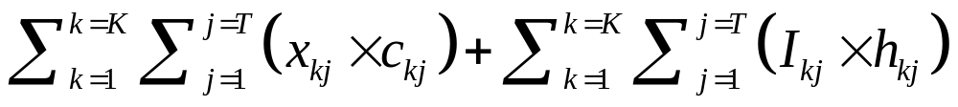

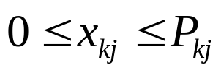
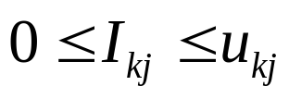

Solution methods
The minimum cost flow problem is an optimization model formulated as follow:
Thank You
Minimize
(1)
Subject To
j=1,….,T ,
(2)
k=1,…,K / j=1,…,T ,
(3)
k=1,…,K / j=1,…,T ,
(4)
k=1,…,K .
(5)

Slide 11
Solution methods - 4
The minimum cost flow problem is an optimization model formulated as follow:
Minimize
subject to
(1)
j=1,….,T ,
(2)
k=1,…,K / j=1,…,T ,
(3)
k=1,…,K / j=1,…,T ,
(4)
k=1,…,K .
(5)

