Slide 1
Application19.5
Asymmetric Data Scaling with Lower and Upper Bounds
Network Optimization Applications 19.5 by 成大工資管

Slide 2
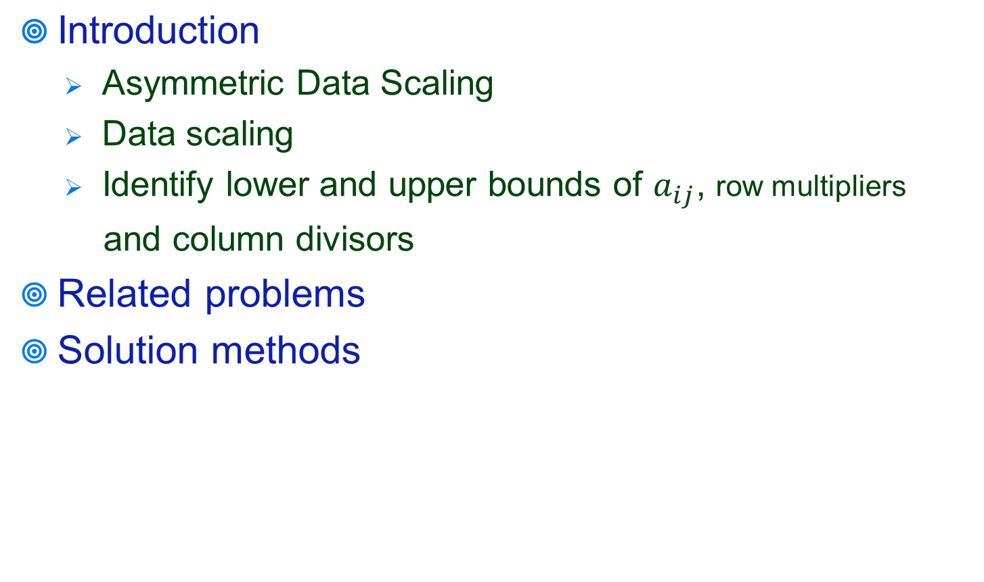
Content
Network Optimization Applications 19.5 by 成大工資管

Slide 3
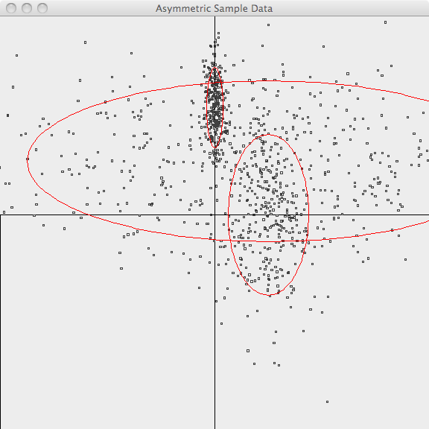
Asymmetric Data Scaling
主要用將不平均分布的點做平均分散處理，以便計算出最短距離，如下圖的群聚點做分散縮放處理。
Network Optimization Applications 19.5 by 成大工資管

Slide 4
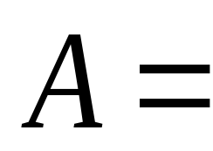
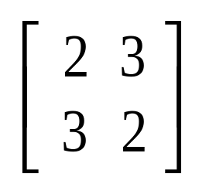
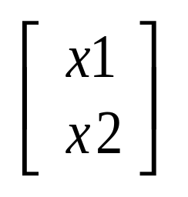
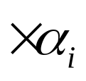
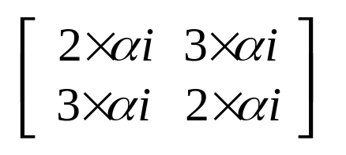
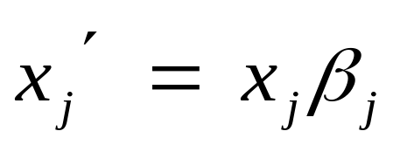

Data scaling
而以下的數學運算式便是透過矩陣算法，將繁雜的矩陣簡化為數學式的結果
Network Optimization Applications 19.5 by 成大工資管

Slide 5
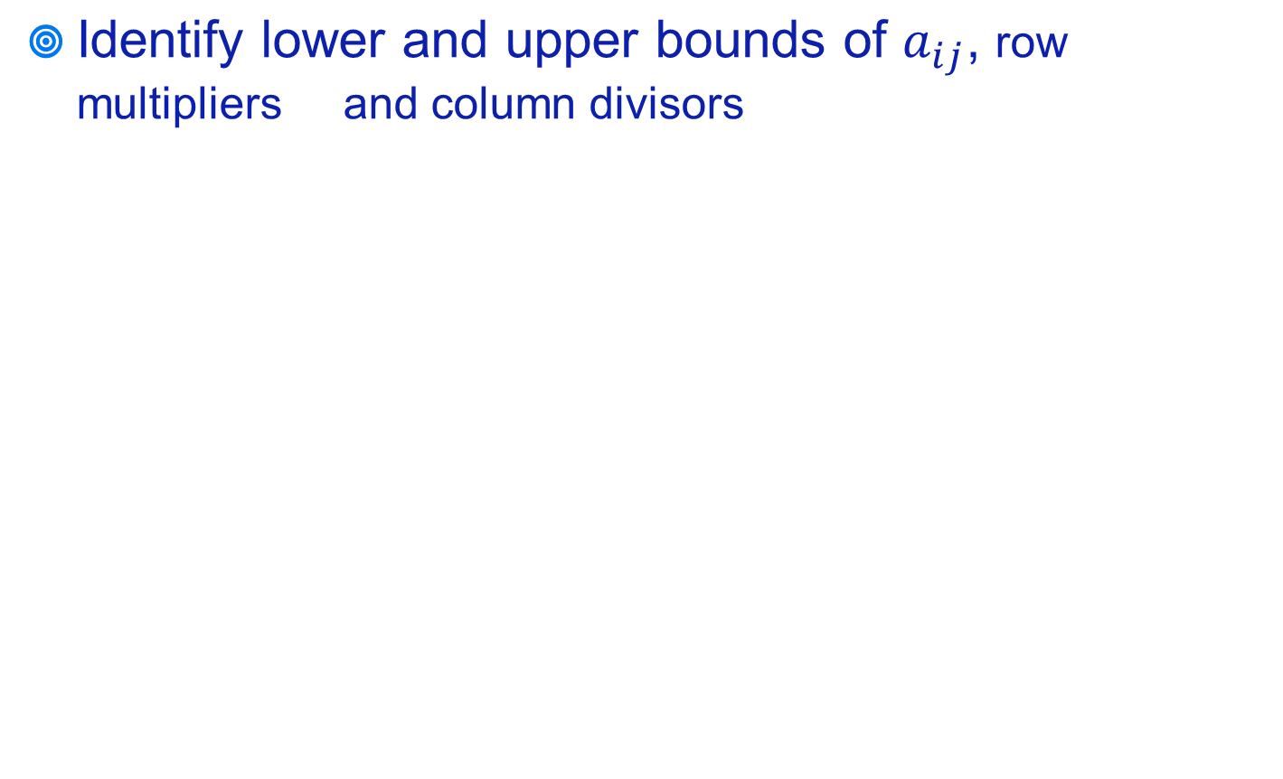


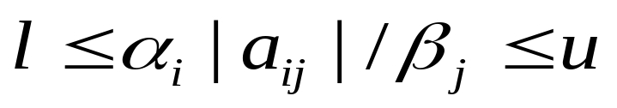
Introduction
solve this data scaling problems by solving a mean cycle problem
Network Optimization Applications 19.5 by 成大工資管

Slide 6
Related problem
差分約束系統
差分約束系統（system of difference constraints），是求解關於一組變數的特殊不等式組之方法。 如果一個系統由n個變量和m個約束條件組成，其中每個約束條件形如x(j)-x(i)<=b(k)(i,j∈[1,n],k∈[1,m]),則稱其為差分約束系統(system of difference)
這是在解決asymmetric data scaling with lower and upper bounds會遇到的問題，用以解決shortest path problem
Network Optimization Applications 19.5 by 成大工資管

Slide 7
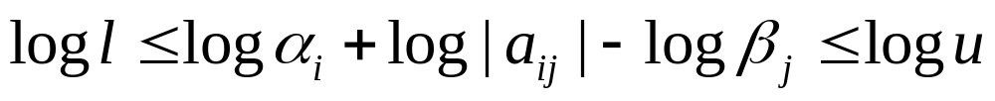
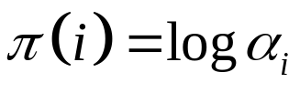
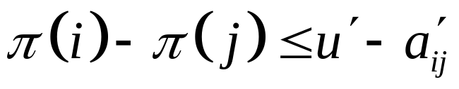
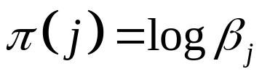

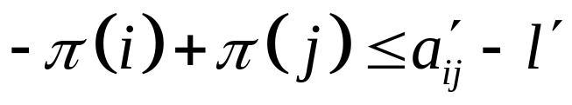
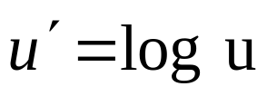
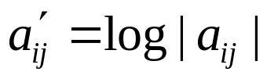
Solution methods
Take the logarithms of both sides
Let
Network Optimization Applications 19.5 by 成大工資管

Slide 8
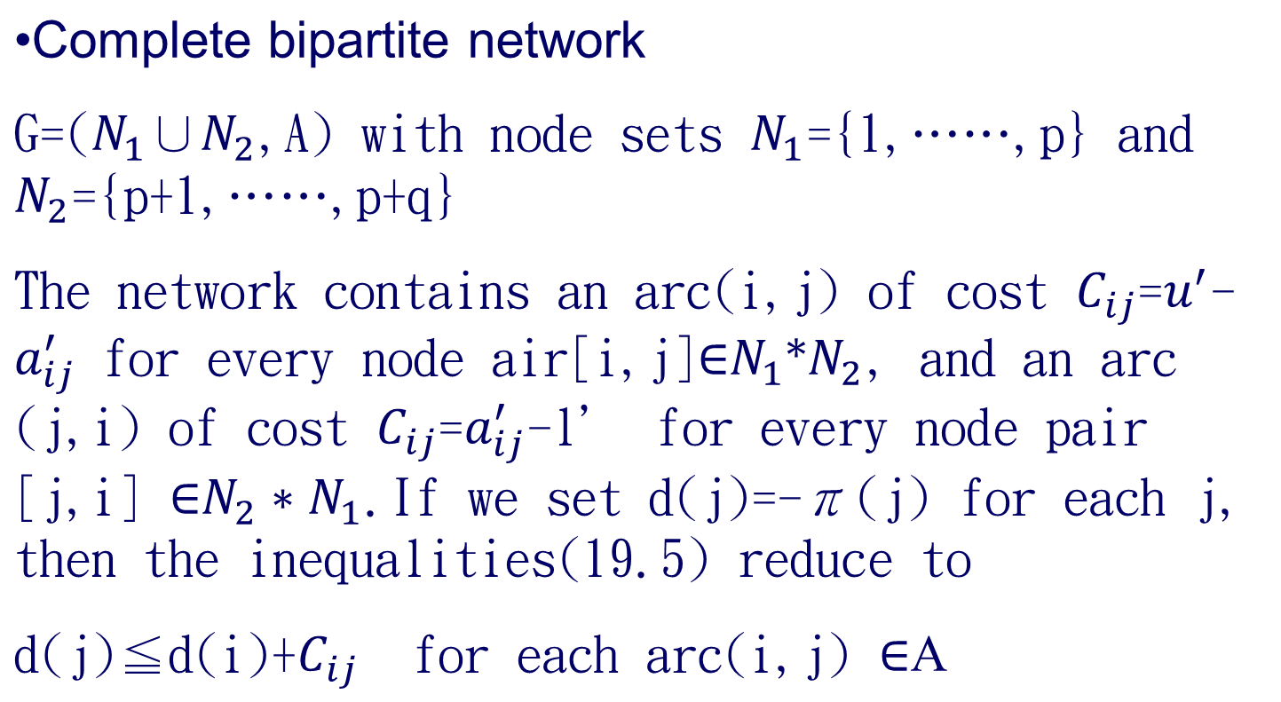
Solution methods
Network Optimization Applications 19.5 by 成大工資管

Slide 9
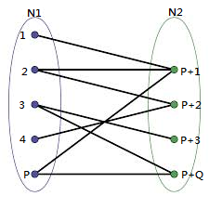
complete bipartite network graphy
日、美公共自行車共享系統參訪經驗與心得 by 成大工資管

Slide 10
Thanks for your listening!!!
Q&A
Network Optimization Applications 19.5 by 成大工資管

